Slide 1


the Sun and PLATO follow up
Dr. Ben Lakeland
(He/Him)
Research Fellow,
University of Birmingham, UK
b.s.lakeland@bham.ac.uk
Notes:
I’m Ben, for those who don’t know me, I’m a postdoc at the University of Birmingham
I’m going to talk about some of the work I’ve done using the Sun in the context of finding exoplanets

Slide 2
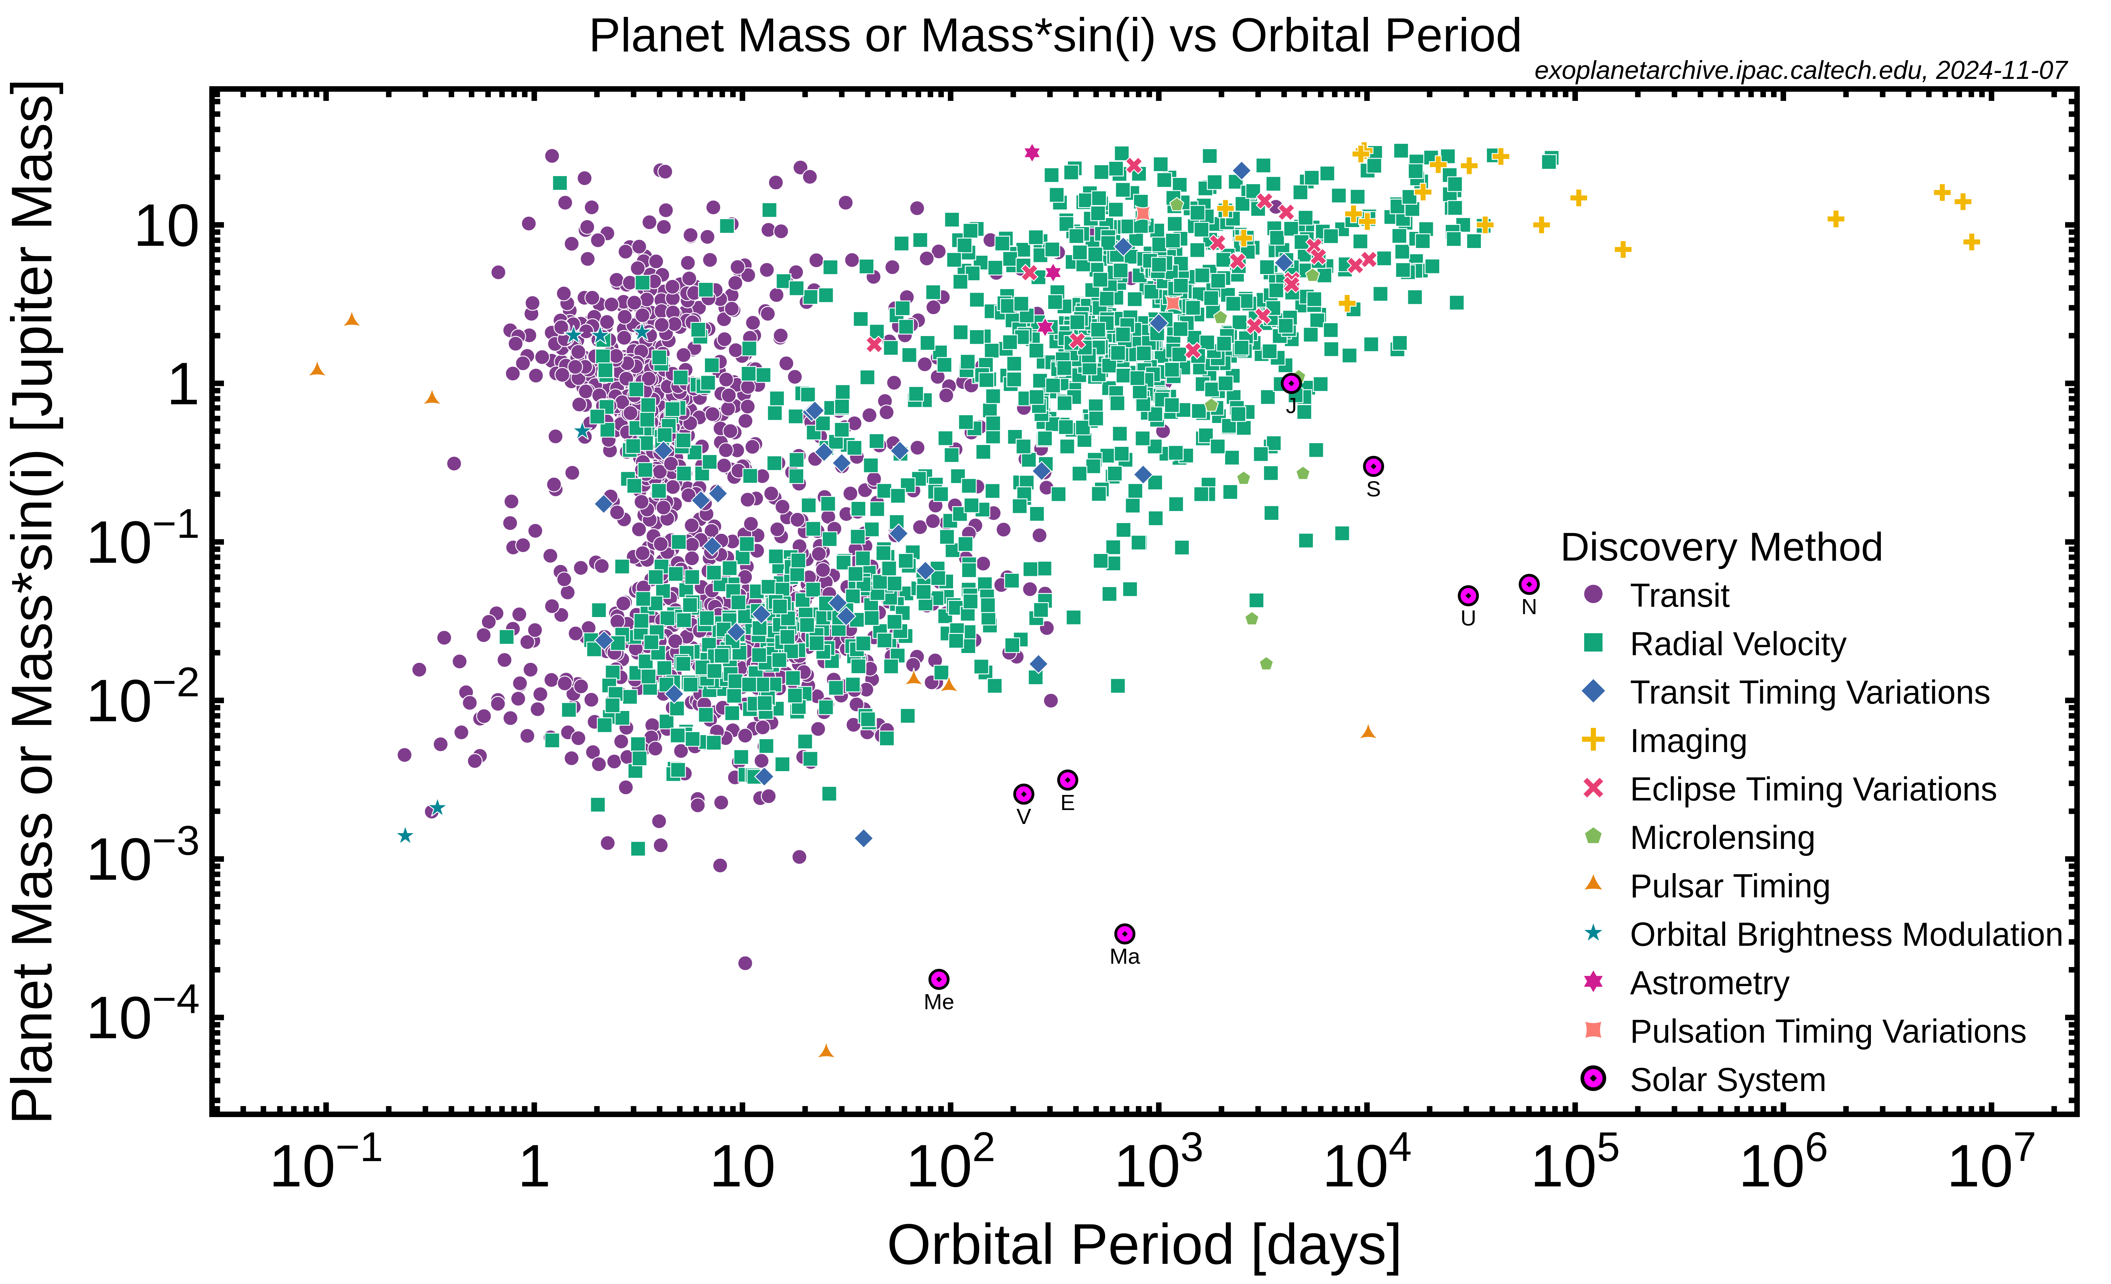
The family of Exoplanets
Notes:
Current state of the field of exoplanet detections
Mass or mass limit vs. period
Each point is a planet, different markers are different detection methods
The two main methods for detecting planets are transit
Or RVs.
While we capture a remarkable variety of planets, we don’t really have anything like the planets in our own solar system.
It’s really these types of planets that the people that people that work on PLATO are interested in

Slide 3
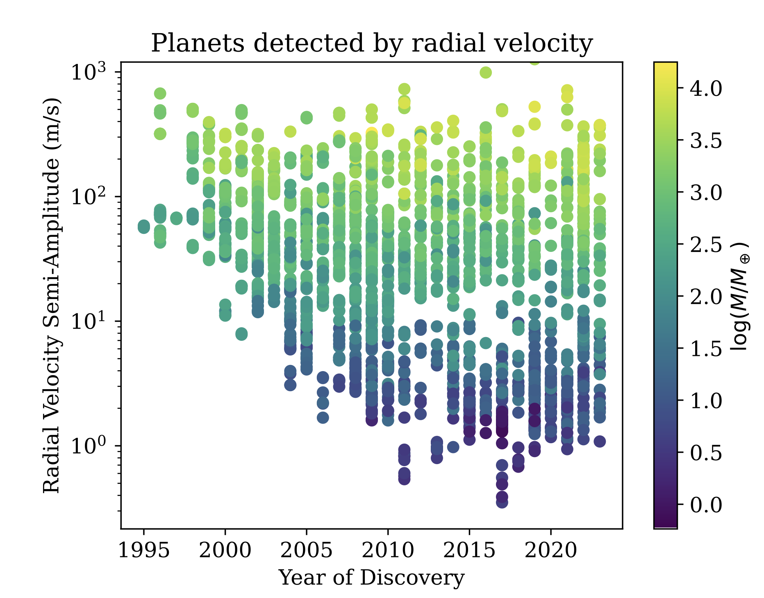
The smallest planets are hard to detect
Stellar variability limits low-mass detection
Notes:
We see an interesting pattern as we plot RV detections vs. time.
I plot the amplitude of the RV signal to normalize for stellar mass/period, but generally high mass is at the top and low mass is at the bottom
Until ~ 2010/2012, our detection limits were improving year on year as our instruments and observation strategies improved
Since then, there’s been a plateau at ~ 1 m/s
Instruments are better than 1 m/s – not an instrumental effect
The limiting factor to finding Earth-like planets is the intrisic variability of the host stars

Slide 4
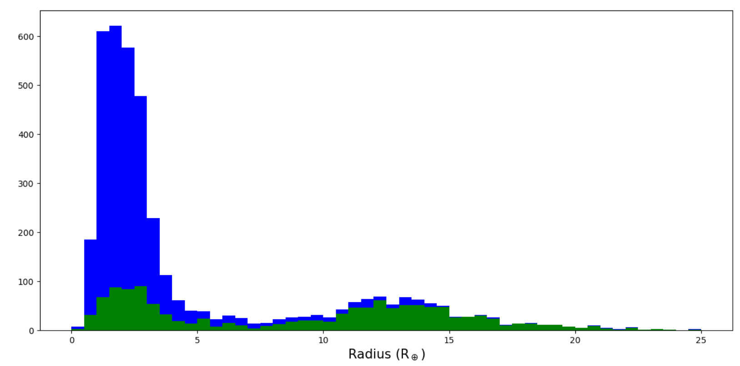
The smallest planets are hard to detect
Planets with radius
Planets with mass and radius
(exoplanet.eu)
Notes:
We can see the biases of RVs clearly here.
Histogram of planet’s radii
Fairly complete for larger mass planets, but it’s very difficult to detect the smallest planets.

Slide 5
Stellar variability limits our ability to detect the smallest planets

Slide 6
Stellar variability limits our ability to detect the smallest planet
validate
candidates

Slide 7
Stellar variability comes in many forms
Acoustic Oscillations
Stellar flares
Granulation
Supergranulation
Magnetic activity (star spots, faculae …)
Activity cycles
Timescale
Notes:
I’m using stellar variability as a catch-all term for a variety of processes.
P-modes
Convective effects

Slide 8
Approaches to mitigating stellar activity
FF’ (Aigrain et al. 2012)
Activity indicators (Boisse et al. 2011)
Gaussian Process analysis (Haywood et al. 2014, Barragán et al. 2022)
PCA analysis (John et al. 2022)
Machine Learning (de Beurs et al. 2022)
Etc ...
Notes:
There are many different methods developed to overcome the stellar activity barrier
In fact there are so many methods that it’s hard to say which method is the best

Slide 9
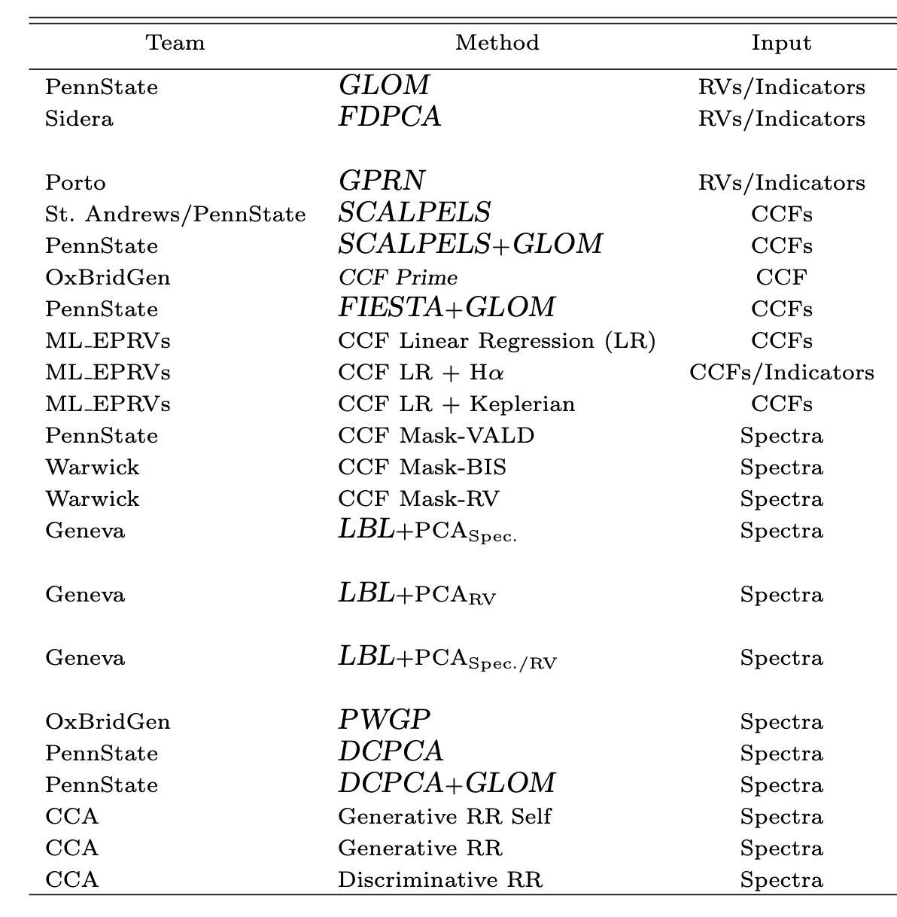
Which method is the best?
22 methods of mitigating stellar activity
4 radial-velocity time series
No technique is consistently the best
No technique consistently gets below 1 m/s
Need a ground truth
(Zhao et al. 2022)
Notes:
This was a focus of a 2022 study
Pulling together teams from all over the world with state-of-the-art techniques to mitigate activity in 4 RV time series

Slide 10
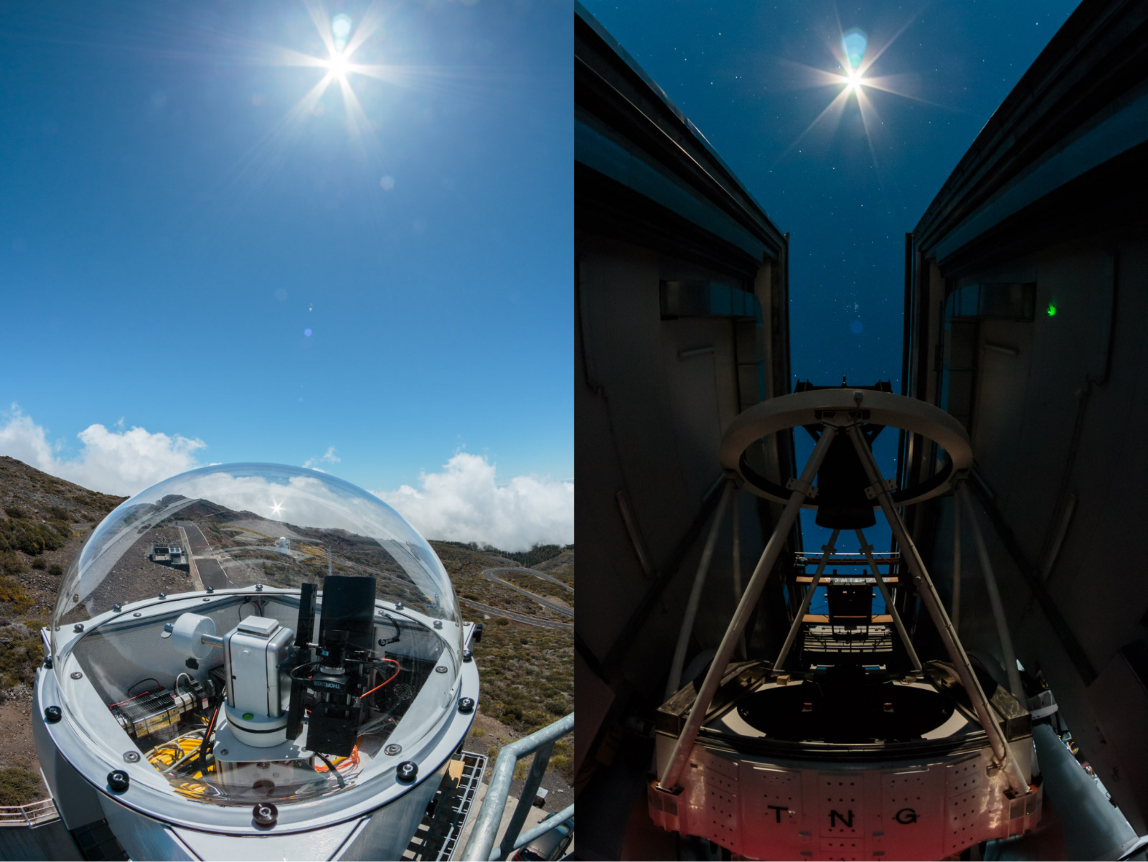
Sun-as-a-star RVs
HARPS-N: state-of-the-art exoplanet spectrograph, since 2012
Solar telescope: since 2015
The only star we can resolve in detail
Unparalleled observations
Only star with no planets
A. Glenday
Notes:
This is where the Sun comes into this...
To understand stellar variability, since 2015 we have been observing the Sun with our Exoplanet spectrographs
This is the HARPS-N solar telescope, the longest running "Sun-as-a-star" telescopes, but this is becoming standard practice for all exoplanet observatories.

Slide 11
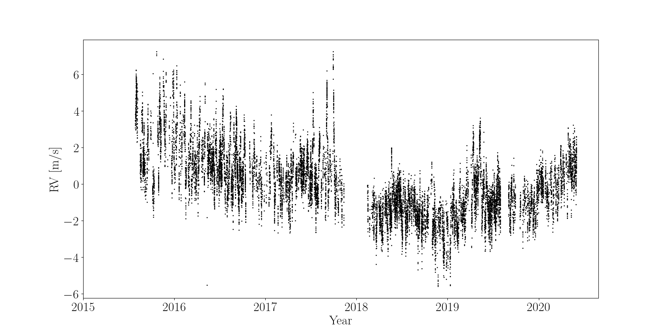
Sun-as-a-star RVs
Notes:
Just to give a sense of the scale of the problem,
If we wanted to find the Earth in this signal, we would be looking for…

Slide 12
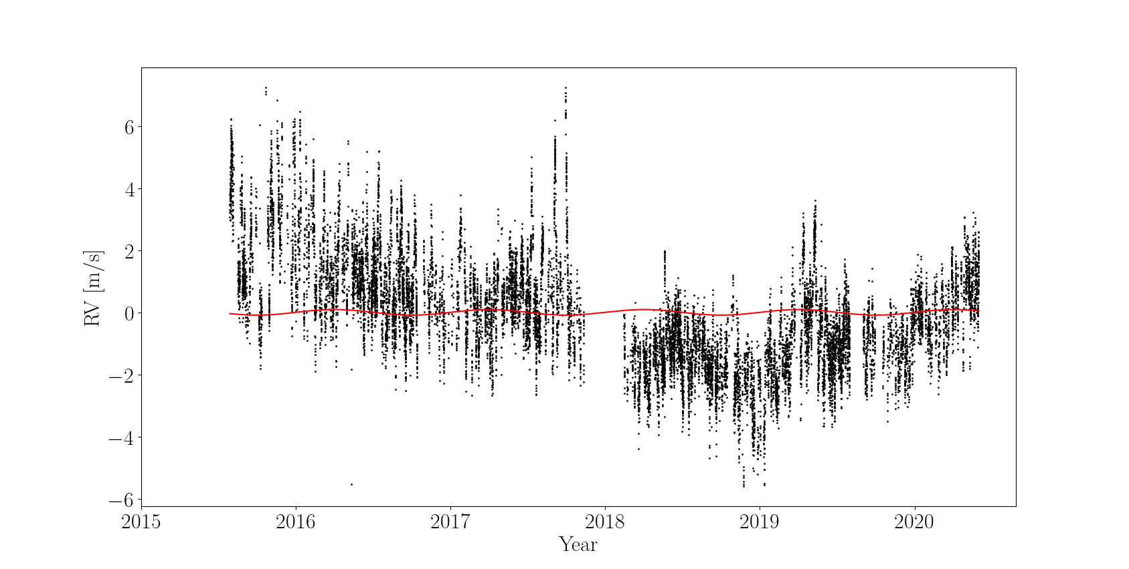
Sun-as-a-star RVs
Notes:
It’s not quite as doom and gloom as it looks, as I said before, we have techniques to remove a lot of this variability.
Benefit of sun is that we can study resolved surface

Slide 13
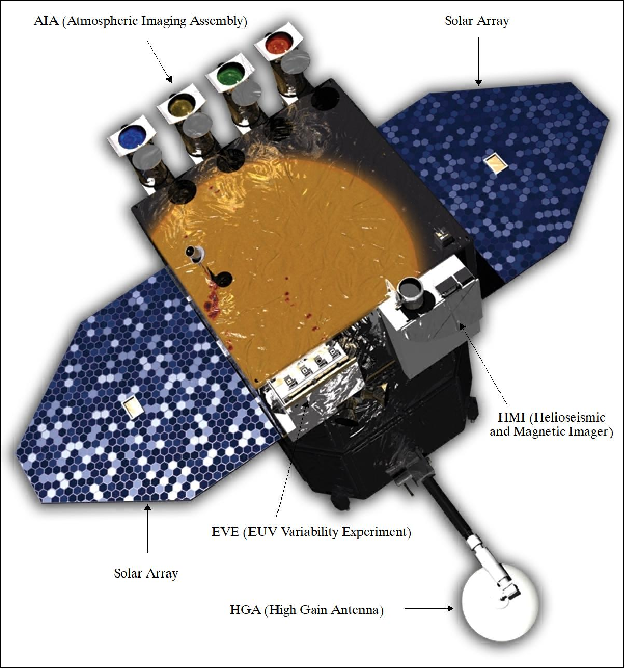
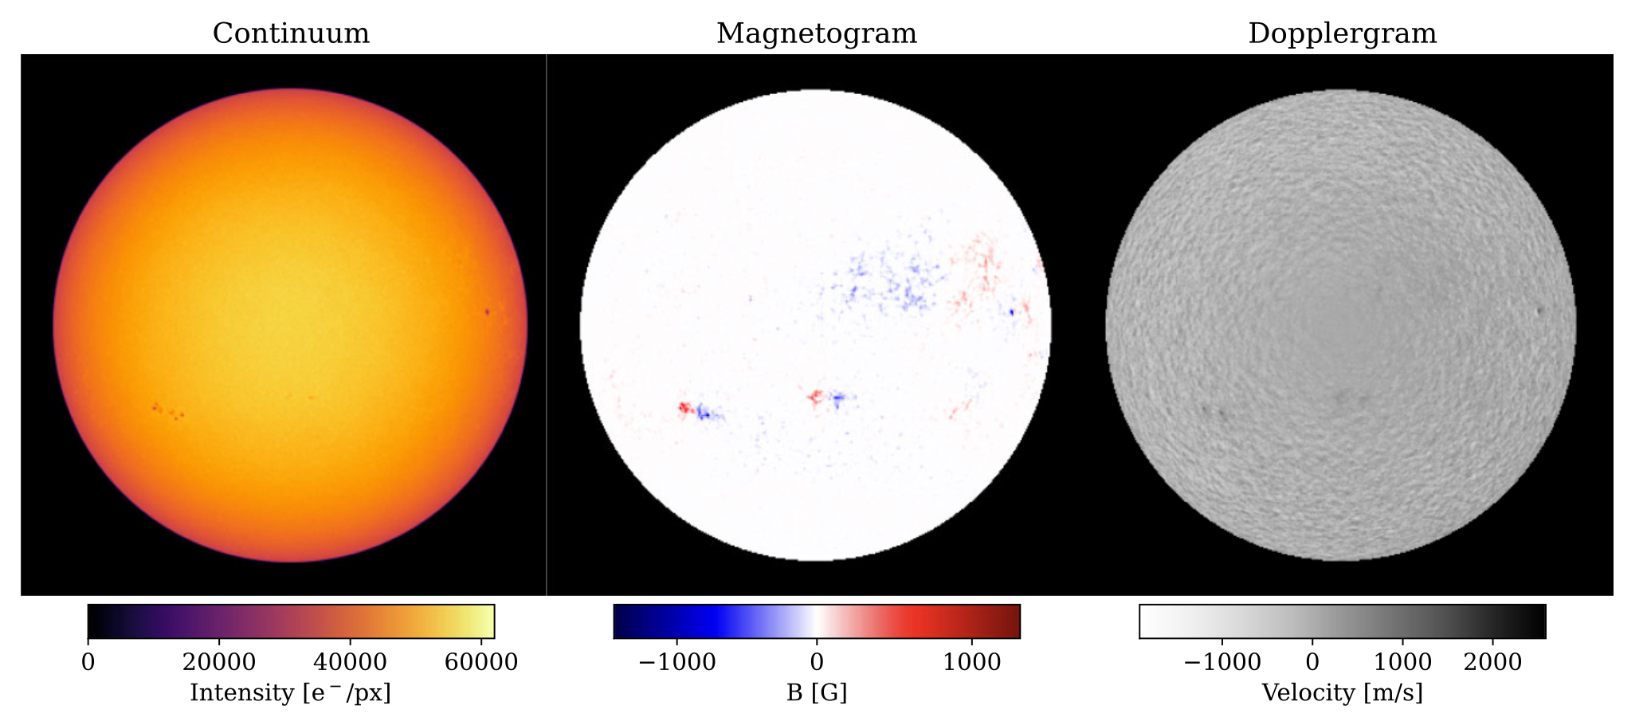
Solar Dynamics observatory
Helioseismic and Magnetic imager:
6 flux measurements around Fe I 6173 line, to produce1” :
Continuum intensity
Magnetic flux
Line-of-sight velocity
Notes:
One of the best tools we have to study the solar surface is SDO
In particular we use the Helioseismic and Magnetic imager, which produces maps of the solar surface in:
*reveal them*
The great thing for us is that we can use these images to calculate the radial velocity variability from the magnetically active regions.
I don't have time to go into details but if you're interested how we do this, come and chat with me later.

Slide 14
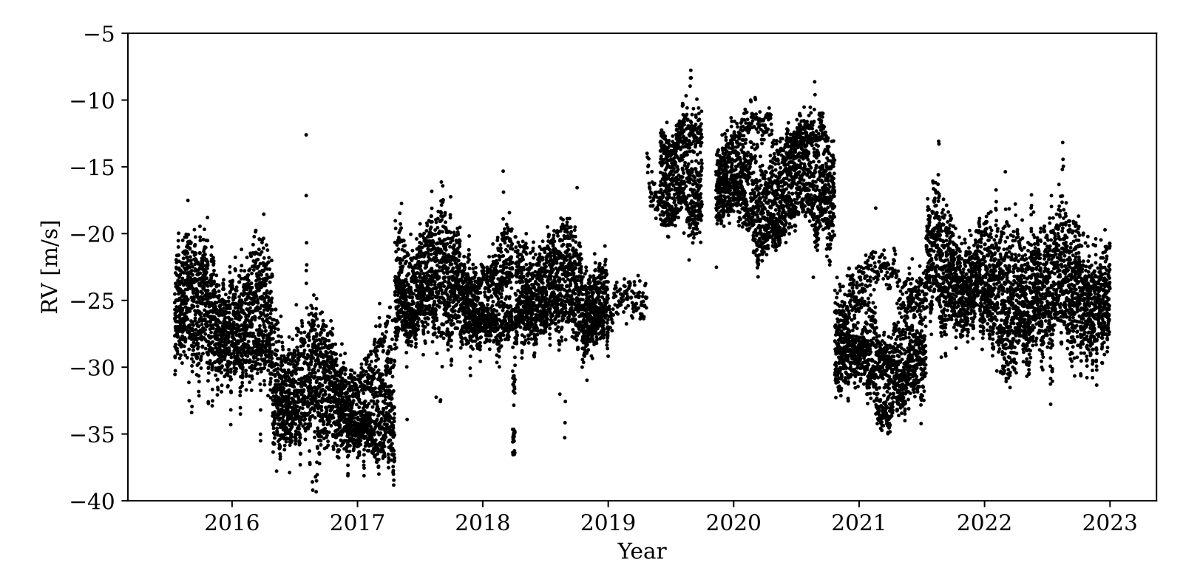
SDO isn’t designed for stability
Notes:
Unfortunately can’t just take the intensity-weighted mean Dopplergram
SDO is a helioseismology instrument, not designed for long-term stability

Slide 15
Stable RVs from SDO
$$RV=A ⋅RV_{phot }+B⋅RV_{conv}$$
Notes:
One of the best tools we have to study the solar surface is SDO
In particular we use the Helioseismic and Magnetic imager, which produces maps of the solar surface in:
*reveal them*
The great thing for us is that we can use these images to calculate the radial velocity variability from the magnetically active regions.
I don't have time to go into details but if you're interested how we do this, come and chat with me later.

Slide 16

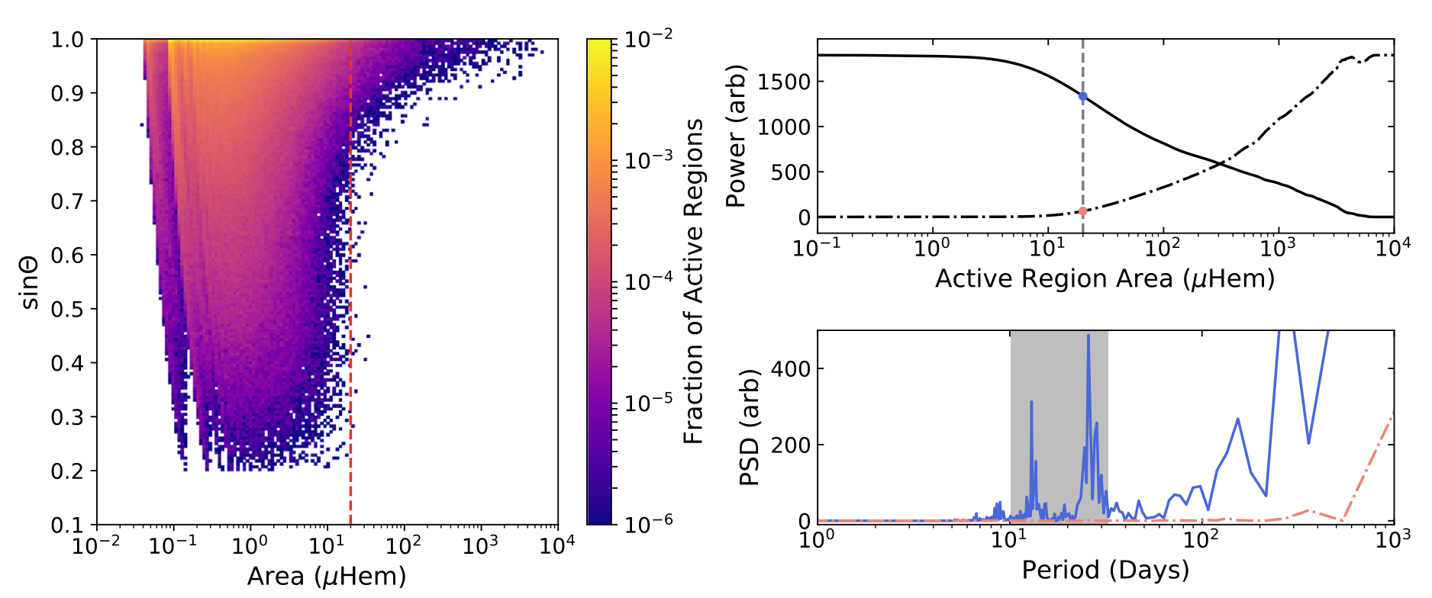
RVs from SDO
Generate them yourself!
(Milbourne et al. 2019)

Slide 17
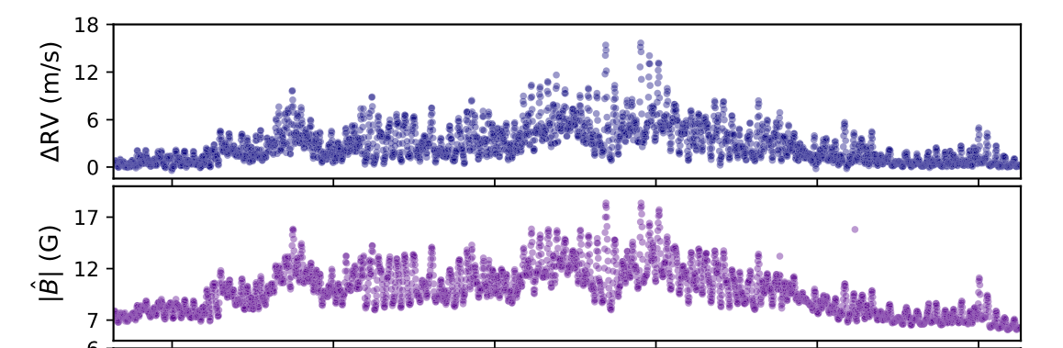
RVs from SDO
(Haywood et al. 2022)
Notes:
This is the time series we get (top)
I also plot the absolute magnetic flux below.
We get a really good correlation.

Slide 18
Approaches to mitigating stellar activity
FF’ (Aigrain et al. 2012)
Activity indicators (Boisse et al. 2011)
Gaussian Process analysis (Haywood et al. 2014, Barragán et al. 2022)
PCA analysis (John et al. 2022)
Machine Learning (de Beurs et al. 2022)
Notes:
In fact, all of the techniques I mentioned earlier in some way focus on the effects of isolated, magnetically active regions
In other words, this time series.
What I set out to answer is, what about the rest of the star?

Slide 19
Two sun-as-a-star time series
HARPS-N
SDO
Sensitive to entire solar disc
Only sensitive to magnetically active regions
Notes:
So I’ve introduced two Sun-as-a-star data sets.

Slide 20
Two sun-as-a-star time series
HARPS-N
SDO
Sensitive to entire solar disc
Only sensitive to magnetically active regions
Notes:
Difference in the time series tells us about what the quiet Sun is doing

Slide 21
RVs of the inactive solar surface
(Lakeland et al. 2024)

Slide 22
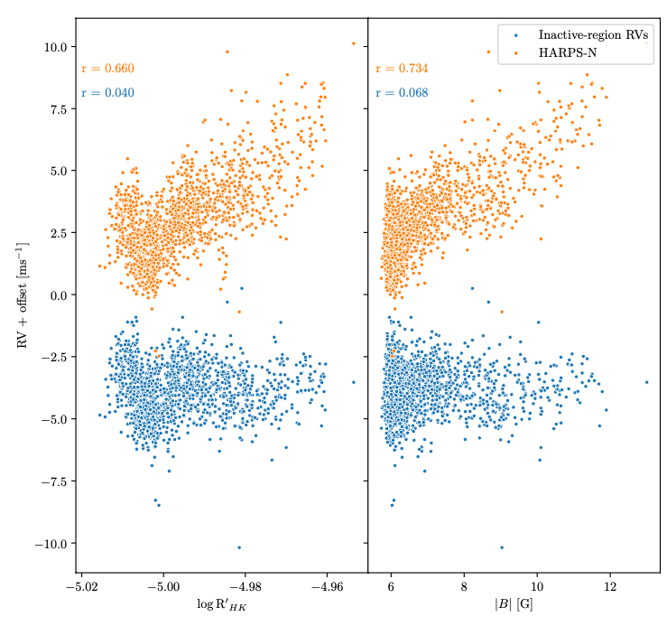
RVs of the inactive solar surface
Remove almost all magnetic signatures
(Lakeland et al. 2024)
Notes:
Say what plot is

Slide 23
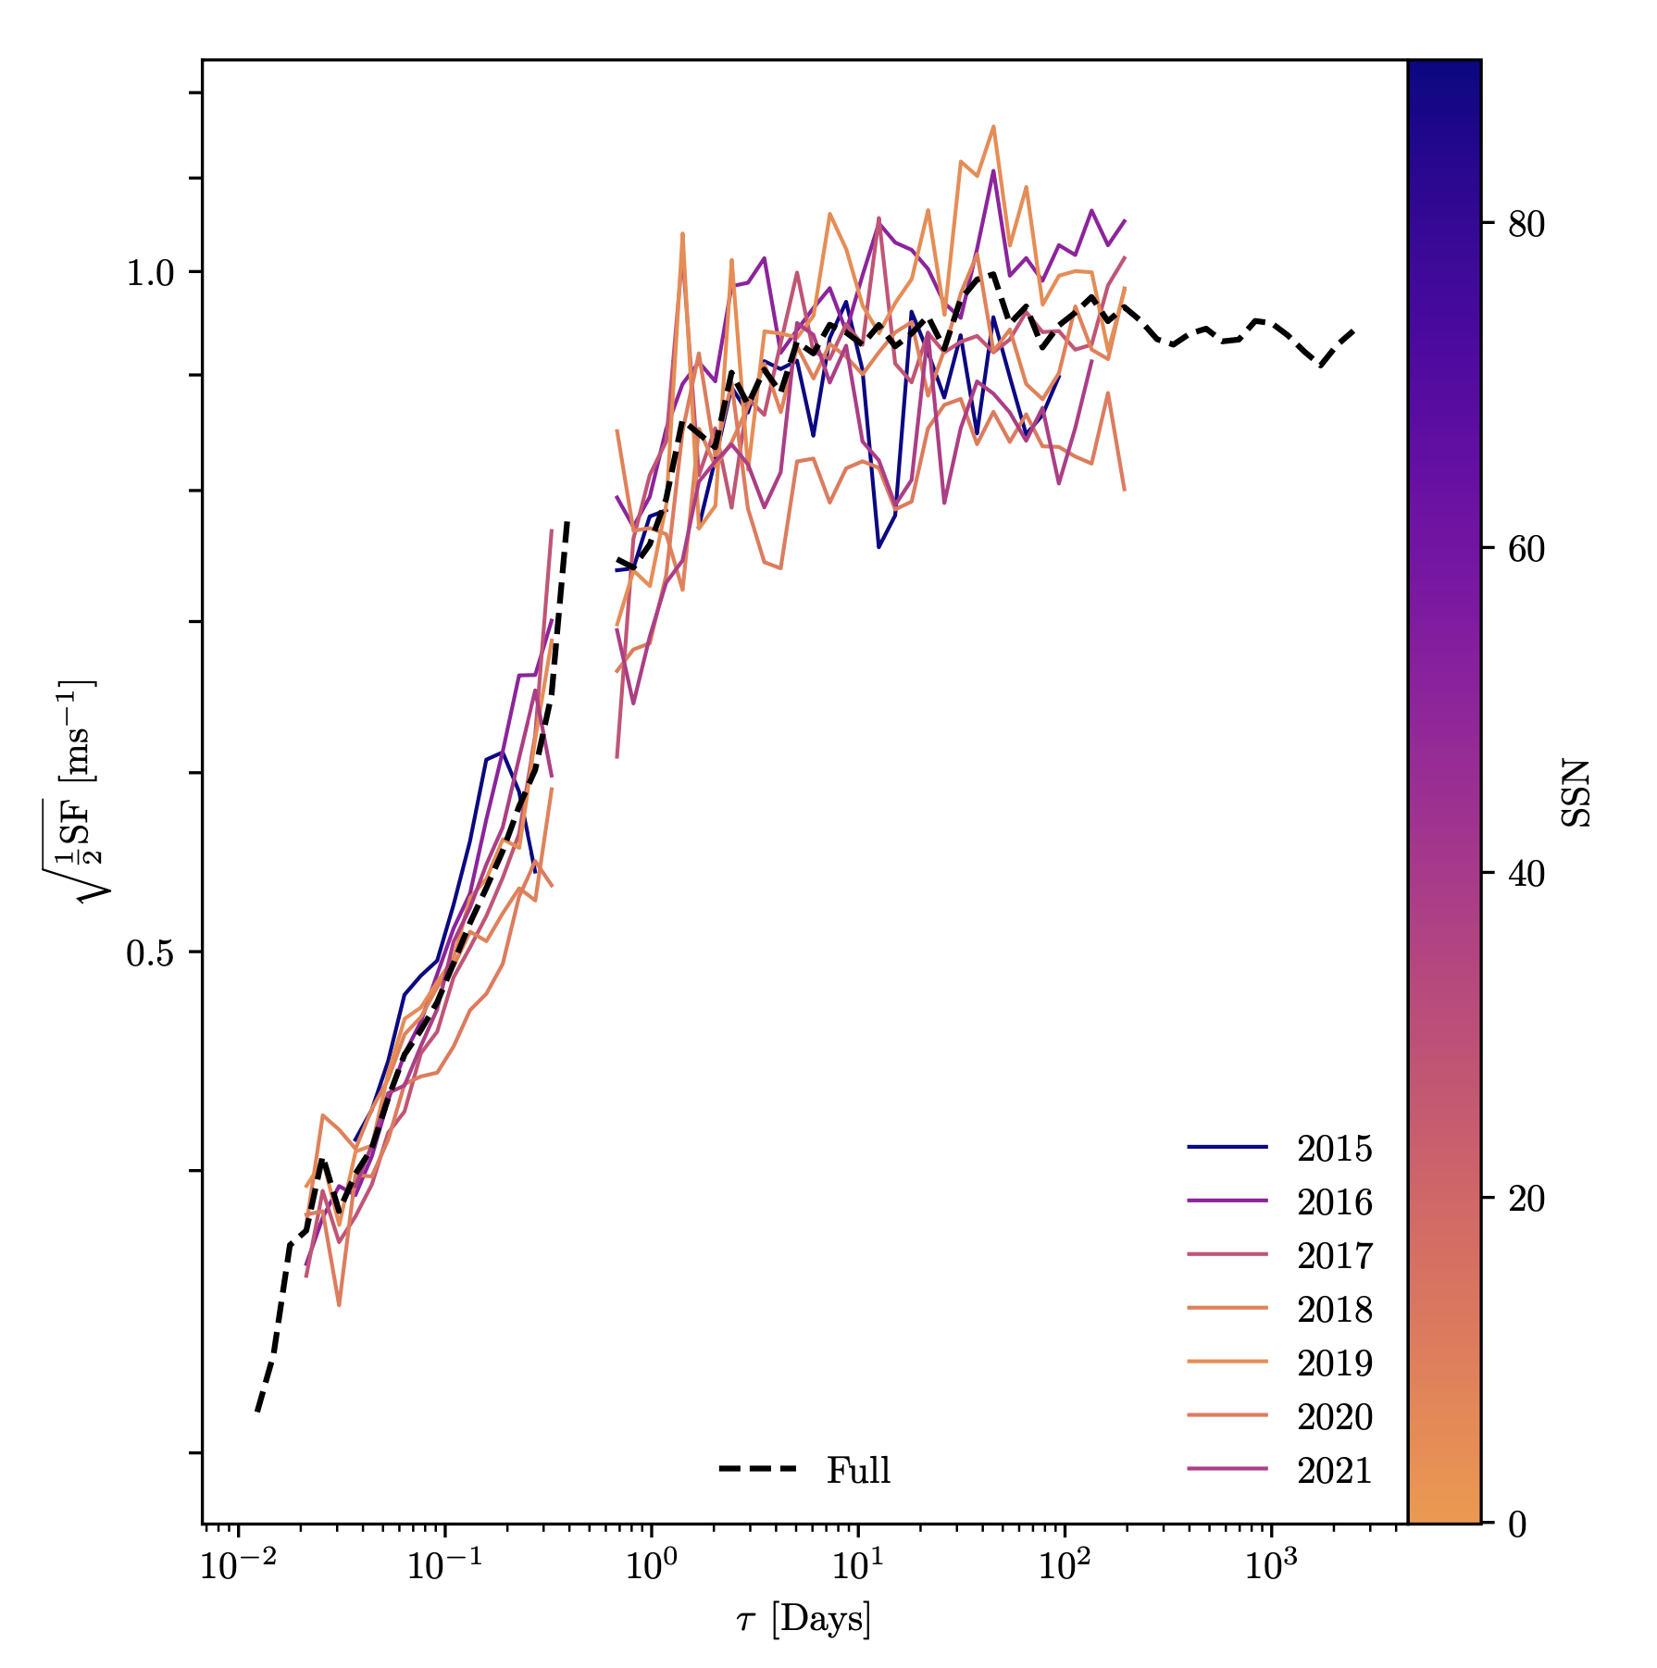
RVs of the inactive solar surface
Variability (m/s)
(Lakeland et al. 2024)
Timescale (days)
Notes:
Coloured lines are split by year, black is the whole time series
Lines are coloured by average sunspot number
Gap is just due to diurnal cycle
See some interesting aspects:
Not flat, this means it’s not just uncorrelated noise
See a distinct time scale at ~ few days
There’s very little variation from year to year (show in the paper it’s comparable to random noise from subsampling)
No trend with sunspot coverage -- Roughly constant at 1 m/s

Slide 24
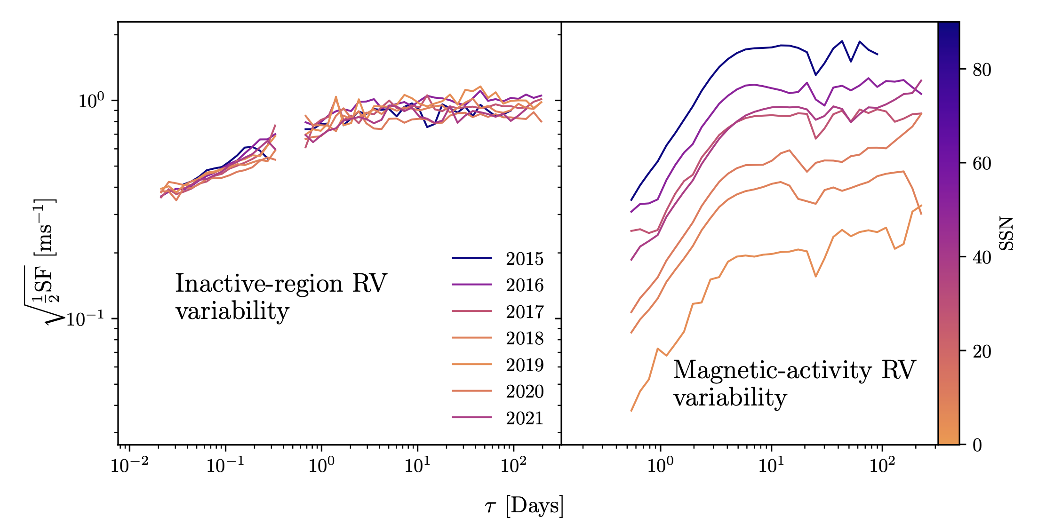
Active vs. inactive …
Variability (m/s)
Timescale (days)
(Lakeland et al. 2024)
Notes:
Now if I plot the magnetic-activity time series back on the same scale, we see a different story
~ order of magnitude change over the same baseline
Note that for most of the baseline, the magnetically quiet sun is the dominant source of variability
Important because *this* is what the vast majority of the methods I mentioned earlier are designed to mitigate

Slide 25
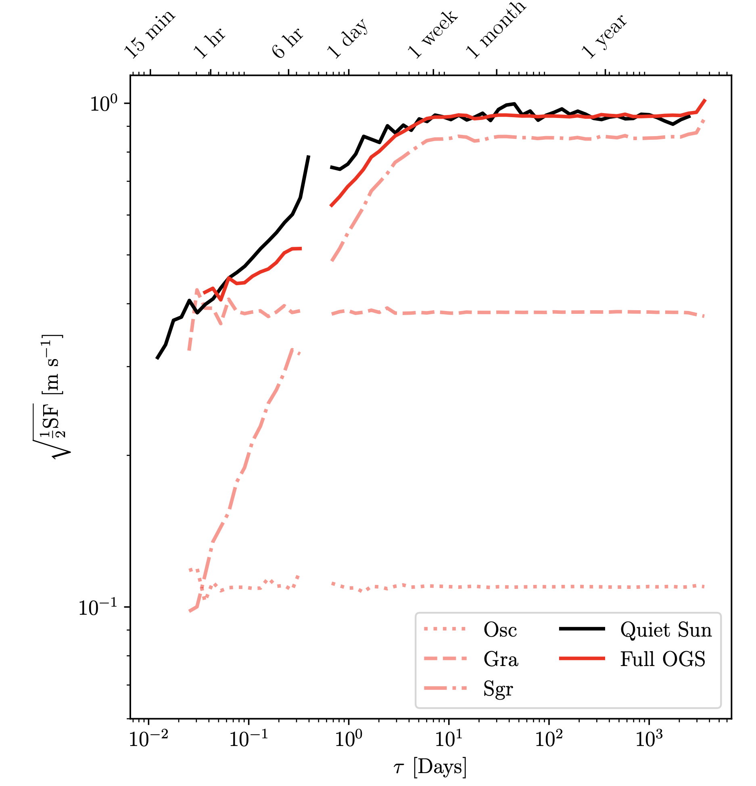
RVs of the inactive solar surface
Compare with simulated RVs:
P-mode oscillations
Granulation
Supergranulation
Supergranulation is the dominant driver of variability in the quiet Sun
Simulations from Meunier & Lagrange (2019)
(Lakeland et al. 2024)
Notes:
So we’ve identified the Quiet Sun as a significant driver of RV variability, what’s causing it?

Slide 26
Conclusions
Solar data offers a unique way to study stellar variability
Using combinations of solar observations, we can extract the RVs of the quiet Sun
The RMS of the inactive regions is constant at ~ 1m/s
The inactive solar surface often dominates the total solar RVs
Supergranulation identified as main driver of RVs from the inactive solar surface
It is vital to understand supergranulation to find Earth twins
(See the next talk!)

Slide 27
Absolute magnetic flux as activity proxy
Spearman’s Rank $$R=0.92$$
(Haywood et al. 2022)
Notes:
I’ve been talking a lot about the quiet Sun, don’t want you to think that the active regions aren’t important
We still do need to model out all of this signal as well.
As I mentioned earlier, absolute magnetic flux is the best correlator we have found yet.

Slide 28
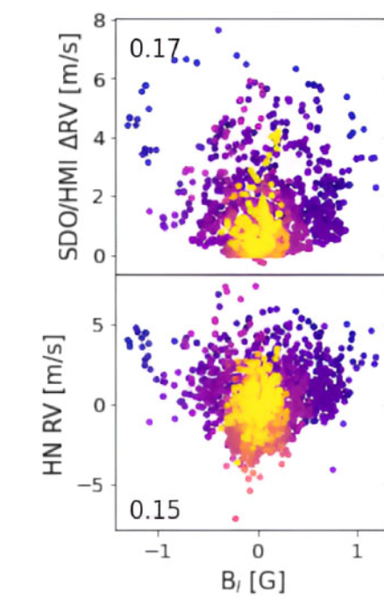
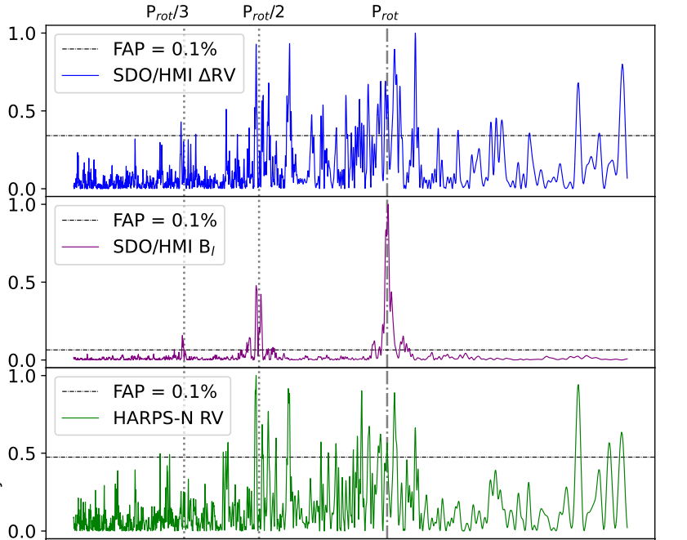
Net magnetic flux can also be useful
Great for detecting solar rotation period!
(Rescigno, Mortier, Lakeland, et al. 2024)
Notes:
Bad correlator,
But very good at finding the solar rotation period

Slide 29
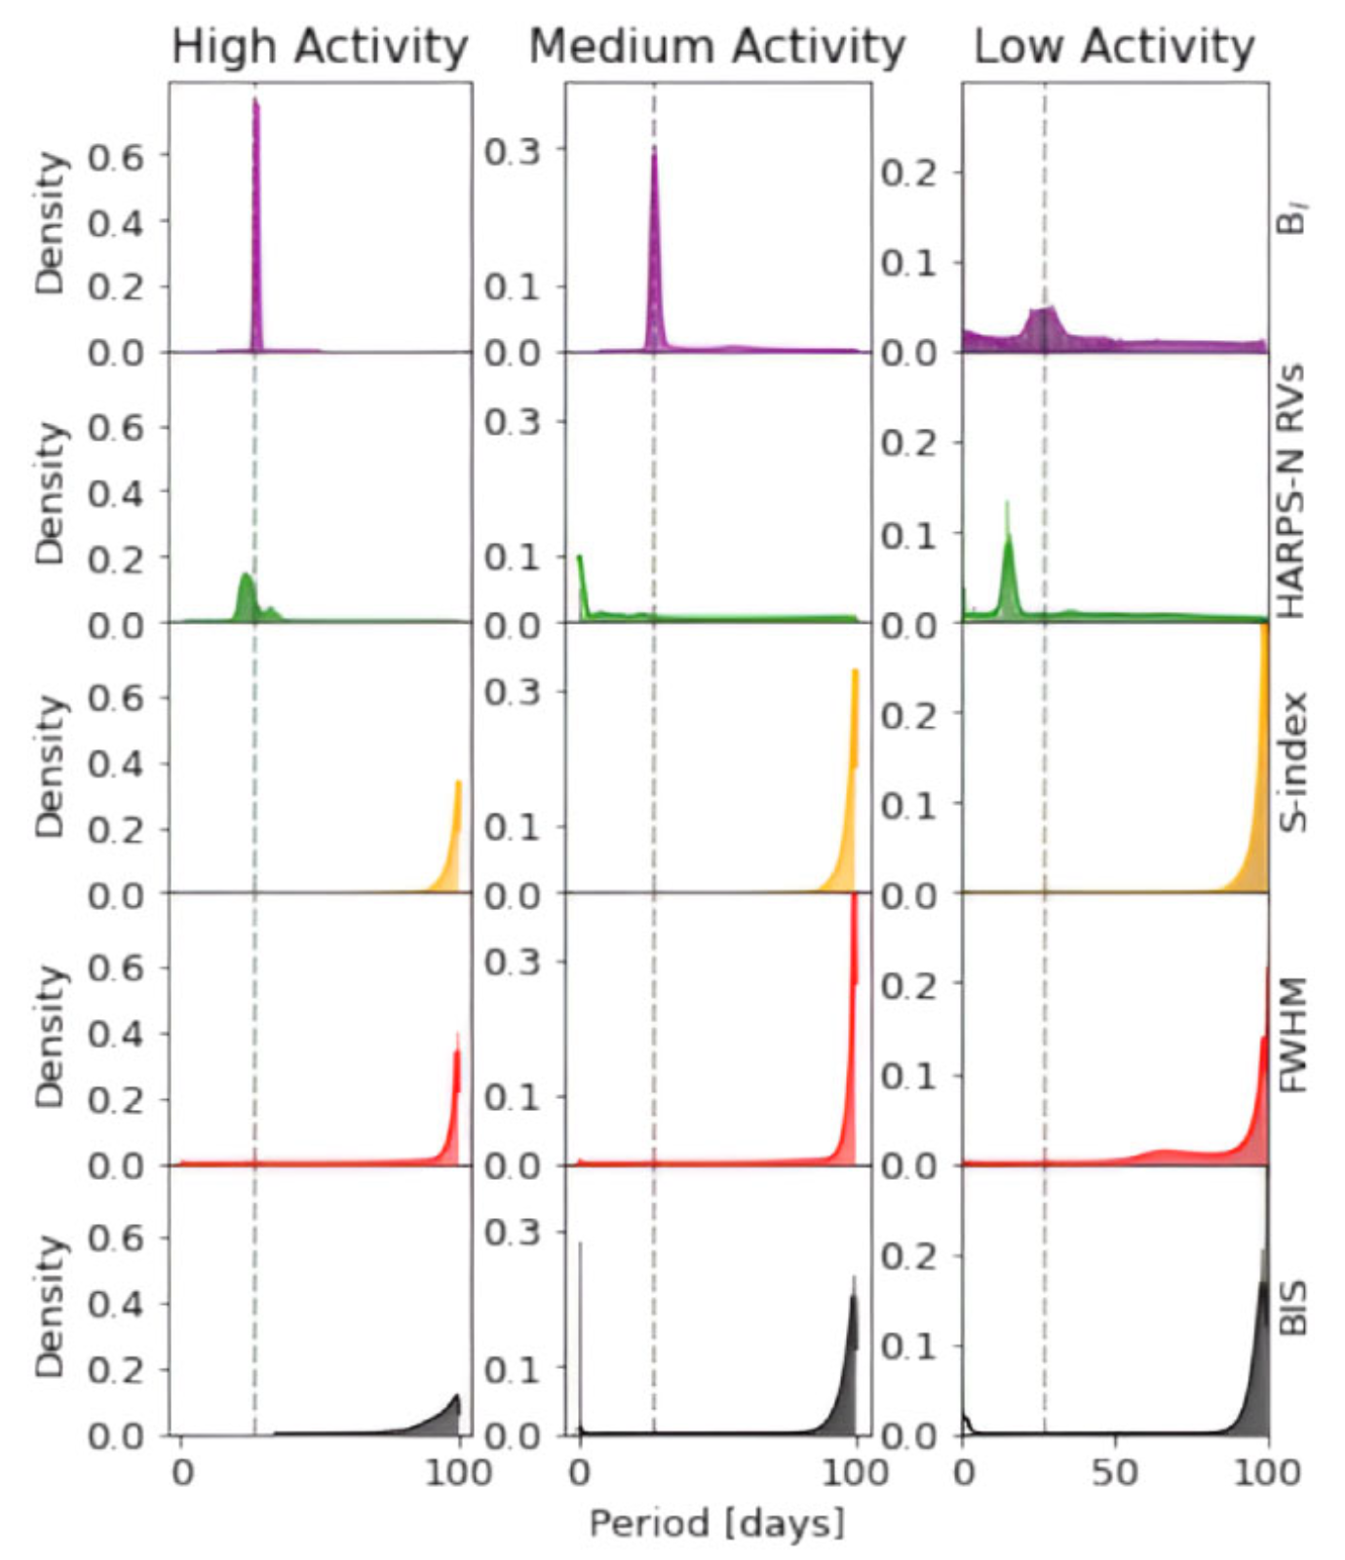
Net magnetic flux can also be useful
Great for detecting solar rotation period at low activity!
(Rescigno, Mortier, Lakeland, et al. 2024)
Notes:
Only reliable way to get the rotation period at solar minimum
Directly measurable for other stars

Slide 30
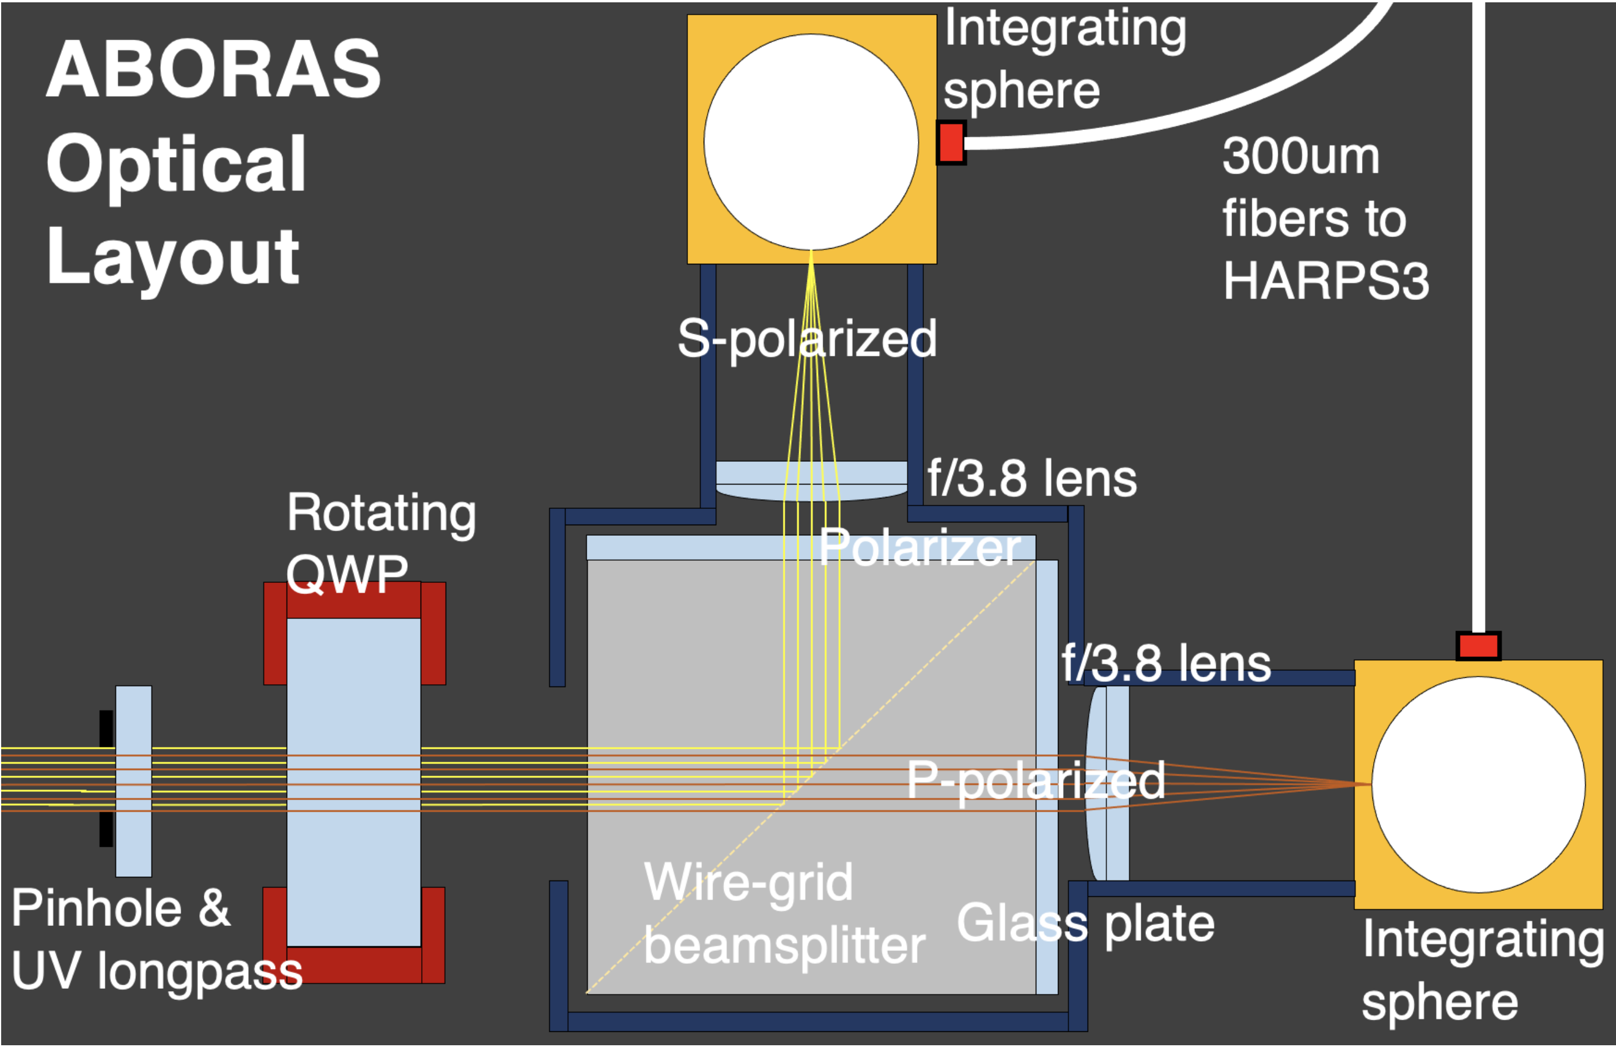
ABORAS: Sun-as-a-star spectropolarimetery
A dual-Beam pOlarimetric Robotic Aperture for the Sun
Coupled to the HARPS3 spectrograph on La Palma
Full Stokes V (and I) optical wavelength coverage
~ 1 Gauss Magnetic field precision
Coming late 2025/early 2026
(Farret Jentink, Mortier, et al. 2022)

Slide 31
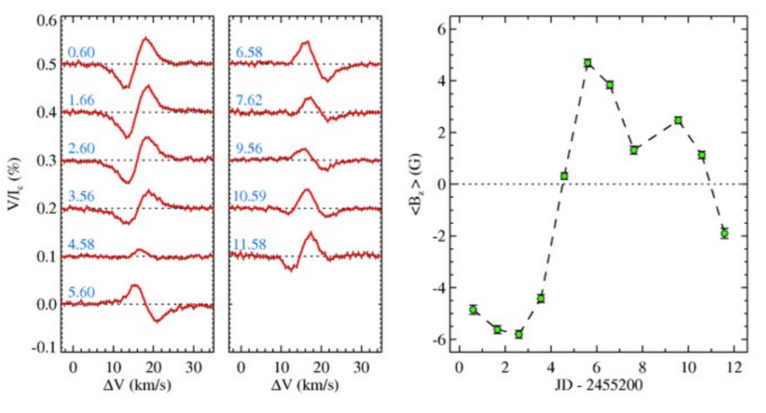
ABORAS will detect circular polarisation
(Piskunov et al. 2011)

Slide 32
Conclusions
Solar data offers a unique way to study stellar variability
Using combinations of solar observations, we can extract the RVs of the quiet Sun
The RMS of the inactive regions is constant at ~ 1m/s
The inactive solar surface often dominates the total solar RVs
Supergranulation identified as main driver of RVs from the inactive solar surface
It is vital to understand supergranulation to find Earth twins
(See the next talk!)

Slide 33
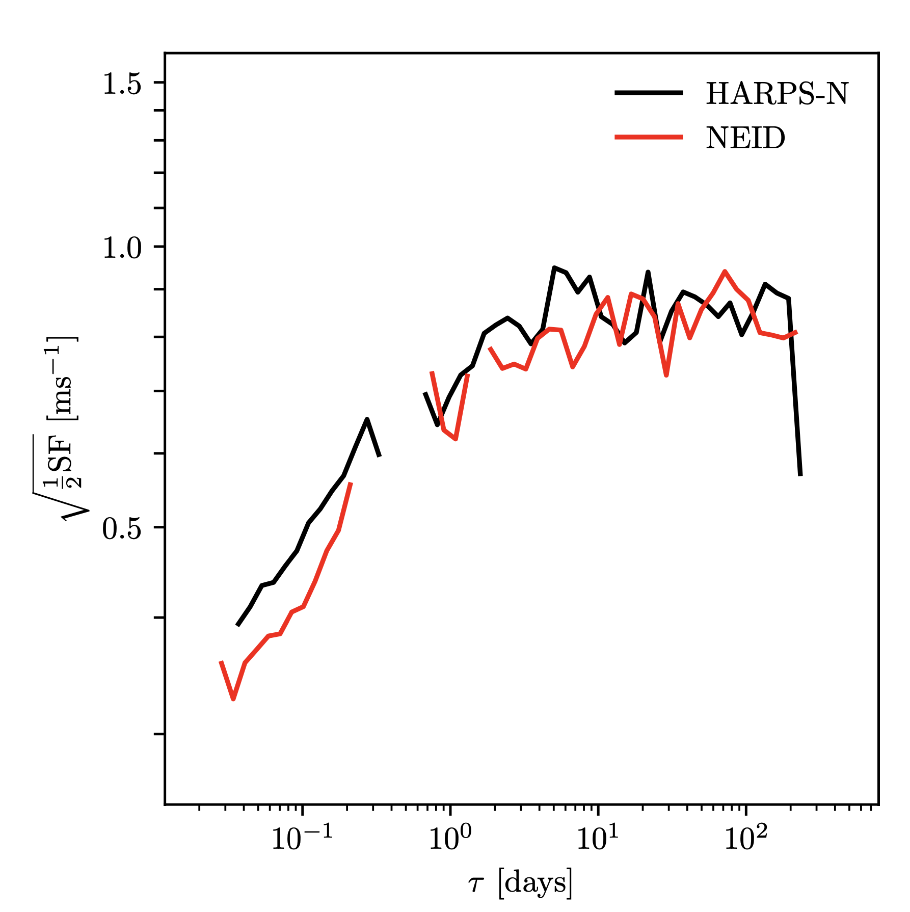
NEID shows the same trend
(Lakeland et al. 2024)
Notes:
I also repeated this test with data from the NEID solar telescope.
Like with the time series plot of the solar RVs before, we see impressive agreement between the two instruments
Any instrumental effects are fairly small

Slide 34
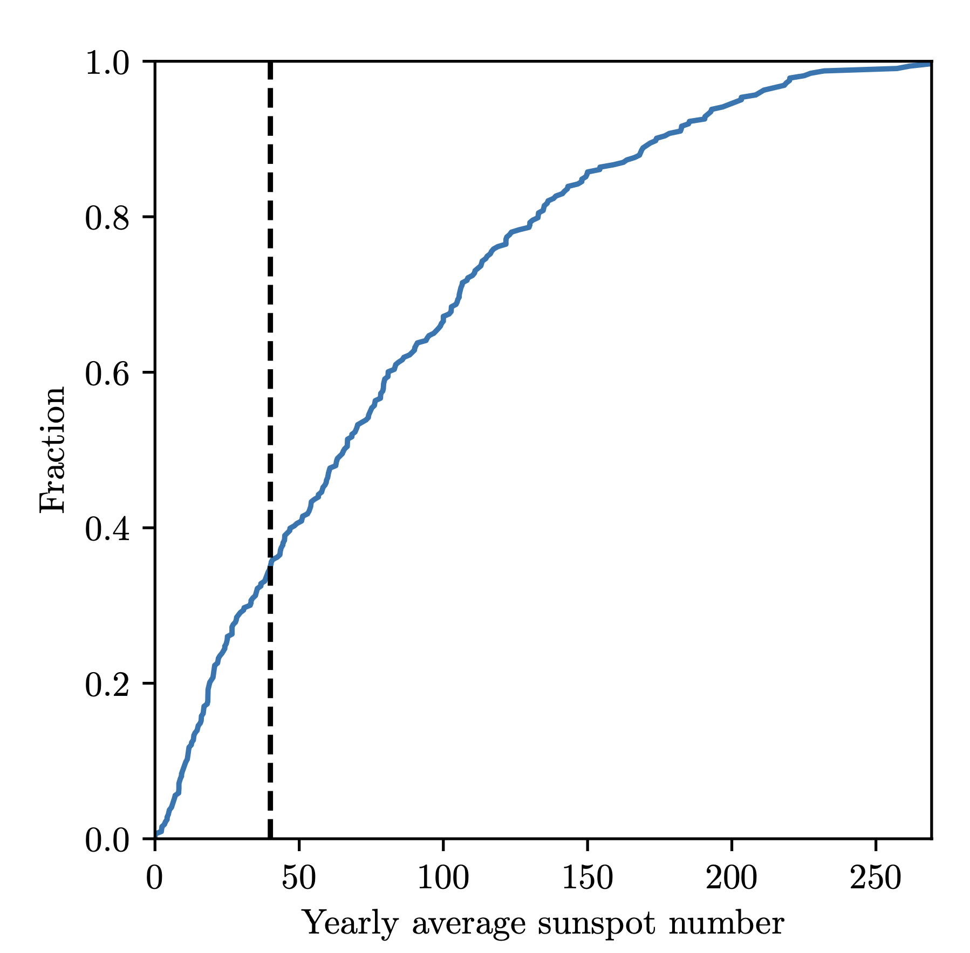
(Lakeland et al. 2024)

Slide 35
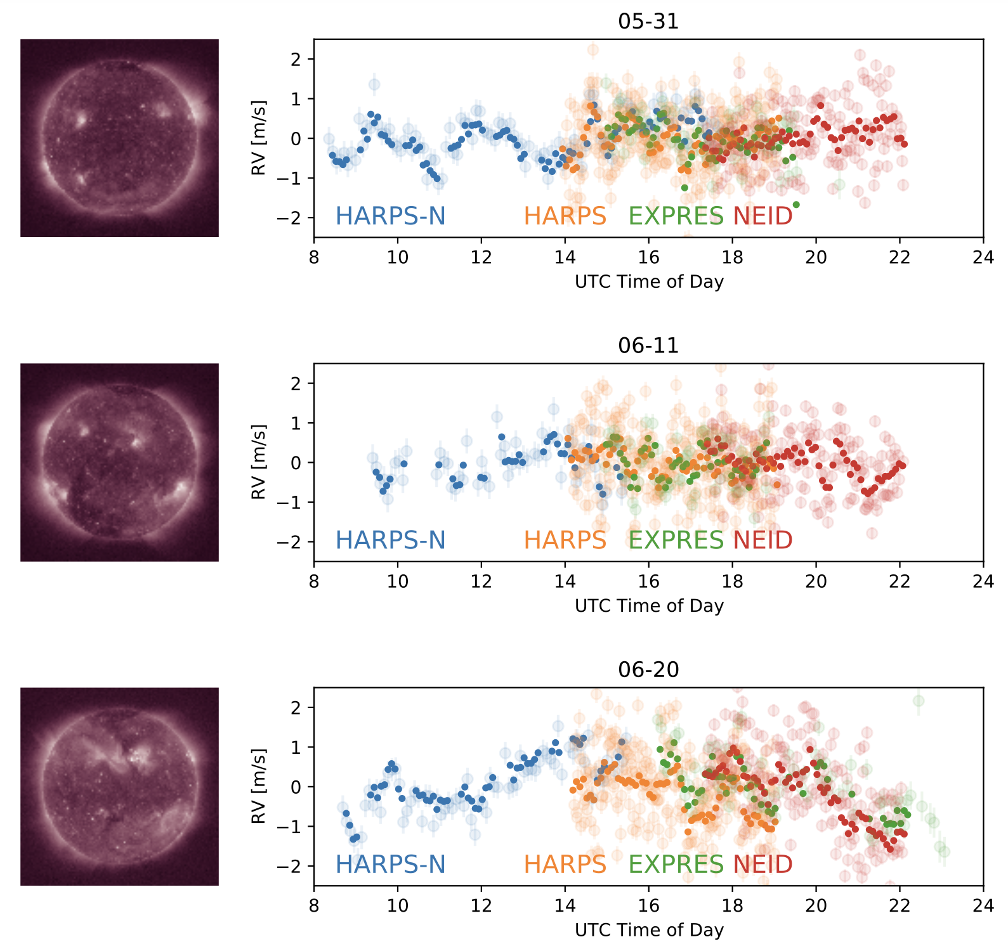
Sun-as-a-star RVs
Great agreement between Sun-as-a-star telescopes all over the world
(Zhao et al. 2023)
Notes:
I work mainly with HARPS-N solar telescope, but there are lots of Sun-as-a-star RV surveys all over the world.
They agree below instrument stability, impressive agreement!
Good confidence that we are seeing genuine astrophysical signals, and that instrumental effects are very small.
This plot also shows how we can use resolved solar images to link RV variations to what’s happening on the surface of the Sun

