Slide 1






A systematic bias in template-based RV extraction algorithms ​
André M. Silva @ PLATO-ESP2025, June 2025
Contacts:
Email: Andre.Silva@astro.up.pt
Github: https://github.com/Kamuish
Credit: MidJourney
Notes:
sjkahdkjsahdas

Slide 2
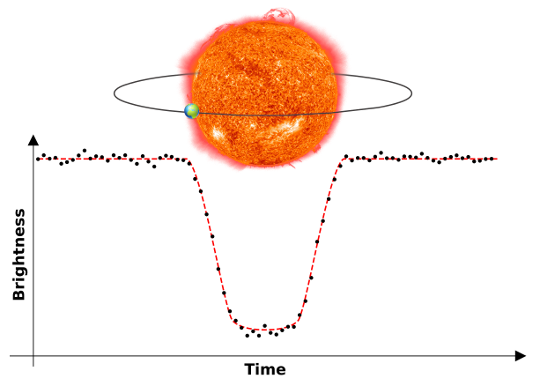
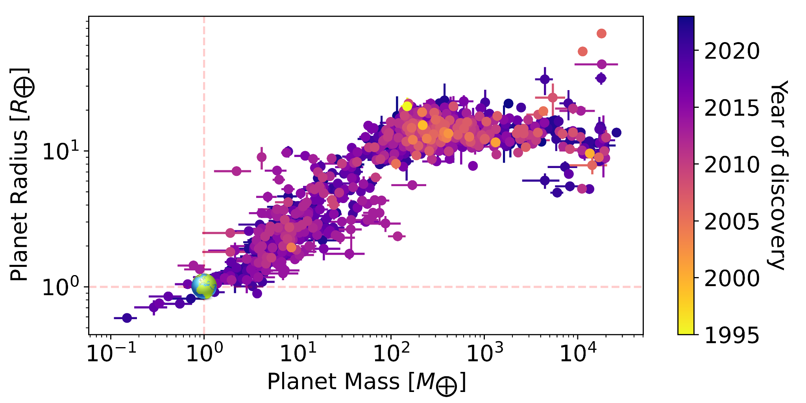
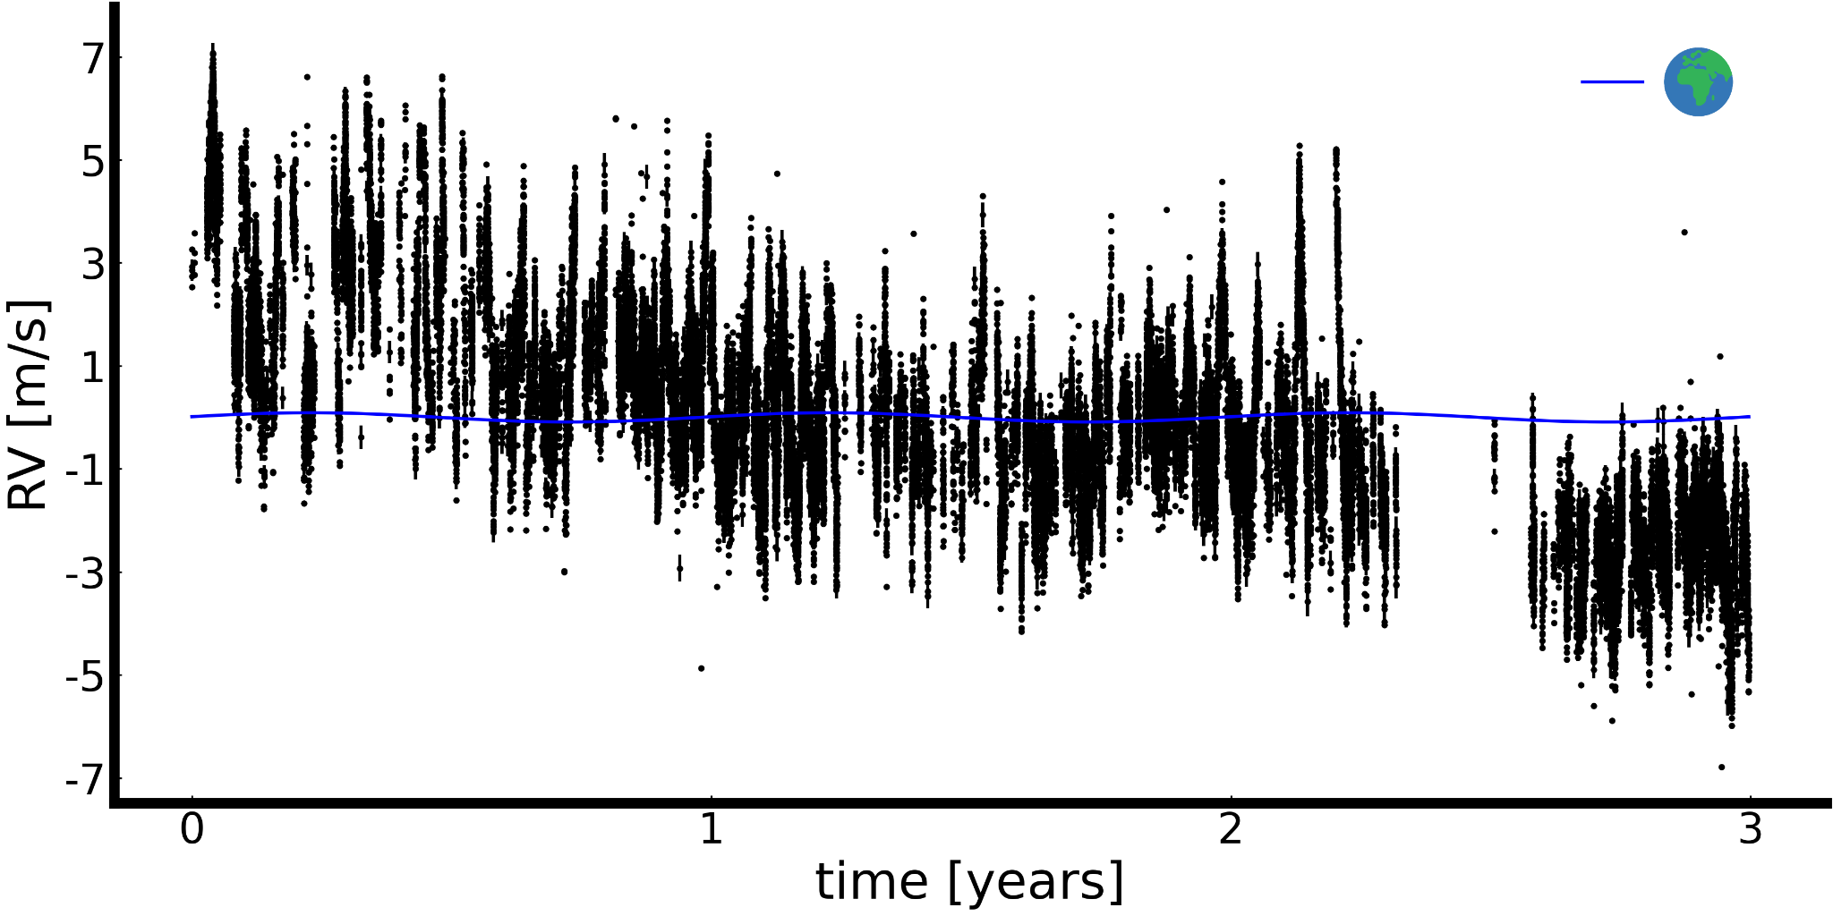
On the quest for an Earth-twin
Collier Cameron+2019, Dumusque+2021

Slide 3
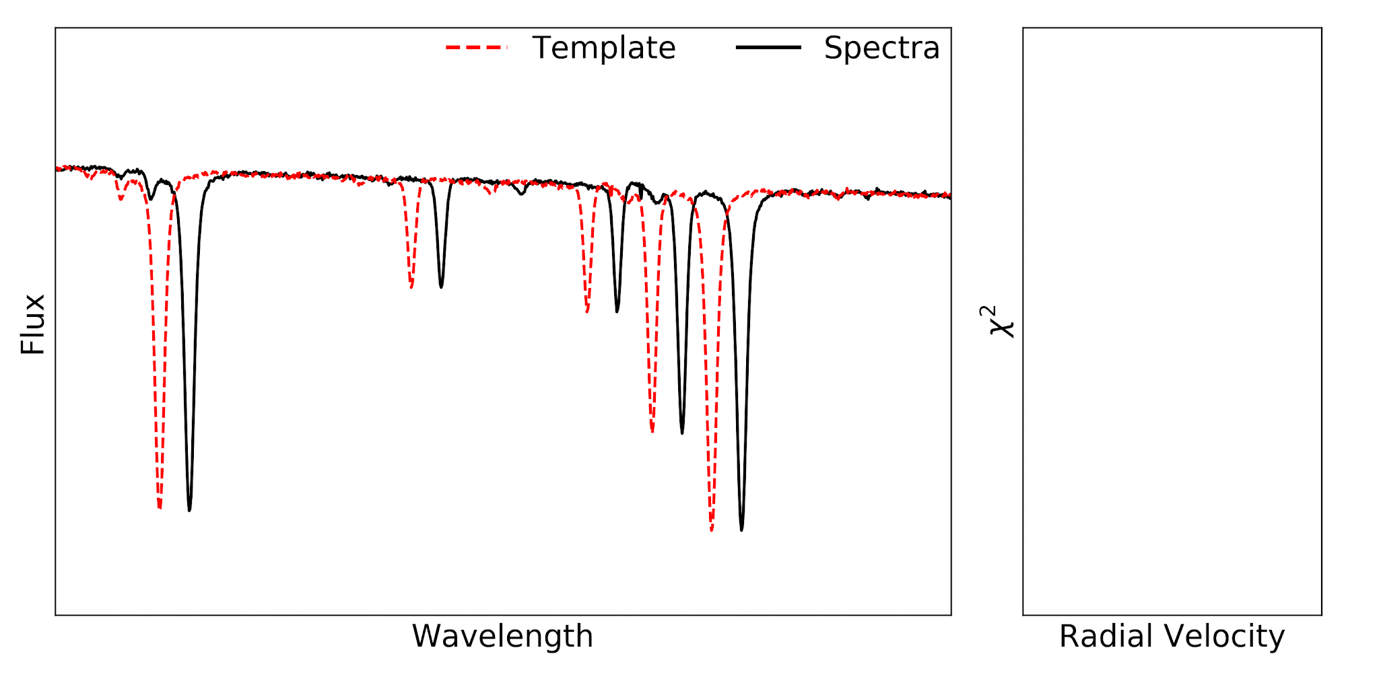
RV estimation through template-based methods
Anglada-Escudé+2012; Zechmeister+2018; Silva+2022

Slide 4







A move towards a Bayesian model: s-BART (Silva et al, 2022)
A common RV value across all echelle orders.
A Bayesian framework allows for:
consistent and straightforward characterization of the RV (posterior) probability for any observation;
Marginalize the continuum level of the stellar spectra;
Crédito: ESO
Notes:
s-bart – Semi-Bayesian Approach for RVs with Template-matching

Slide 5
The impact of observation strategy on RV extraction
Observations spread over multiple months/years
Detection and characterization of exoplanets

Slide 6

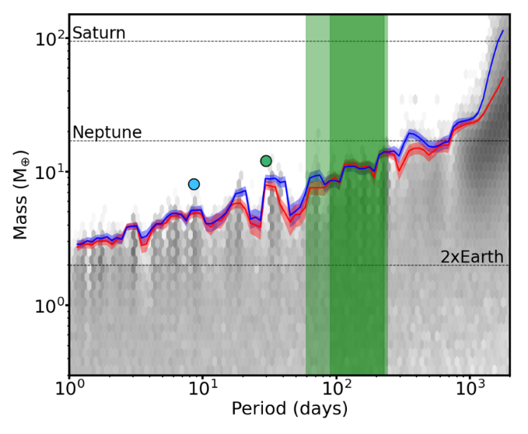
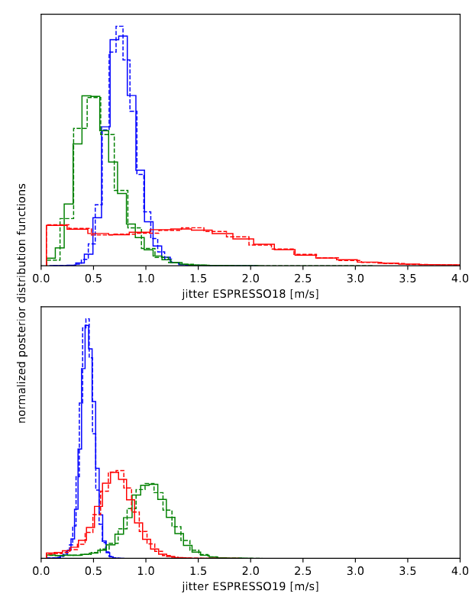
A brief overview of s-BART
40 cm/s jitter
Lillo-Box+2022, Balsalobre Ruza+2025
Figueira+accepted

Slide 7
The impact of observation strategy on RV extraction
Observations spread over multiple months/years
Detection and characterization of exoplanets
Planets with ultra-short (P<12h) orbital periods
Observations spread over a few days / hours
Asteroseismology
Transit/atmospheric characterization

Slide 8
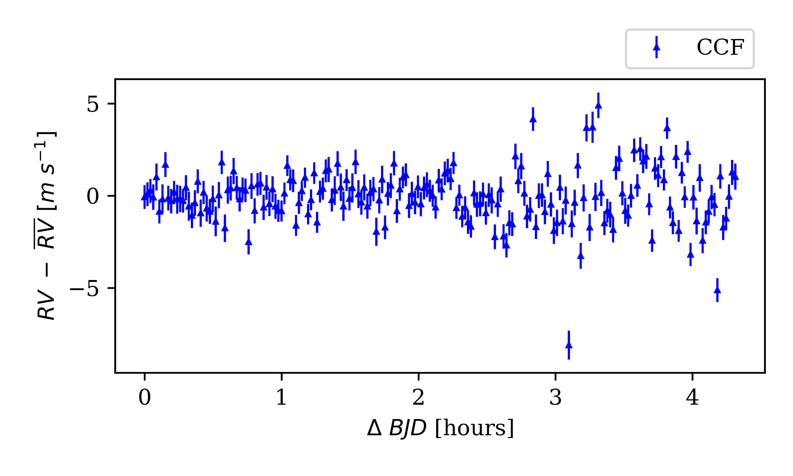
An intra-night RV time-series
Silva+in review

Slide 9
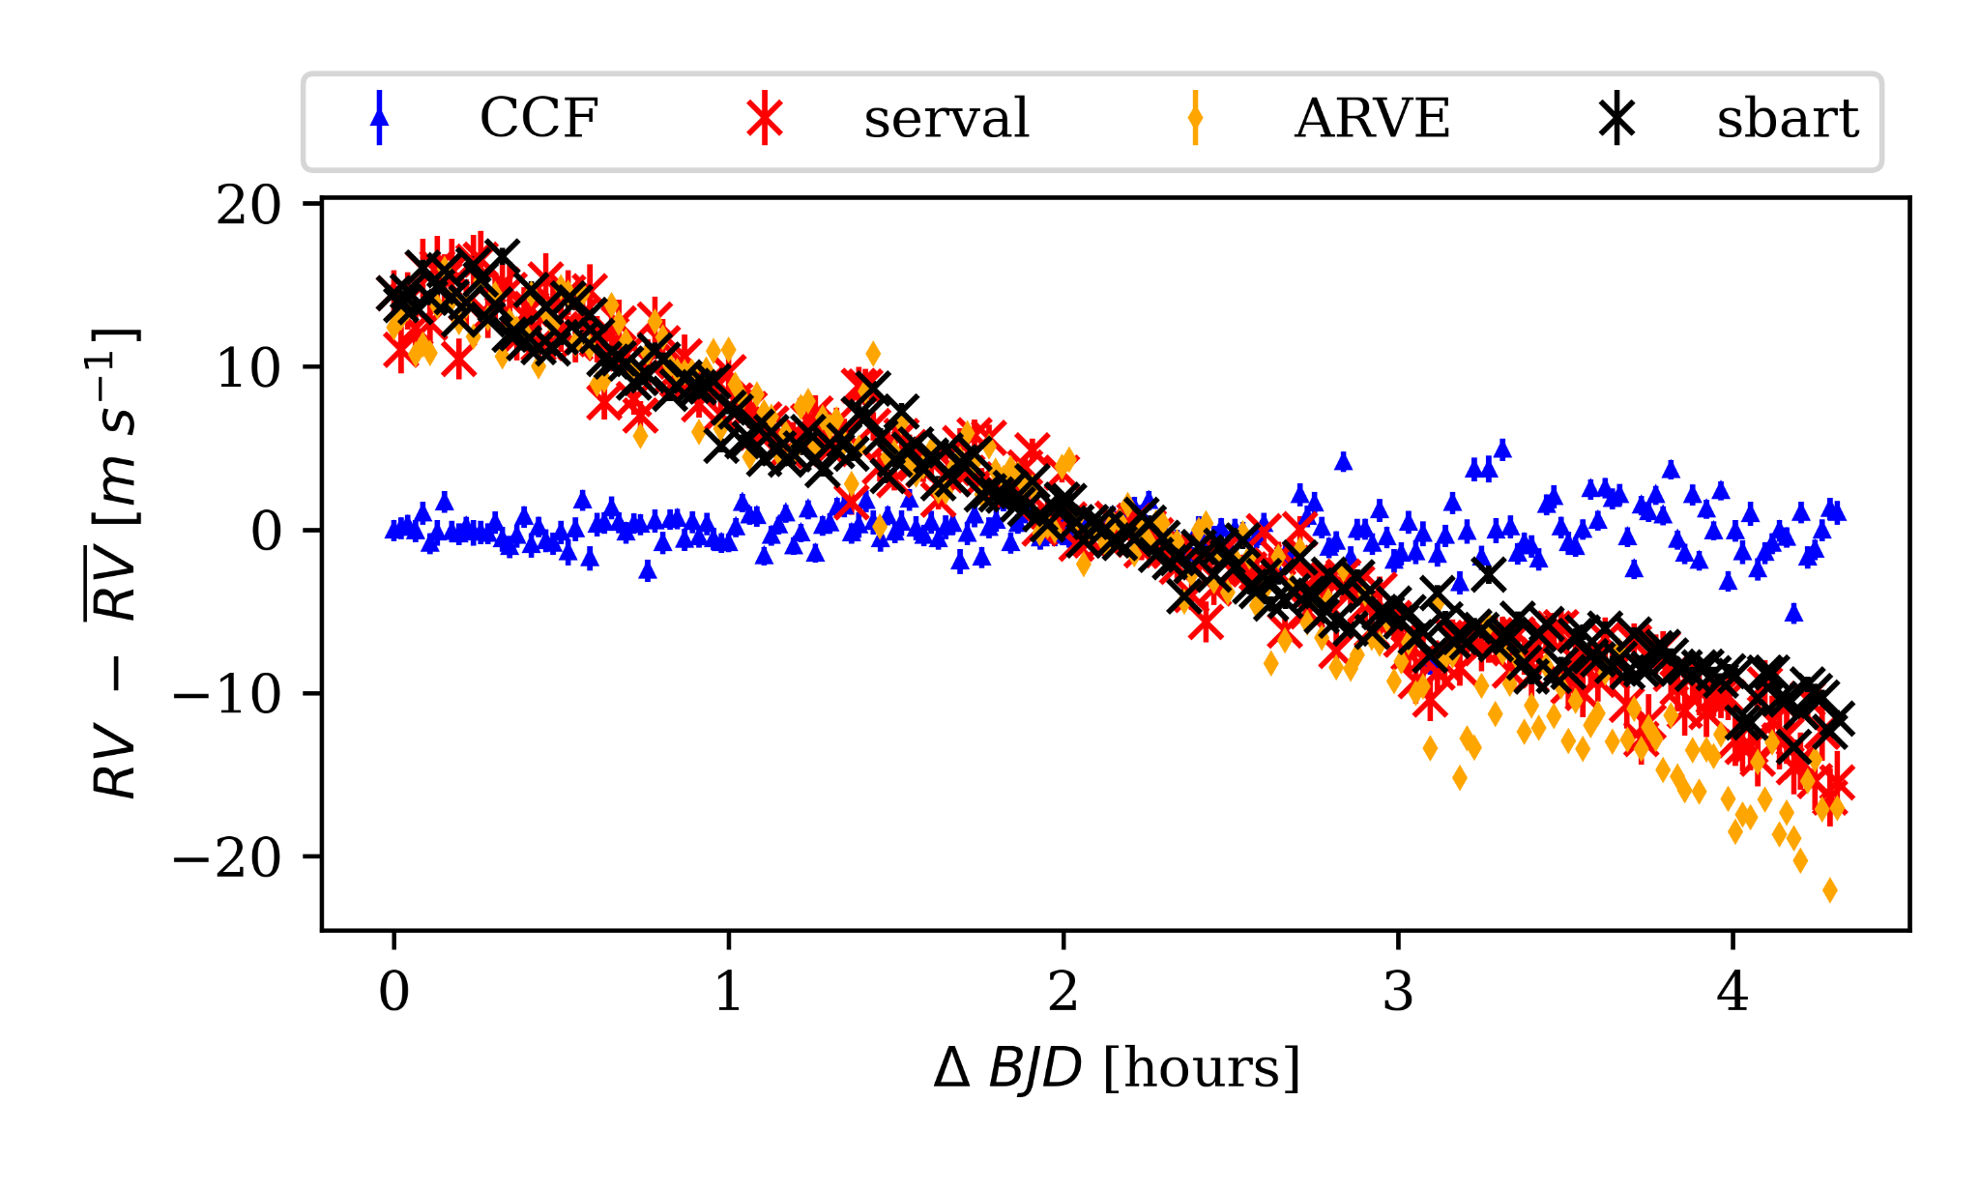
An intra-night RV time-series
Silva+in review

Slide 10
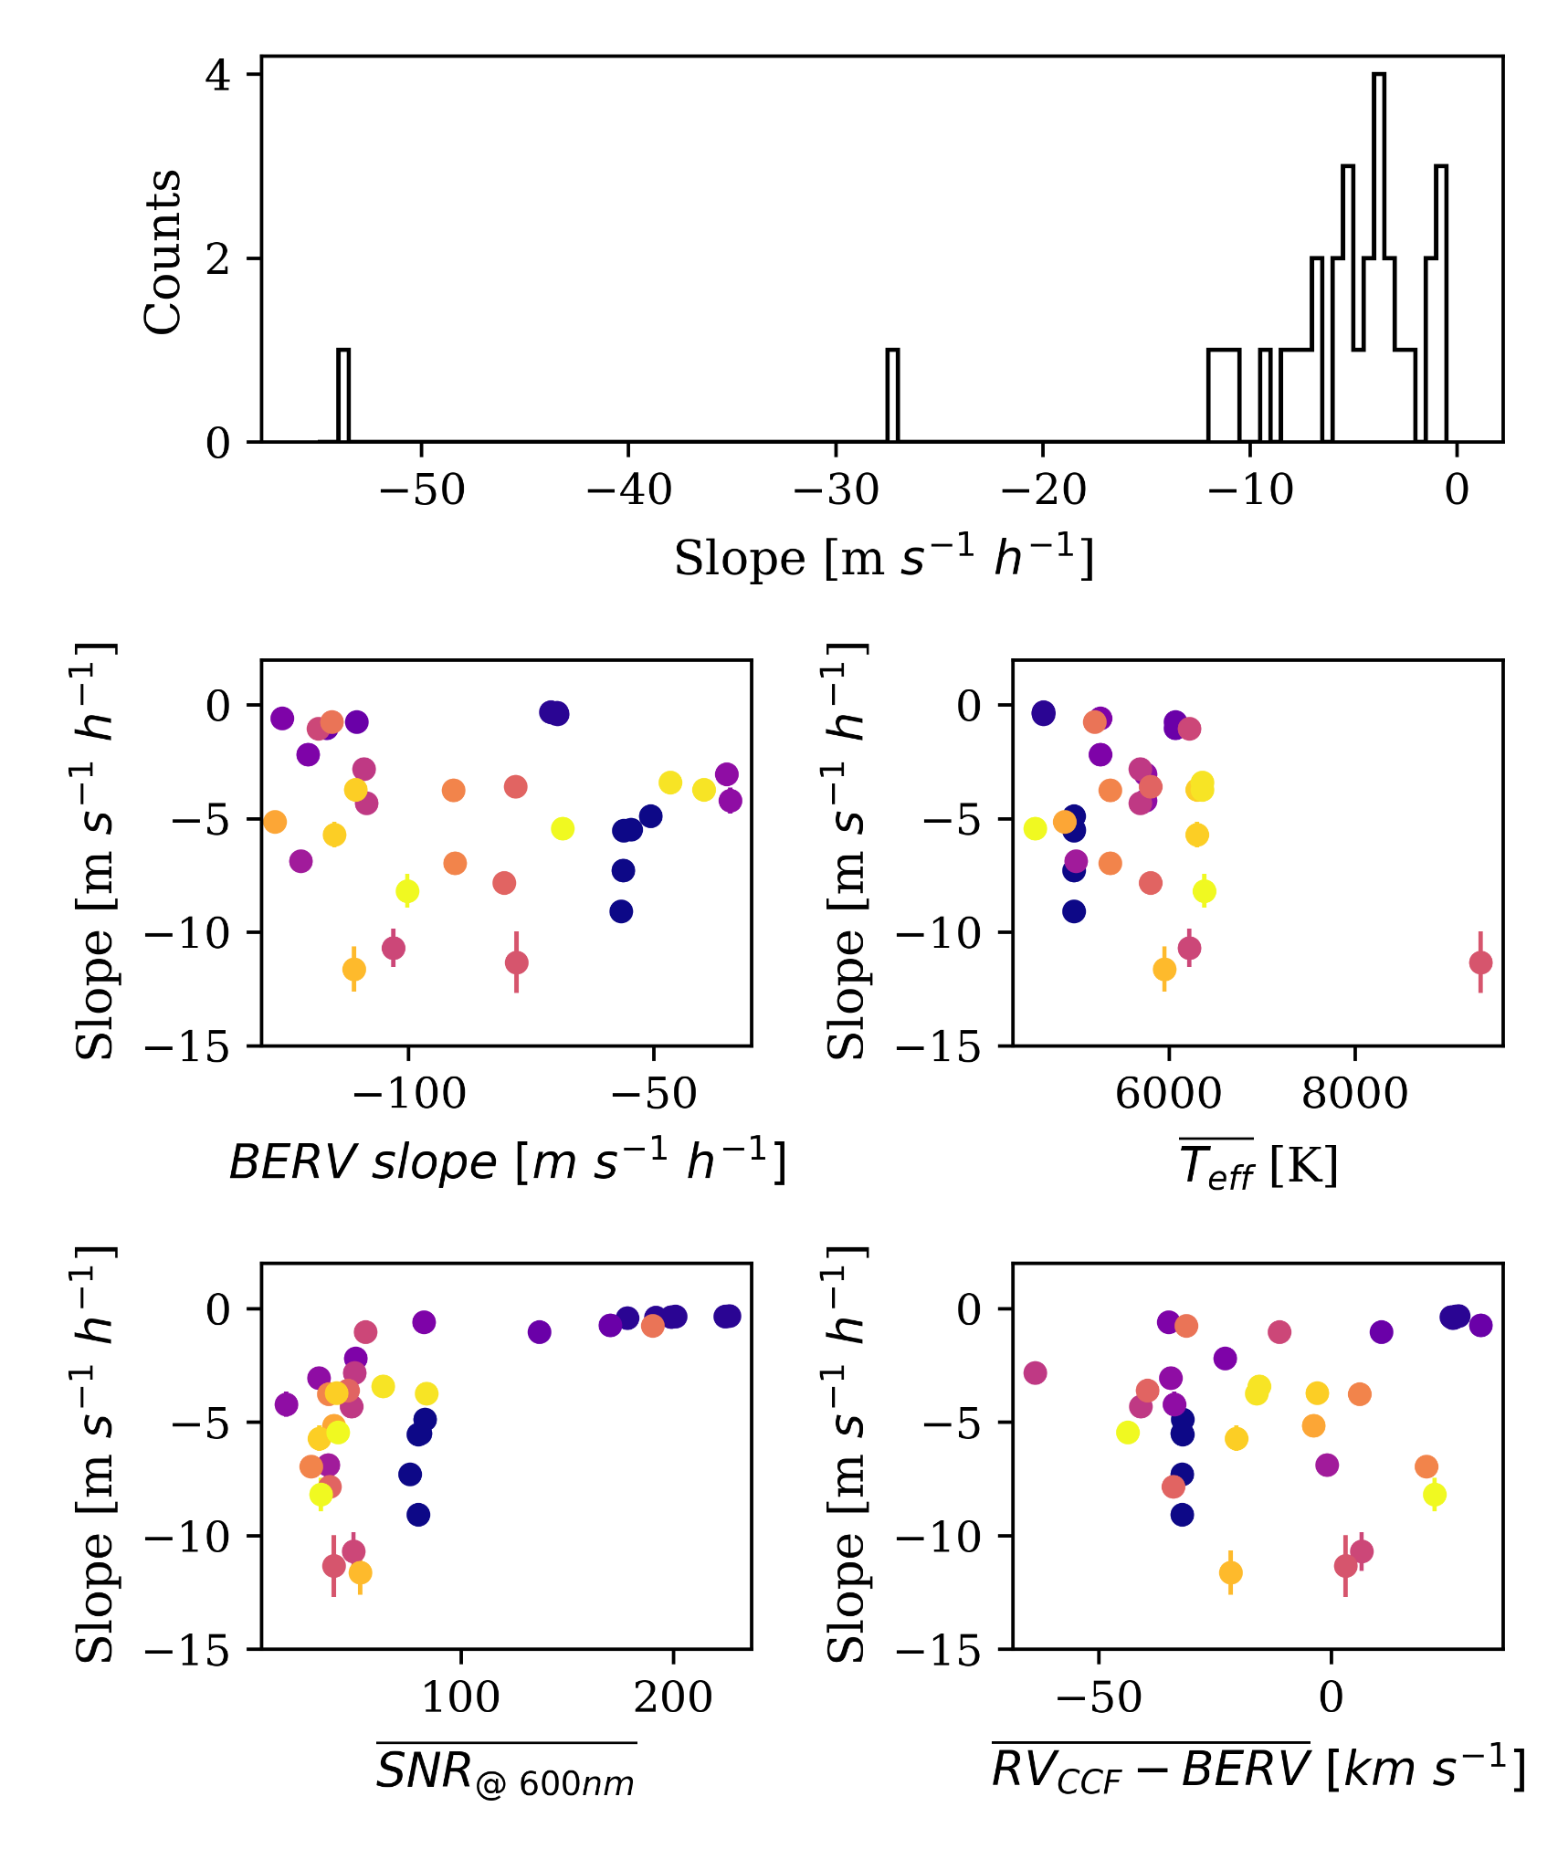
A large sample of ESPRESSO observations
4000 ESPRESSO observations of 20 stars, over 38 nights
Computed RV time-series for each night
Linear fit on each night
Silva+in review

Slide 11
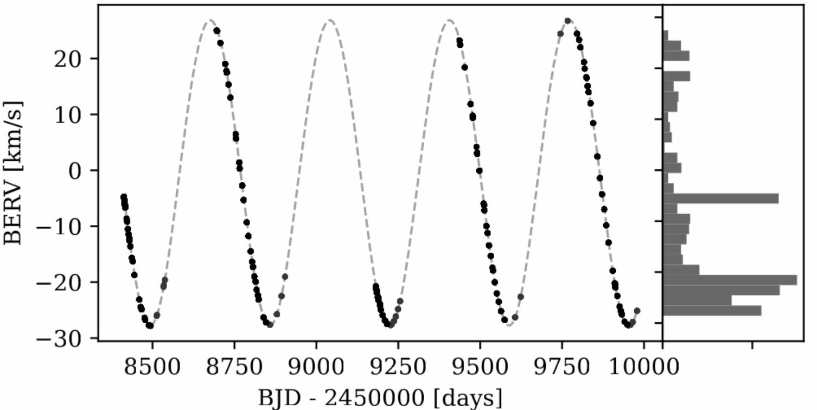
HD10700 - an ideal test bed
Multiple consecutive exposures per night
Figueira+accepted

Slide 12
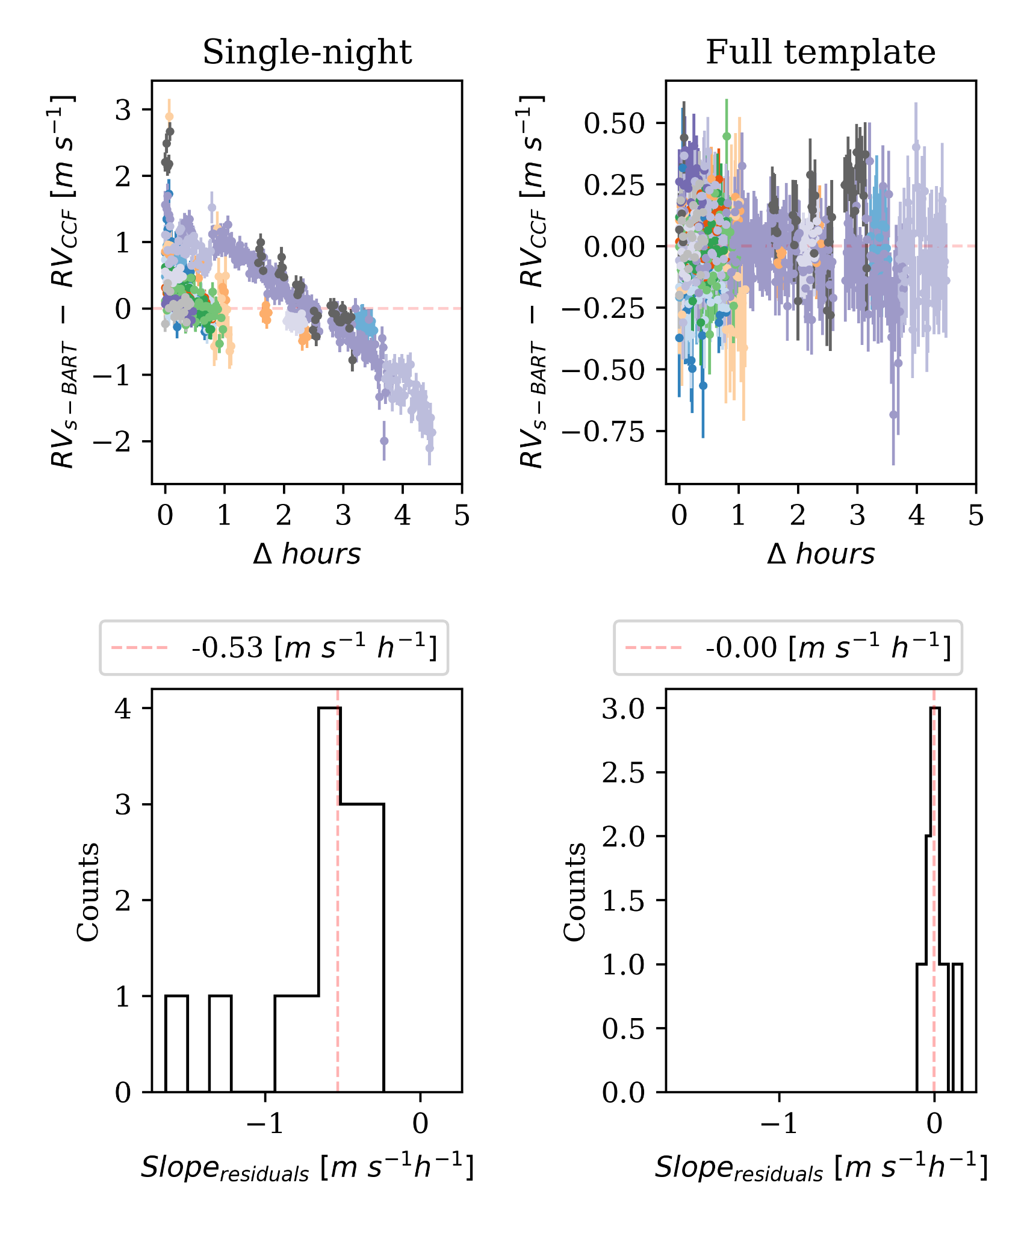
HD10700 - a nightly division
With a stellar template constructed with the full dataset
With a stellar template constructed with only data of the night
Silva+in review

Slide 13
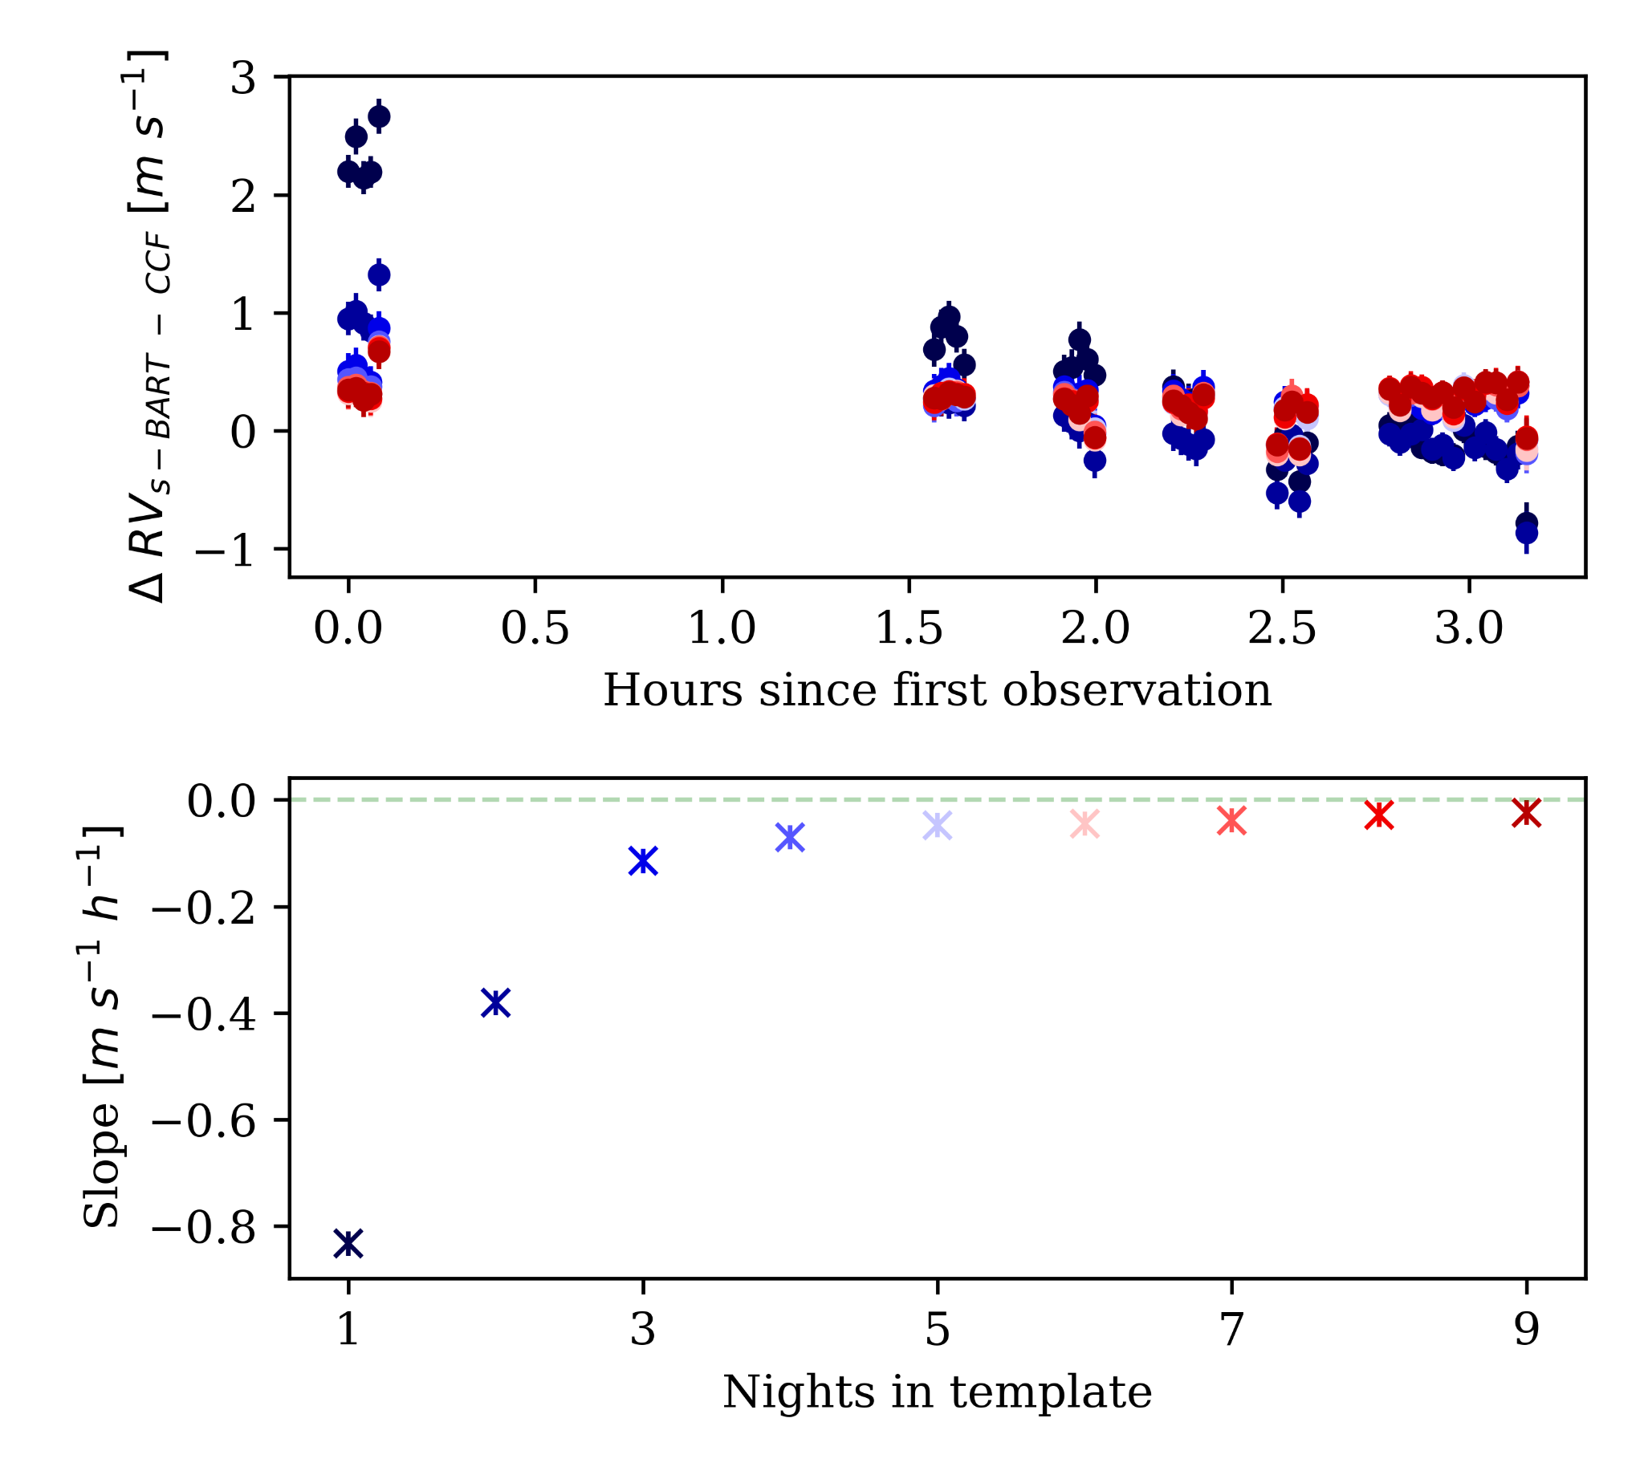
HD10700 - Increase of span of data in template
Select one night
Construct template from N nights
Compute RVs
Add one more night to template
Silva+in review

Slide 14
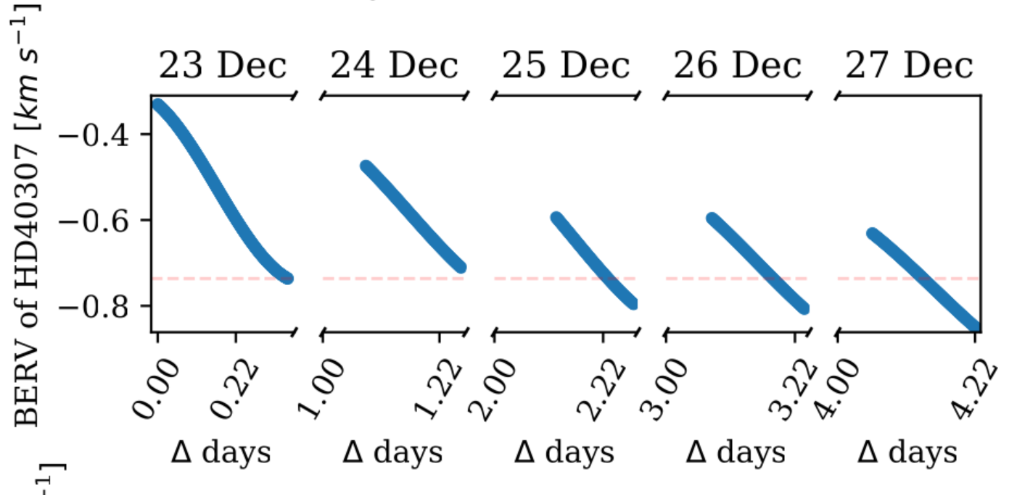
The likely culprit - fixed pattern noise on detector frame
Δ BERV < median pixel size
Flux systematics (e.g., tellurics) on detector frame will always overlap and be present in the stellar template, biasing RV extraction
Silva+in review

Slide 15
Takeaway messages
s-BART template-matching pipeline
  Provides a consistent method to characterize RVs and uncertainties;
  Has been adopted by multiple international consortia / projects;
Template-based methods present a systematic signal when data is collected within few days/hours
  Large sample analysis shows RV slopes in the interval [-0.3, - 52] m/s/h;
  Connected with the construction of the stellar template, particularly the BERV spread of spectra;
  We postulate that it is introduced by flux systematics on the reference frame of the detector;
  Will impact multiple science cases;

