Slide 1
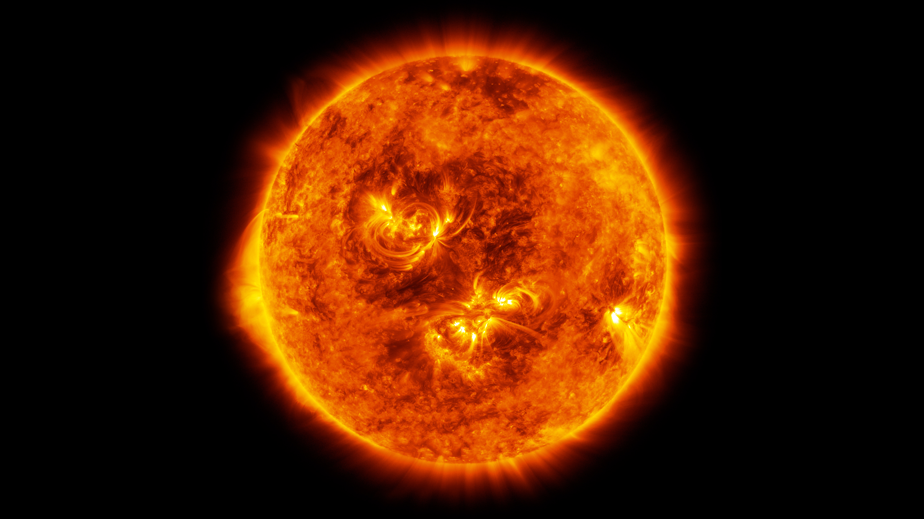


Tackling Supergranulation in Earth-Twin Surveys using the HARPS-N Solar Data
Niamh K. O’Sullivan
University of Oxford
Suzanne Aigrain, Michael Cretignier, Ben Lakeland et al.
Image credit: NASA

Slide 2
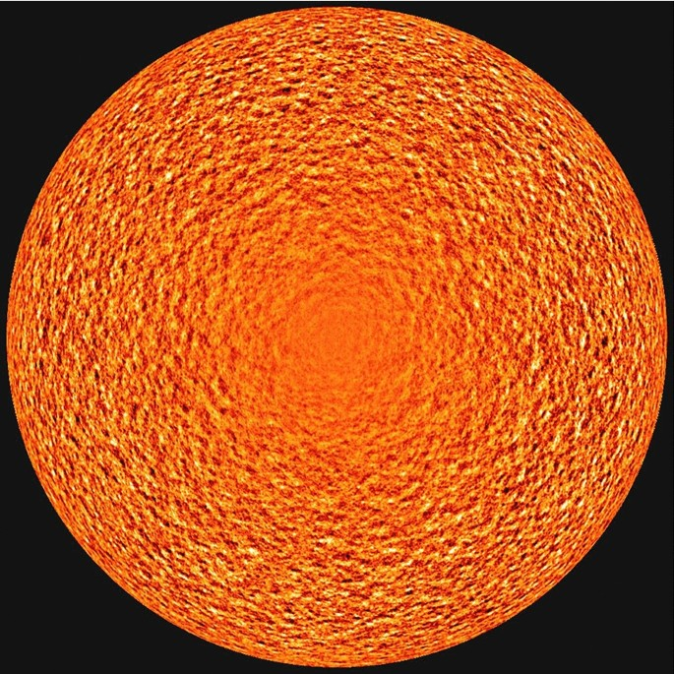
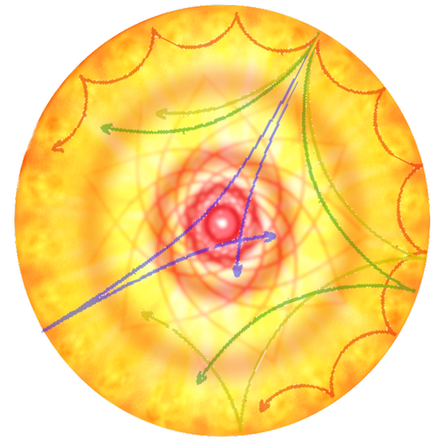
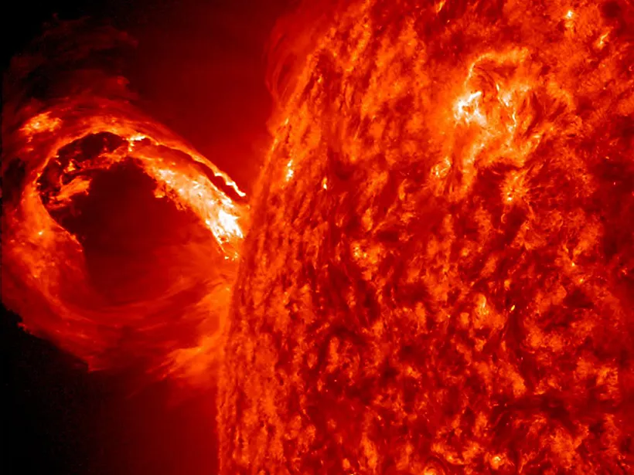
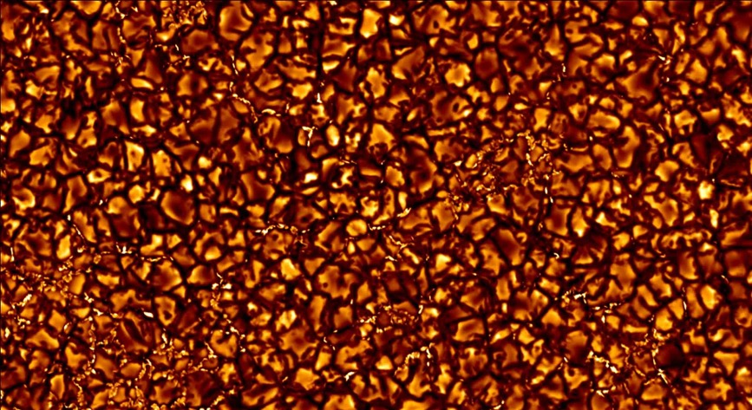
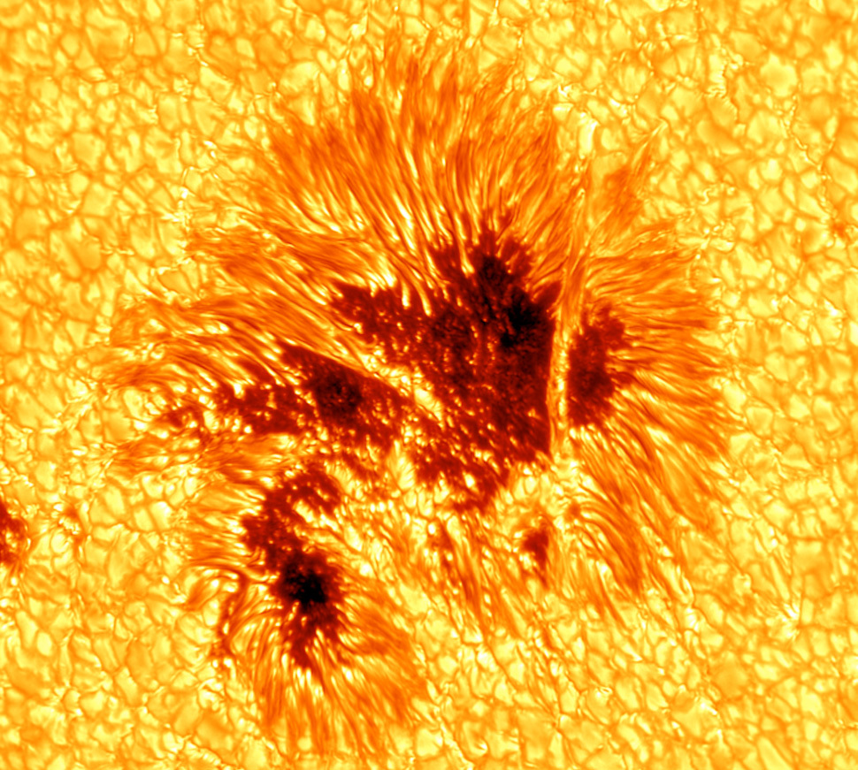
Supergranulation
Seen in Doppler imaging of the Sun
Horizontal flow of 200 – 300 m/s
(Vertical flow of 20 - 30 m/s)
Horizontal scale of 30-35 Mm
Convective origin
Timescale of 1-3 days
0.5-1 m/s RV scatter
Review by Rincon & Rieutord 2018
Image credit: SDO/HMI
Notes:
Well, its because stars aren’t just homogenous balls of gas like we would like them to be, they are incrediable veraible

Slide 3
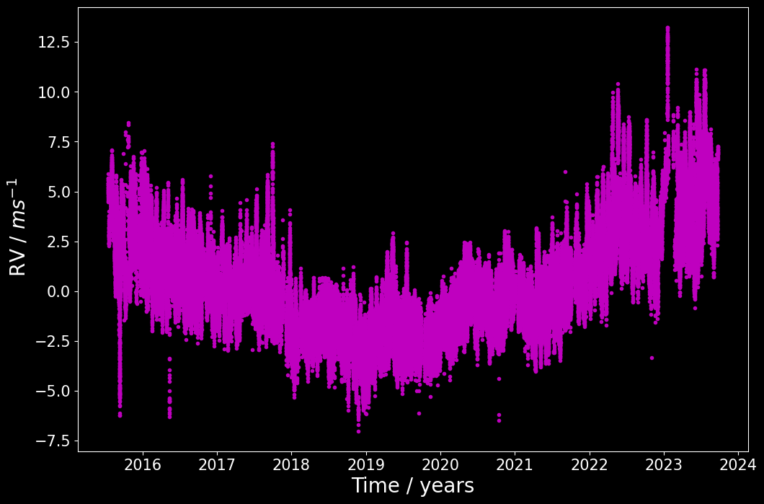
HARPS-N Solar Data
Solar Max
Solar Max
Solar Min
Collier Cameron et al. (2019), Dumusque et al. (2021), Dumusque et al. (in prep)
Notes:
The harps-n solar telescope has been observing the sun every 5 minutes when the sun is visable since 2014
This graph shows the solar RVs and how they evolve over time, with the planet signals removed
As I said the planetary signals have been removed, all that is left here is instrumentals, gran, super gran and activity.

Slide 4
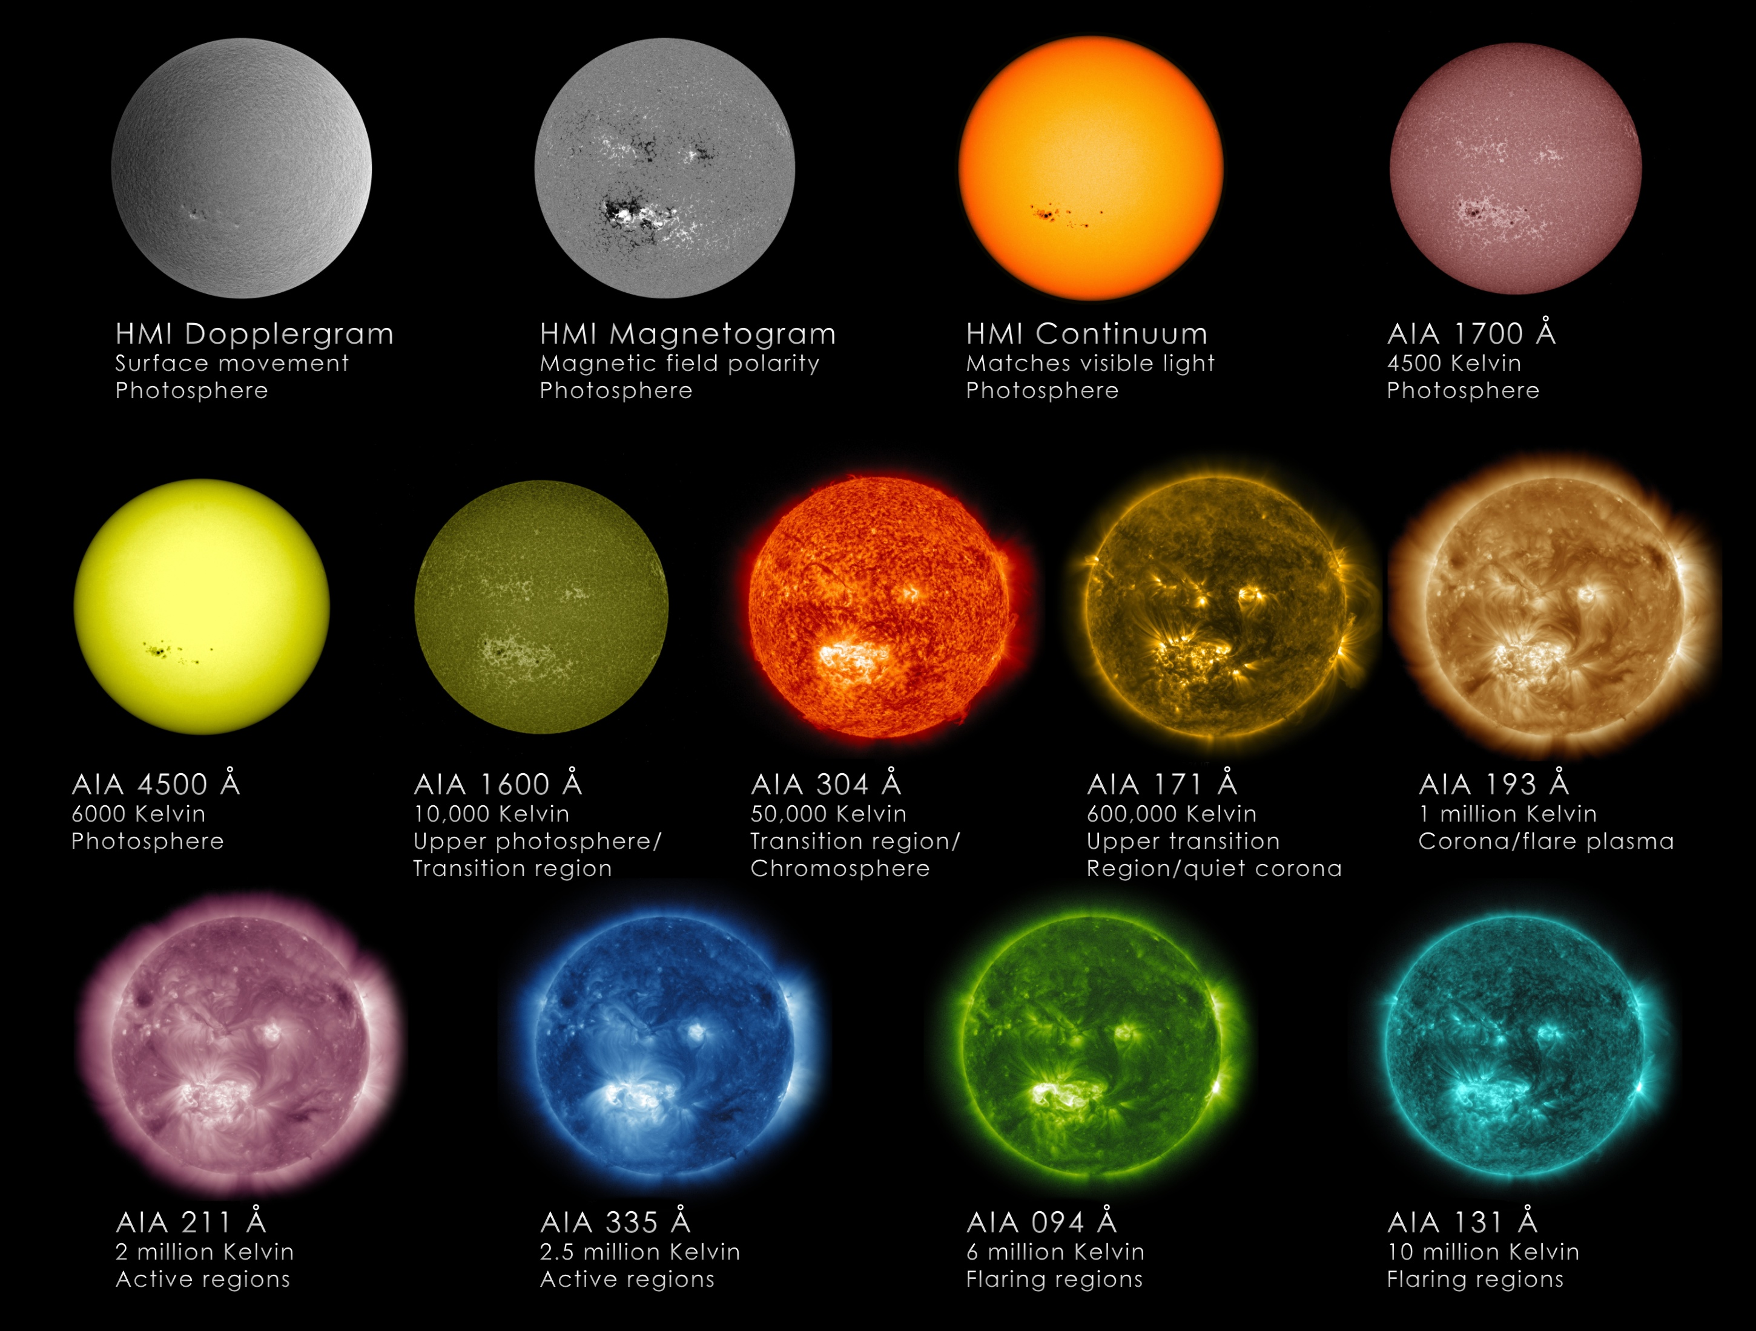
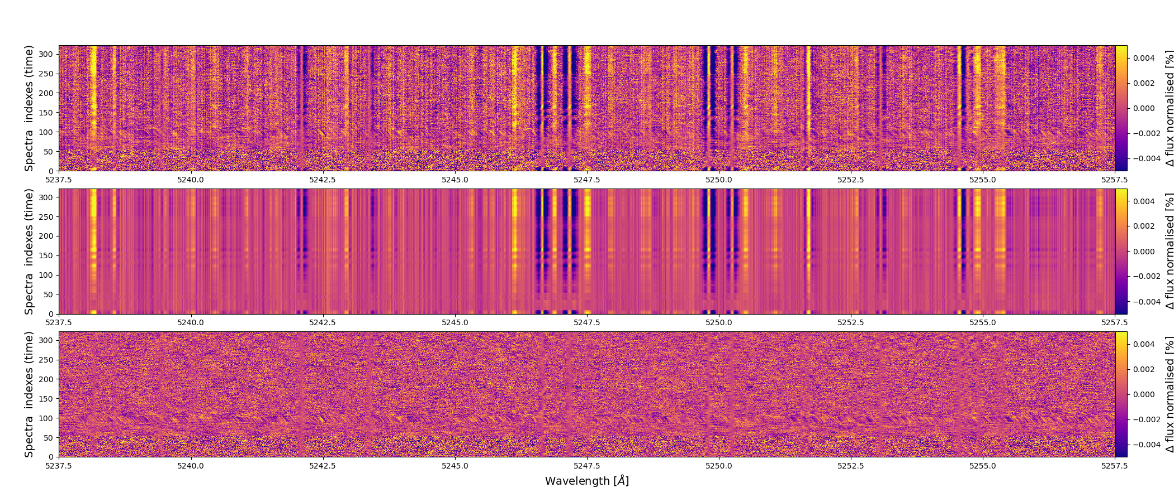
Evaluating Activity Induced RV Variation:
SDO vs YARARA
Image credit: SDO/HMI
Haywood et al (2016), Milbourne et al (2019) ,
Haywood et al (2022), Lakeland et al (2024)
Image credit: Cretignier courtesy
Notes:
But we are interested in the supergranulation signal only, so we start looking at other observations
For example these are images from the Solar Dynamics observatory, that has been observing resolved images of the sun since 2010.
We can separate the signals of the quite sun (gran and super_gran) and the active regions through the magnetic field measurer on bored and I refer you to these papers to see how
But we can also get the the magntiically induces RV variaon using the YARARA code developed by Michael Cretingier which removes the telluric, lines, cosmic rays, long-term stellar activity contamination, and variations in the instrument.

Slide 5
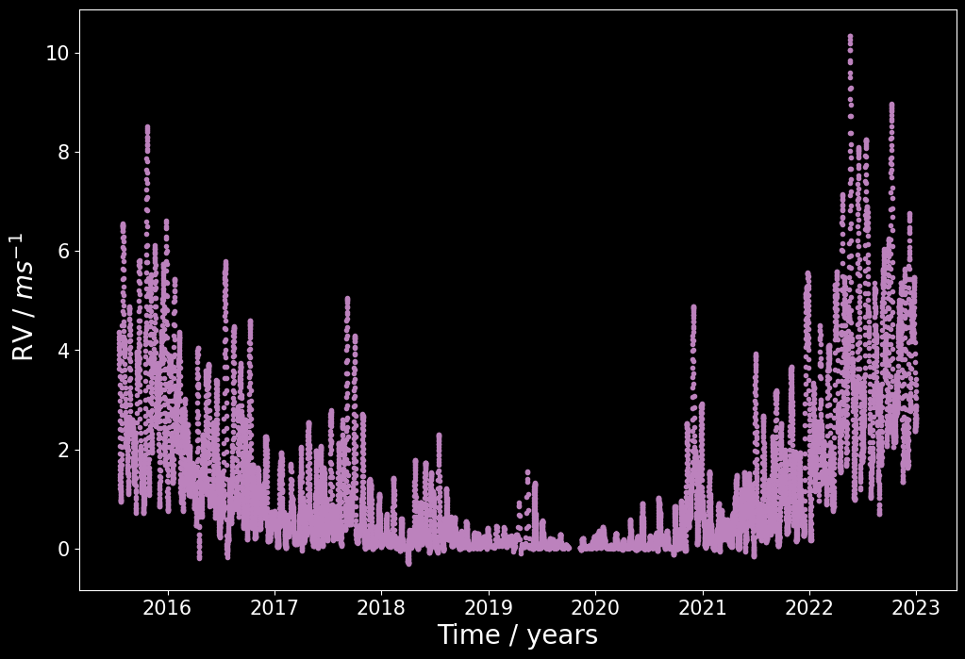
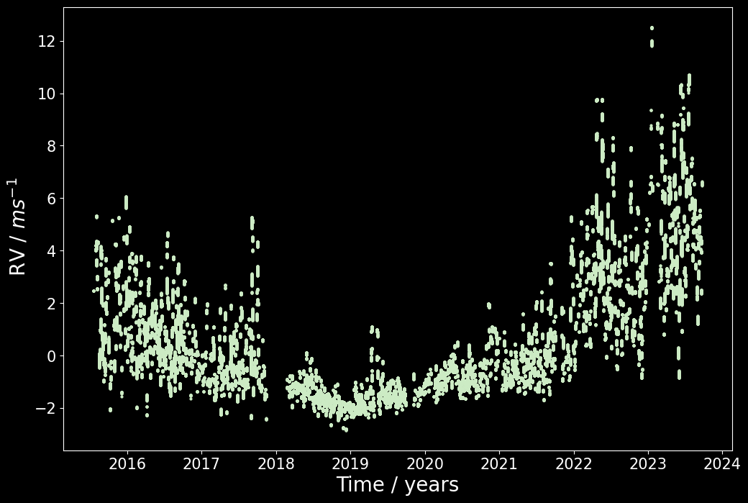
SDO
Magnetically Active Solar RVs
YARARA
Haywood et al (2016), Milbourne et al (2019) ,
Haywood et al (2022), Lakeland et al (2024)
Cretignier et al (2021)
Notes:
This allows us to find the active rv’s, aka the rv contribution that is soming from those star spots, and those bright spots caused by the suns magnetic field

Slide 6
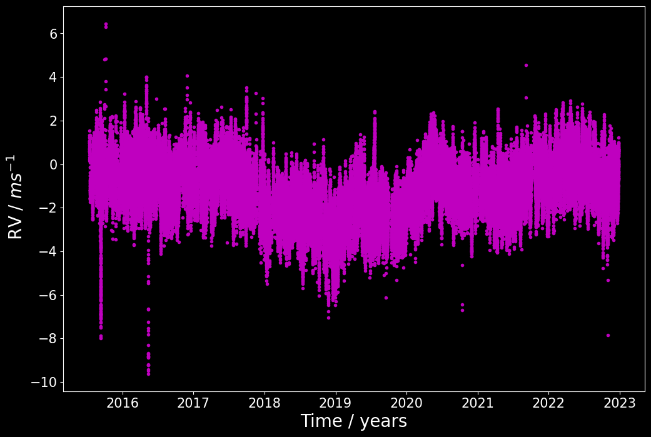
Quiet Sun RVs
Magnetically Active Solar RVs
HARPS-N Solar RVs
Quiet Solar RVs
Lakeland et al (2024)
Notes:
And if we combine those data sets together
So we take the HARPS-N solar RVs. That have the magnetic activity, granulation and supergranulatin in them
Subtract the SDO Active RVs
Then we can get a quiet solar RVs, with just the granulation and supergranulation signals in them

Slide 7
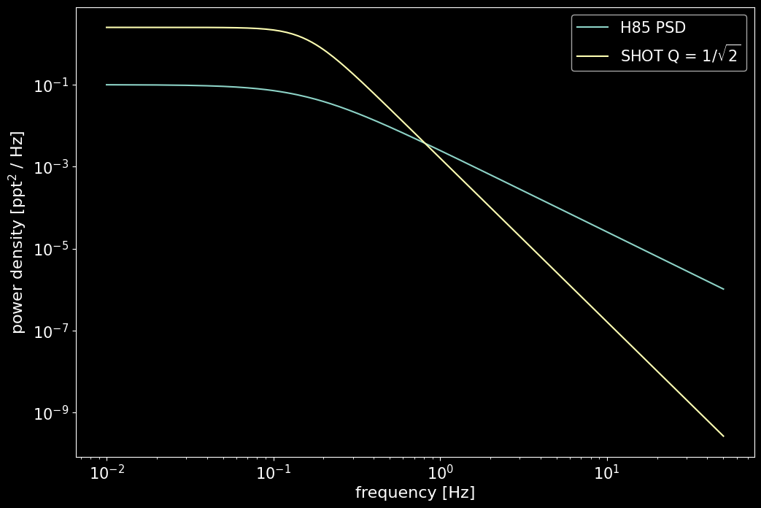
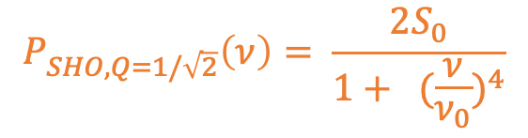
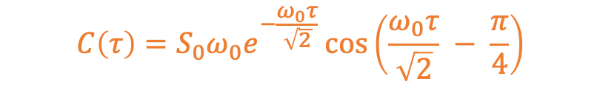
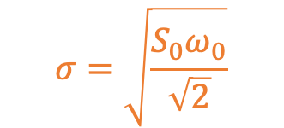
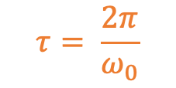
Characterising Stellar Signals with Gaussian Processes (GPs)
Define the data set as a multivariant Gaussian, and fit the correlation between data points
$$C\left(τ\right)=S_{0}ω_{0}e^{−\frac{ω_{0}τ}{\sqrt{2}}}\cos\left(\frac{ω_{0}τ}{\sqrt{2}} − \frac{π}{4}\right)$$
$$P_{SHO, Q=1/\sqrt{2}}\left(ν\right)= \frac{2S_{0}}{1+ {(\frac{ν}{ν_{0}})}^{4}}$$
$$τ= \frac{2π}{ω_{0}}$$
$$σ=\sqrt{\frac{S_{0}ω_{0}}{\sqrt{2}}}$$
O’Sullivan & Aigrain (2024)
Notes:
Can use a covarance matrix of this for G and SG
PSD form similar to harevy law
Debate about which power law is better to use
Nordland et al argue that the Harvey model corresponds to a turbulent cascade, which has power on all timescales, whereas granulation is a convection phenomenon, for which there is a minimum characteristic spatial (and thus temporal) scale, and thus a steep decay in the power spectrum.

Slide 8
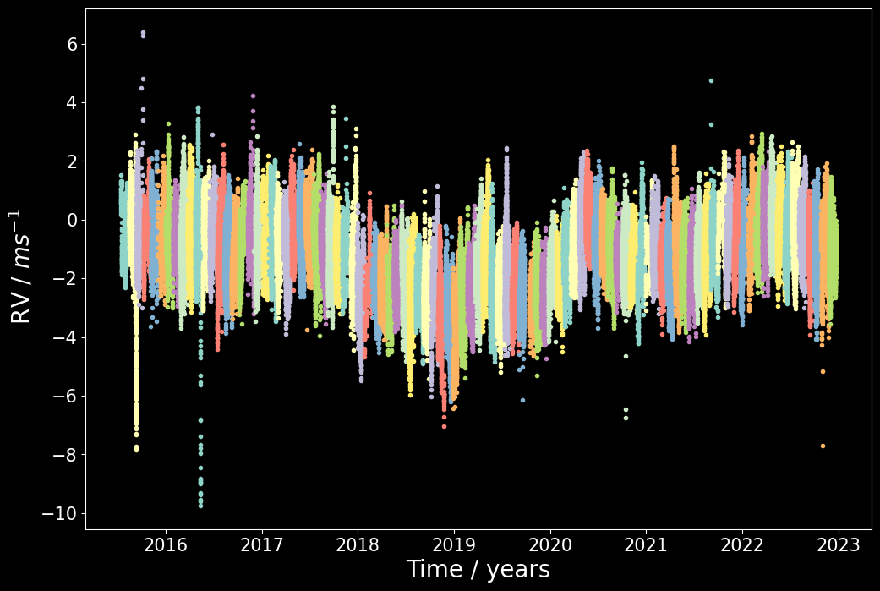

Slide 9
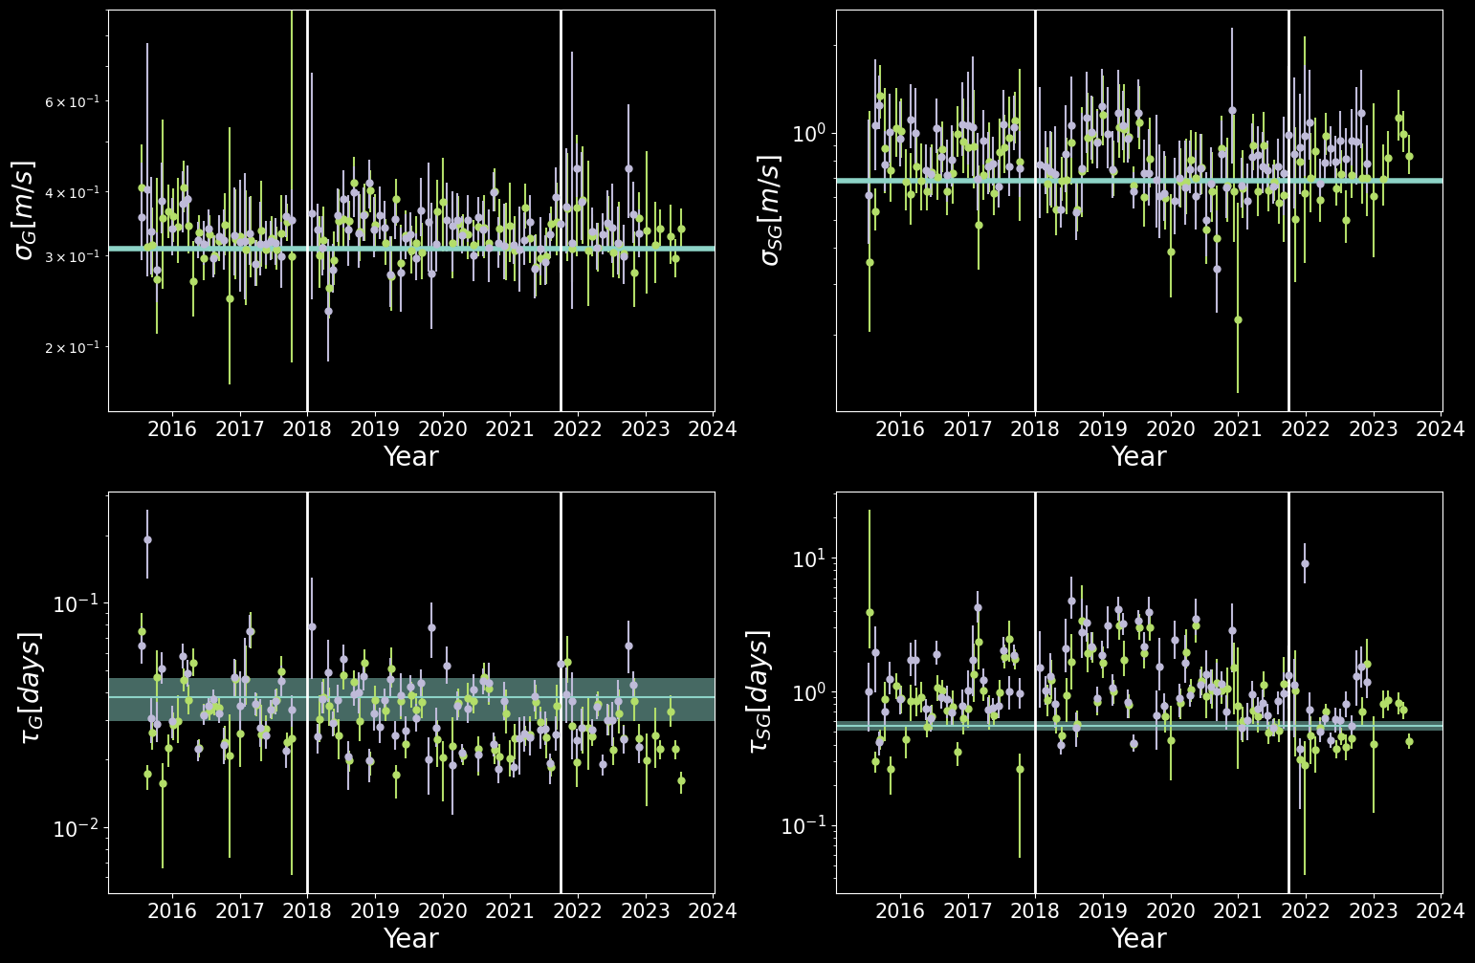
(Super)Granulation Characteristics
O’Sullivan et al. (2025 Submitted)
Notes:
YARARA is in blue
SDO in green
So at the top we have the variance of the granulation signal, and below that the time scale of the granulation
And then the same for the supergranulation
The granulation signal is failry constant over the cycle
But it’s the supergranulation that I really won’t to focus on, because you can see there is a pattern in the data

Slide 10
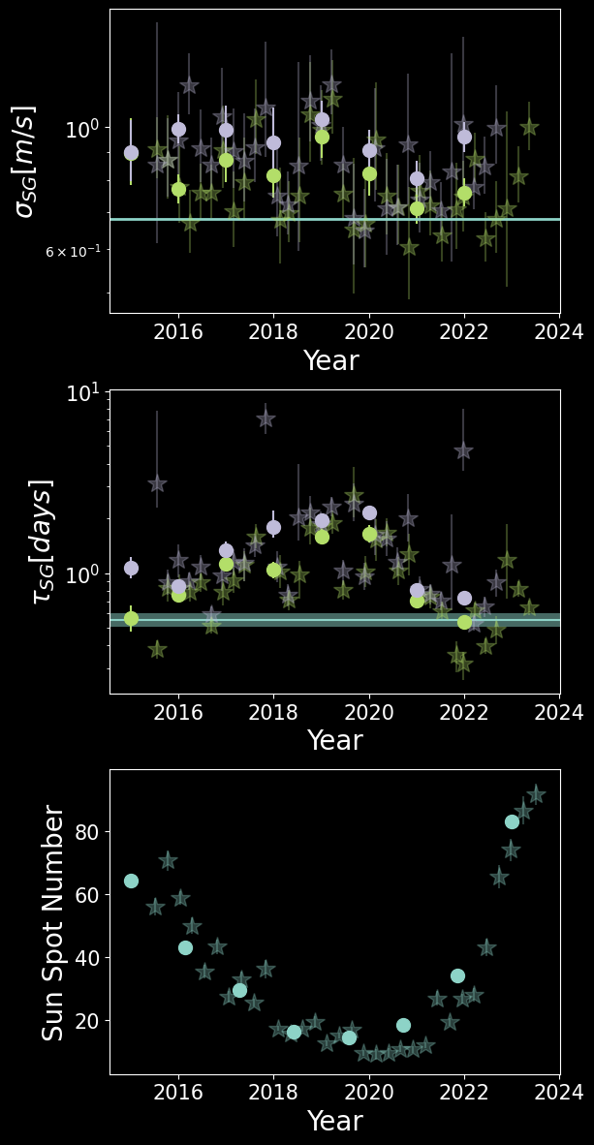
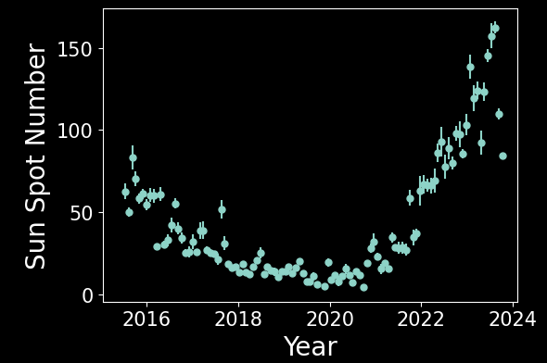
Supergranulation Cycle?
O’Sullivan et al. (2025 Submitted)
Notes:
Anti phase to time
Varabnce should be static – isn’t in SDO because of small scale magetnic structures that herd the sg granulas
Important to not treat SG as static – it can vary – need to try and characterse in other stars as well in order to understand

Slide 11
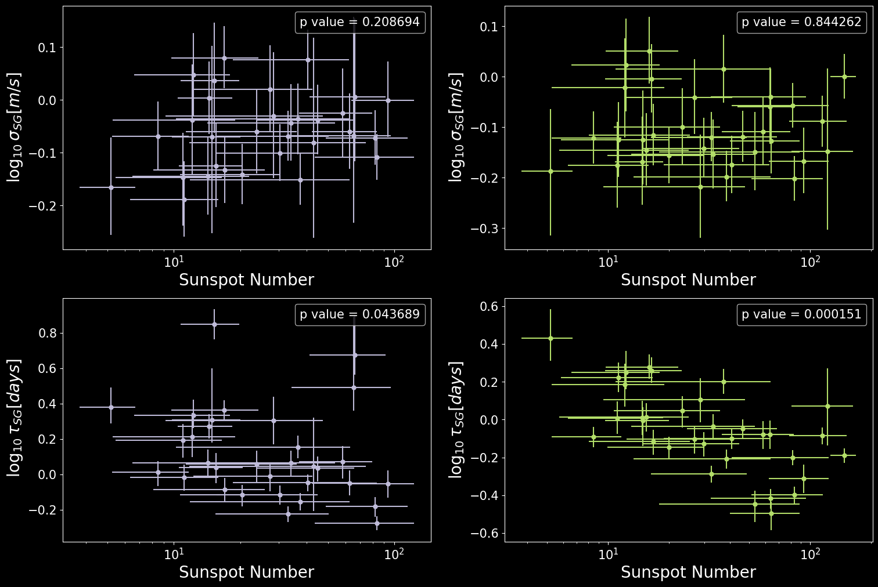
Supergranulation Cycle?
O’Sullivan et al. (2025 Submitted)
Notes:
I split the 9 years of data up into 4 week chunks and modlled each chunk seperatly and here you can see the results
YARARA is in blue
SDO in green
So at the top we have the variance of the granulation signal, and below that the time scale of the granulation
And then the same for the supergranulation
The granulation signal is failry constant over the cycle
But it’s the supergranulation that I really won’t to focus on, because you can see there is a pattern in the data

Slide 12
Comparison to Structure Functions
Lakeland et al. (2024)
SDO
YARARA
O’Sullivan et al. (2025 Submitted)

Slide 13
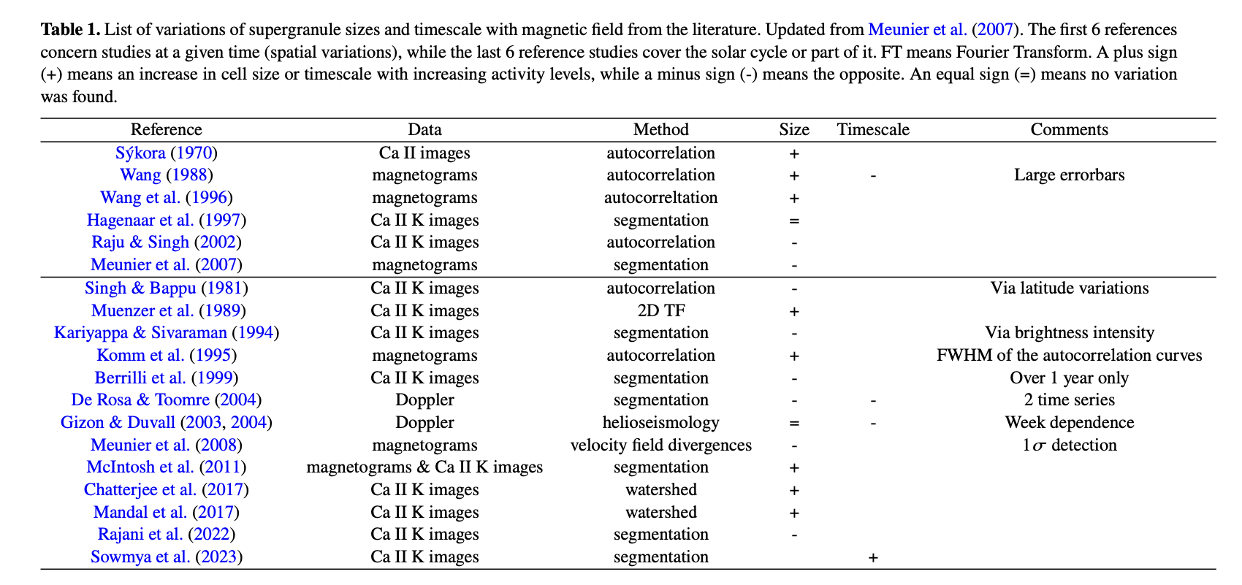
O’Sullivan et al. (2025 Submitted)
Notes:
Cobfusion in lit also due to magnetic field def – need to be careful –need to understand more

Slide 14
Supergranulation is confusing in the Sun…we need more stars!

Slide 15

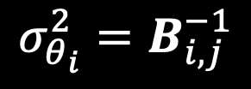
How much do we need to observe?
Use the Fisher information content which allows us to quantify the fractional uncertainty of a parameter as a function of the observational strategy used.
$$B_{ij}= {\left(\frac{∂μ}{∂θ_{i}}\right)}^{T}C^{−1}\left(\frac{∂μ}{∂θ_{j}}\right)+ \frac{1}{2}tr\left(C^{−1}\frac{∂C}{∂θ_{i}}C^{−1}\frac{∂C}{∂θ_{i}}\right)$$
$$σ_{θ_{i}}^{2}=B_{i, j}^{−1}$$
Gupta + Bedell (2024)
Notes:
Just need time stamps and covarance matrix
Use the average yarara covarance matrix
No first time because no mean model (aka planet) in this case

Slide 16
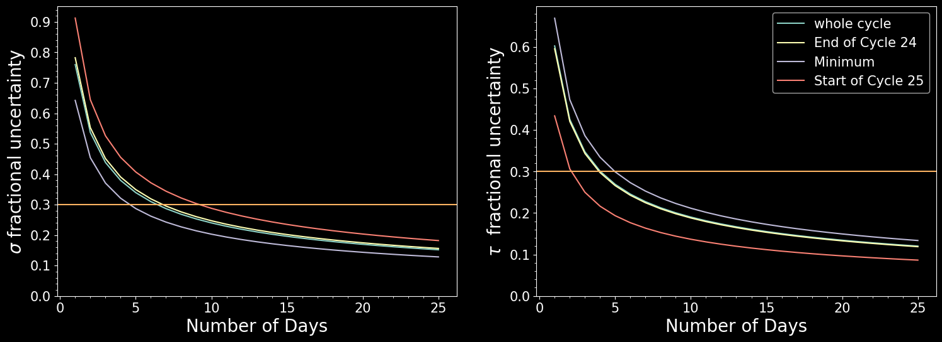
How much do we need to observe?
O’Sullivan et al. (2025 Submitted)

Slide 17
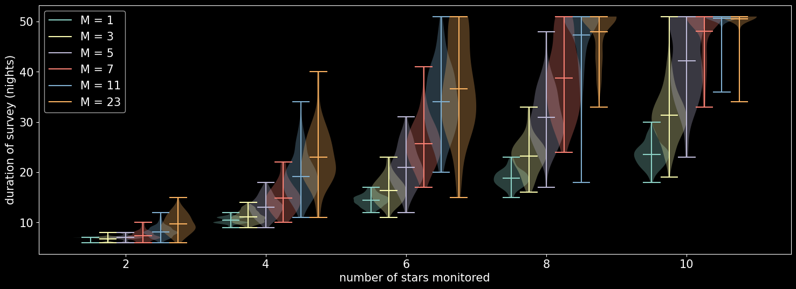
How much do we need to observe?
O’Sullivan et al. (2025 Submitted)
Notes:
So this plot shows how much we need to observe to characterise the supergranulation time scale
On the x axis we have the number of stars. For this simulation I am taking a night to be 8 hours long, so the more stars we have the less time each one is observed.
The y-axis is the number of days it would take to get to a fractional uncertainity of 30%
The lines on the graph represent different observatipnal strategies.
For this test I randomise the next star to be observed, so the stars are obsrved at random times during the night. The lines show the results for how many times each star was observed before we slew to the next random star.
5 min slew time used
For example, for the blue line, we observed for 1 5 minute observations befoe going to the next star, aka 50% of time is slewng

Slide 18
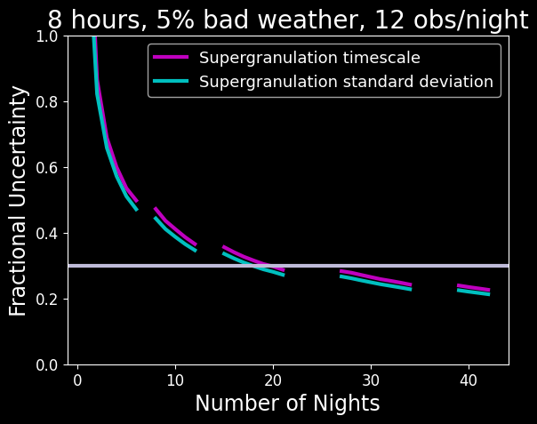
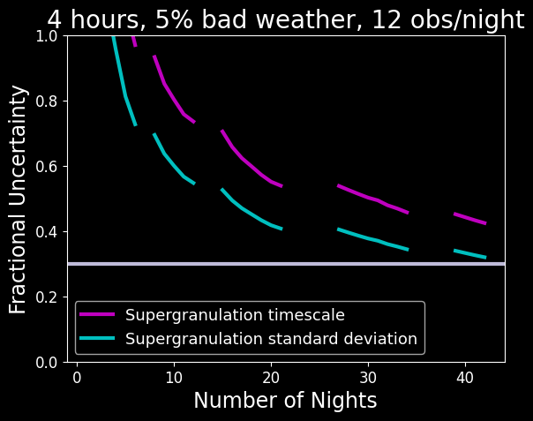
A larger spread of observations is better

Slide 19
What we need to observe supergranulation
3 Key Ingredients:
Bright stars to get high SNR
Lots of exposures spread randomly across the whole night to sample the SG timescale
Stars that are visible for most of the night for a month+
Image credit: SDO/HMI

Slide 20
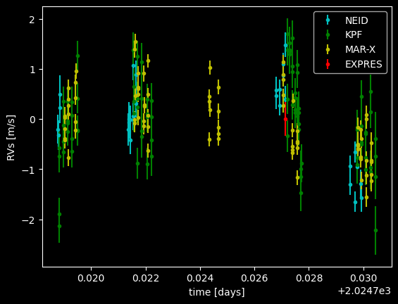
EPRV Standard Star Survey
Tau Ceti
Survey looking into supergranulation across multiple instruments + spectral types.
First round of observations in Sept 2024 focused on k-type stars.
Standard deviation lower than anticipated.
But there are still large errors on it so hard to be sure…
More observations incoming – 100h across 6 instruments!

Slide 21
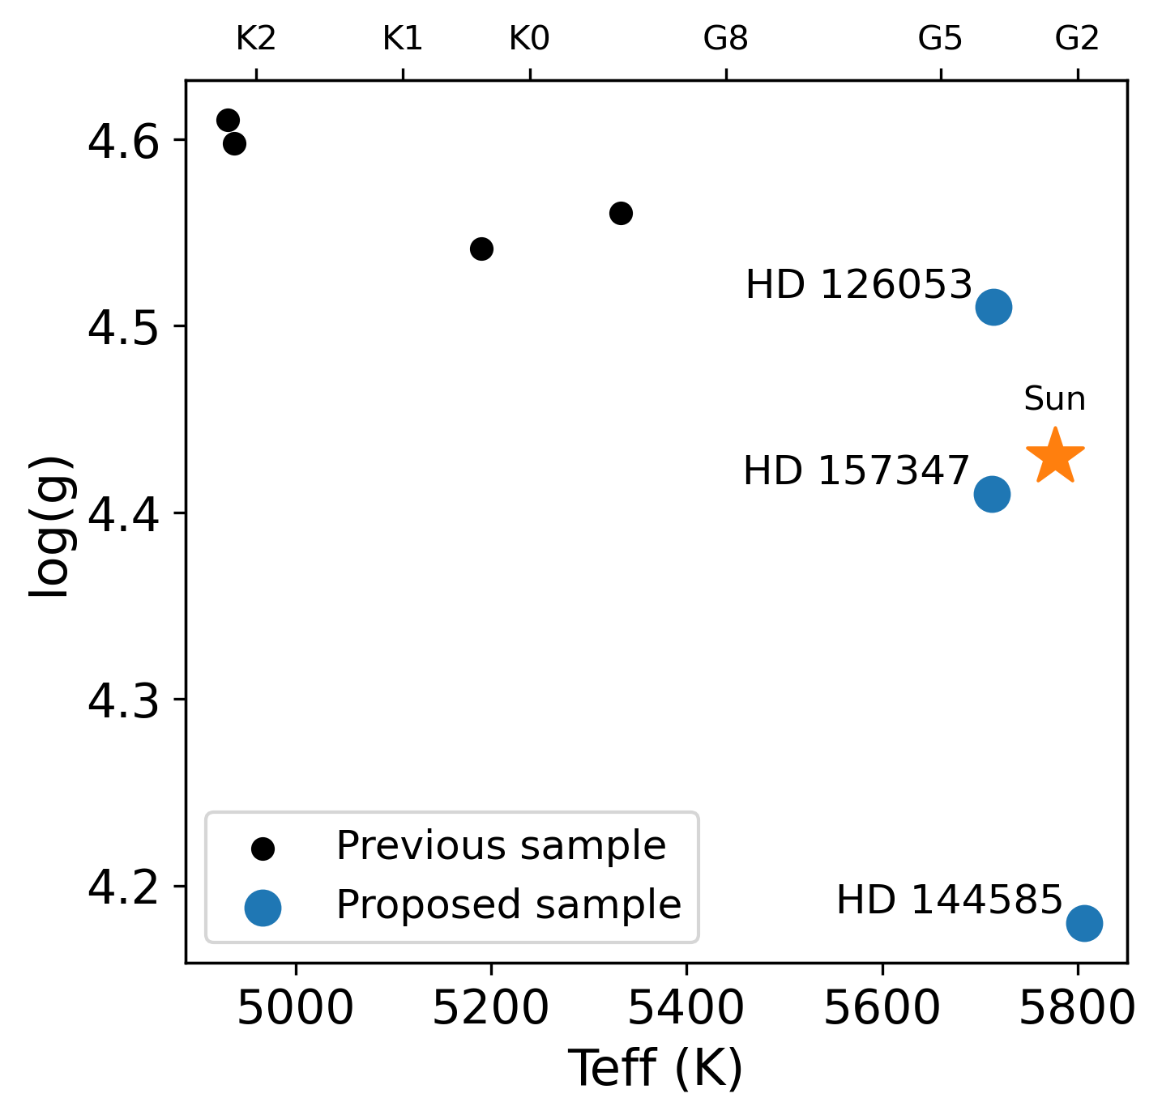
EPRV Standard Star Survey
Survey looking into supergranulation across multiple instruments + spectral types.
First round of observations in Sept 2024 focused on k-type stars.
Standard deviation lower than anticipated.
But there are still large errors on it so hard to be sure…
More observations incoming – 100h across 6 instruments!

Slide 22
Summary
We need to mitigate supergranulation to detect Earth-twins.
We can’t model supergranulation as stationary over 10 years.
We can characterise supergranulation in 10 stars in 23 nights.
Understanding how supergranulation changes via spectral type will help us develop mitigation techniques.
Email: niamh.osullivan@physics.ox.ac.uk

Slide 23
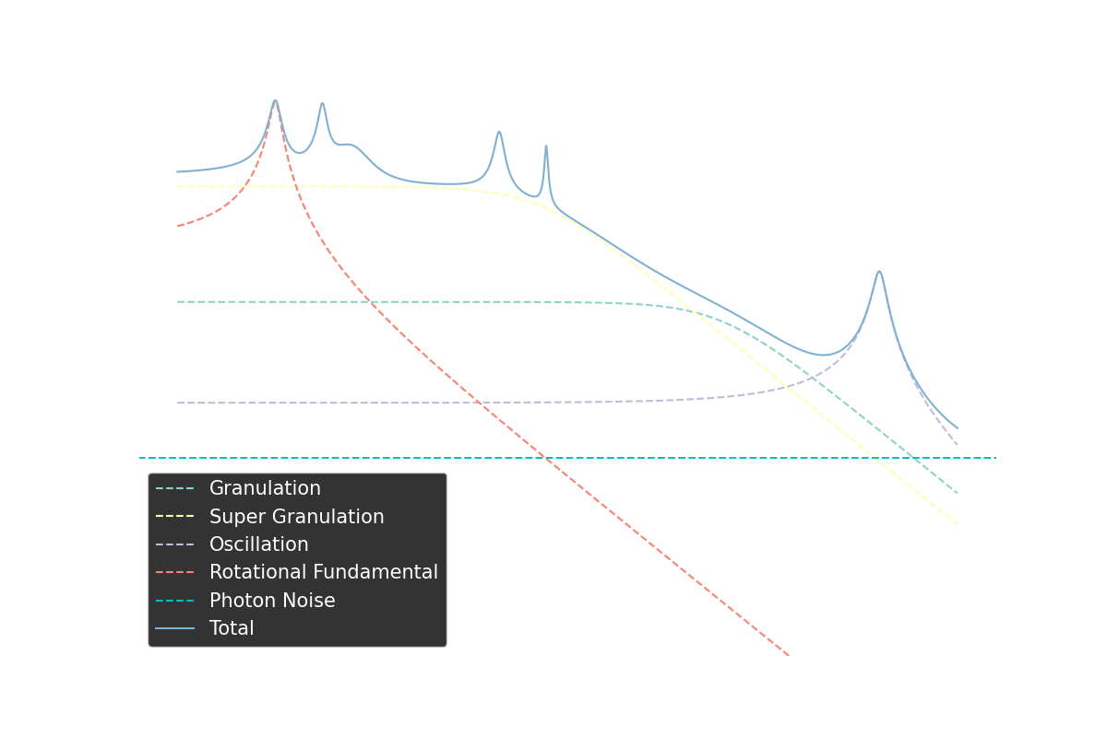
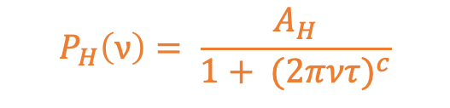
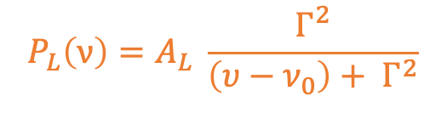
Characterising Stellar Signals with a Power Spectral Density (PSD)
Supergranulation
Rotational Modulation
Granulation
$$P_{L}\left(ν\right)=A_{L} \frac{Γ^{2}}{\left(υ−ν_{0}\right)+ Γ^{2}}$$
$$P_{H}\left(ν\right)= \frac{A_{H}}{1+ {(2πντ)}^{c}}$$
Al Moulla et al (2023)
Notes:
with non-zero characteristic freuqencies for quasi-periodic terms like rotation and oscillations, and zero characteristic frequency for aperiodic terms like (super-)granulation.

Slide 24
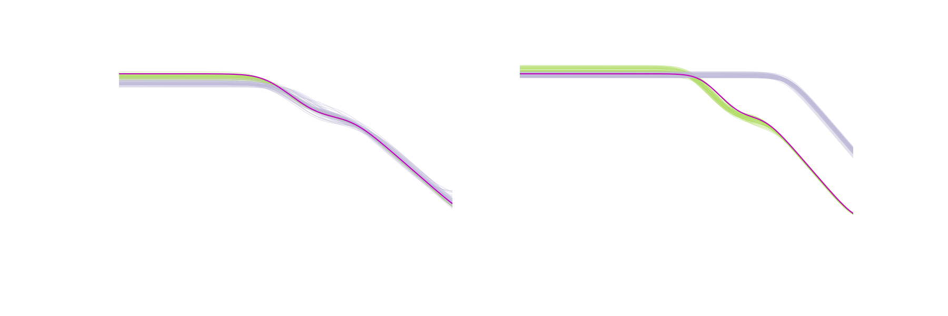
Frequency vs Time Domain – FFT vs GP
Regular Time Sampling
Irregular Time Sampling
O’Sullivan & Aigrain 2024
Notes:
So here are some simulations I have done for 2 aperiodic components, like the granulation and supergranulation.
I simulated a time series with 2 aperiodic componets in it , with the same frequency as the granulation and supergranulation signal found by al moulla
I simulated this data both with regular time sampling and with irregular time sampling
And with that data I did 1 of 2 things
I either fitted the data in the time domain with a gaussian process, and then plotted here the psd of that best fit
or I transformed the datato the frequency domain and then fitted
Let me explain these results
The green samples are the time domain results , and the purplish ones are the frequency domain fit, and the inputted psd is in pink
and you can see when you move to irregular time sampling, that the frequency fit does incredible badly, which the time domain fit can still distinguish the two knees, so this suggests we should really be modelling in the time domain when it comes to this data
The corner plots here also show the improved precision with using the GP method
So knowing that GPs where the way to go to characterse this signal, I then fitted a 2 aperiodic model to the quiet solar rvs

Slide 25
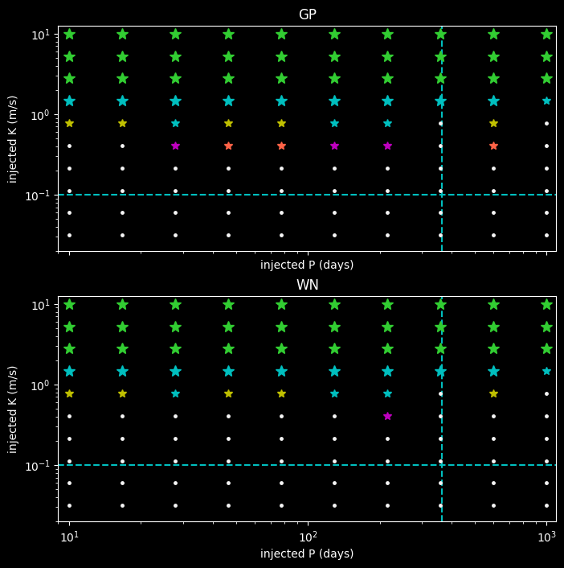
Injection Recovery Tests
One Earth Planet
Green = -50 > Log FAP
Blue = -10 > Log FAP > - 50
Yellow = -5 > Log FAP > -10
Pink = -1.5 > Log FAP > -5
Red = -1.5 < Log FAP
White =Not Detected
Hara et al (2017)
Notes:
Because this is a talk abaut how this can hep us find exoplantes – I wanted to end by showing you that knowing about supergranulation will help us detect smaller planets
What I did was I simulated 10 years of obvservations of the quiet sun, using granulation supergranulation and white noise– one obs per night for a season of 210 days – us
I injected planets into this data set with a varity iof periods and semi amplitudes, represented by the points on this graph
With these data sets – I then tried to detect planets
I used the L1 periodogram, which is a periodogram that calculates the power assuming a covarance structure of the data
I used two covariance structurs – one which just assumed white noise, and one that was based on the granulation and supergranulation structures of our star
The results are shown here.
The colour corresponds to the FAP of the detected planets
The size to if it was the main signal detected/

