Slide 1


Search for Earth Analogues: Characterising Exoplanets
Amid Stellar Variability
Luca Malavolta
Università degli Studi di Padova

Slide 2
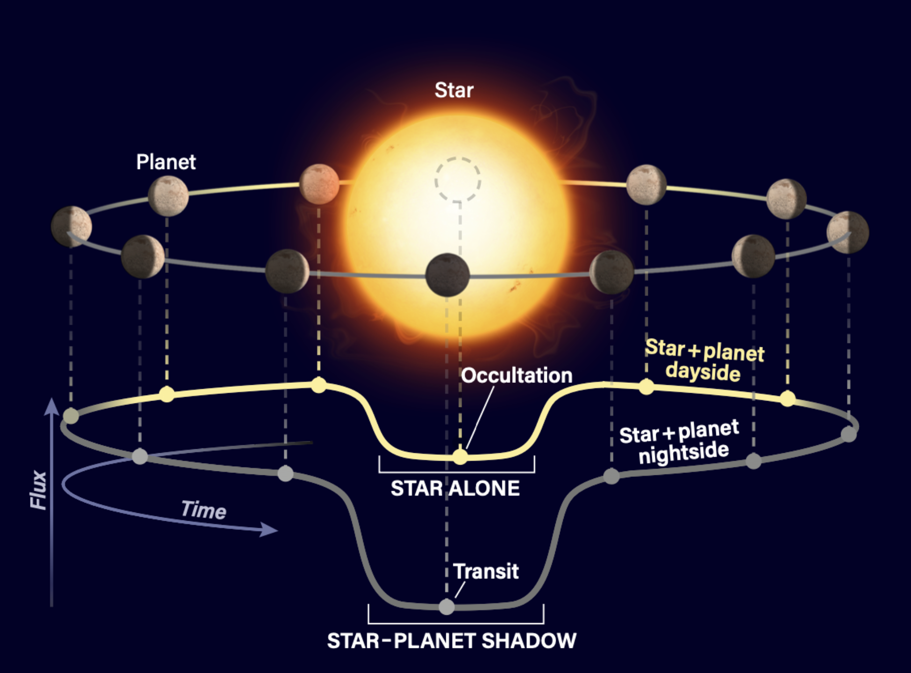
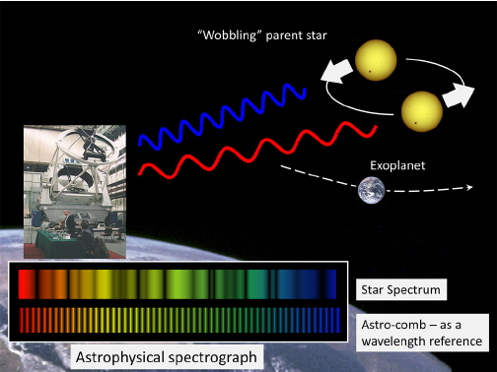
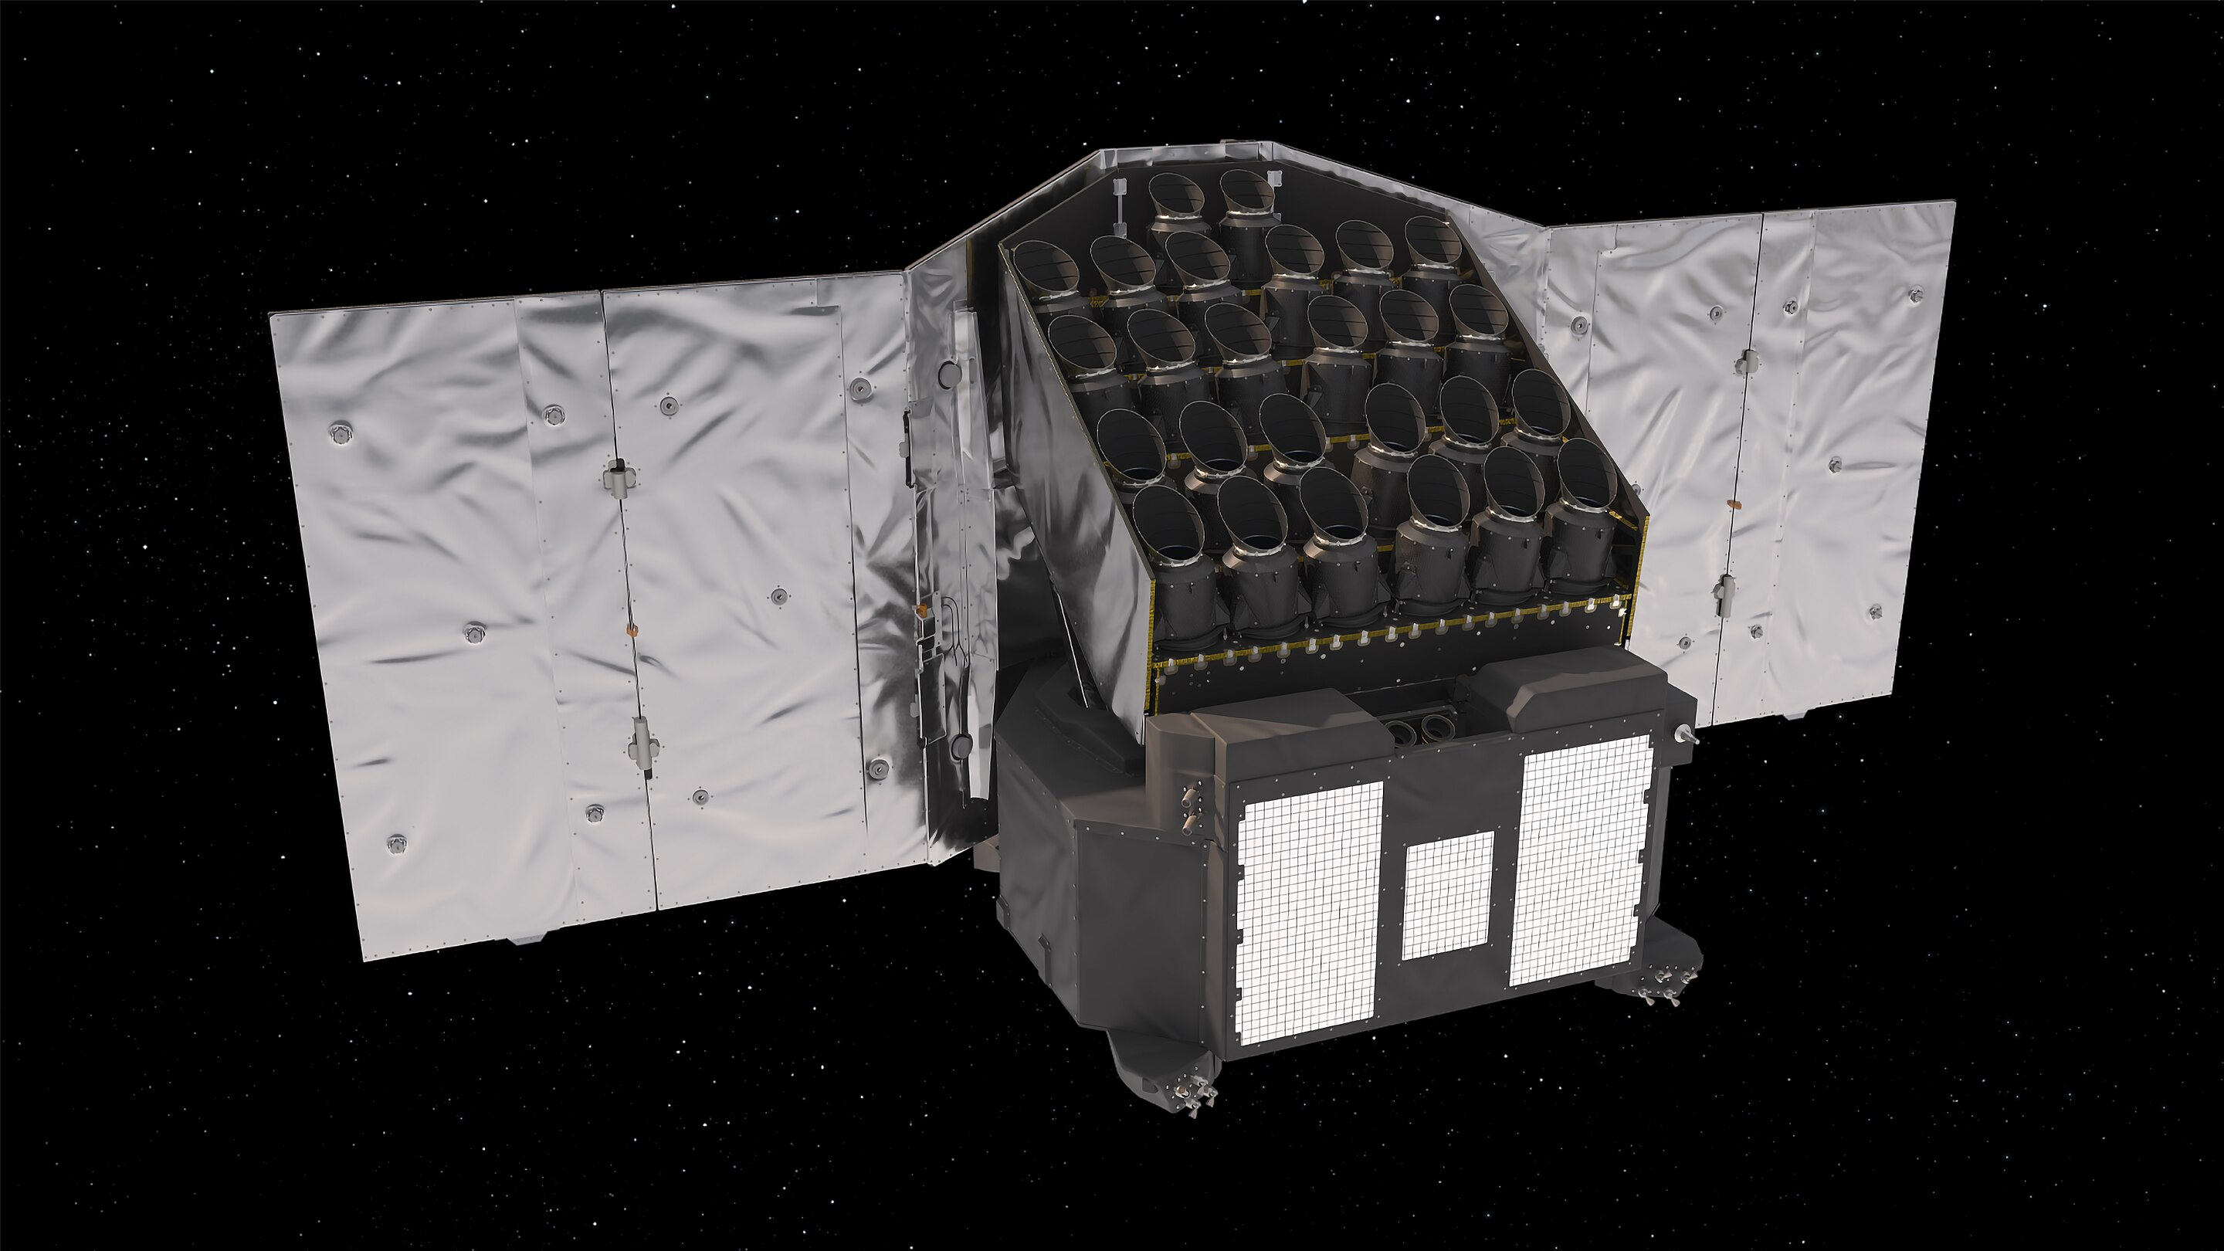
Planetary signals and stellar activity in the context of the PLATO Mission
Plato Stellar Variability
Working Group
Aigrain, Sulis, Wilson
Ground-based
Observation
Programme
Astronomy: Roen Kelly; Chih-Hao 2015, ESA
Notes:
Granules are the smallest convective structures on the Sun. Sir William Herschel first noted their existence in 1794. Granules exist at the top of the photosphere and represent the boundary between convective heat transport of the interior and radiative cooling of the optically thin atmosphere of the Sun.
Convection Cells. Granules (left) have diameters of ~1000 km, velocities of ~3000 m/s, and lifetimes of ~10 minutes.
Supergranules (middle) have diameters of ~30,000 km, velocities of ~500 m/s, and lifetimes of about a day.
Giant cells (right) have diameters of ~200,000 km, velocities of ~10 m s−1, and lifetime of a couple months.

Slide 3
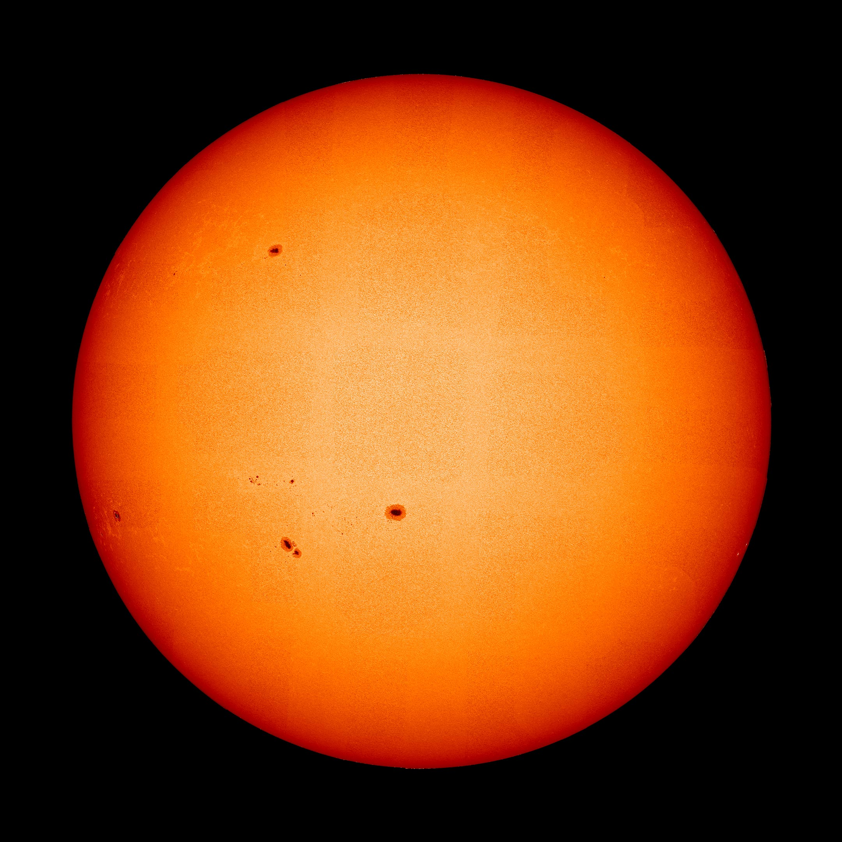
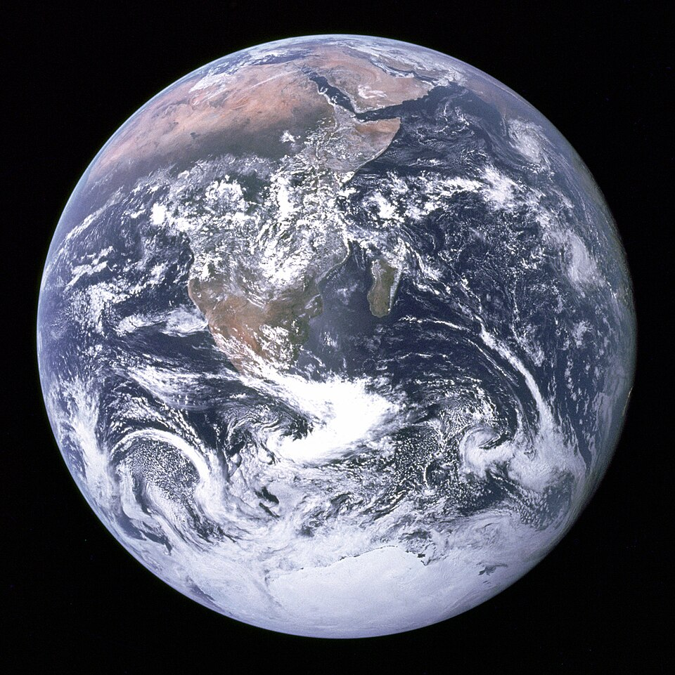
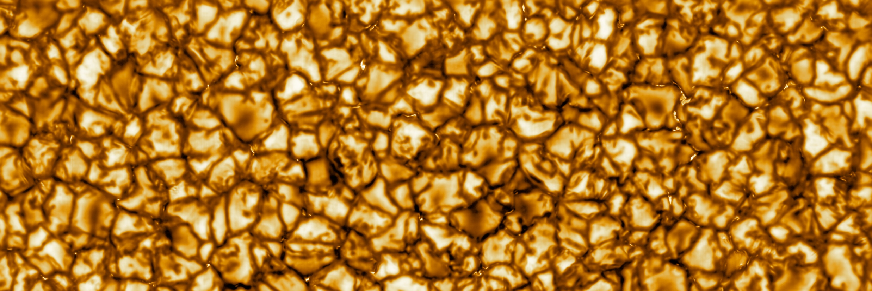
The Sun seen from
ESA Solar Orbiter
Granulation
Spots
Faculae
Visible light
Notes:
https://www.ncei.noaa.gov/products/space-weather/legacy-data/solar-chromosphere
The chromosphere is a thin layer (approximately 2,000 km) above the photosphere. The plasma density decreases to about 10,000 times lower than the photosphere. Historically, chromospheric observations were often made in the Calcium II H & K and H-alpha spectral lines. The Calcium K index can be used as an indicator of solar activity.
NOAA NCEI has acquired these legacy data sets from multiple sources over many decades. The data presented here are provided, ‘as is,’ and in most cases the linked documentation is the entirety of available information. In some cases, older data may also be found in the Space Weather Legacy Print Publications.
Source: Observing the Sun, A Pocket Field Guide. Jamey L Jenkins, Springer.
This is an "inverted" Calcium K image of the Sun on 12th September 2014 taken with a 1000/100mm refractor, Baader B1200 CaK module, Baader K-line filter and Skyris 274m CCD camera.
The SO/PHI (Solanki et al. 2020) is an imaging spectropolarimeter, sampling the photospheric Fe i 617.3 nm absorption line.

Slide 4
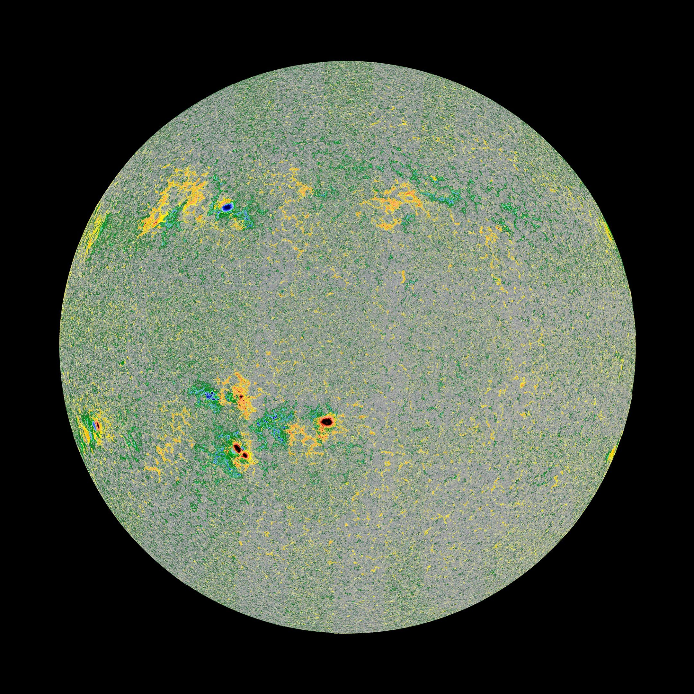
The Sun seen from
ESA Solar Orbiter
Granulation
Spots
Faculae
Chromospheric network
Magnetogram
Notes:
This image shows the line-of-sight direction of the magnetic field on the Sun’s disc. This kind of map is also called a ‘magnetogram’. It was measured by the Polarimetric and Helioseismic Imager (PHI) onboard the Solar Orbiter spacecraft on March 22, 2023. This map shows that the Sun’s magnetic field is concentrated within and around sunspots. It either points outward (red) or inward (blue) wherever the sunspots lie. Elsewhere the magnetic field is much smaller, indicated by grey (no magnetic field), yellow, or green (small magnetic field). The strong magnetic field inhibits convection in the Sun, because charged particles are forced to follow the magnetic field rather than following the heat-mixing convective flow. As a result, sunspots are colder than their surroundings. Credit: ESA & NASA/Solar Orbiter/PHI Team
https://solarscience.msfc.nasa.gov/feature2.shtml

Slide 5
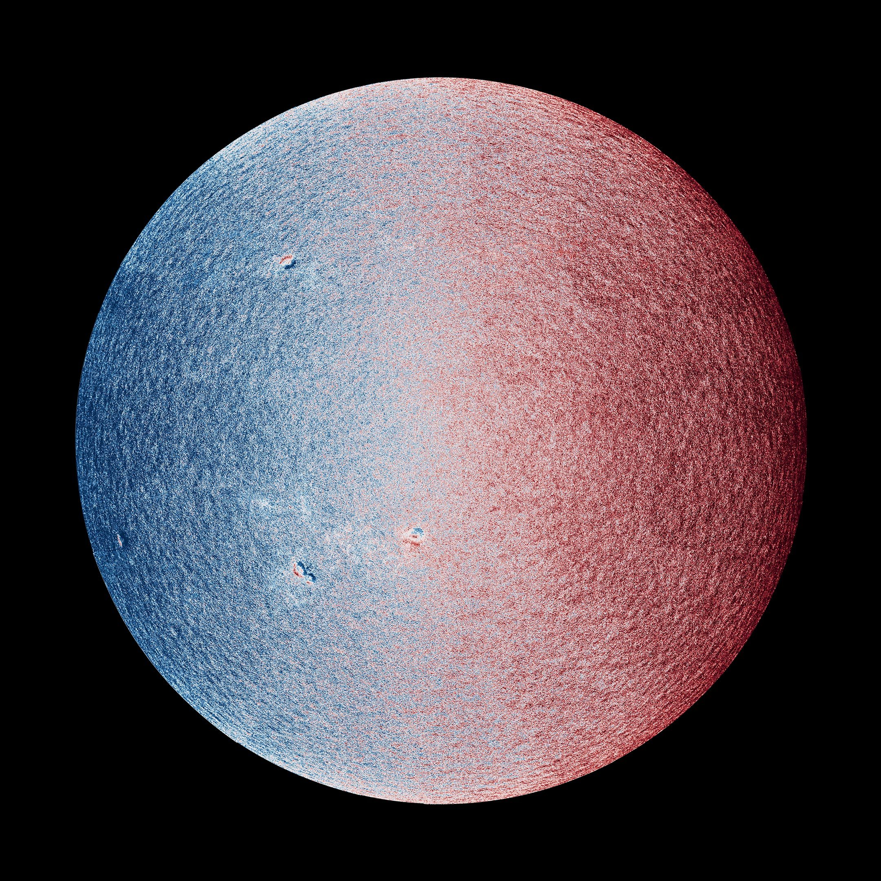
The Sun seen from
ESA Solar Orbiter
Granulation
Spots
Faculae
Chromospheric network
Supergranulation
Giant cells
Velocity map, or tachogram
Notes:
https://www.esa.int/ESA_Multimedia/Images/2025/04/Solar_Orbiter_s_widest_high-res_view_of_the_Sun
The three views of the Sun’s surface shown here are based on measurements taken on March 22, 2023, by the ESA-led Solar Orbiter mission. From left to right, you see the Sun in visible light, a magnetic map of the Sun, and a map of the line-of-sight speed and direction of movement of material at the Sun’s visible surface. These are the first high-resolution full-disc views of the Sun by the spacecraft’s Polarimetric and Helioseismic Imager (PHI) instrument. Credit: ESA & NASA/Solar Orbiter/PHI Team

Slide 6
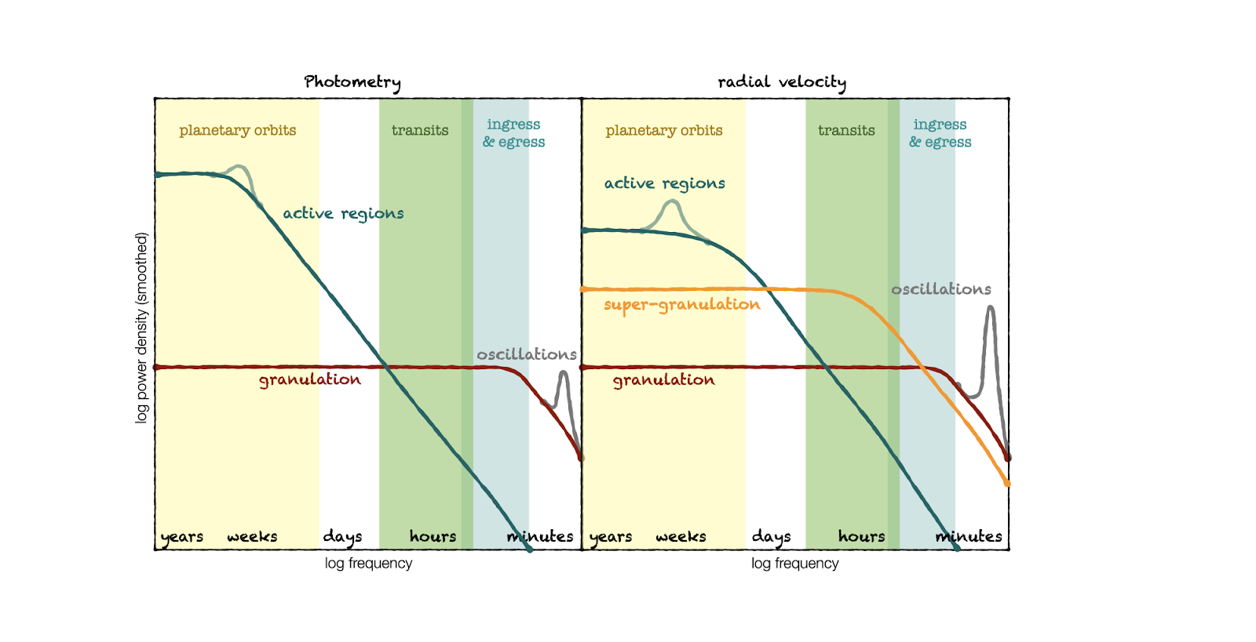
What to worry about in photometry
PLATO SVWG
Notes:
https://www.esa.int/ESA_Multimedia/Images/2025/04/Solar_Orbiter_s_widest_high-res_view_of_the_Sun
The three views of the Sun’s surface shown here are based on measurements taken on March 22, 2023, by the ESA-led Solar Orbiter mission. From left to right, you see the Sun in visible light, a magnetic map of the Sun, and a map of the line-of-sight speed and direction of movement of material at the Sun’s visible surface. These are the first high-resolution full-disc views of the Sun by the spacecraft’s Polarimetric and Helioseismic Imager (PHI) instrument. Credit: ESA & NASA/Solar Orbiter/PHI Team

Slide 7
What to worry about in spectroscopy
PLATO SVWG
Notes:
https://www.esa.int/ESA_Multimedia/Images/2025/04/Solar_Orbiter_s_widest_high-res_view_of_the_Sun
The three views of the Sun’s surface shown here are based on measurements taken on March 22, 2023, by the ESA-led Solar Orbiter mission. From left to right, you see the Sun in visible light, a magnetic map of the Sun, and a map of the line-of-sight speed and direction of movement of material at the Sun’s visible surface. These are the first high-resolution full-disc views of the Sun by the spacecraft’s Polarimetric and Helioseismic Imager (PHI) instrument. Credit: ESA & NASA/Solar Orbiter/PHI Team

Slide 8
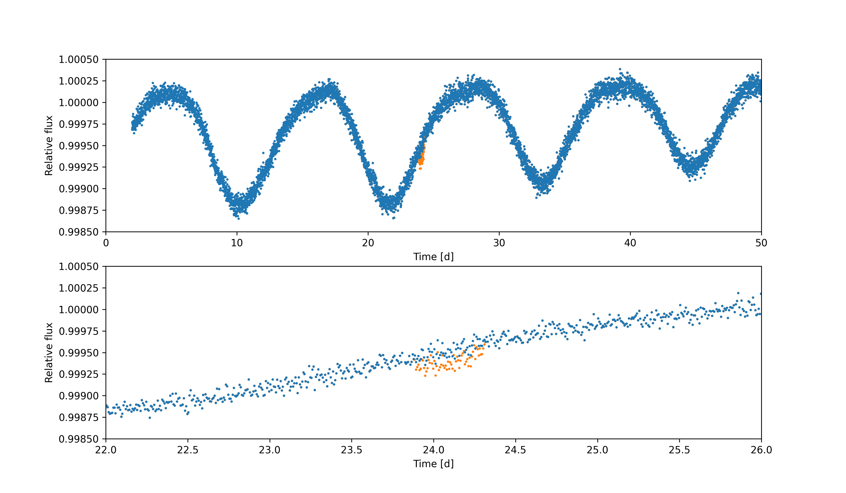
What if PLATO discovers an Earth analogue?
Spots + Granulation + Oscillations
The transit of an Earth analogue
Talk by
Geert Jan Talens
Wednesday 14:20
VARLET&PHALET (Grziwa+2016)
Notch & LOCoR (Rizzuto+2017)
ARIMA (Feigelson+2018)
Wotan (Hippke+2019)
YSD (Battley+2020)
Nuance (Garcia+2024)
See also Canocchi +2023
Simulated data available on request
Notes:
https://www.esa.int/ESA_Multimedia/Images/2025/04/Solar_Orbiter_s_widest_high-res_view_of_the_Sun
The three views of the Sun’s surface shown here are based on measurements taken on March 22, 2023, by the ESA-led Solar Orbiter mission. From left to right, you see the Sun in visible light, a magnetic map of the Sun, and a map of the line-of-sight speed and direction of movement of material at the Sun’s visible surface. These are the first high-resolution full-disc views of the Sun by the spacecraft’s Polarimetric and Helioseismic Imager (PHI) instrument. Credit: ESA & NASA/Solar Orbiter/PHI Team

Slide 9
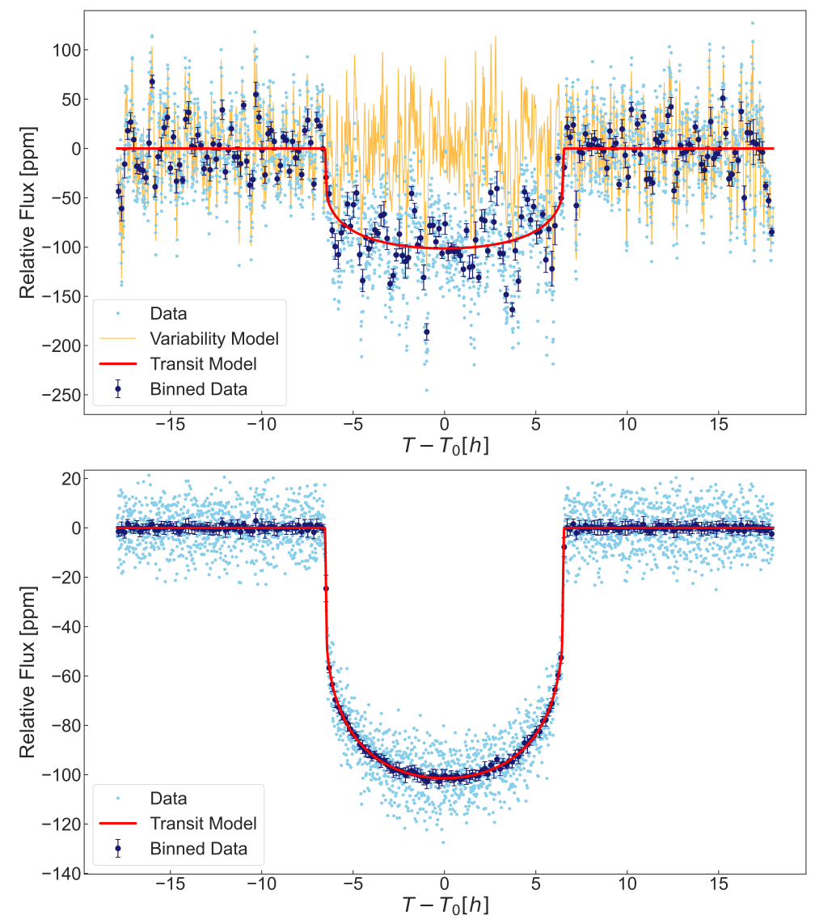
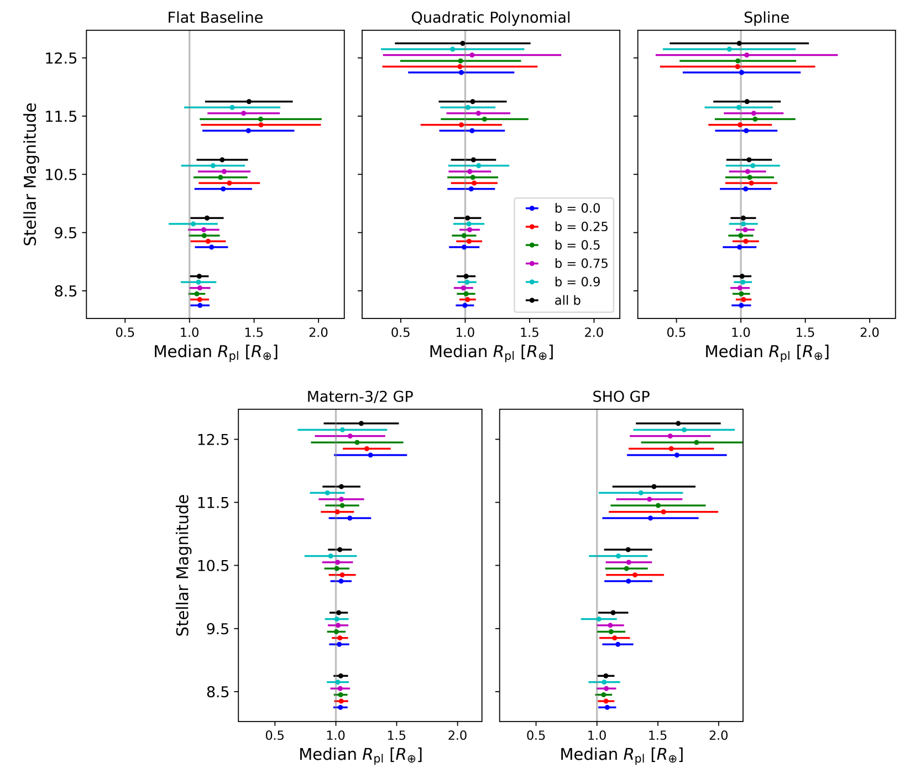
What if PLATO discovers an Earth analogue?
Solar data + PlatoSim + Earth-sized transit (Krenn+2024)
See also: Barros+2020
Notes:
https://www.esa.int/ESA_Multimedia/Images/2025/04/Solar_Orbiter_s_widest_high-res_view_of_the_Sun
The three views of the Sun’s surface shown here are based on measurements taken on March 22, 2023, by the ESA-led Solar Orbiter mission. From left to right, you see the Sun in visible light, a magnetic map of the Sun, and a map of the line-of-sight speed and direction of movement of material at the Sun’s visible surface. These are the first high-resolution full-disc views of the Sun by the spacecraft’s Polarimetric and Helioseismic Imager (PHI) instrument. Credit: ESA & NASA/Solar Orbiter/PHI Team

Slide 10
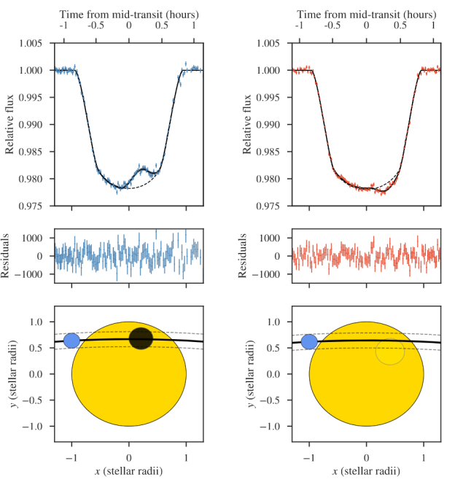
What if PLATO discovers an Earth analogue?
Active region crossing events
Focused on giant planets with many transits
Still unexplored: small planets with a limited number of transits
Photometric challenge
led by Geert Jan Talens
Plato Stellar Variability WG
Espinoza+2019
Notes:
https://www.esa.int/ESA_Multimedia/Images/2025/04/Solar_Orbiter_s_widest_high-res_view_of_the_Sun
The three views of the Sun’s surface shown here are based on measurements taken on March 22, 2023, by the ESA-led Solar Orbiter mission. From left to right, you see the Sun in visible light, a magnetic map of the Sun, and a map of the line-of-sight speed and direction of movement of material at the Sun’s visible surface. These are the first high-resolution full-disc views of the Sun by the spacecraft’s Polarimetric and Helioseismic Imager (PHI) instrument. Credit: ESA & NASA/Solar Orbiter/PHI Team

Slide 11
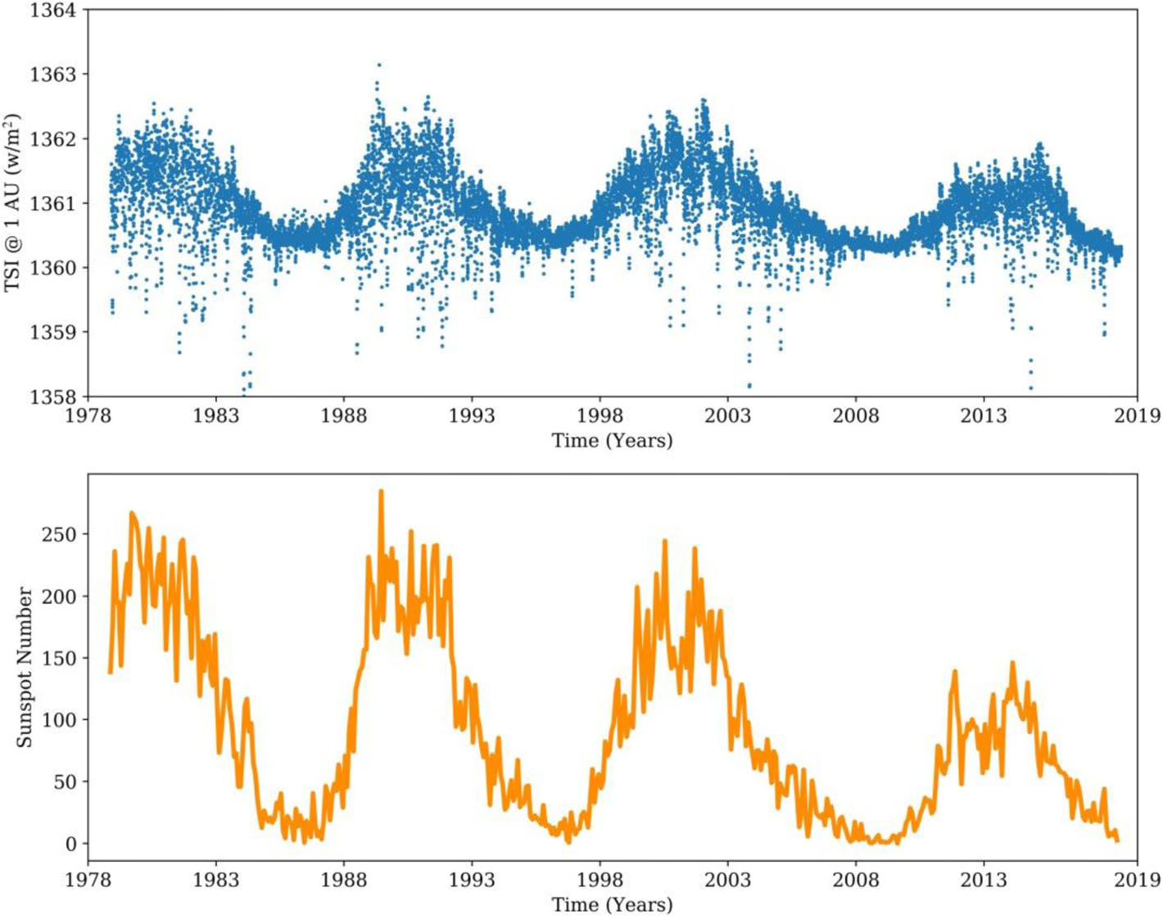
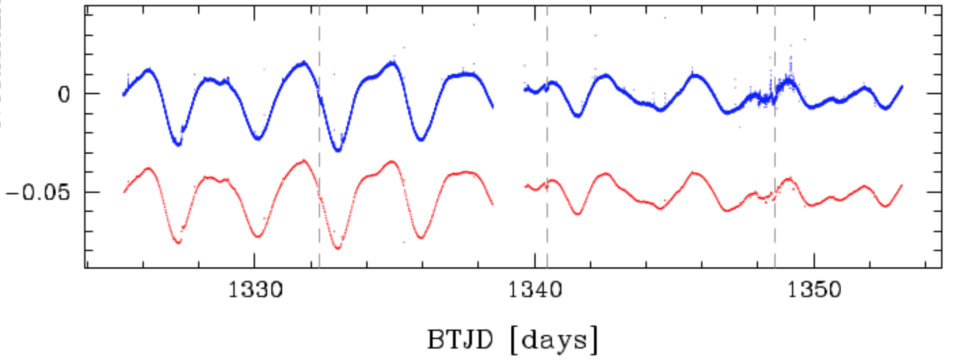
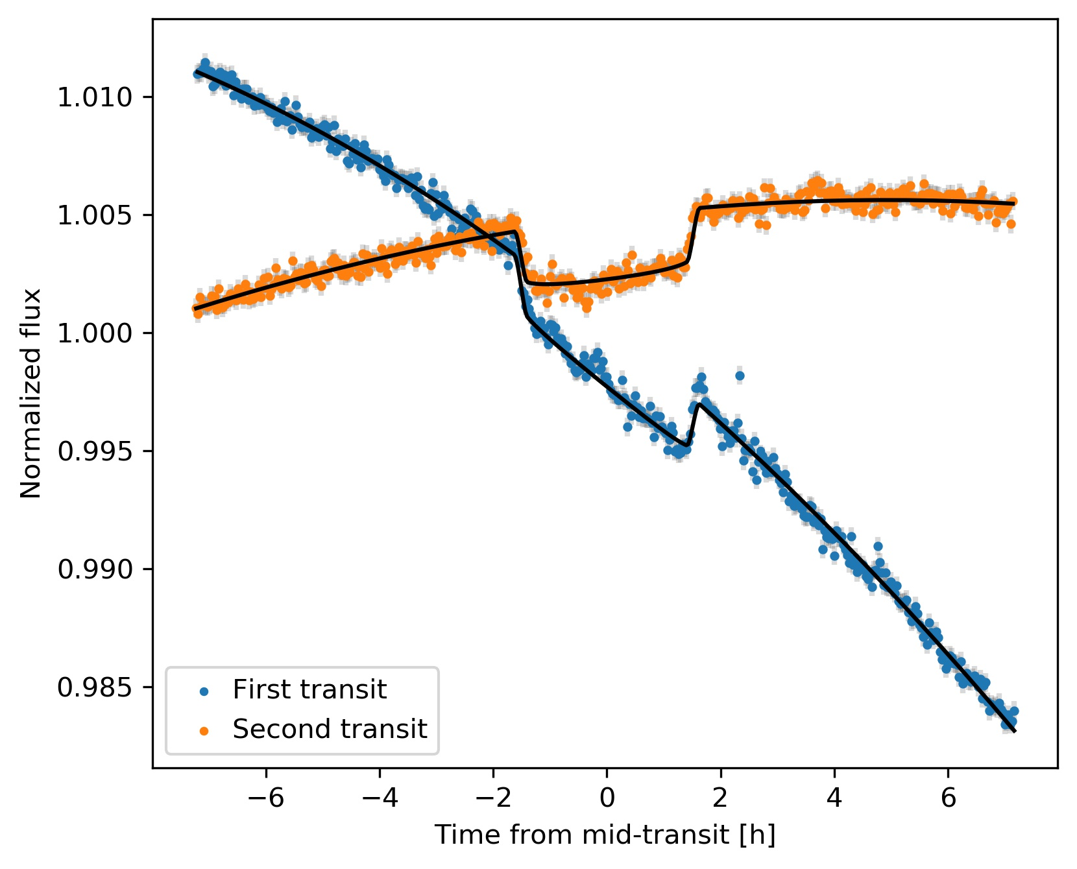

What if PLATO discovers an Earth analogue?
$${\left(\frac{R_{p}}{R_{⋆}}\right)}^{2}=1−\frac{F_{in}}{F_{out}}$$
The Sun, Nandy+2019
0.2 %
DS Tuc A, adapted from Benatti+2019
Notes:
https://progearthplanetsci.springeropen.com/articles/10.1186/s40645-021-00430-x
Earth has a transit depth of 9 * 10-5

Slide 12
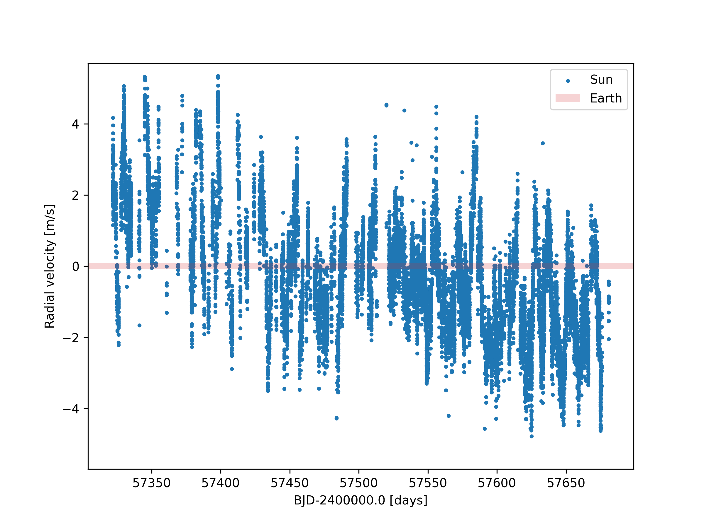
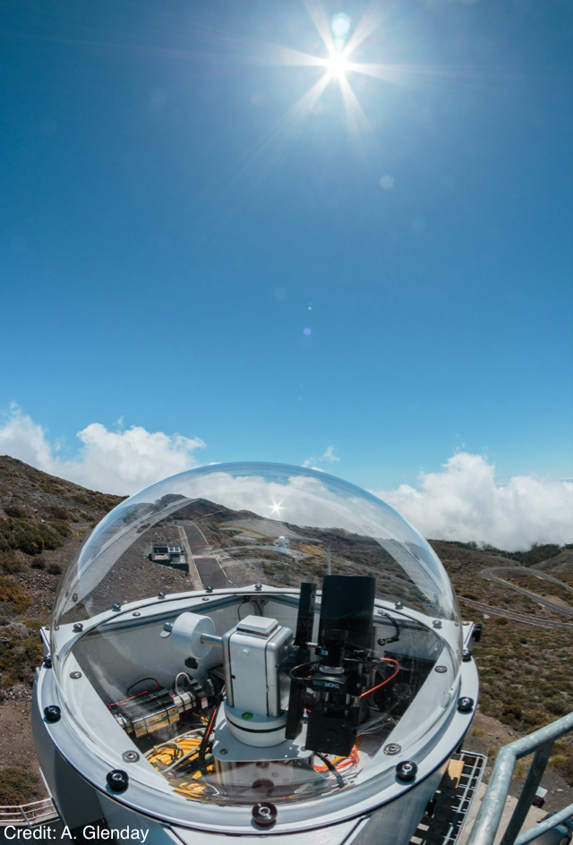
Can we measure the mass of an Earth analogue?
The Solar Telescope of HARPS-N@TNG
Notes:
Complication

Slide 13
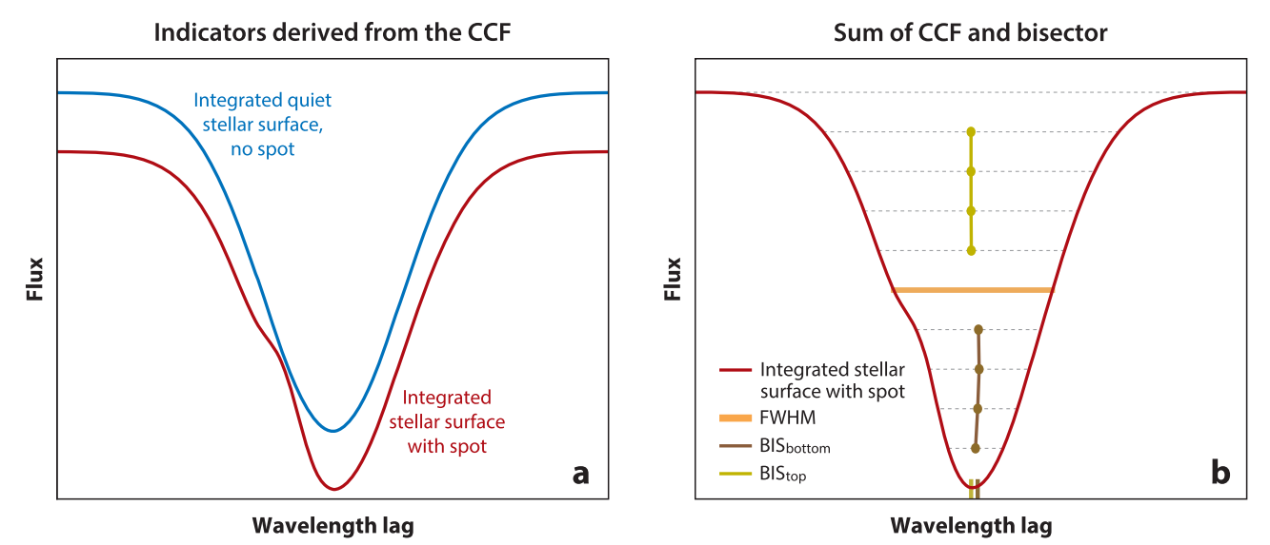
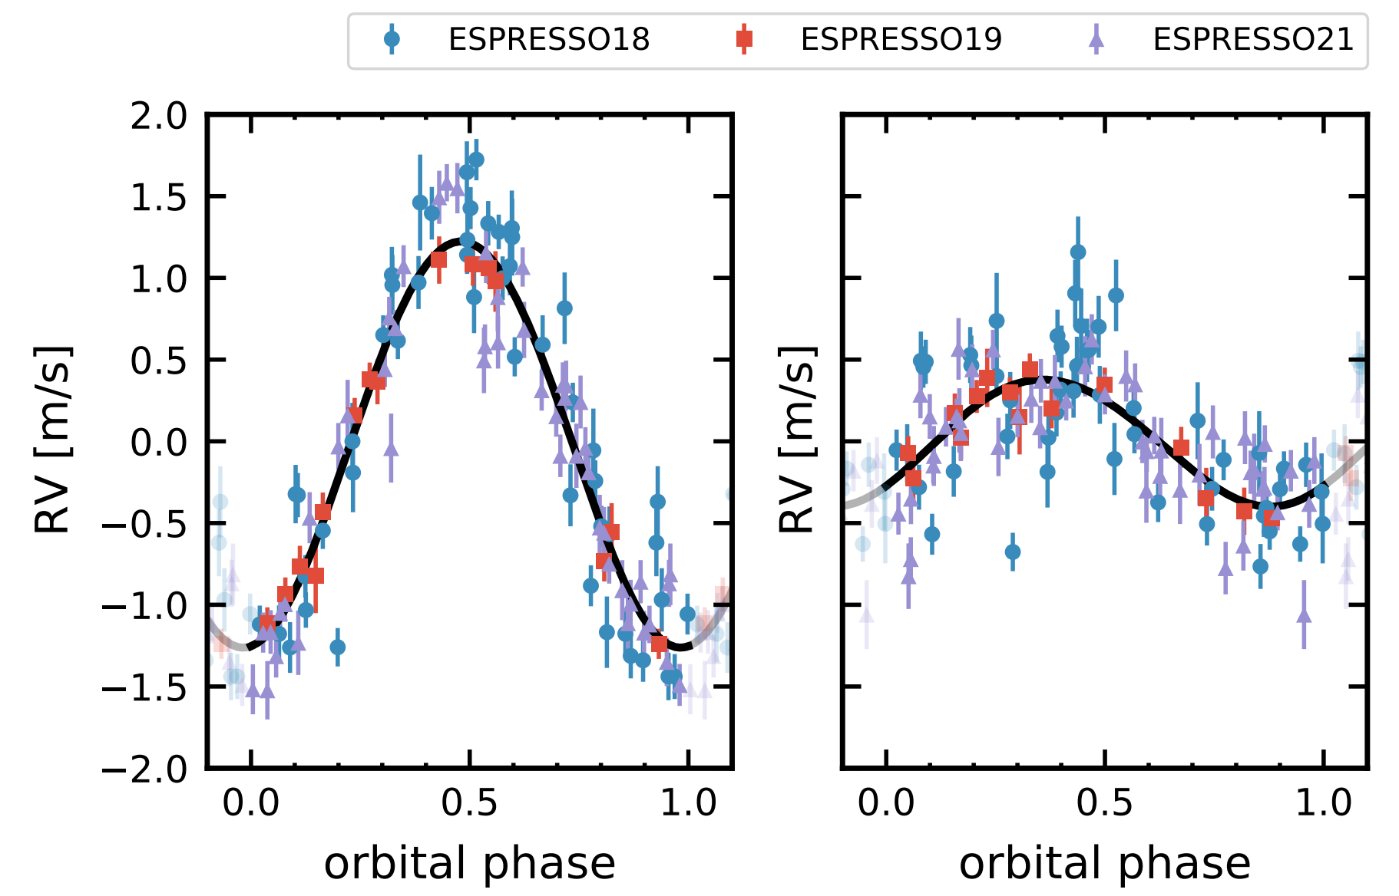
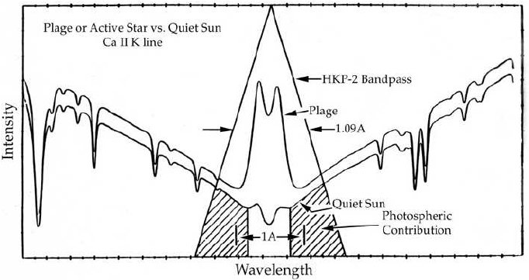
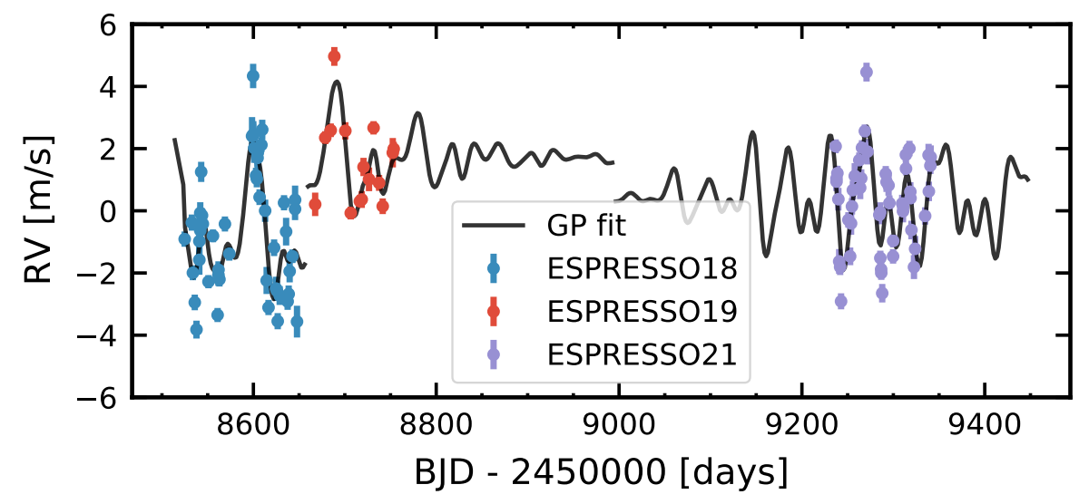
Can we measure the mass of an Earth analogue?
Spectral precision
Ultra-stability (constant LSF)
High SNR in the wavelength range of chromospheric indexes
Proxima Centauri b & d with ESPRESSO
K_{d} = 39 ± 7 cm/s
K_{c} = 127 ± 7 cm/s
Hara & Ford 2023; Robert Donahue
Faria+2022
Notes:
Complication

Slide 14
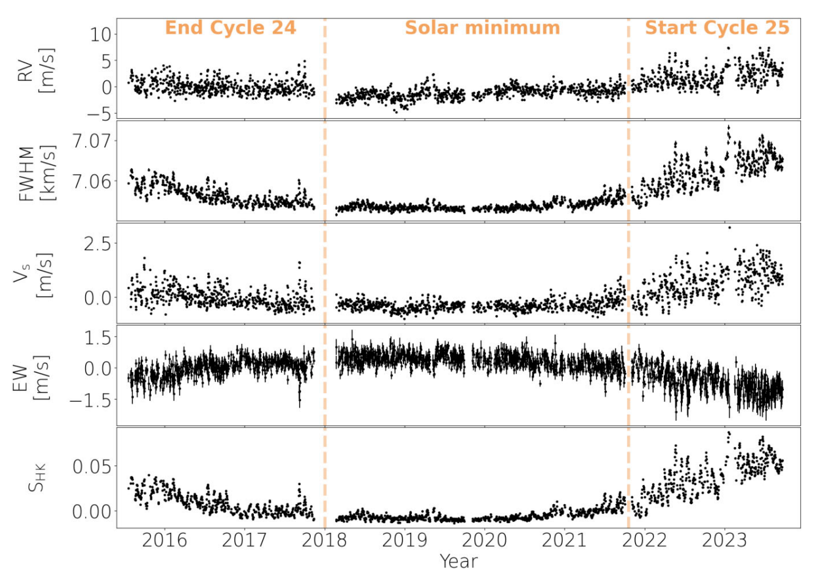
Can we measure the mass of an Earth analogue?
The Solar Telescope of HARPS-N@TNG
From Klein+2024. See also Dumusque+2021, Collier-Cameron+2019
Notes:
https://www.esa.int/ESA_Multimedia/Images/2025/04/Solar_Orbiter_s_widest_high-res_view_of_the_Sun
The three views of the Sun’s surface shown here are based on measurements taken on March 22, 2023, by the ESA-led Solar Orbiter mission. From left to right, you see the Sun in visible light, a magnetic map of the Sun, and a map of the line-of-sight speed and direction of movement of material at the Sun’s visible surface. These are the first high-resolution full-disc views of the Sun by the spacecraft’s Polarimetric and Helioseismic Imager (PHI) instrument. Credit: ESA & NASA/Solar Orbiter/PHI Team

Slide 15
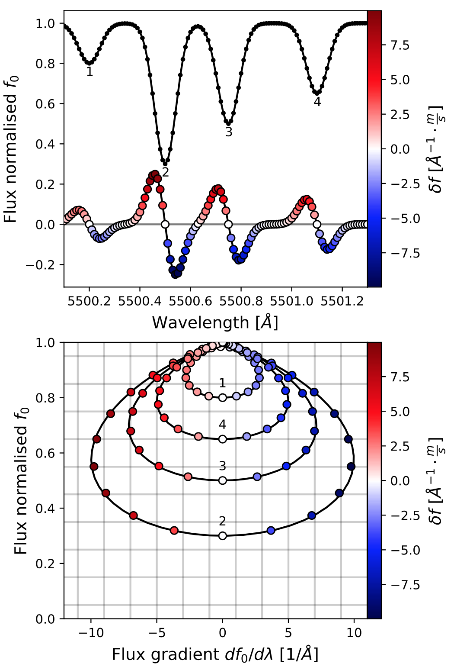
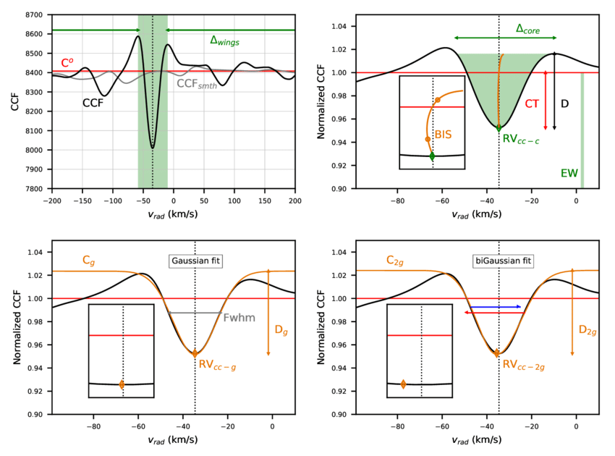
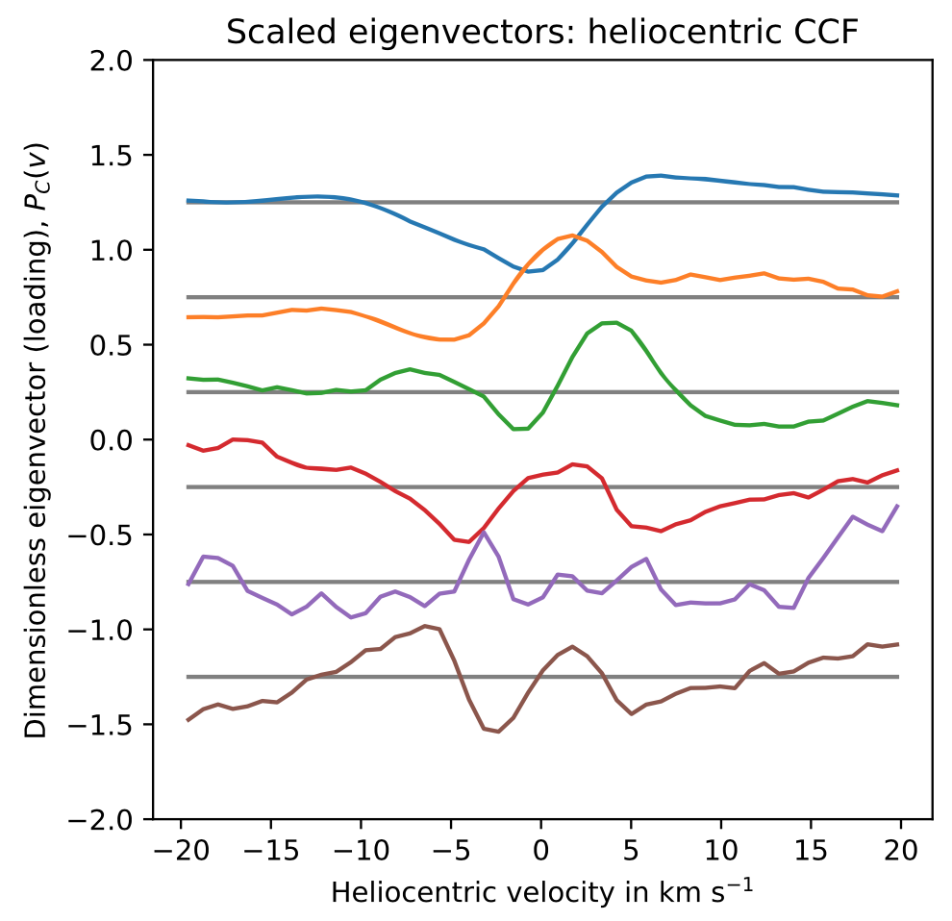
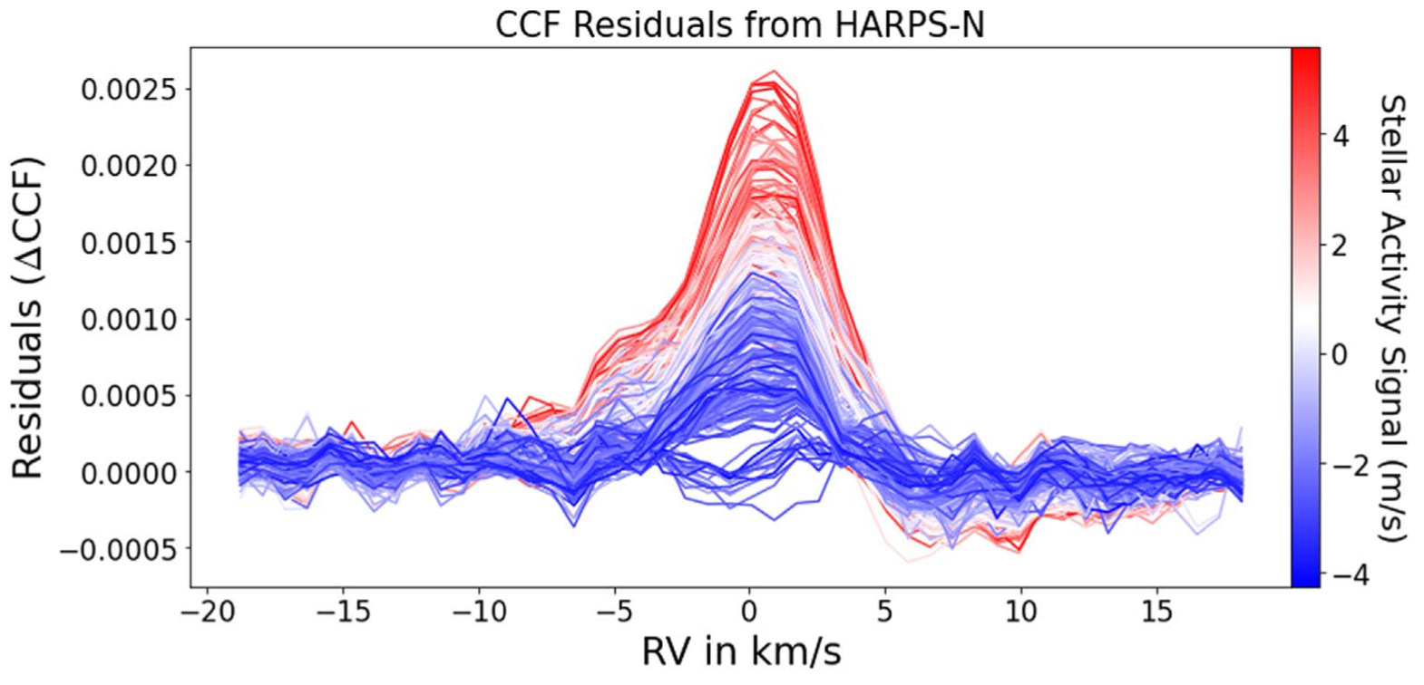
Three approaches, not mutually exclusive
RV + activity indexes
(more or less) simultaneous modelling
Activity removal at the level of
Cross-Correlation Function
Activity removal at the spectral level
K2-141b, McGill University
All the due references in the next slides….
Notes:
Complication

Slide 16
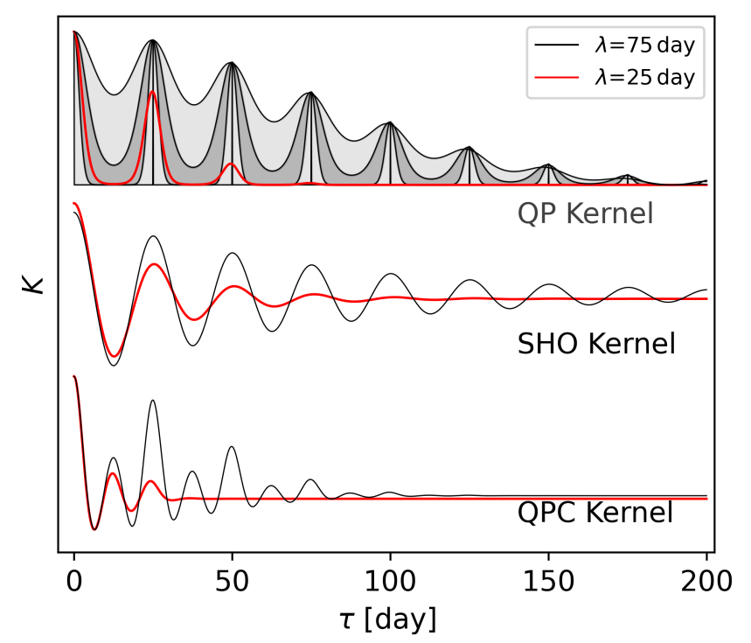
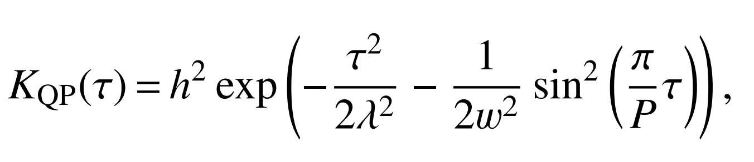
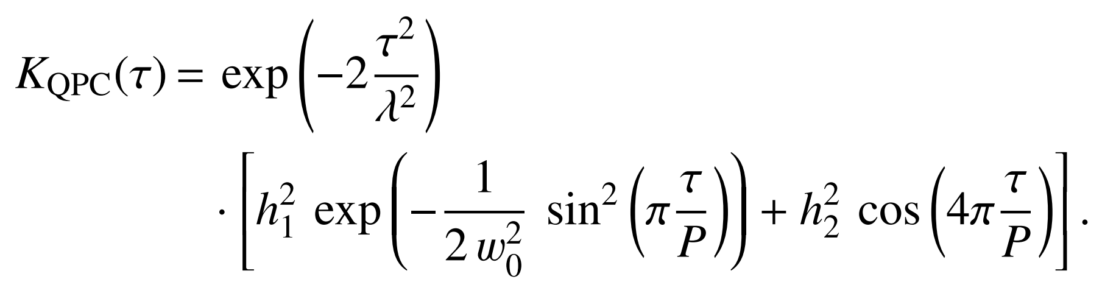
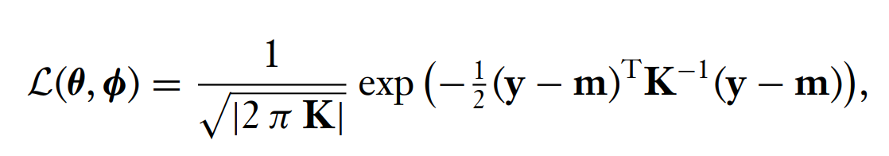

RV: Gaussian Processes
Time delay $τ=$ $t_{2}−t_{1}$ to describe correlation between observations through a kernel
Perger+2022; Hara & Ford 2023; Aigrain & Foreman-Mackey 202
Notes:
Complication

Slide 17
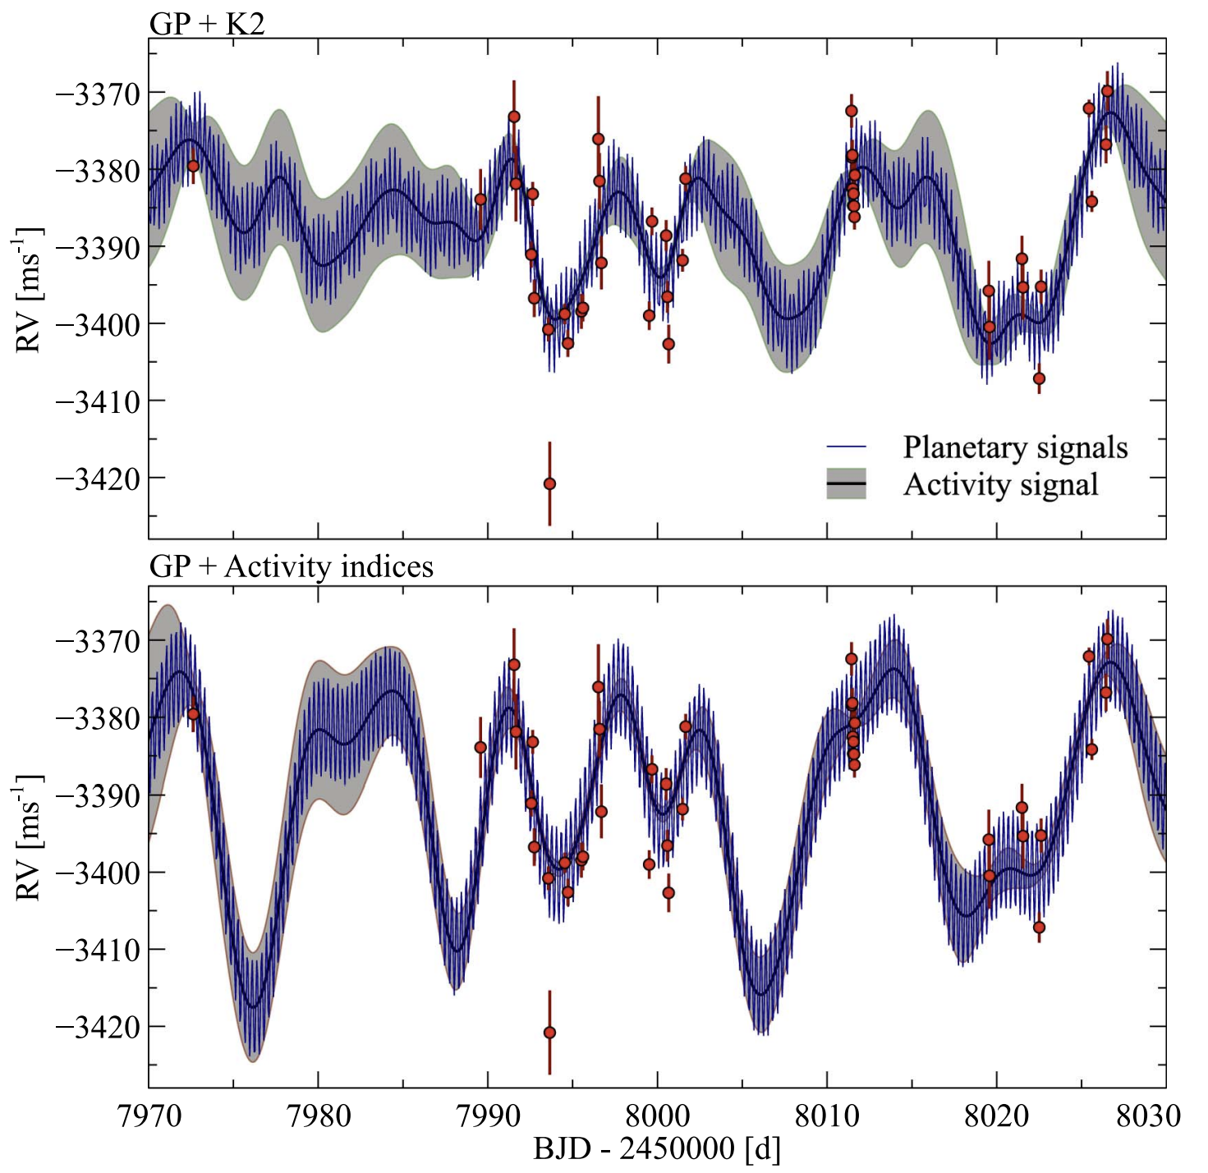
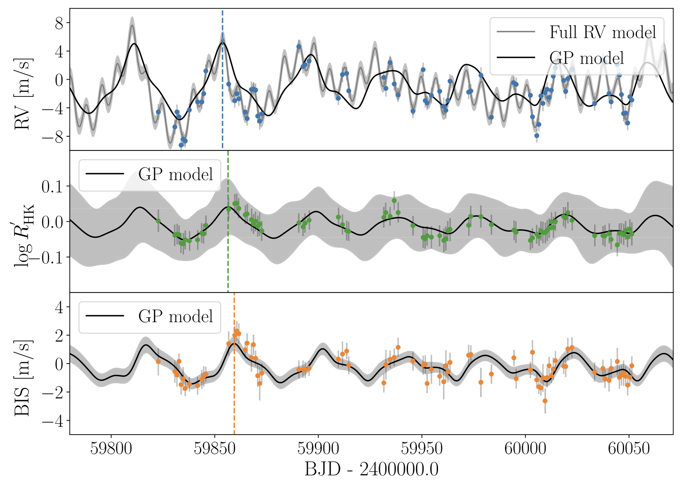
RV: Gaussian Processes
Trio of super-Earth candidates orbiting K-dwarf
HD 48948: a new habitable zone candidate (Dalal+2024)
Trained
GP Framework
Notes:
Complication

Slide 18
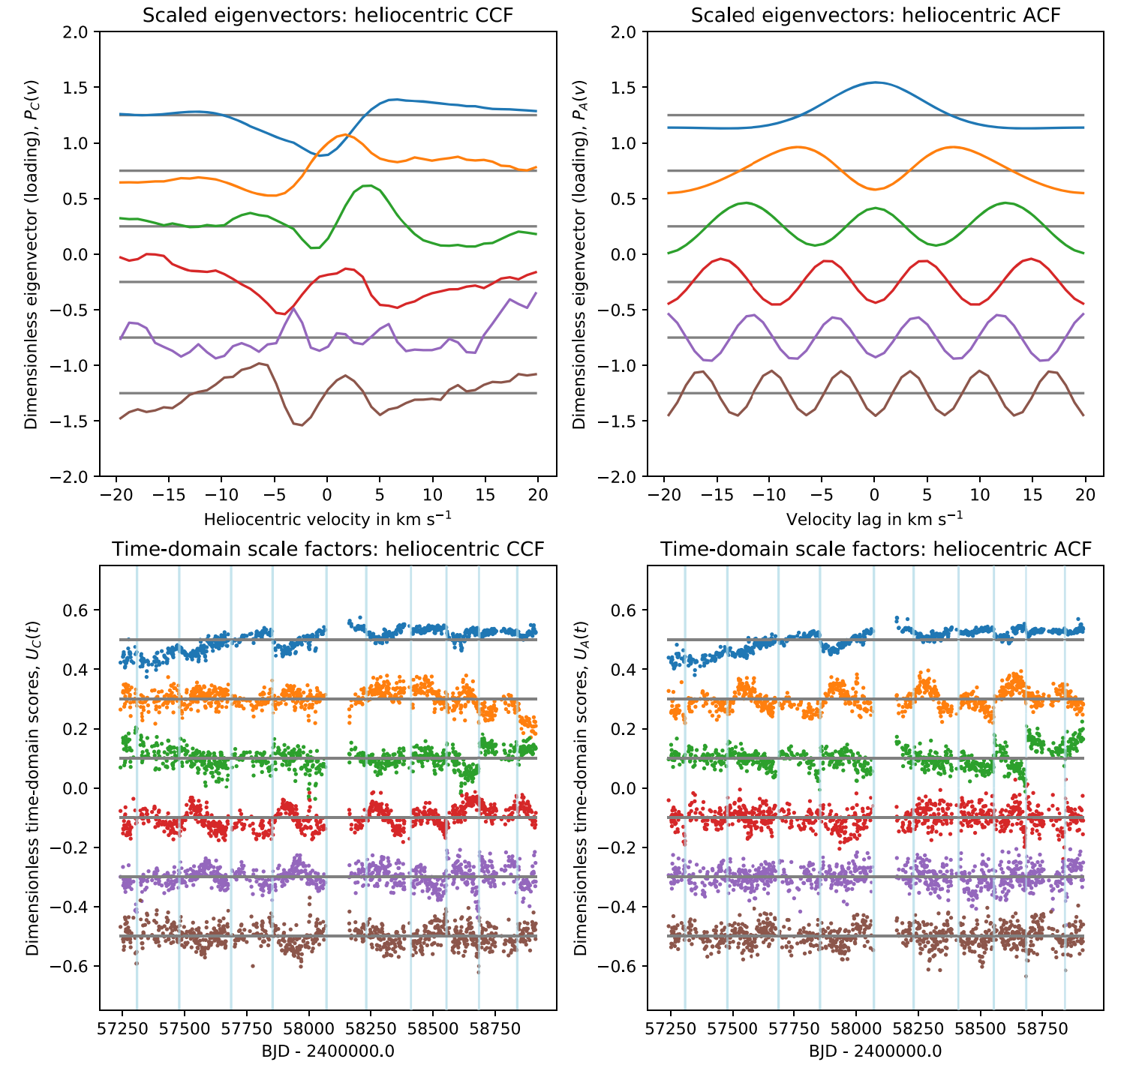
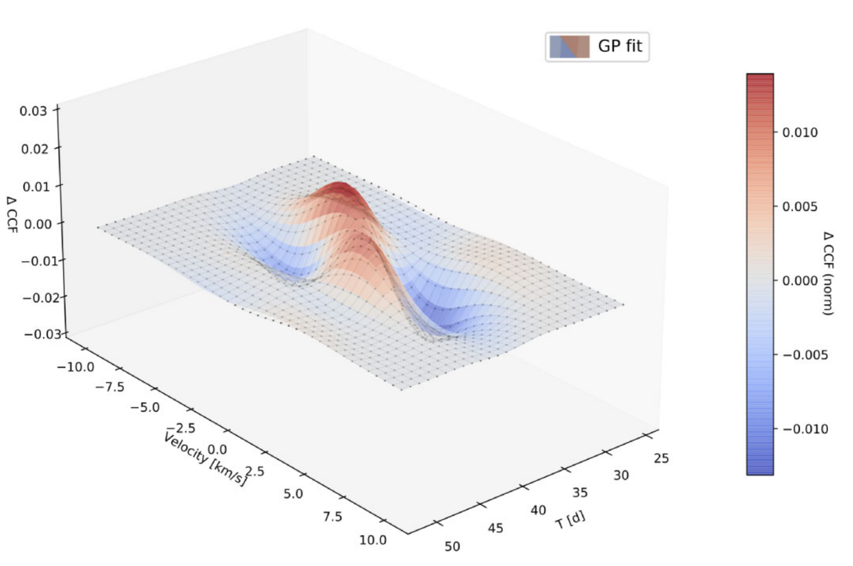
CCF: modelling non-Doppler variations
SCALPELS, Collier-Cameron+2019
A Gaussian process model for stellar activity in 2D line profile time-series, Haochuan+2024
Notes:
Complication

Slide 19
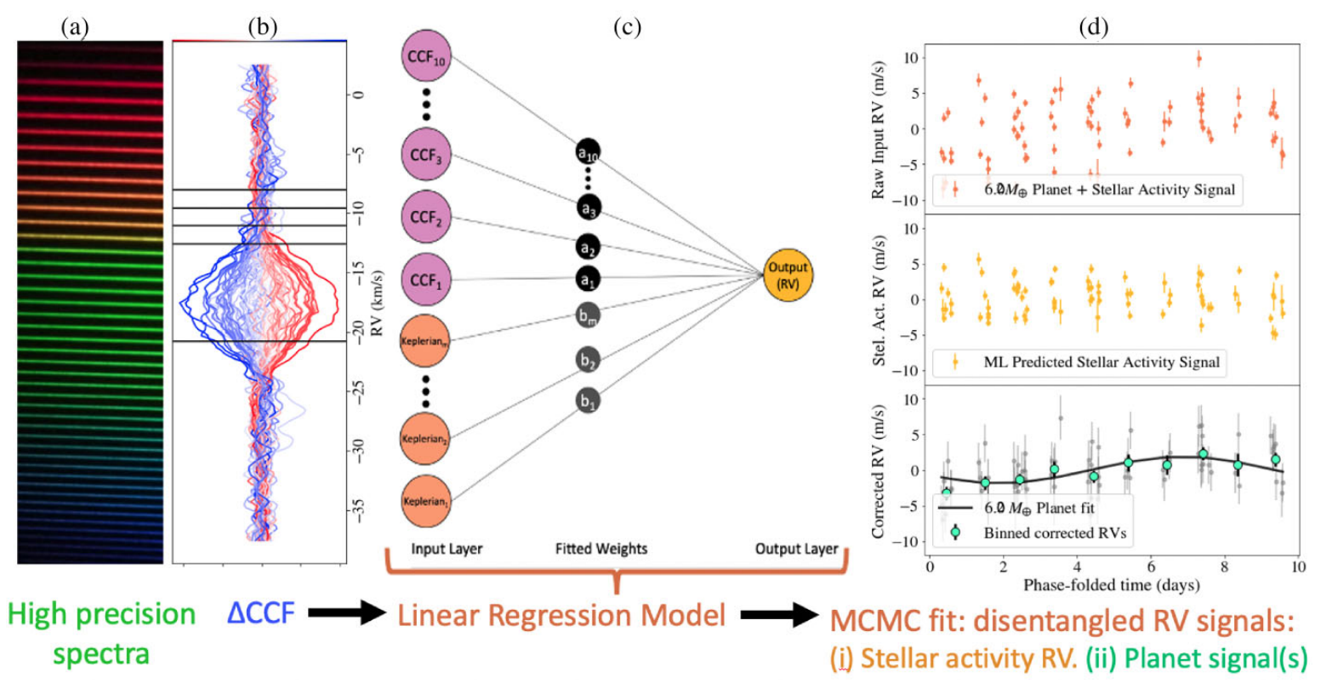
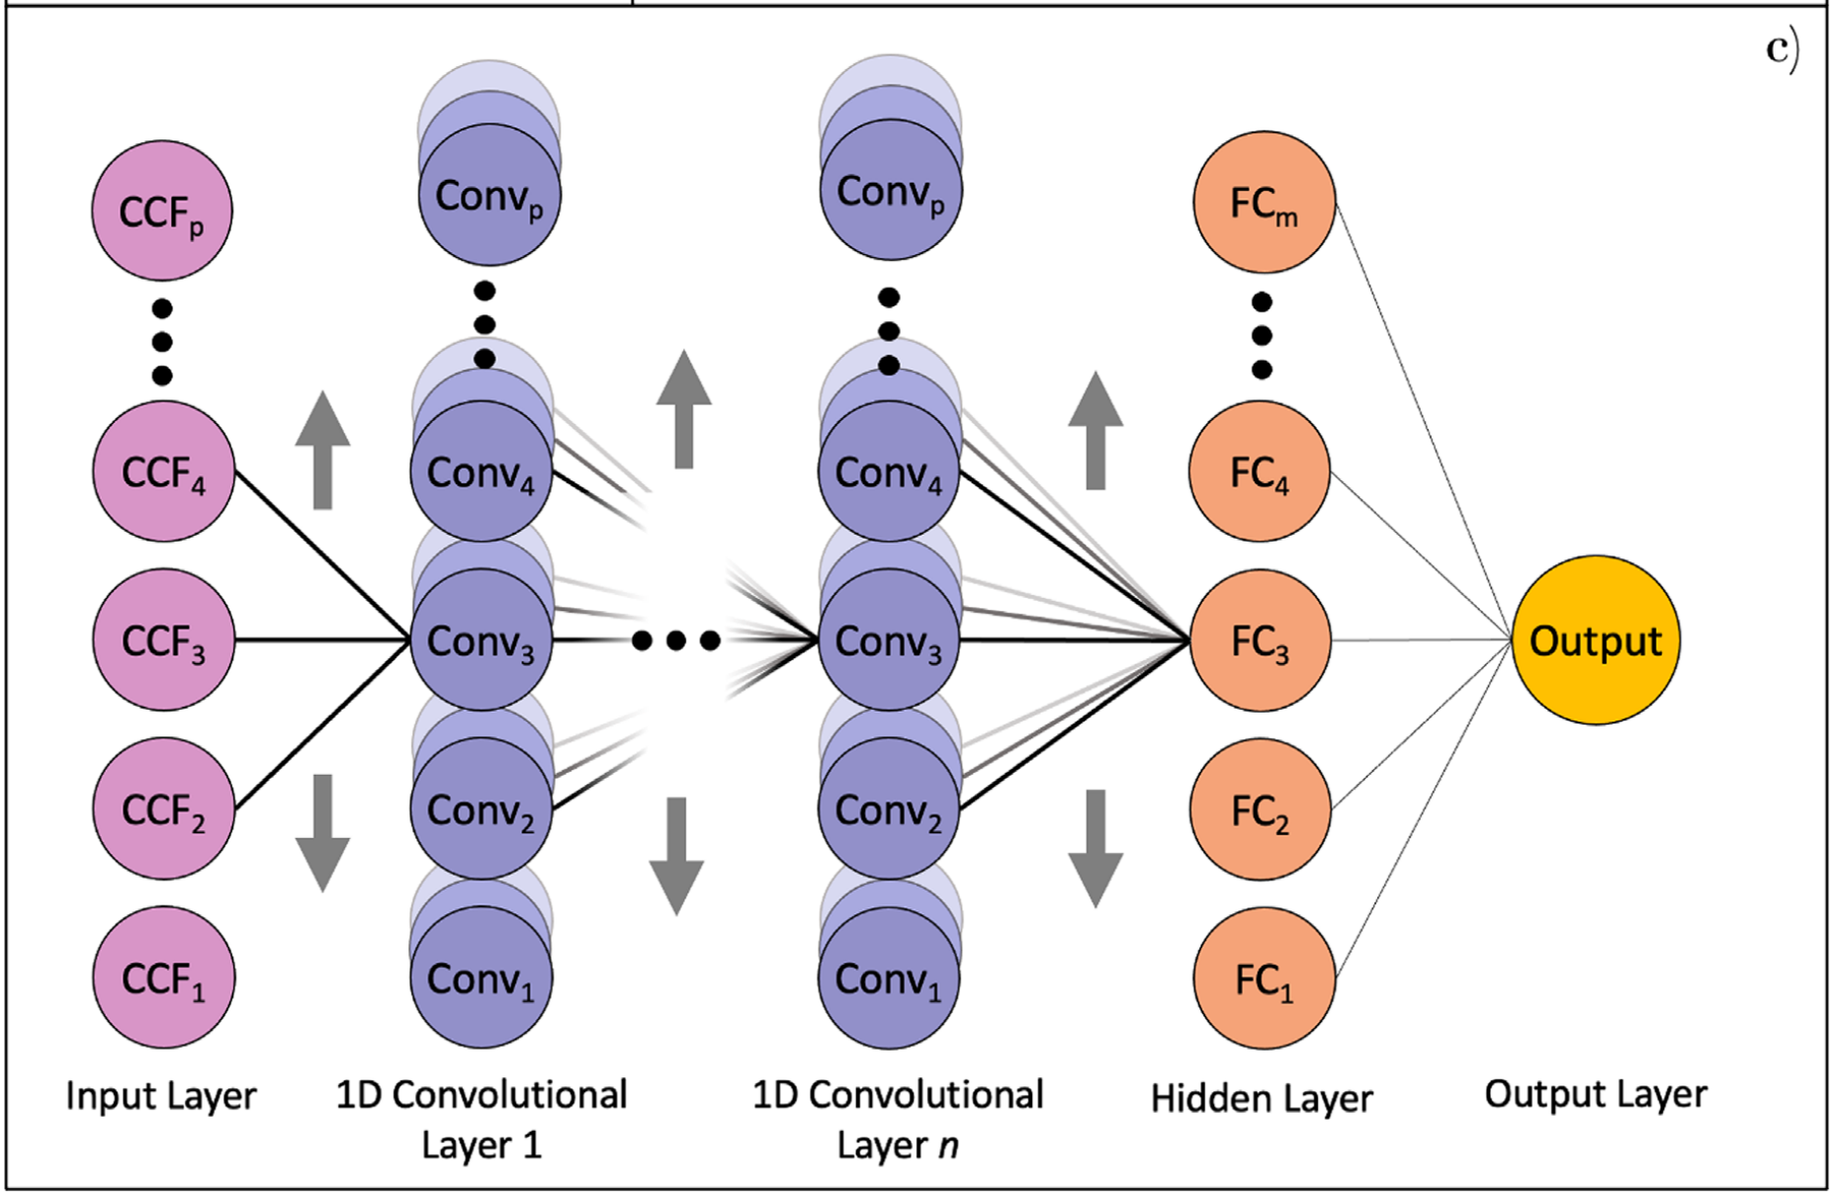
CCF: modelling non-Doppler variations
Convolutional Neural Networks (De Beurs+2022), CALM approach (De Beurs+2024)
Notes:
Complication

Slide 20
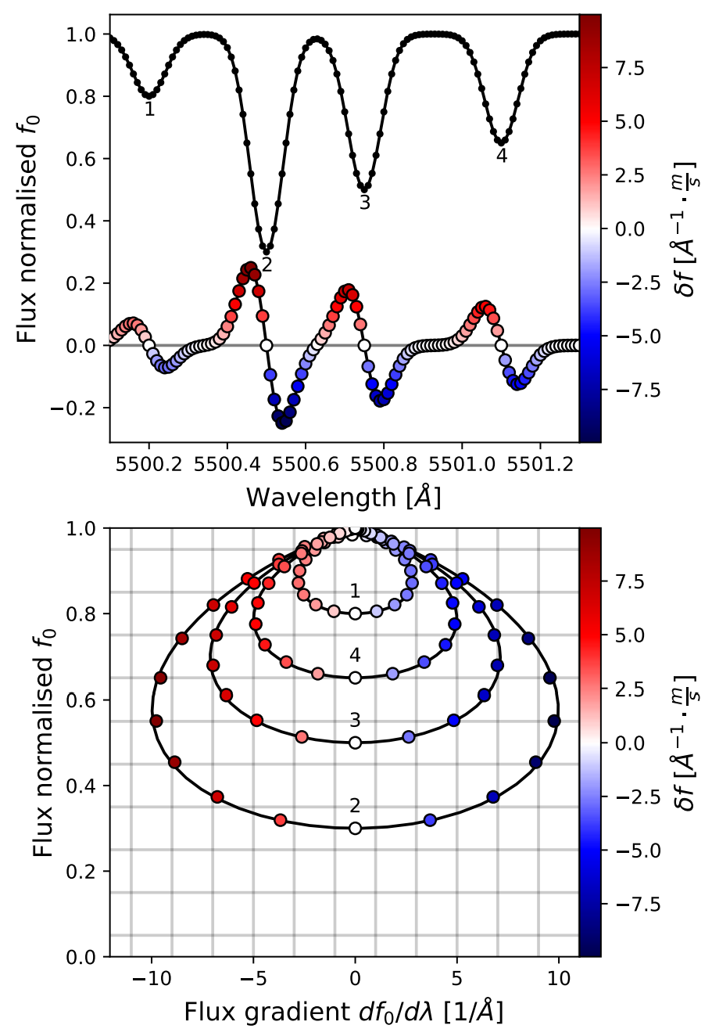
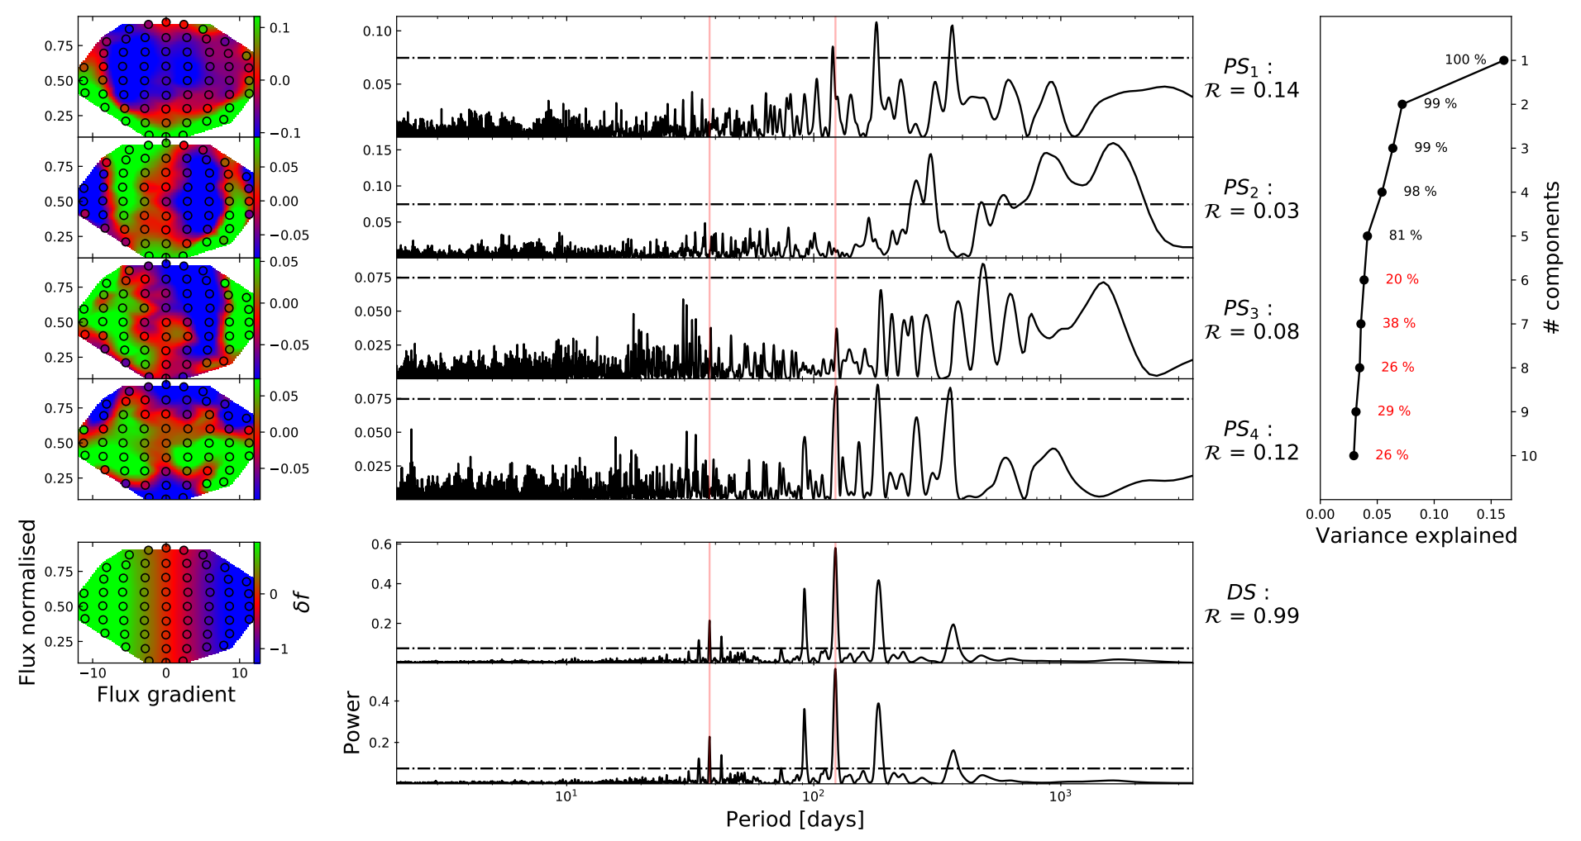
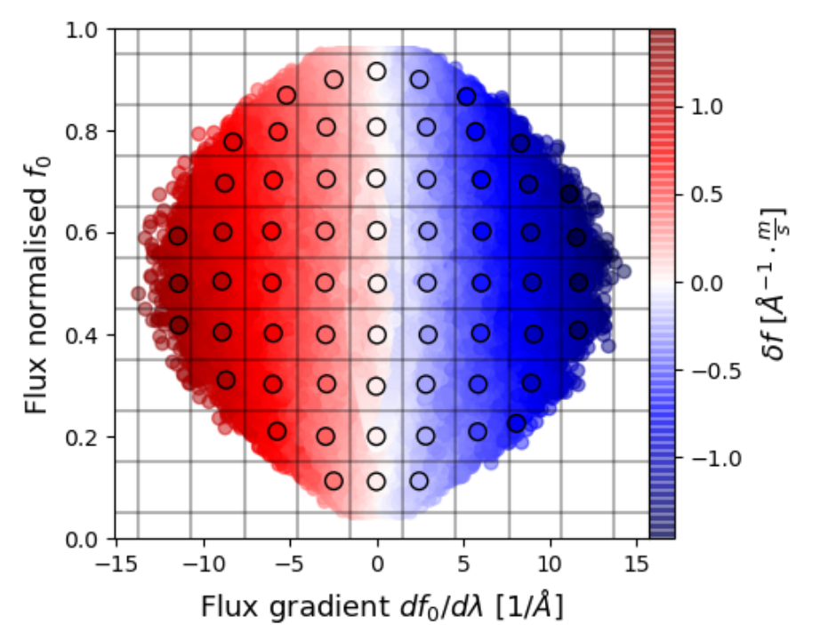
Spectra: remove stellar activity at the source
Cretignier+2022
Notes:
Complication

Slide 21
The EXPRES Stellar Signals Project
Method | Metric | Mitigation | Separation | Reference
GP Framework |  | Multidimensional GP Modeling |  | Rajpaul+2015, Barragan+2022
GLOM |  | Multidimensional GP Modeling |  | Gilbertson+2022
FDPCA |  | Commonalities in Fourier Space |  | Ramirez Delgado+2022
GPRN |  | GP Neutral Net Modeling |  | Camacho +2022
SCALPELS | PCA Amplitudes (CCF) |  | Shape/Shift-driven RVs | Collier Cameron+2021
CCF Prime | GP Model Coefficients |  | Shape/Shift-driven RVs | Baptiste Klein tbs
FIESTA+GLOM | Fourier Model Coefficients |  |  | Zhao & Ford 2022
CCF Linear Regression |  |  | Shape/Shift-driven RVs | de Beurs+2020
CCF Masks |  |  | Variable/Stable Lines | Alex Wise, Lafarga+2020
LBL+PCA spectr |  |  | Variable/Stable Lines | Dumusque 2018, Cretignier+2022
LBL+PCA rv | PCA Amplitudes (LBL RVs) |  |  | Cretignier+2021, +2022
PWGP |  |  | Variable/Stable Lines | Rajpaul +2020
DCPCA | PCA Amplitude (Spectra) |  |  | Jones+2017
Generative RR |  | Regression w/ Spectral Residuals |  | Zhao+2022
Discriminative RR |  |  |  | Zhao+2022
K2-141b, McGill University
Gaussian Process Linear Ordinary Differential Equation (ODE) Maker (GLOM) | Fourier Phase Spectrum Analysis (FIESTA)
Fourier Domain Principal Component Analysis (FDPCA), | Line By Line (LBL)
Gaussian Process Regression Network (GPRN) | Pairwise GP (PWGP) RV extraction
Self-correlation Analysis of Line Profiles for Extraction of Low-amplitude Shifts (SCALPELS) | Doppler-constrained PCA (DCPCA)
Adapted from
Zhao+2022
Notes:
Complication

Slide 22
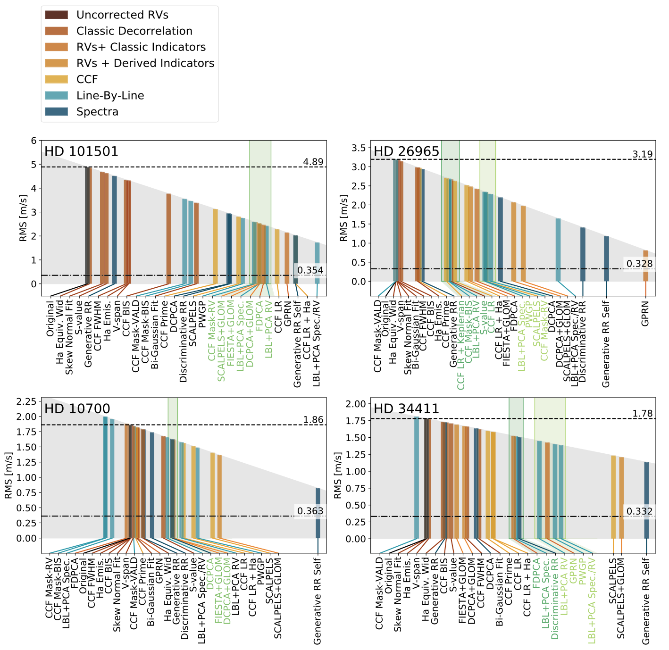
The EXPRES Stellar Signals Project
ESSP II. State of the Field in Disentangling Photospheric Velocities (Zhao+2022)
K2-141b, McGill University
No method is yet consistently reducing the RV rms to sub-m/s levels
Concerning lack of agreement between the RVs returned by different methods
Notes:
Complication

Slide 23
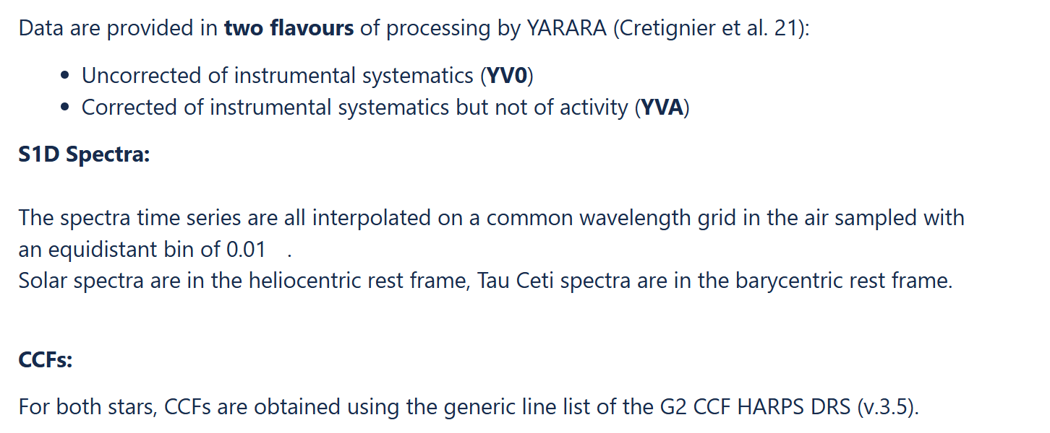
Radial Velocity data challenges
Extreme Stellar Signals Project (Zhao)
Instruments: HARPS, HARPS-N, EXPRES, NEID
https://essp-eprv.github.io/index.html
PLATO SVWG RV Challenge (Cretignier, Hara)
Instruments: HARPS, HARPS-N, SDO photometry
Major challenge:
No target overlap between Kepler photmetry and
high-cadence, high-SNR spectroscopic observations
Caution with
Human biases from human participants of challenges
K2-141b, McGill University
PSVWG Bonus
CoRoT-7 (Cortes Zuleta)
Instruments: CoRoT + HARPS
Notes:
https://essp-eprv.github.io/index.html

Slide 24
Conclusion: we can do it!
All stars are active: deal with it
Photometry
PLATO will drive further improvements to data modelling
We are in a safe land - PLATO goals at reach
Spectroscopy
Current datasets or simulations only provide a partial view of our ability in detecting Earth analogues
PLATO + ESPRESSO data may kickstart new modelling methods, leading to future Earth analogues characterization
K2-141b, McGill University
Notes:
https://essp-eprv.github.io/index.html

Slide 25

Waiting for PLATO data…
Thank you for your attention!

