Slide 1

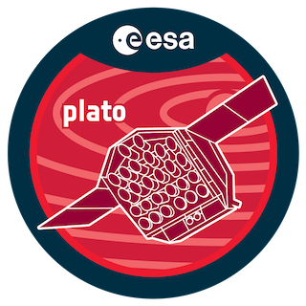
SINGLETRANS
A Dedicated Pipeline for the Detection of Single Transits in Stellar Light Curves
Sascha Grziwa
RIU, Planetary Research, at the University of Cologne
PLATO ESP 2025, 24.06.2025, Marseille
Notes:
I am presenting our wavelet based filter methods VARLET and PHALET.
On our 6 years ongoing journey with CoRoT many lessons were learned,
and so the way we detect planetary candidates has evolved.

Slide 2
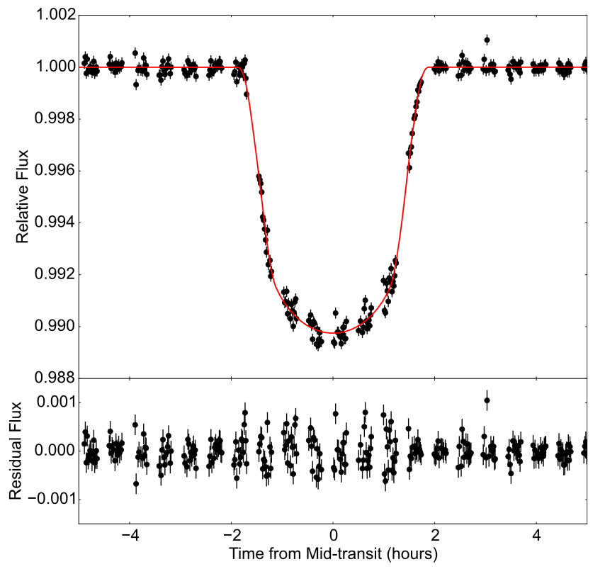
What is a single transit?
Single-transits are single events in light curves which show the shape of a transiting planet.
Single-transits because
- orbital period longer than light curve
- gaps in light curves
- disturbing events in light curves
Main problem: Periodicity is missing,
Remains: The shape of the transit
Notes:
The next example is a Kepler light curve.
The variability is substantially reduced by VARLET by a factor of 100.
The residual light curve contains noise and the transit.
The transit is easily detected by the BLS algorithm.

Slide 3
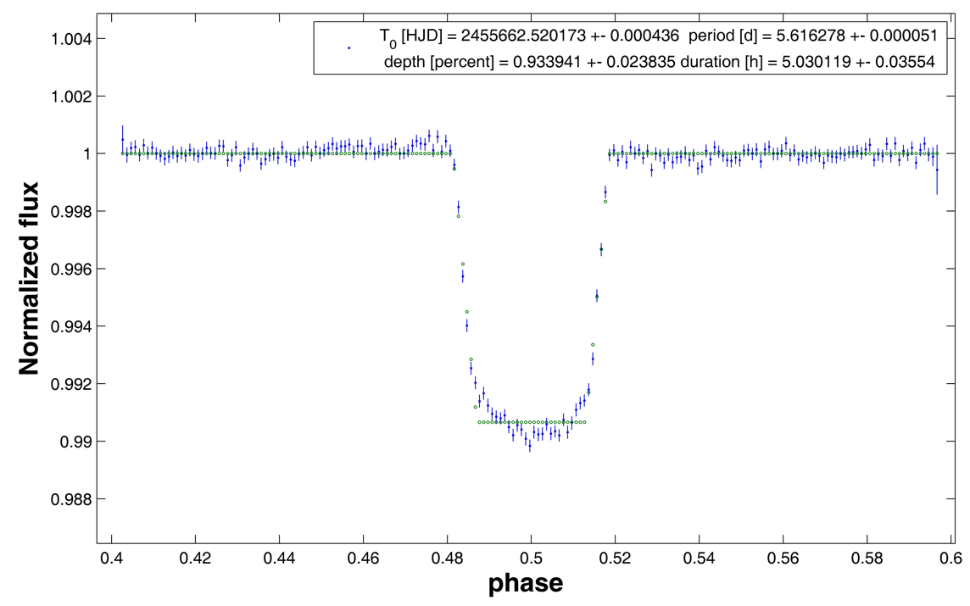
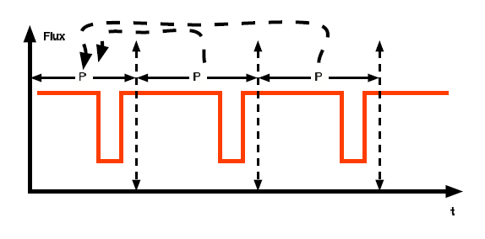
Usual detection methods ( e.g. BLS Kovacs et al. 2002)
Usual detection methods use the periodicity of at least 3 transit events.
Multiple transit events help to amplify the transit event (e.g. phasefolding)
Main problem for single transits:
Periodicity is missing,
Remains: The shape of the transit
Notes:
The next example is a Kepler light curve.
The variability is substantially reduced by VARLET by a factor of 100.
The residual light curve contains noise and the transit.
The transit is easily detected by the BLS algorithm.

Slide 4

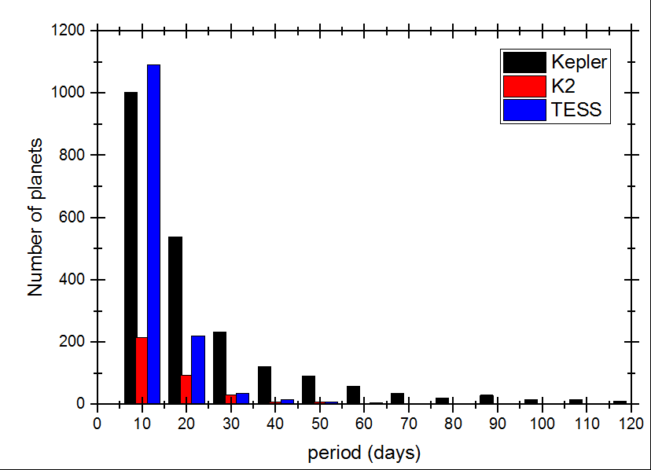
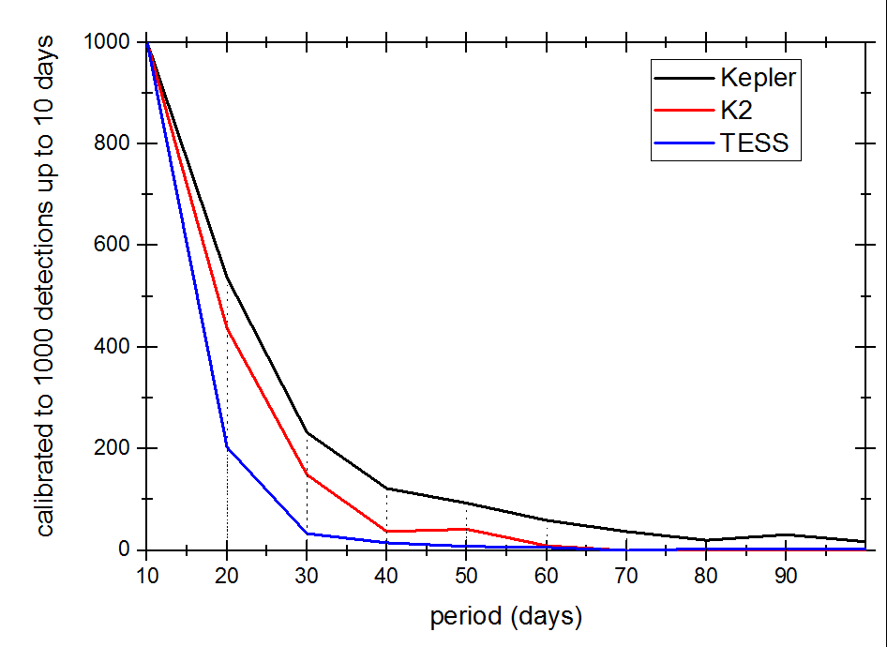
Why single transit survey ?
Number of detections per period of different space missions.
Number of detections per period calibrated for 10 days period.
(Dez 2019)
(Dez 2019)
>400 single transits are hidden in TESS light curves
Notes:
The next example is a Kepler light curve.
The variability is substantially reduced by VARLET by a factor of 100.
The residual light curve contains noise and the transit.
The transit is easily detected by the BLS algorithm.

Slide 5
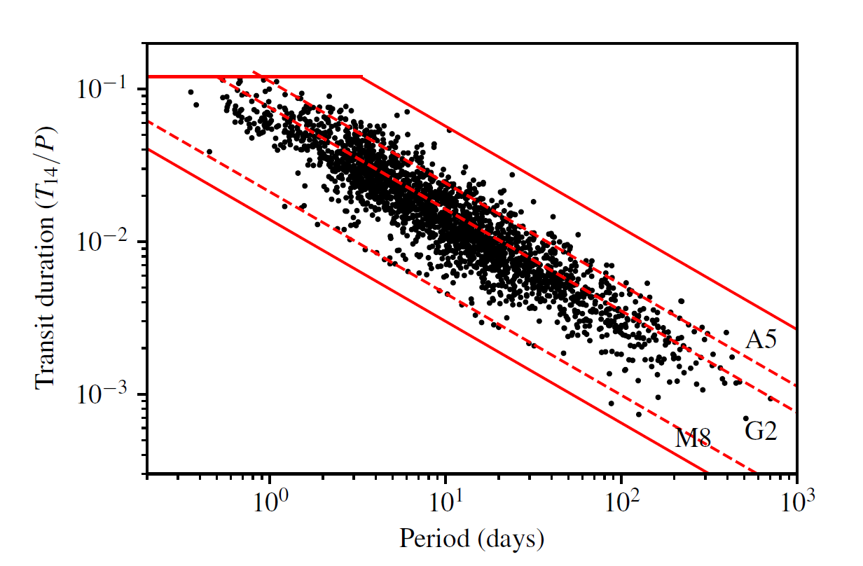
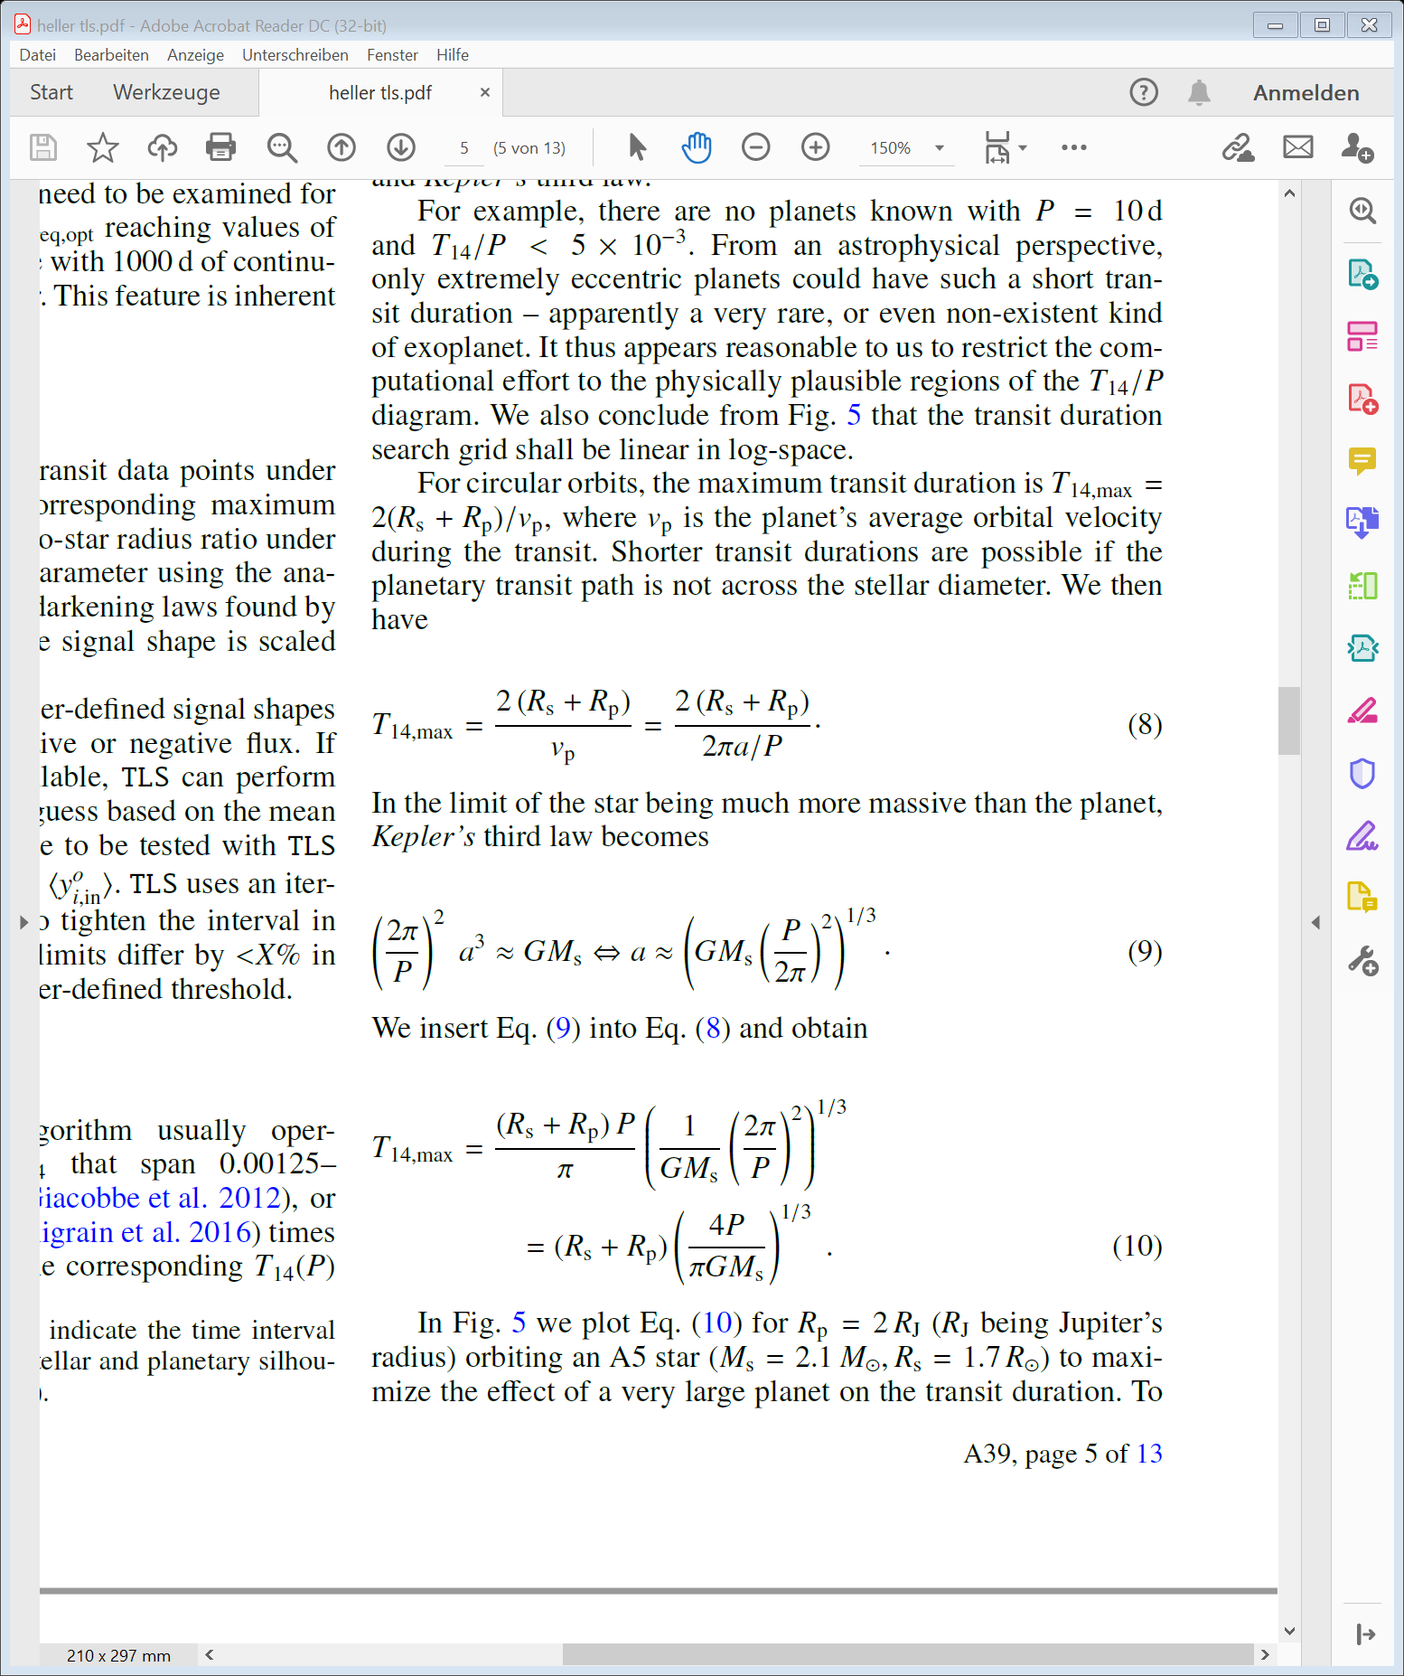
Calculating the orbital period from transit duration
Transit duration:
Using circular orbits:
Using Kepler third law (Ms>>Mp):
Hippke & Heller, 2019
~ 10% error calculating the orbital period
Notes:
The next example is a Kepler light curve.
The variability is substantially reduced by VARLET by a factor of 100.
The residual light curve contains noise and the transit.
The transit is easily detected by the BLS algorithm.

Slide 6
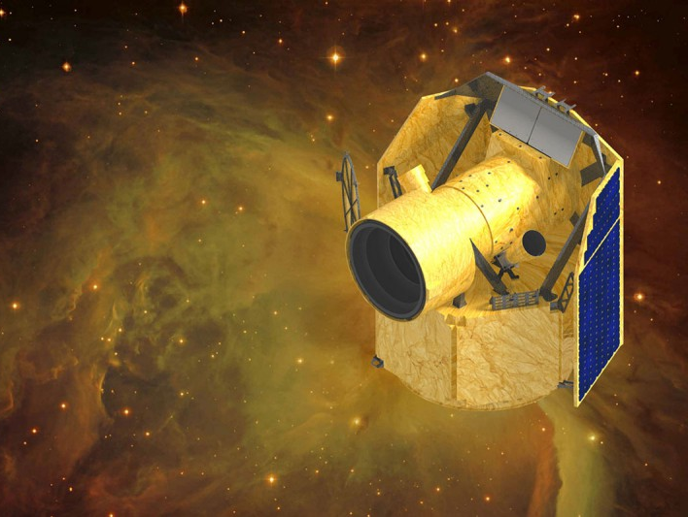
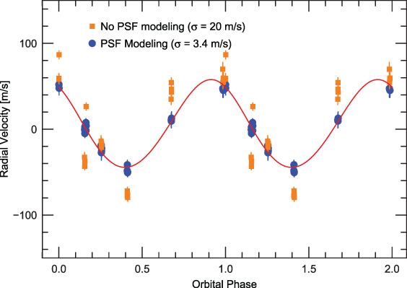
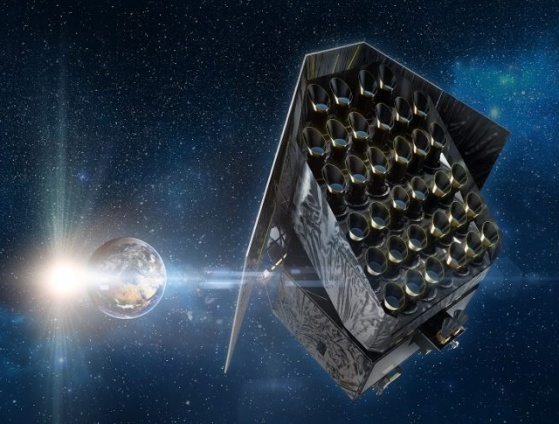
Why is this useful?
Calculation of next transit event
~10% error
Calculation of next transit event
~10% error
Calculation of next transit event
~10% error
Notes:
The next example is a Kepler light curve.
The variability is substantially reduced by VARLET by a factor of 100.
The residual light curve contains noise and the transit.
The transit is easily detected by the BLS algorithm.

Slide 7
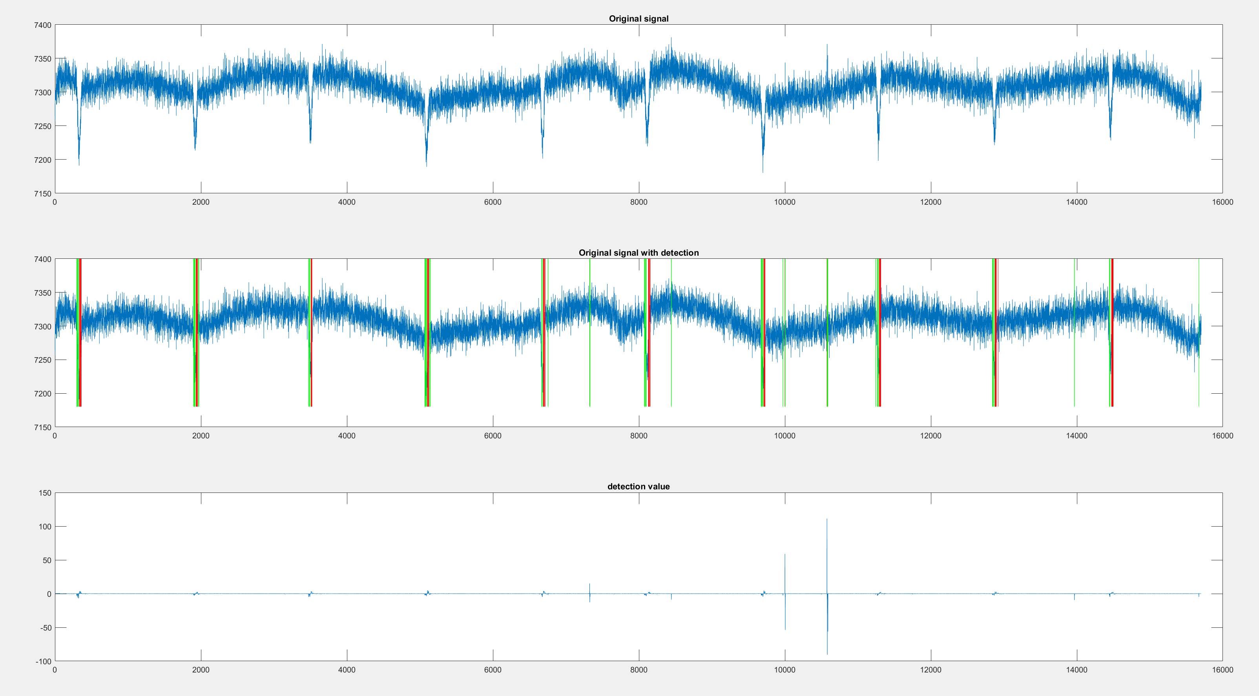
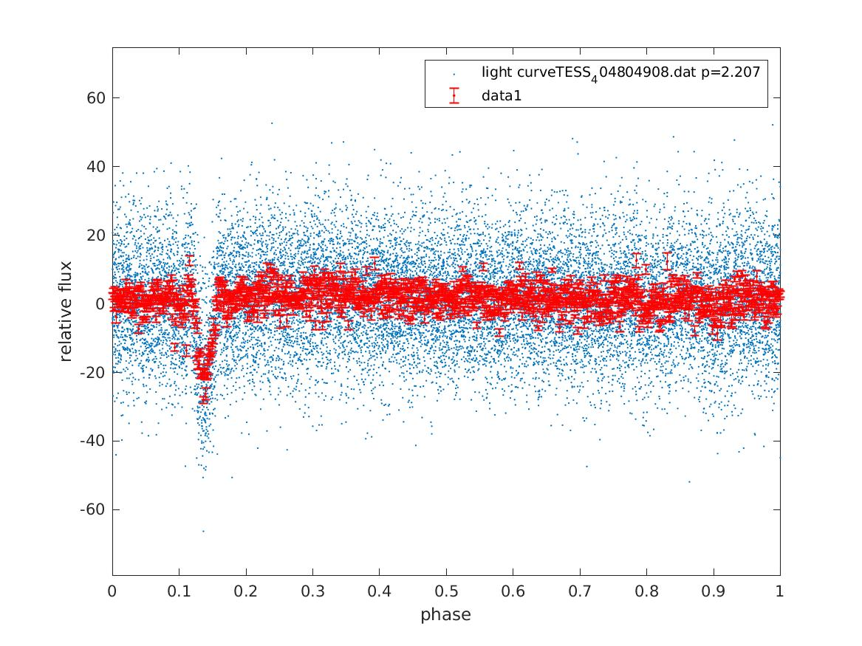
SINGLETRANS examples (TESS Sector 37)
Notes:
The next example is a Kepler light curve.
The variability is substantially reduced by VARLET by a factor of 100.
The residual light curve contains noise and the transit.
The transit is easily detected by the BLS algorithm.

Slide 8
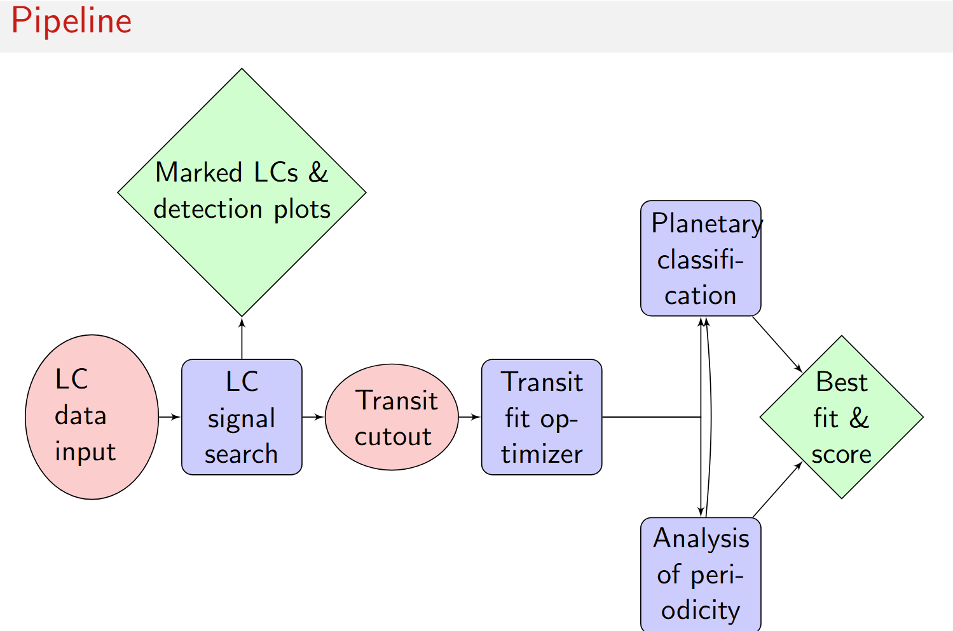
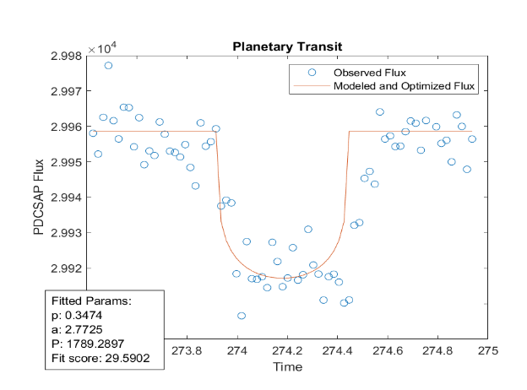
Final concept of SINGLETRANS (Hendrik Schmerling)
Notes:
The next example is a Kepler light curve.
The variability is substantially reduced by VARLET by a factor of 100.
The residual light curve contains noise and the transit.
The transit is easily detected by the BLS algorithm.

Slide 9
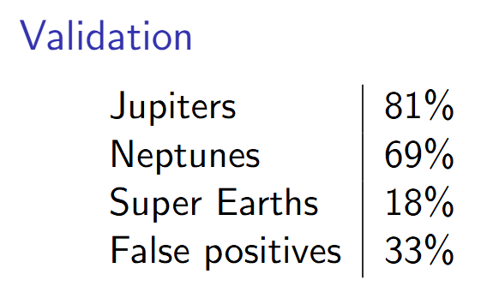
Inject and retrieval test on TESS light curves
Injecting 5000 transits of planets into
TESS light curves clear of intrinsic transits.
Several planetary radii, all kind of periods
50% single transits and 50% multiple transits.
Pipeline treads all transits independent
Notes:
The next example is a Kepler light curve.
The variability is substantially reduced by VARLET by a factor of 100.
The residual light curve contains noise and the transit.
The transit is easily detected by the BLS algorithm.

Slide 10
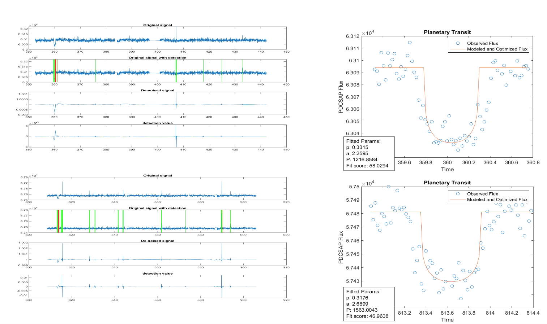
Examples of single transits found in Kepler light curves
Notes:
The next example is a Kepler light curve.
The variability is substantially reduced by VARLET by a factor of 100.
The residual light curve contains noise and the transit.
The transit is easily detected by the BLS algorithm.

Slide 11
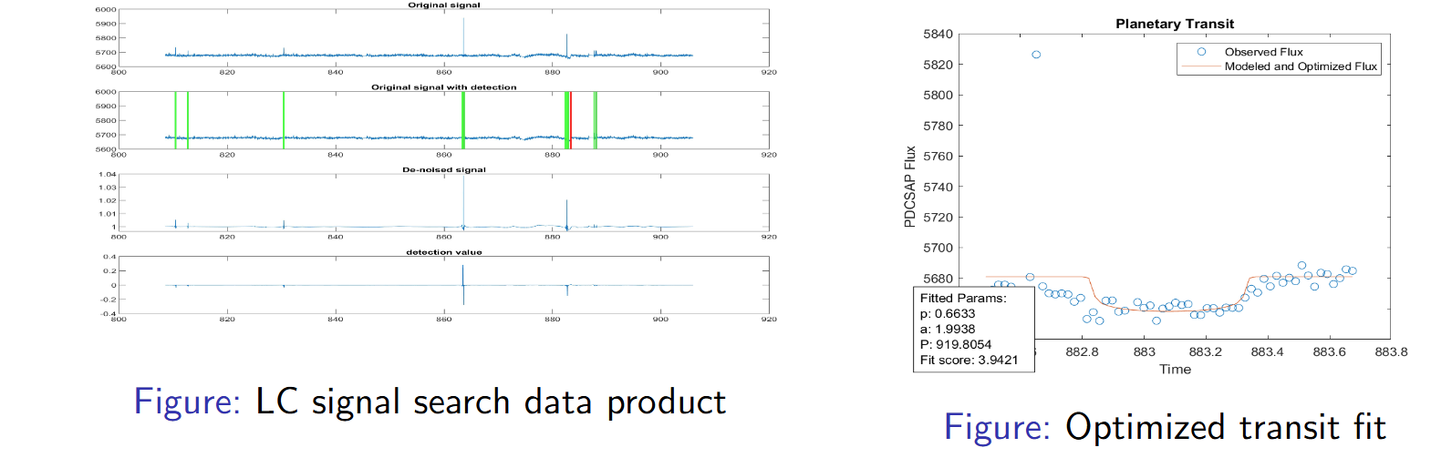
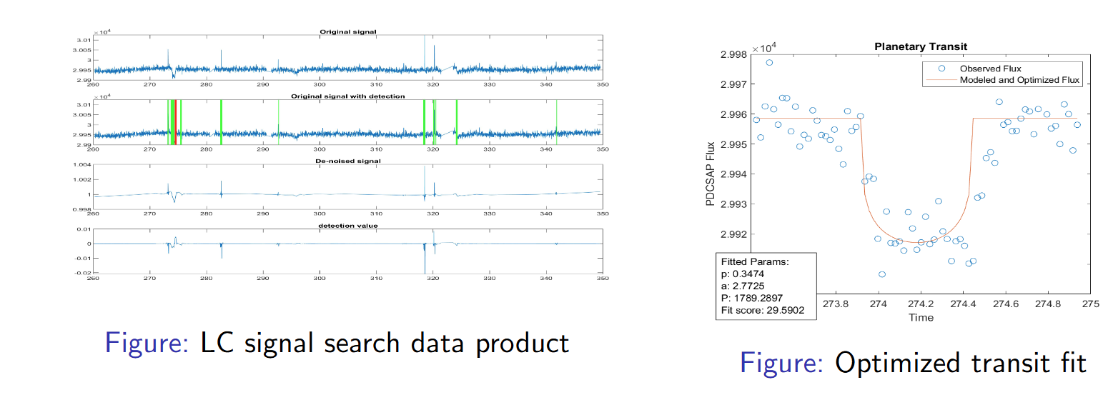
Examples of single transits found in Kepler light curves
Notes:
The next example is a Kepler light curve.
The variability is substantially reduced by VARLET by a factor of 100.
The residual light curve contains noise and the transit.
The transit is easily detected by the BLS algorithm.

Slide 12
Conclusion SINGLETRANS
Many mono-transits are still hidden in the archival data (>400 in TESS data)
A dedicated mono transit pipeline shall find candidates
with periods larger than 1/3 of the light curve length.
Detecting mono-transits is important for a complete statistic.
Detecting mono-transit is helpful for missions like PLATO, Cheops…
SINGLETRANS is able finding mono-transits even small ones (not all but many).
SINGLETRANS can detect and analyze quasi-periodic transits (TTV, circumbinary)
SINGLETRANS is fast and the pipeline runtime scales linear with the light curve length.
Notes:
The next example is a Kepler light curve.
The variability is substantially reduced by VARLET by a factor of 100.
The residual light curve contains noise and the transit.
The transit is easily detected by the BLS algorithm.

Slide 13
SINGLETRANS runtime
Mission | Computer | Number of LC | Runtime (s) | Runtime (days)
TESS | I5 16GB | 100 | 104
TESS | I5 16GB | 1 | 1,04
PLATO | I5 16GB | 1 | 56,28
PLATO | I5 16GB | 1000000 | 56277092 | 651,31
PLATO | 32 cores | 1000000 |  | 20,34
SINGLETRANS runtime scales linear
A larger desktop or a small cluster can handle the complete PLATO data set
Notes:
The next example is a Kepler light curve.
The variability is substantially reduced by VARLET by a factor of 100.
The residual light curve contains noise and the transit.
The transit is easily detected by the BLS algorithm.

Slide 14

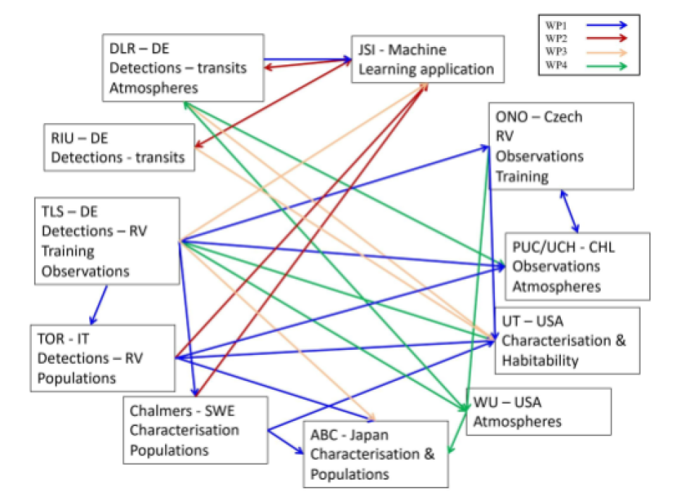
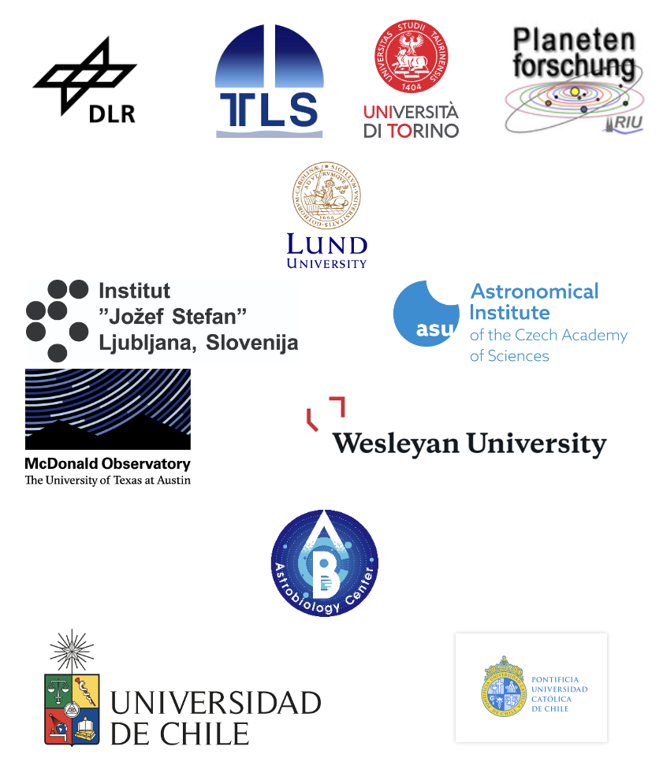
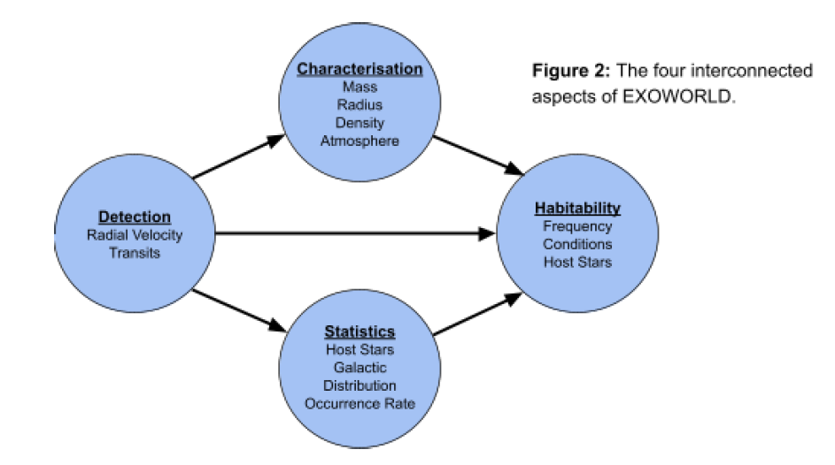
MSCA Staff Exchanges 2021
Notes:
The next example is a Kepler light curve.
The variability is substantially reduced by VARLET by a factor of 100.
The residual light curve contains noise and the transit.
The transit is easily detected by the BLS algorithm.

Slide 15
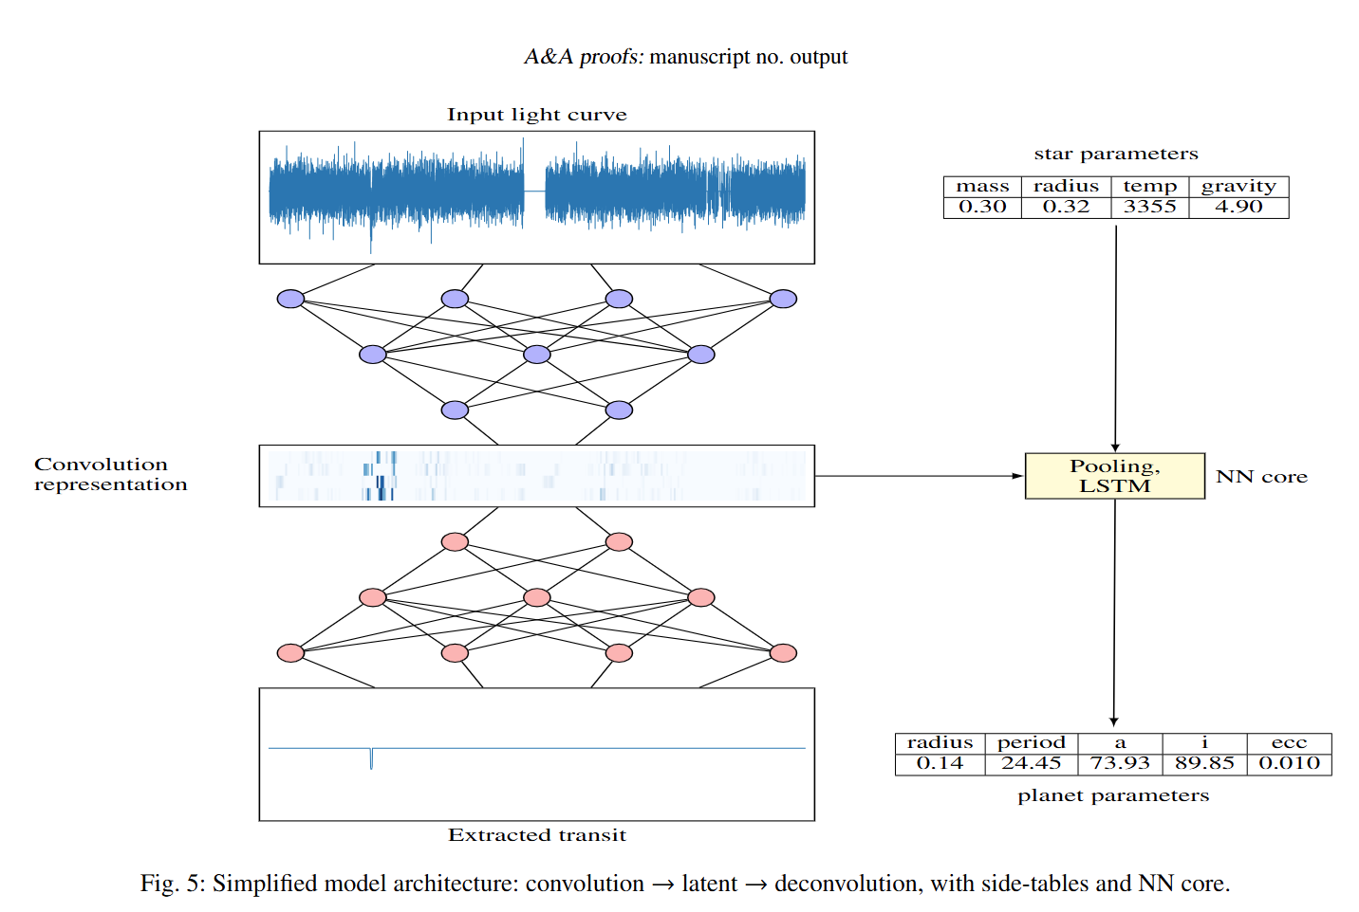
TRANSCENDENCE by Hendrik Schmerling & Rok Hribar
Characterizing planets by analyzing transits in light curves
Injecting transits of simulated planets
into TESS light curves.
Giving information on stellar parameters
Train with dataset of a varity of planets
radius, period, semi major axis,
inclination, eccentricity…
Training on dedicated Cluster (2 days)
Schmerling et al. (in preparation)
Notes:
The next example is a Kepler light curve.
The variability is substantially reduced by VARLET by a factor of 100.
The residual light curve contains noise and the transit.
The transit is easily detected by the BLS algorithm.

Slide 16
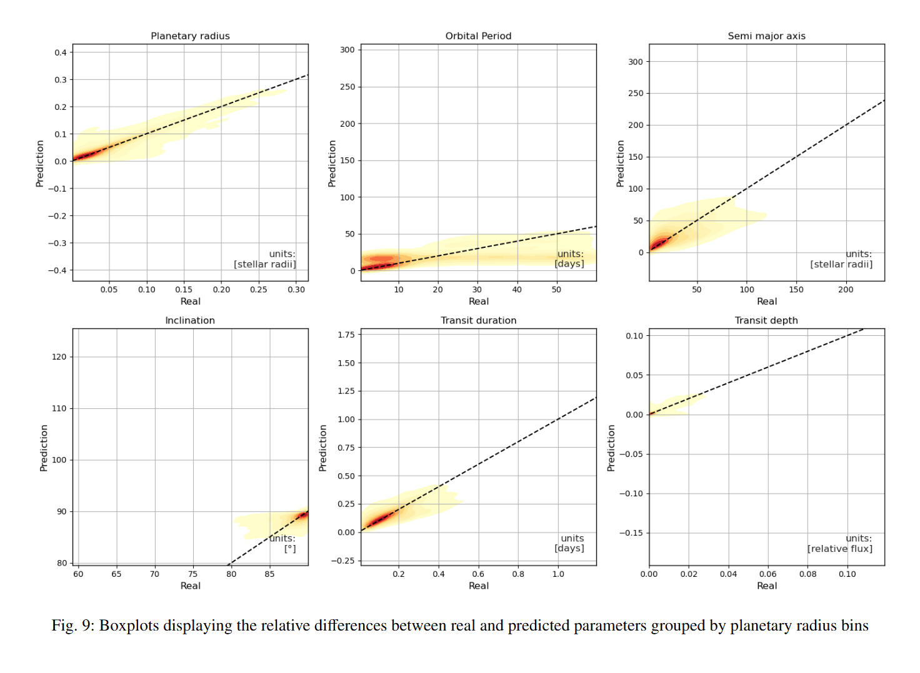
Predicted parameters of TRANSCENDENCE
Schmerling et al. (in preparation)
Notes:
The next example is a Kepler light curve.
The variability is substantially reduced by VARLET by a factor of 100.
The residual light curve contains noise and the transit.
The transit is easily detected by the BLS algorithm.

Slide 17
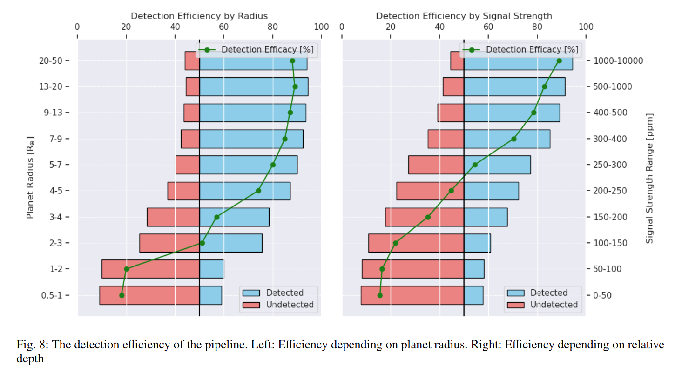
Detection Efficiency of TRANSCENDENCE
Schmerling et al. (in preparation)
Notes:
The next example is a Kepler light curve.
The variability is substantially reduced by VARLET by a factor of 100.
The residual light curve contains noise and the transit.
The transit is easily detected by the BLS algorithm.

Slide 18
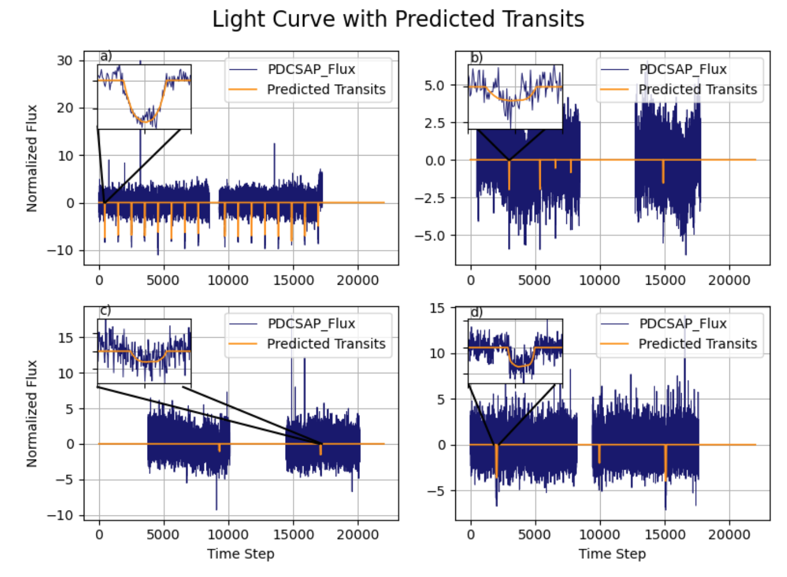
Example TOIs found by TRANSCENDENCE
Notes:
The next example is a Kepler light curve.
The variability is substantially reduced by VARLET by a factor of 100.
The residual light curve contains noise and the transit.
The transit is easily detected by the BLS algorithm.

Slide 19
Runtime of TRANSCENDENCE
TRANSCENDENCE processing time on 4925 TESS LC is 4s
But this excludes 8,7s for loading hdf5 file including the tensor with 4925 LC
Preprocessing this one large tensor takes 5712s
→ 1,16s for per TESS LC
Mission | Computer | Number of LC | Runtime (s) | Runtime (days)
TESS | I5 16GB | 4925 | 4+8,7+5712
TESS | I5 16GB | 1 | 1,16
PLATO | I5 16GB | 1 | 62,85
PLATO | I5 16GB | 1.000.000 | 62854386 | 727
PLATO | 32 cores | 1.000.000 |  | 22,7
The detection process alone (1.000.000 PLATO LC) takes 12 hours.
Notes:
The next example is a Kepler light curve.
The variability is substantially reduced by VARLET by a factor of 100.
The residual light curve contains noise and the transit.
The transit is easily detected by the BLS algorithm.

Slide 20
Conclusion
Many mono-transits are still hidden in the archival data (>400 in TESS data) and detecting these transits is very helpful (PLATO, CHEOPS, …)
SINGLETRANS is able finding mono-transits even small ones (not all but many).
Detection methods using phasefolding get slow when they are used on large data sets.
SINGLETRANS and TRANSCENDENCE scale linear with the length of the light curves.
SINGLETRANS and TRANSCENDENCE can process light curves independently.
They can process large data sets on relatively small computers.
TRANSCENDENCE still has to learn a few things (existence of multiplanets,…)
Notes:
The next example is a Kepler light curve.
The variability is substantially reduced by VARLET by a factor of 100.
The residual light curve contains noise and the transit.
The transit is easily detected by the BLS algorithm.

