Slide 1
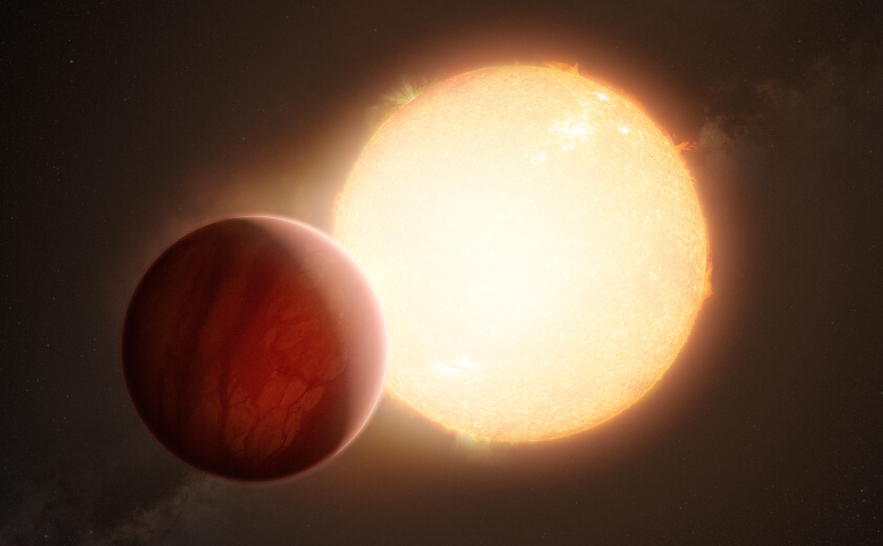
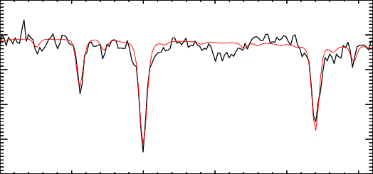


The calcium triplet as an infrared chromospheric indicator: a large-scale study, from Gaia DR4 to PLATO
Vincent Bruniquel
Supervisors : Nadège Meunier, Lucile Mignon
Vincent.bruniquel@univ-grenoble-alpes.fr
25/06/2025

Slide 2
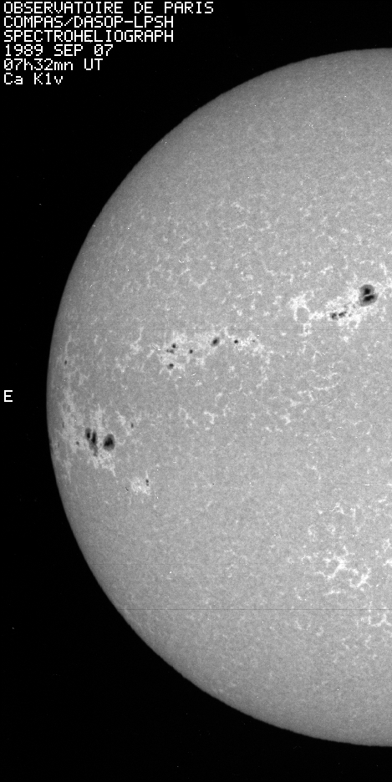
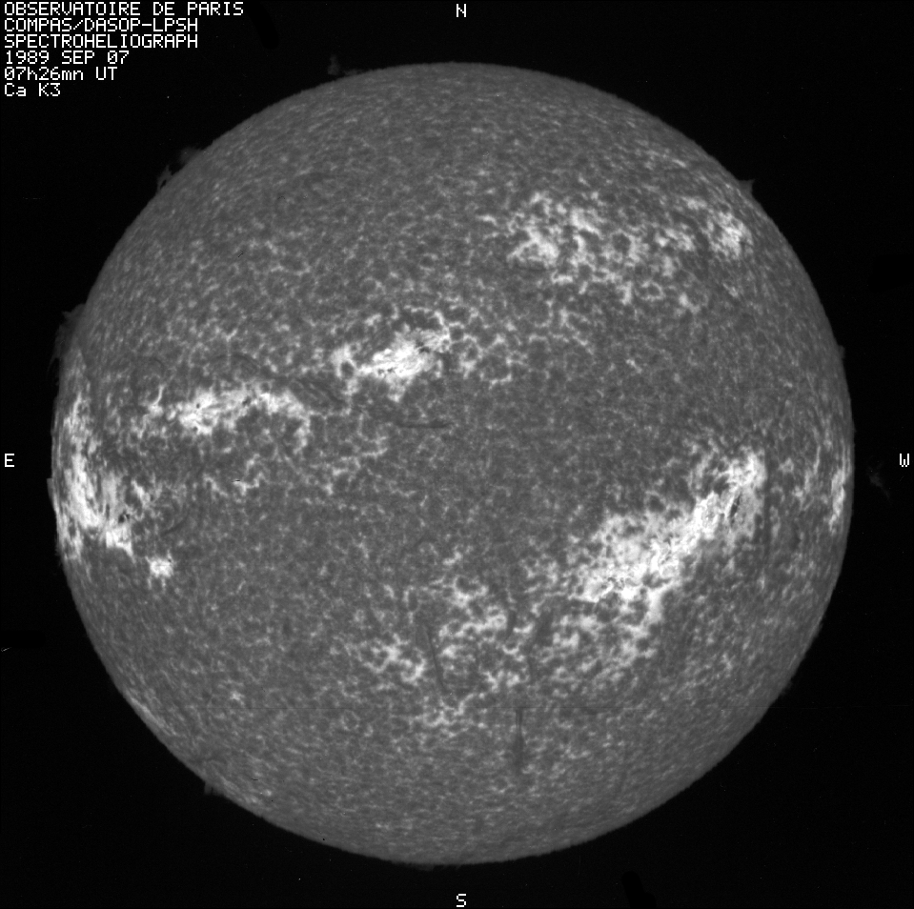
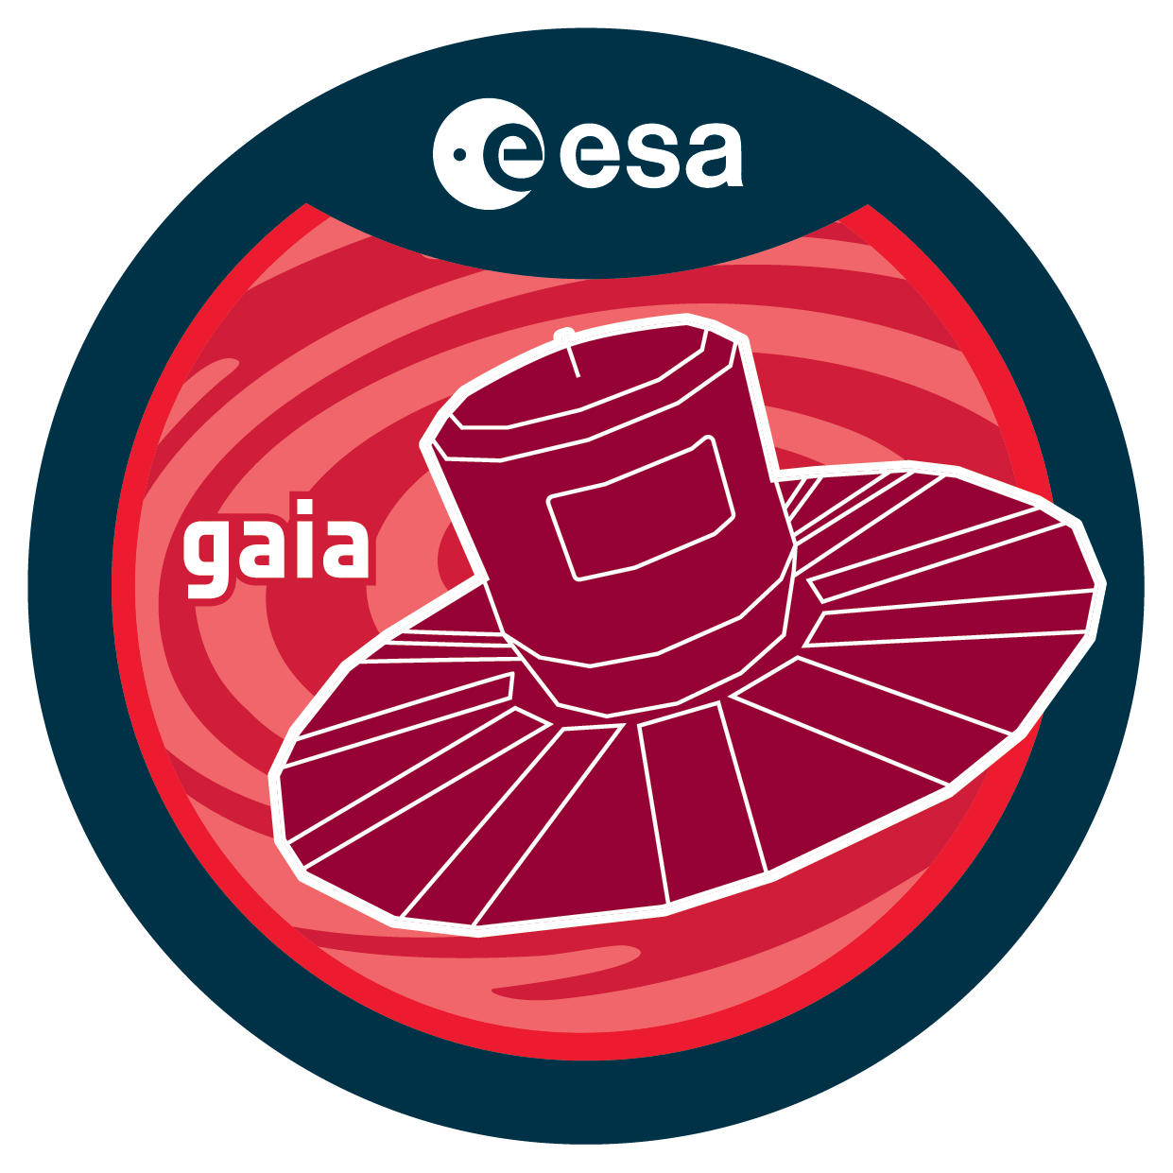
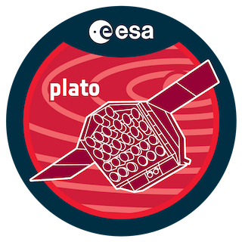


Introduction to Stellar Activity: Photosphere vs. Chromosphere
Photosphere
Chromosphere
Photometry
Spectroscopie
Activity indicators
Emission in specific lines
Photometry reveals surface variability, while spectroscopy probes magnetic activity via chromospheric lines
Skumanich et al. (1984)

Slide 3

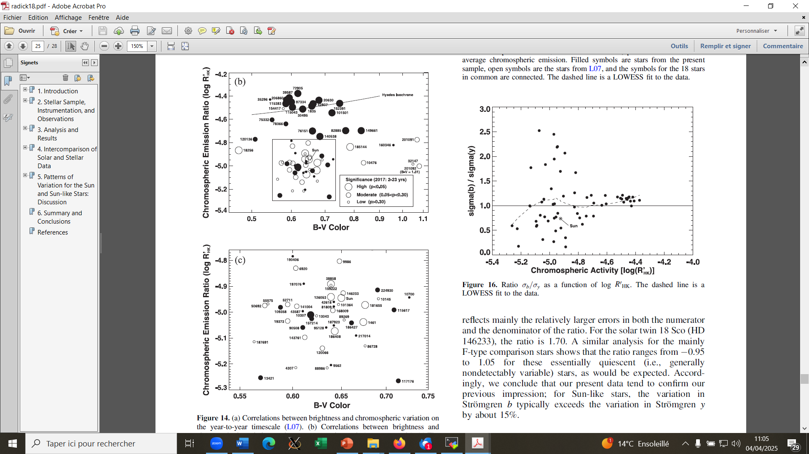

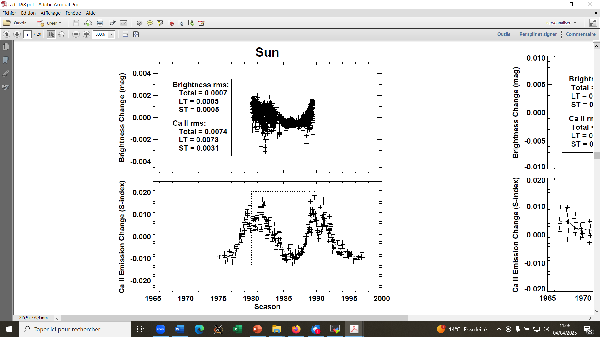
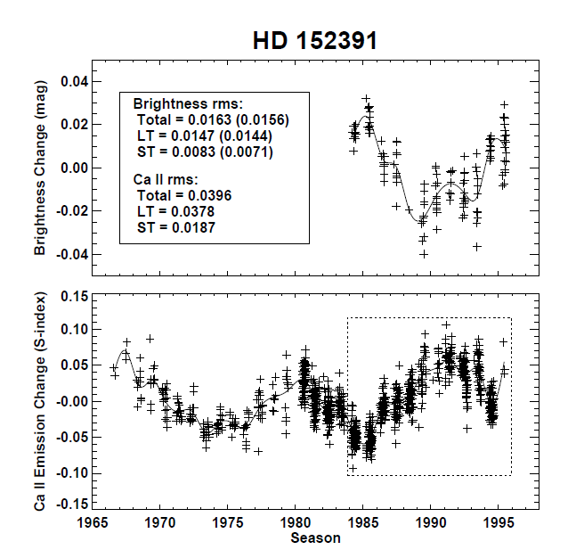
Introduction to Stellar Activity: Photosphere vs. Chromosphere
Sun dominated by faculae :
Correlation: brightness chromospheric emission
Exemple star dominated by spots:
Anticorrelation: brightness chromospheric emission
In a small sample, photometric and chromospheric emissions are anticorrelated in young stars and correlated in older ones
We aim to conduct a large-scale study using Gaia DR4 to extend this analysis and explore additional stellar parameters beyond age
Radick et al. 2018
Radick et al. 1998
Radick et al. 2018

Slide 4
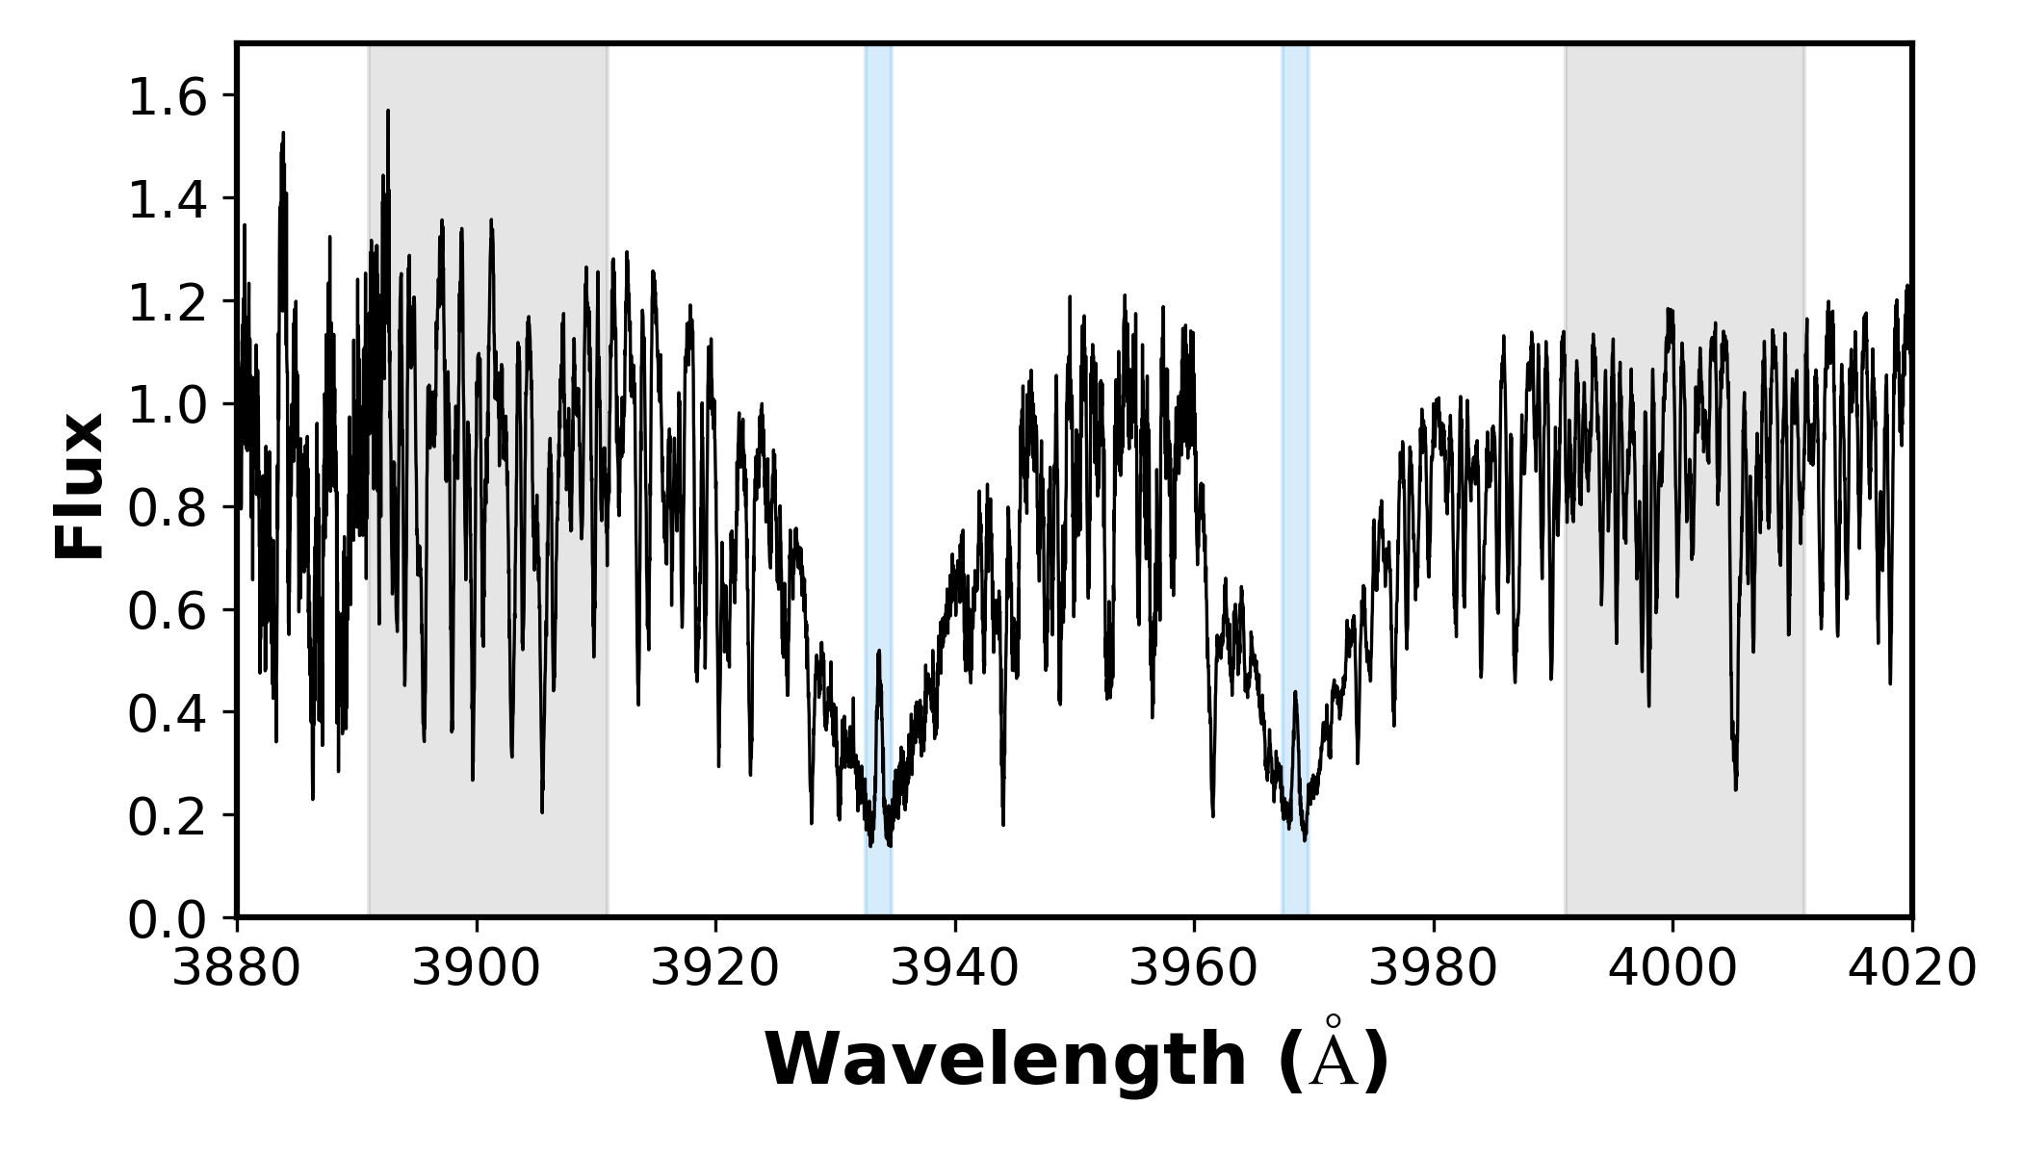







Standard activity indicator : log R’_{HK}
Indicator in the blue
S index method
⚠️ Not computable on Gaia's spectral range (8460-8700 Å) but computable using NARVAL’s spectra.
$$F_{K}$$
$$F_{H}$$
$$F_{B}$$
K line
H line
$$F_{V}$$
B-V
$$S\text{−}index= \frac{F_{K }+F_{H}}{F_{B}+F_{v}}$$
Log R’_{HK}
Correction for photospheric contribution and bolometric flux
Cretignier et al. (2024) proposed improved activity proxies, however our aim is to compare new NIR indicators with the standard one.

Slide 5

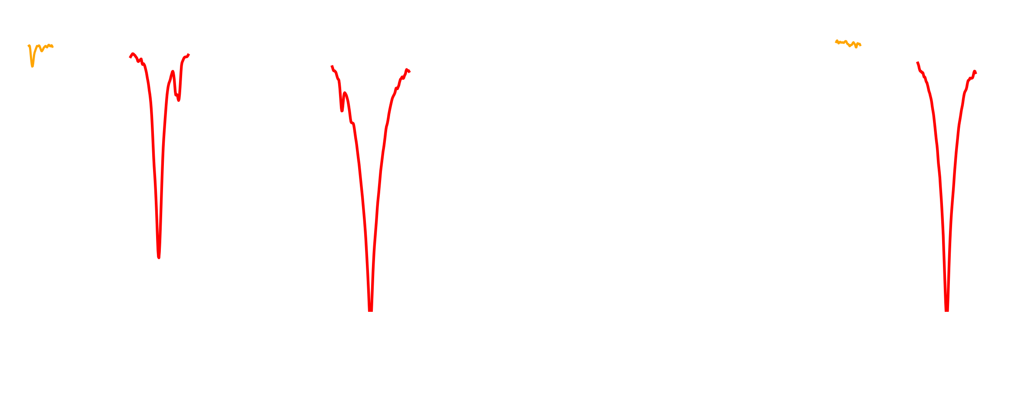
Objectives/Context
Create reliable activity indicators in the infrared !
Preparation of the spectra (continuum, model fit …)
Computation of the indicators
Analysis

Slide 6
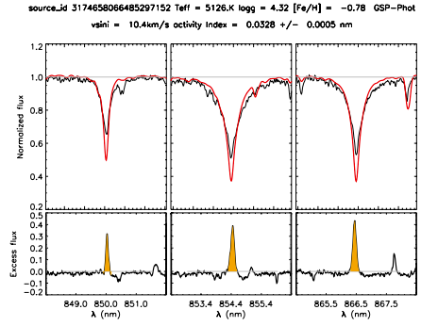
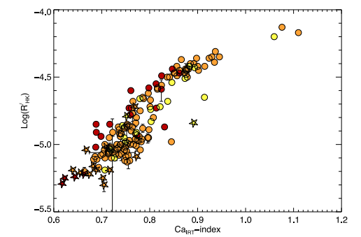
Objectives/Context
Create reliable activity indicators in the infrared !
Lanzafame et al , 2023
Marsden et al, 2014
No systematic work done in the litterature on time series/correlations for individual stars
Large scale study of stellar activity with Gaia DR4 : Study Ca IRT variability for a large sample of stars

Slide 7

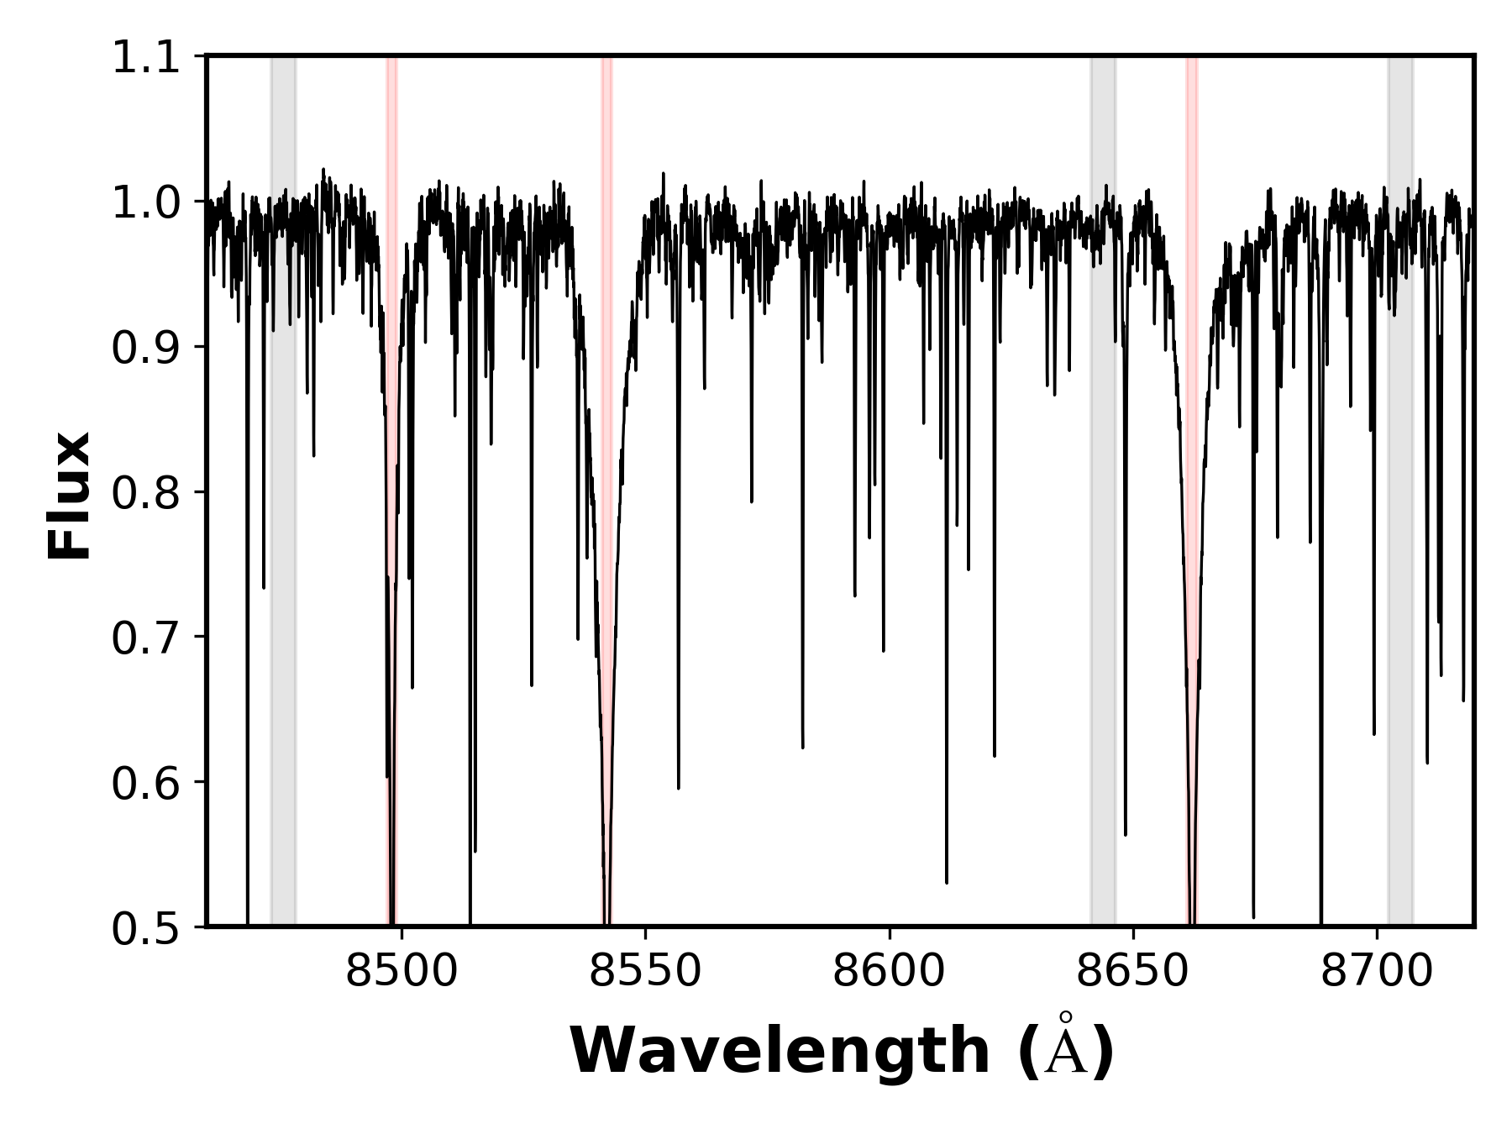








CA-IRT index : S index-like indicator in the red
≈ S-index without corrections for photospheric contribution nor bolometric flux.
$$F_{V_{IRT}}$$
$$F_{8498}$$
$$F_{8542}$$
$$F_{8662}$$
$$F_{R_{IRT}}$$
Marsden et al. 2014
$$CA IRT ⅈndⅇx=\frac{F_{8498}+F_{8542}+F_{8662}}{F_{V_{IRT}}+F_{R_{IRT}}}$$
Indicator in the red
S index method
No correction for photospheric contribution

Slide 8




α-indice : substraction of LTE models
Indicator in the red
Difference model/obs
Compares observed spectrum with an LTE inactive star model. Detects excess chromospheric emission in Ca II IRT lines.
Value of the α-index
$$α≡\int_{−Δλ}^{+Δλ}{\left(\frac{r_{λ}^{obs}}{r_{λ}^{model}}−1\right)ⅆλ}$$
Correction for photospheric contribution
Lanzafame and al , 2023

Slide 9

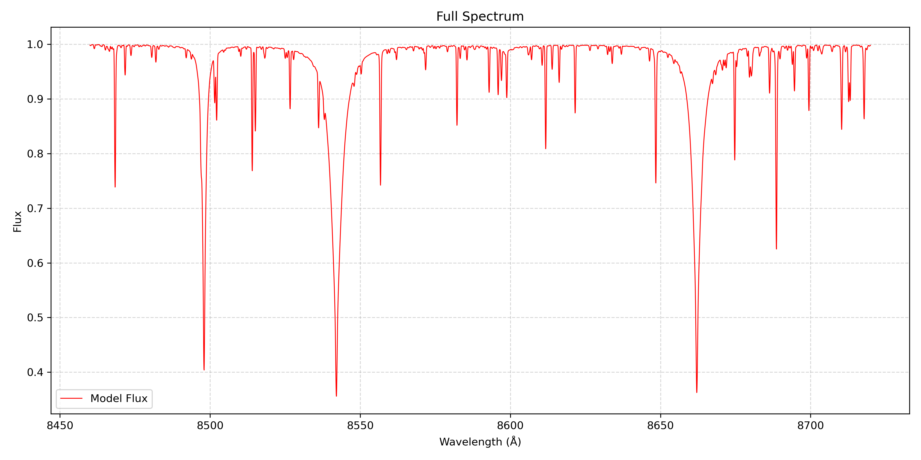
Model grid used for α Index : MARCS
LTE models of inactive stars
4 fundamentals parameters for the models :
Teff
Effective Temperature
log g
Surface gravity
[Fe/H]
Metallicity
[alpha/Fe]
Chemical Index
ℹ️ Based on MARCS model grid (P. de Laverny, A. Recio-Blanco)

Slide 10
T I M E L I N E
NARVAL/ESPaDOnS
Plato
2022
2026
< 2019
2027
Gaia DR3
Gaia DR4

Slide 11

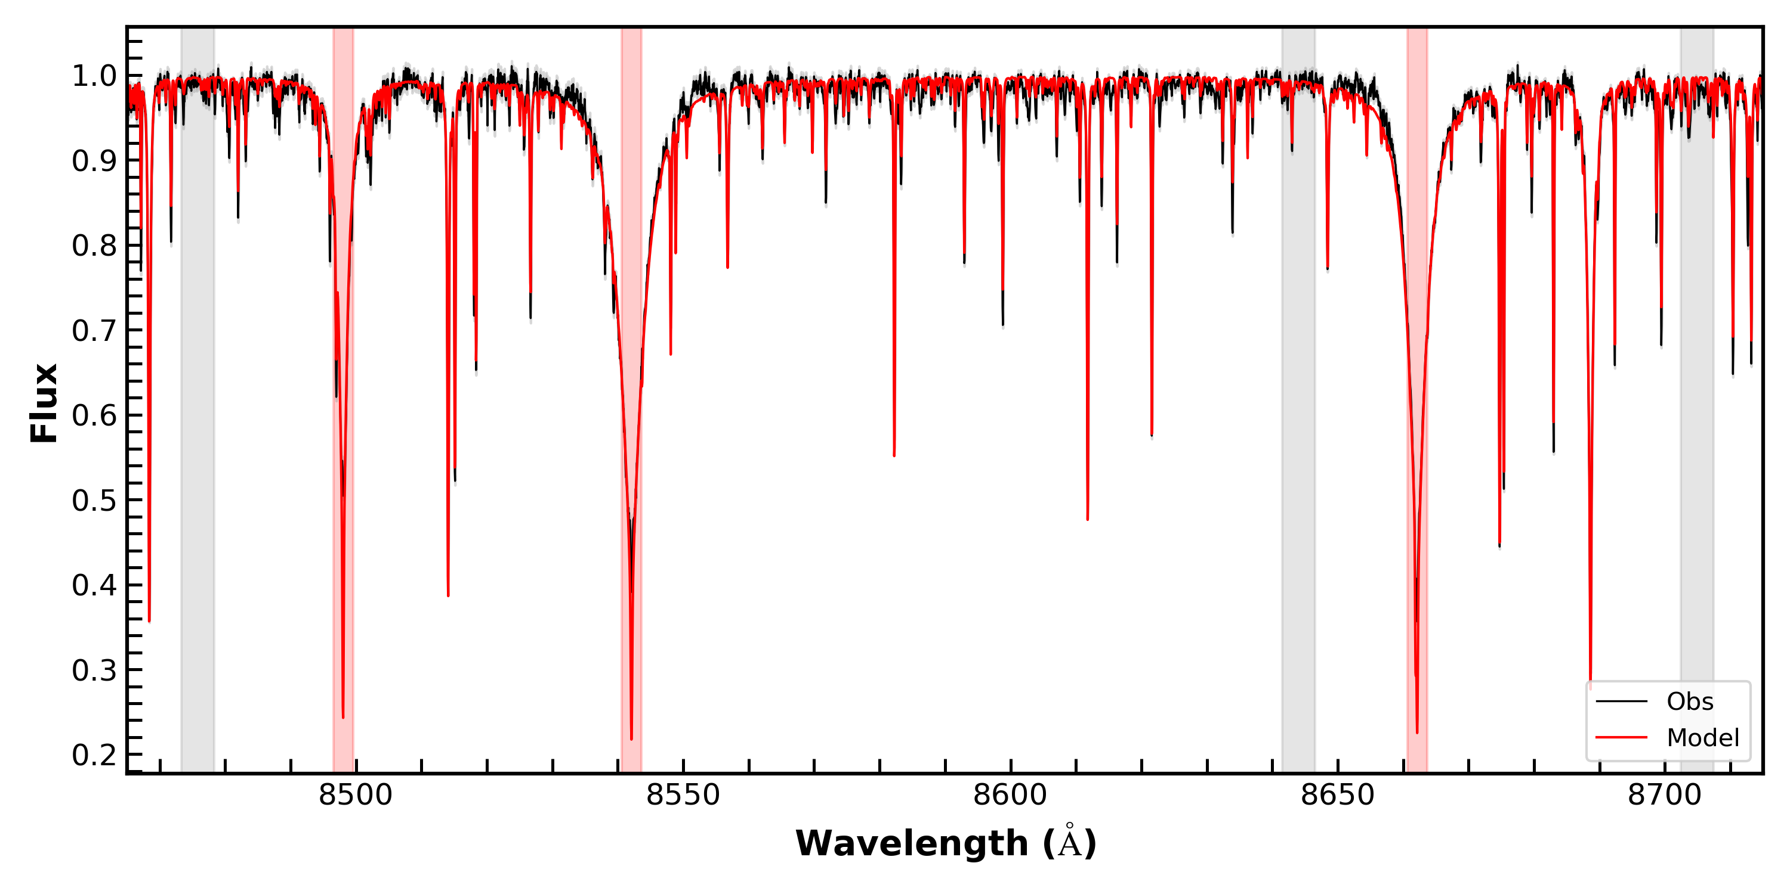

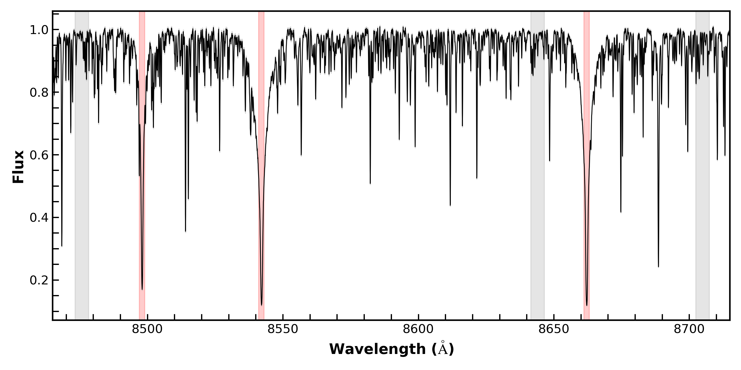
Continuum fixed by RASSINE, Cretignier et al. 2020b
One Spectrum, three activity indicators
NARVAL/ESPaDOnS
α-indice
Covers both blue and red wavelengths
  All indices from one spectrum
Spectra available for each observation
  Study time variations
CA IRT
Log R’HK
Not possible on Gaia’s spectra due to limited wavelength coverage
Gaia DR3 provides averaged spectra only
Same spectrum, three indices

Slide 12
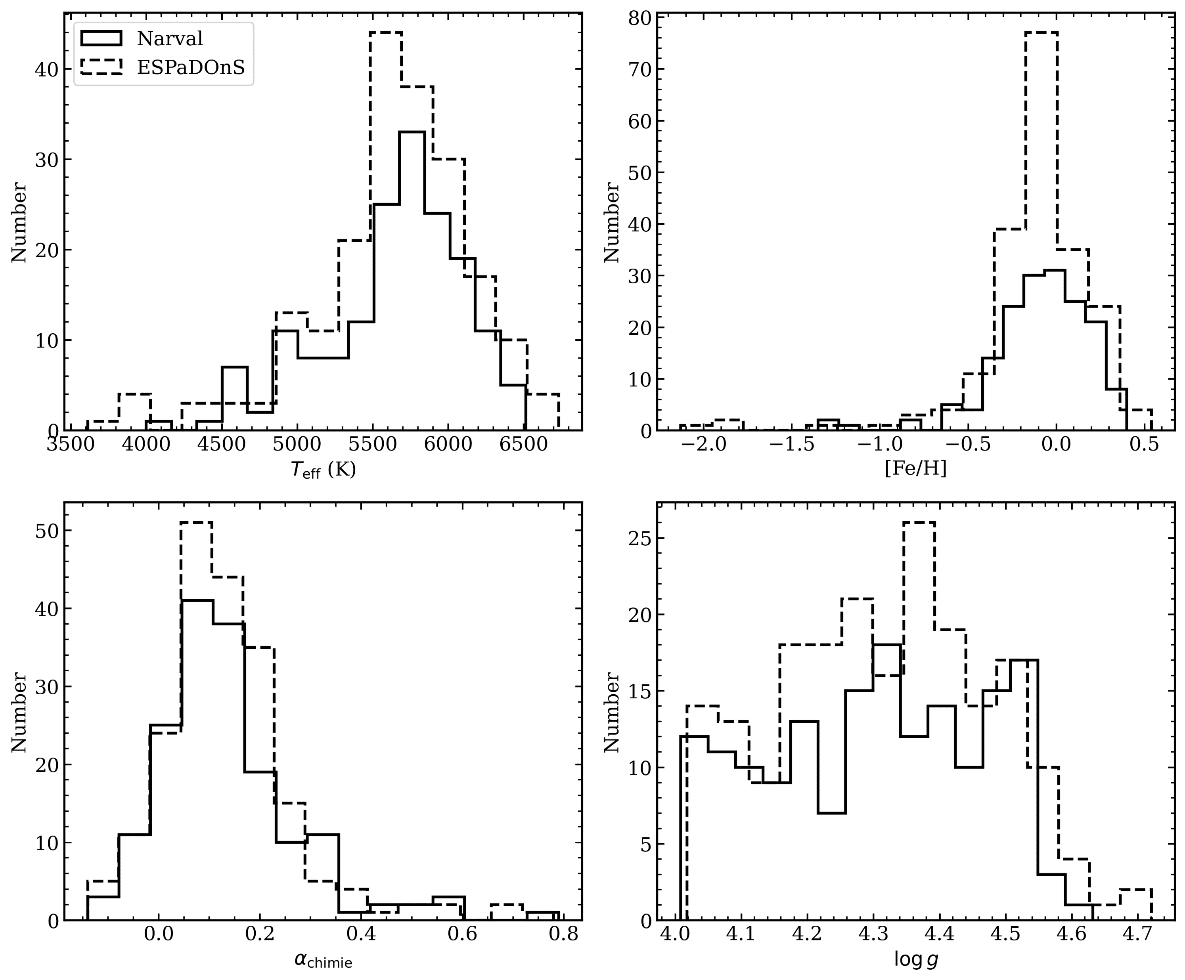
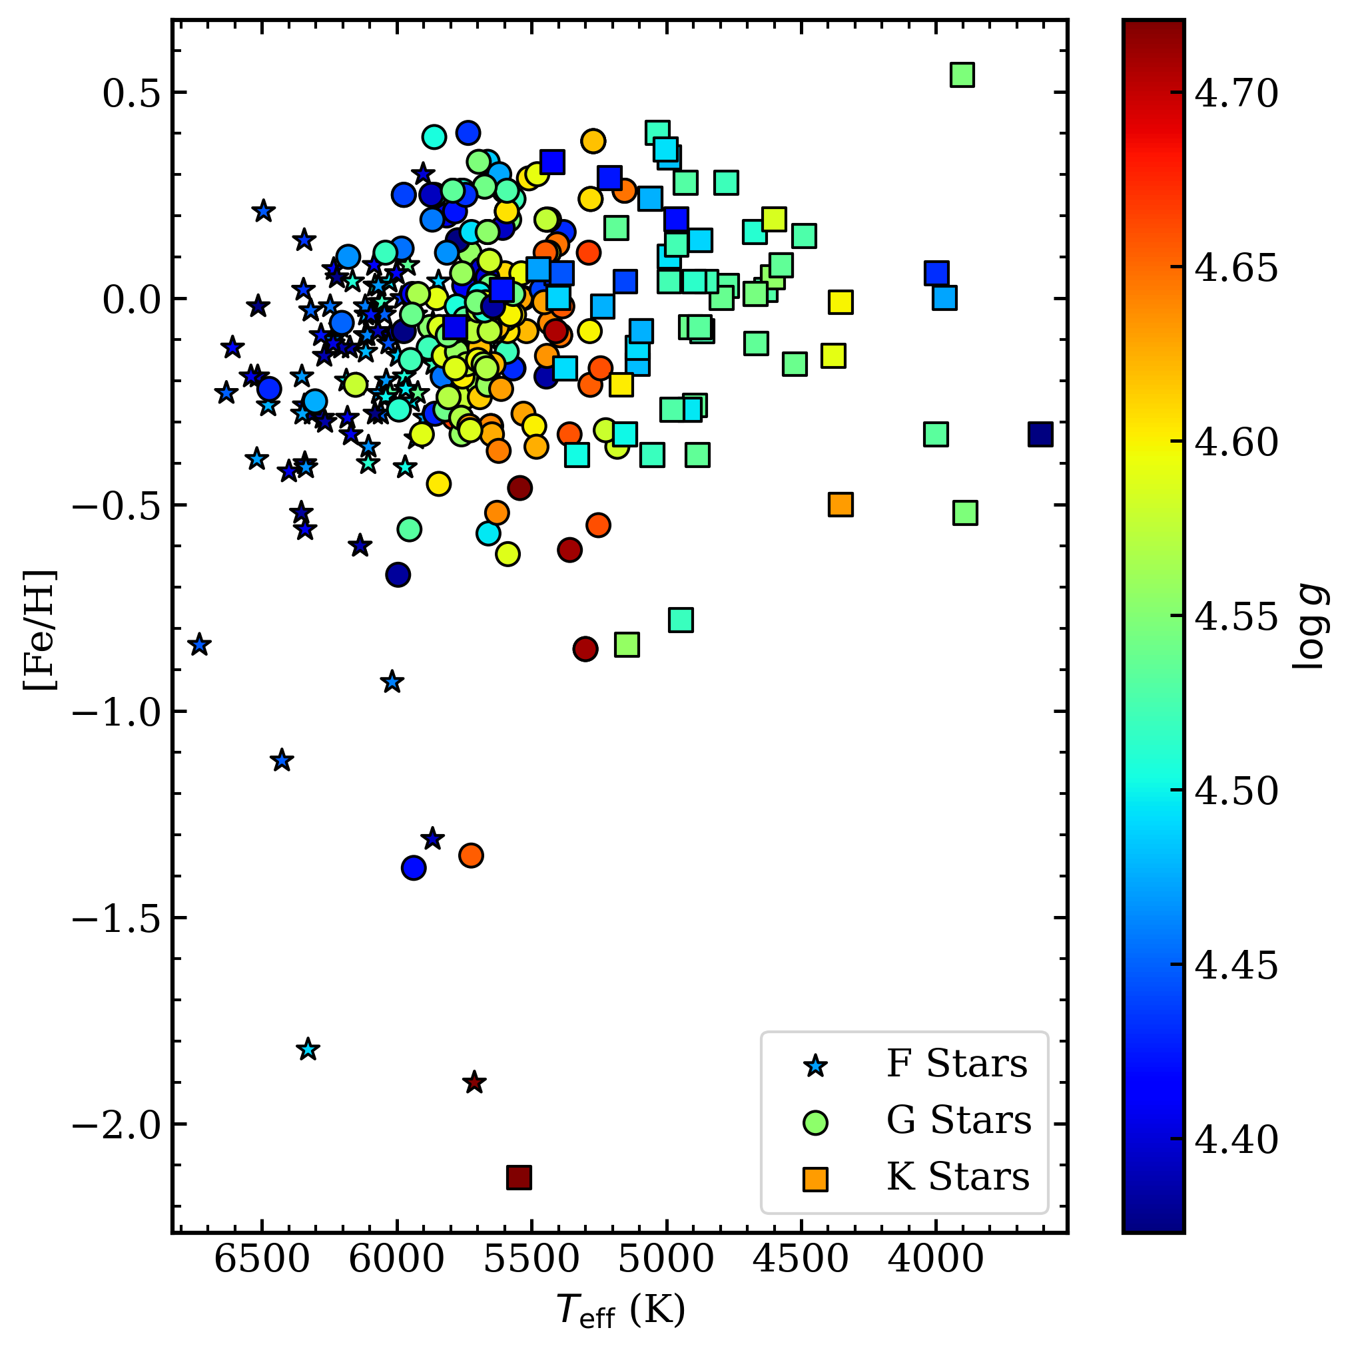
Stellar samples used for analysis : NARVAL/ESPaDOnS
⚠️ Need all four fundamental parameters available in Gaia DR3 and have a B-V value.
Bruniquel et al, in prep
NARVAL/ESPaDOnS
All Stars available (369): ★ 101 F ● 194 G ■ 74 K

Slide 13
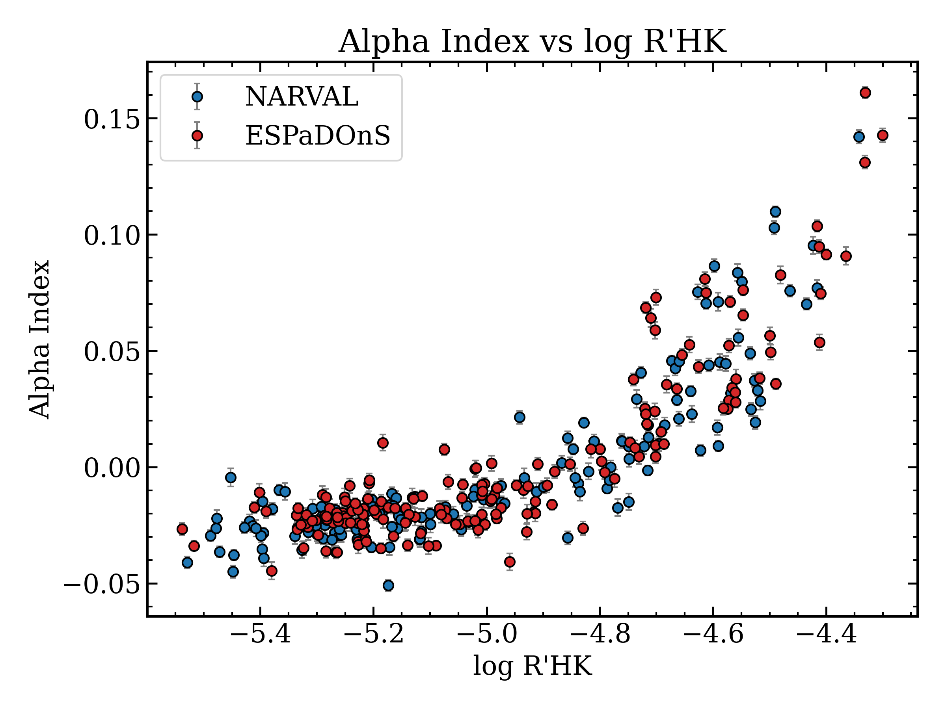
Results : NARVAL/ESPaDOnS
Bruniquel et al, in prep

Slide 14
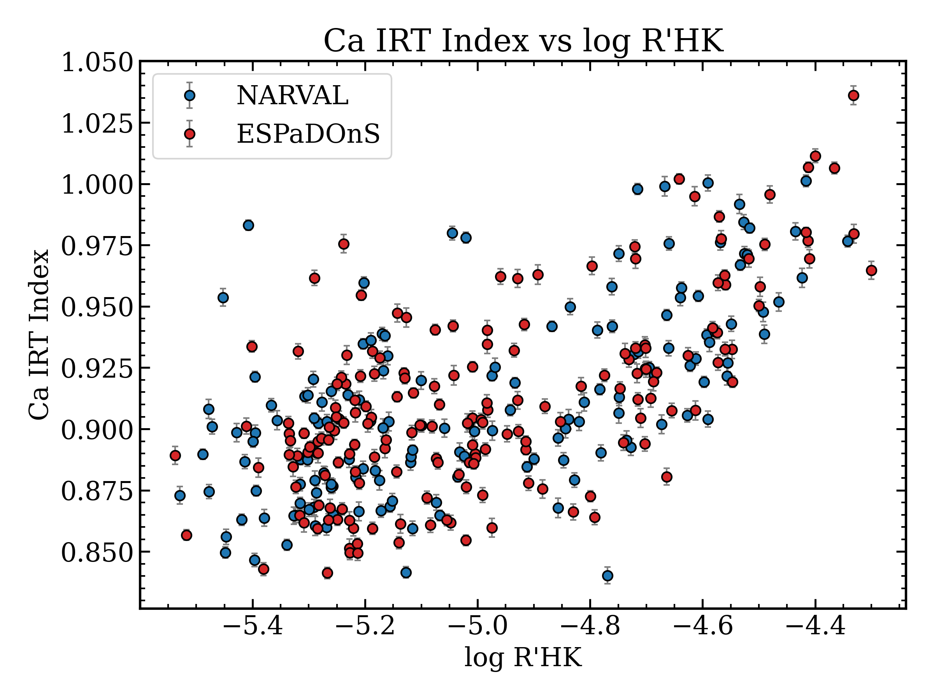
Results : NARVAL/ESPaDOnS
Bruniquel et al, in prep

Slide 15
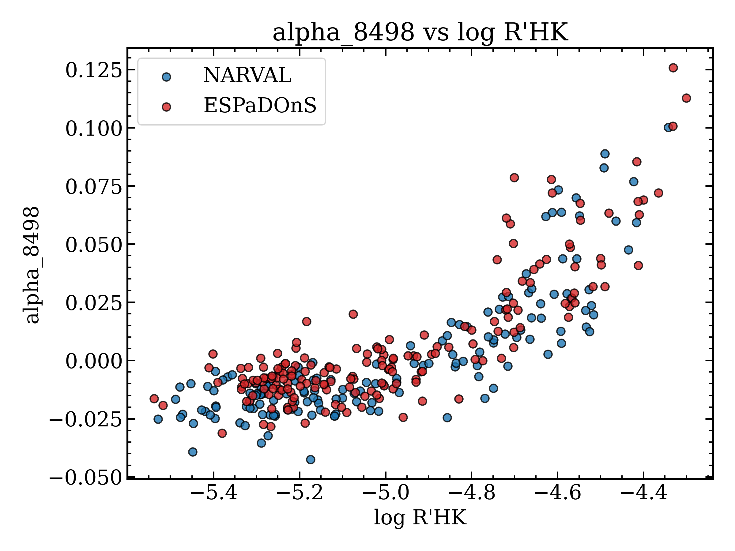
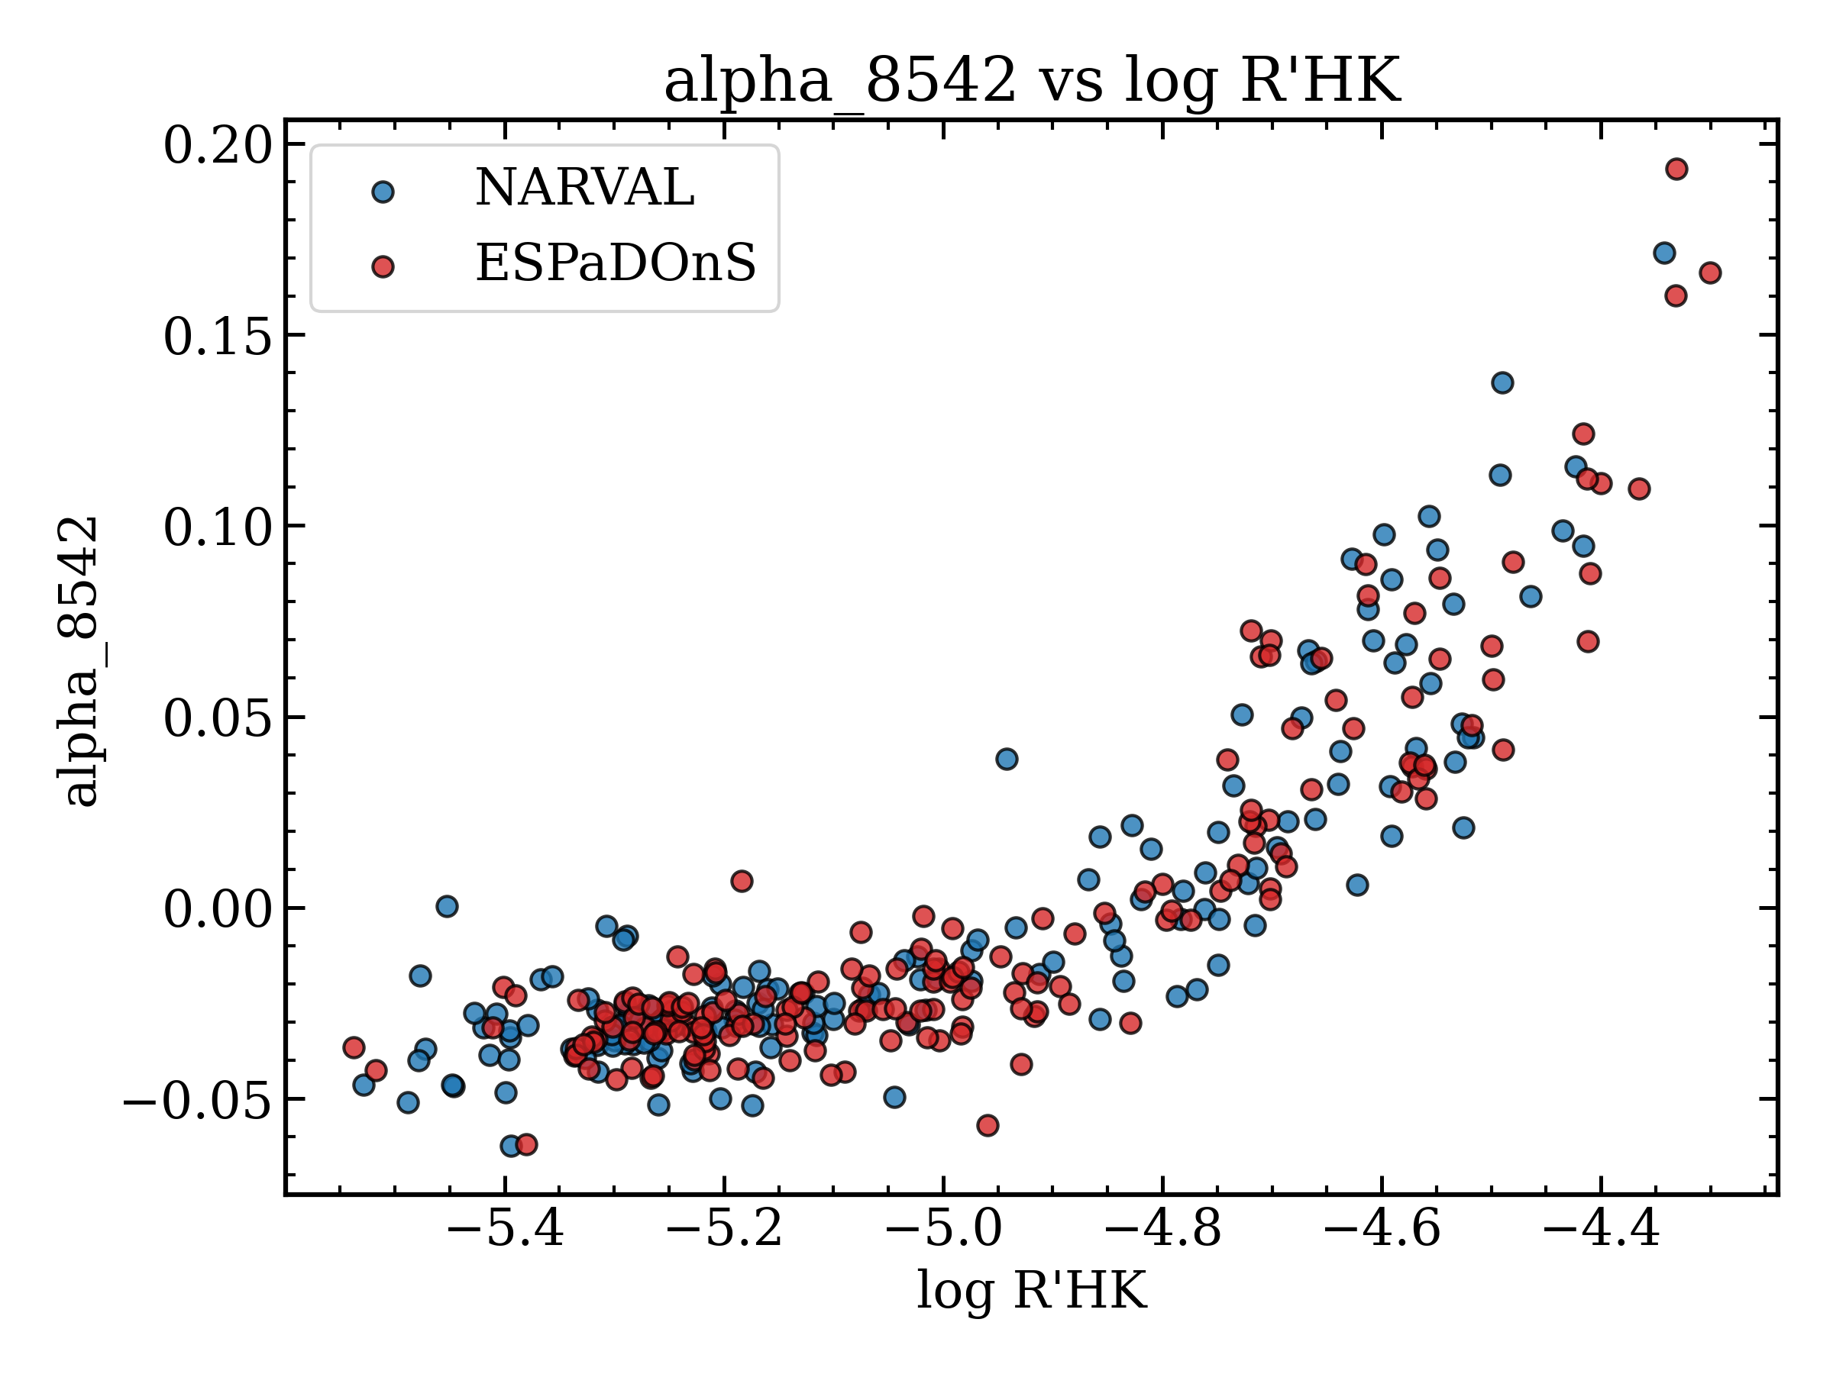
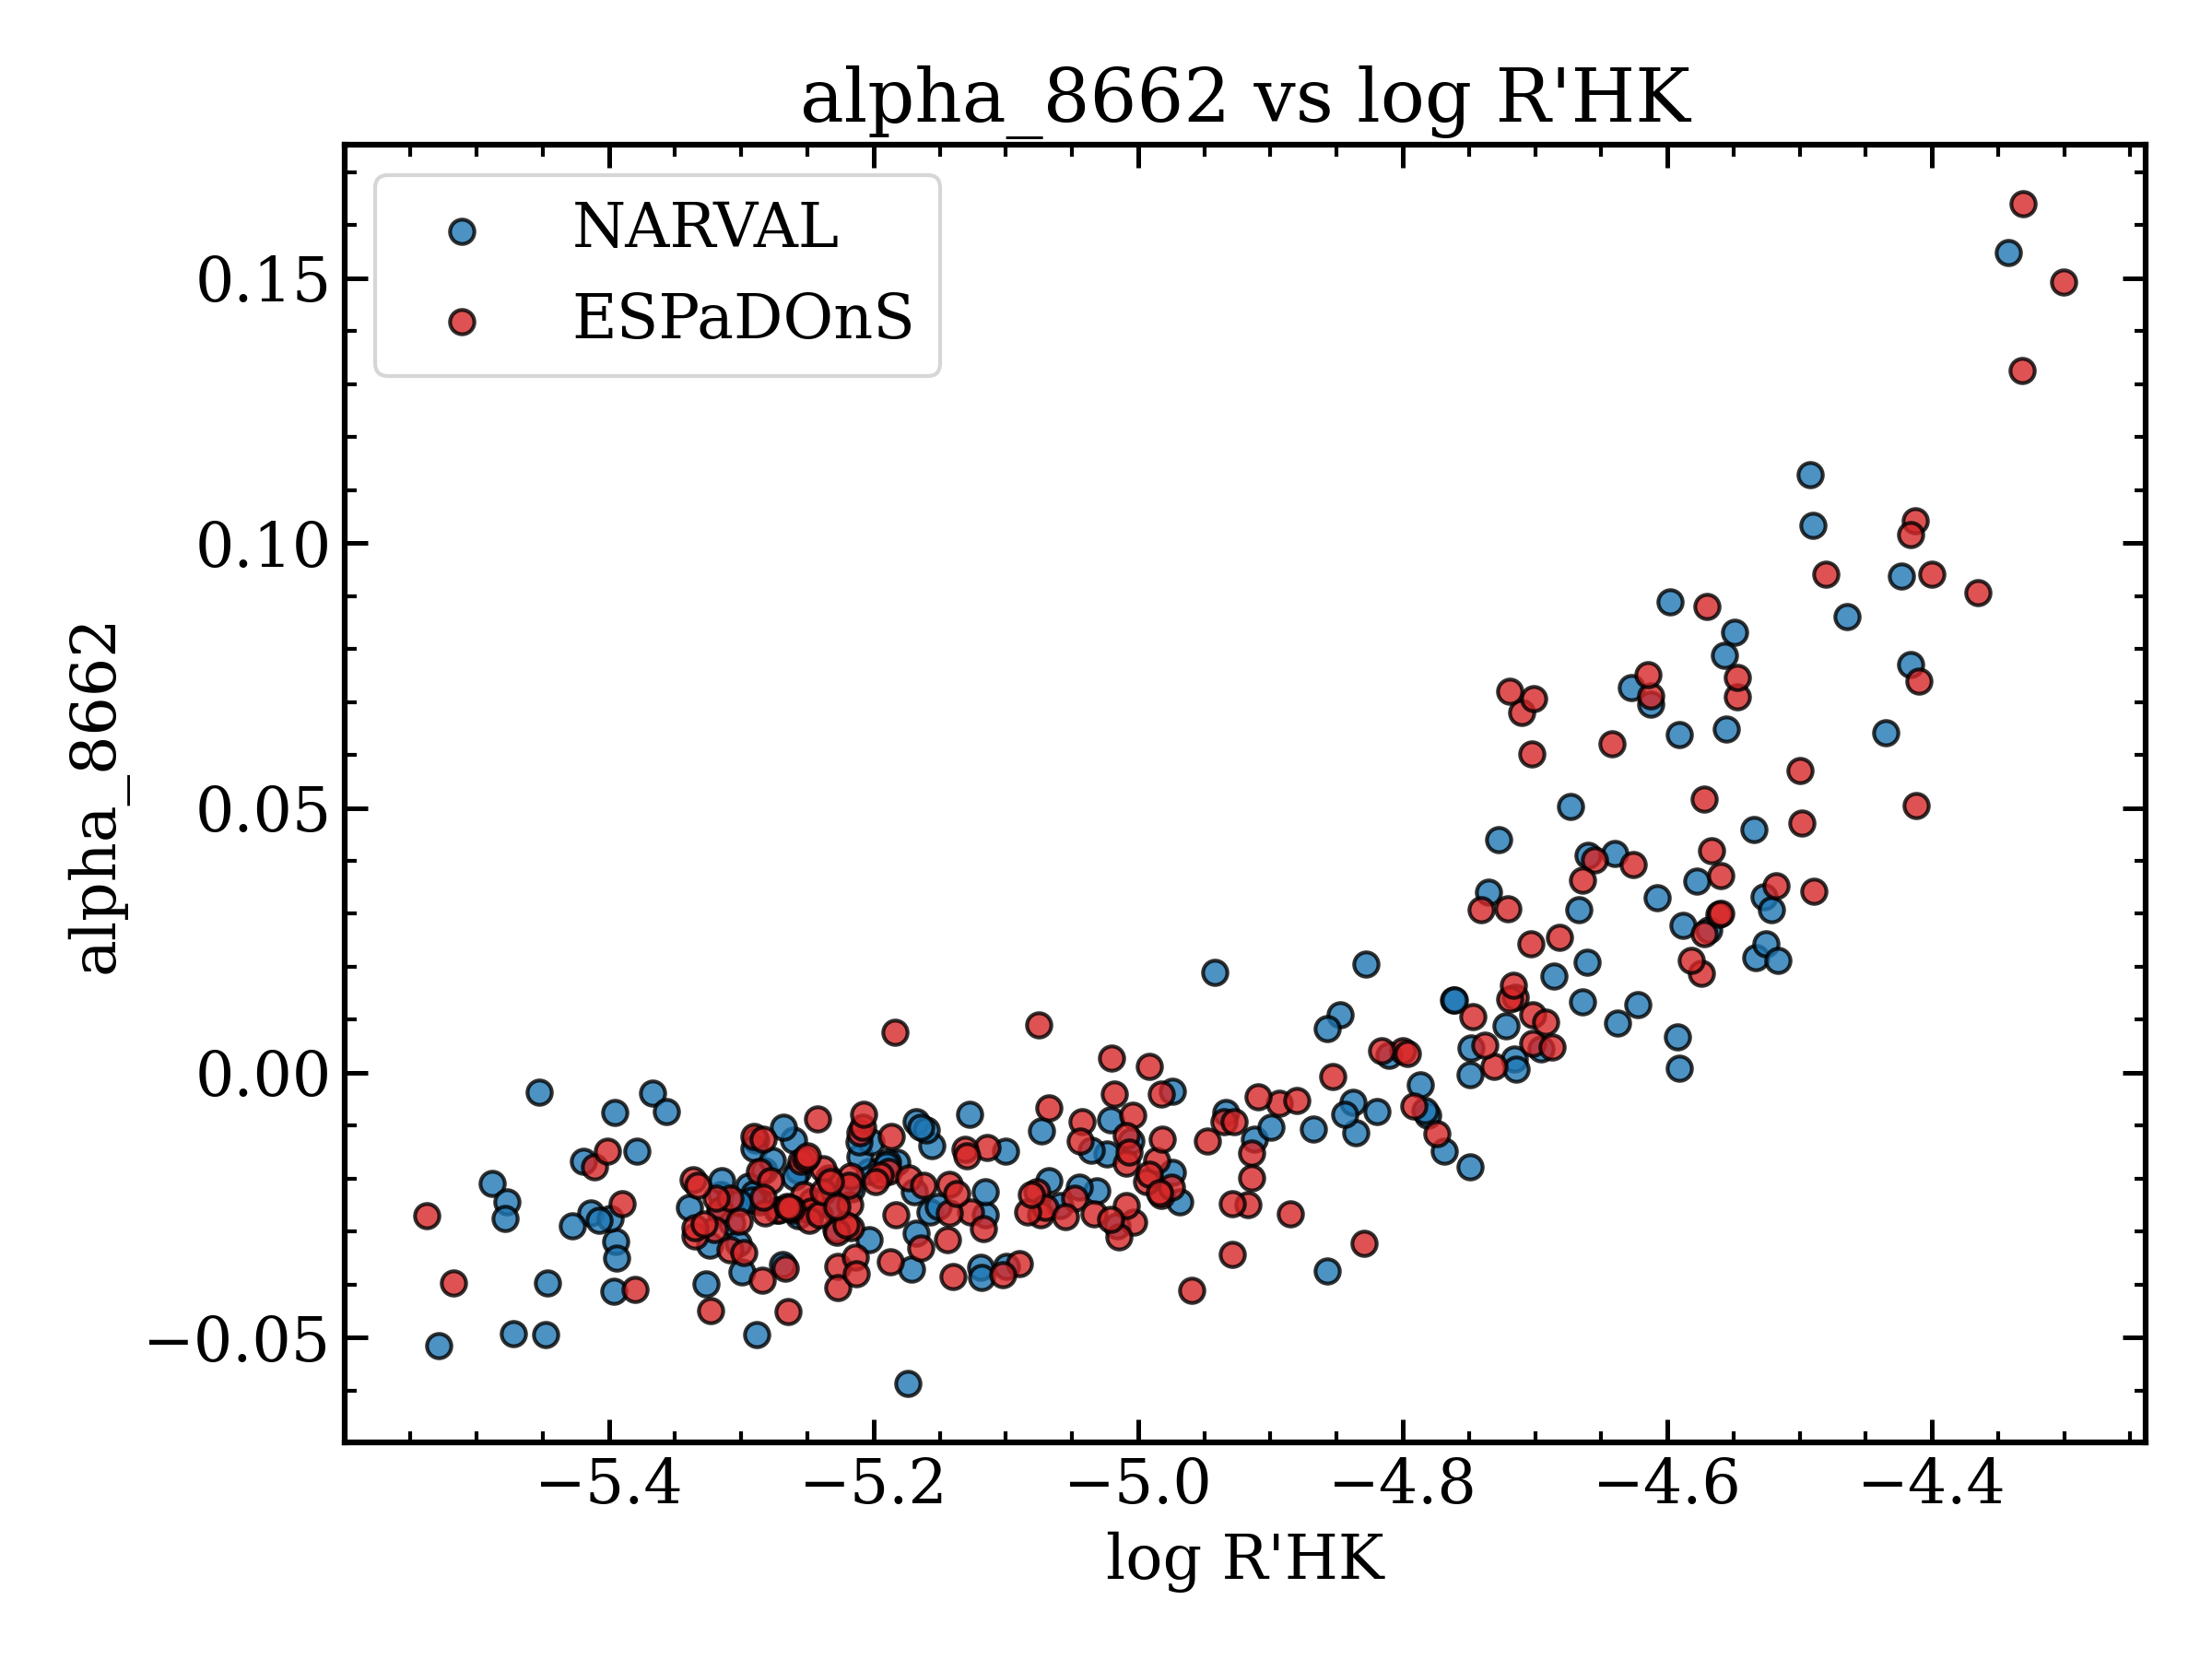
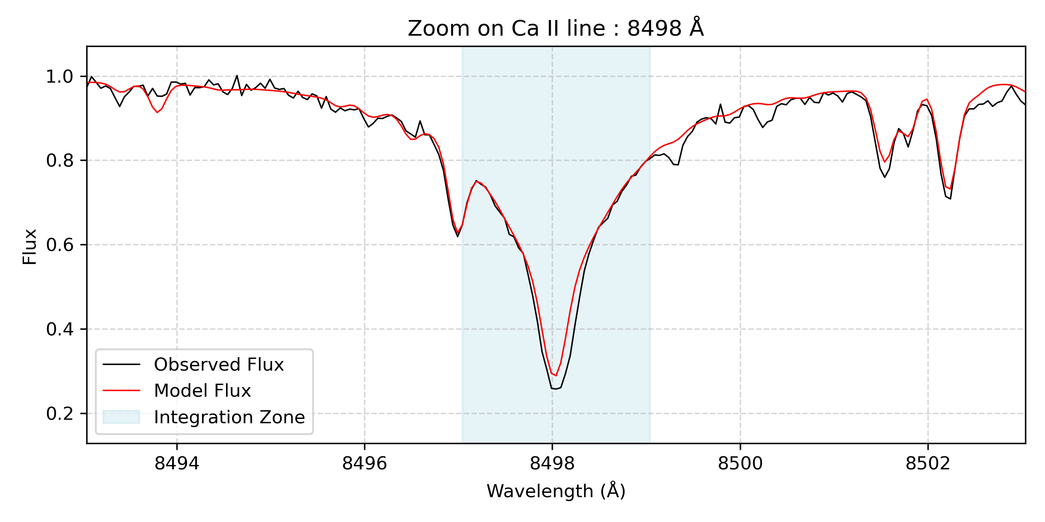
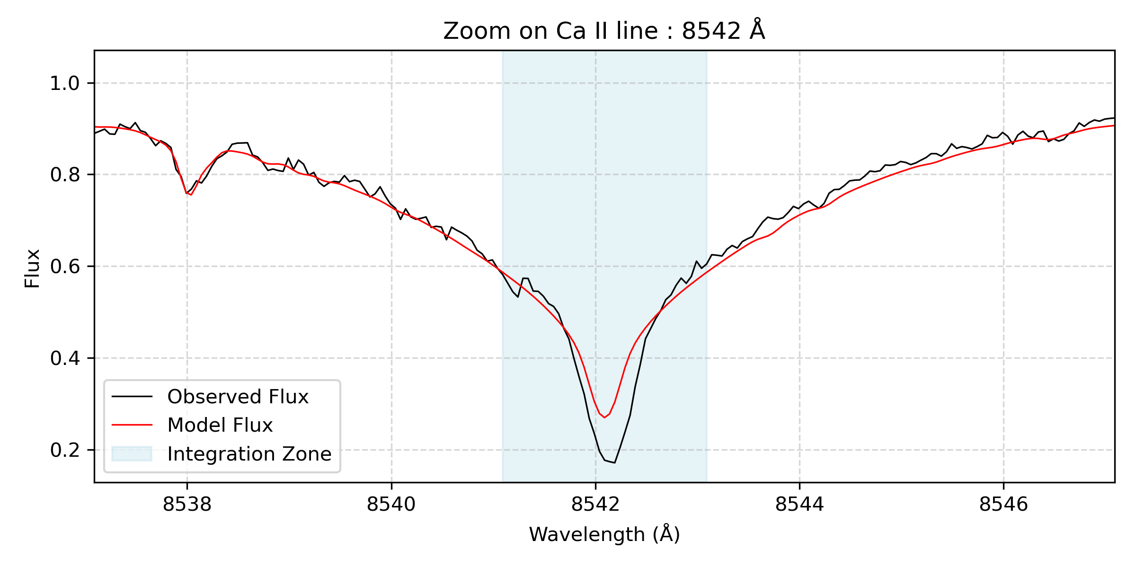
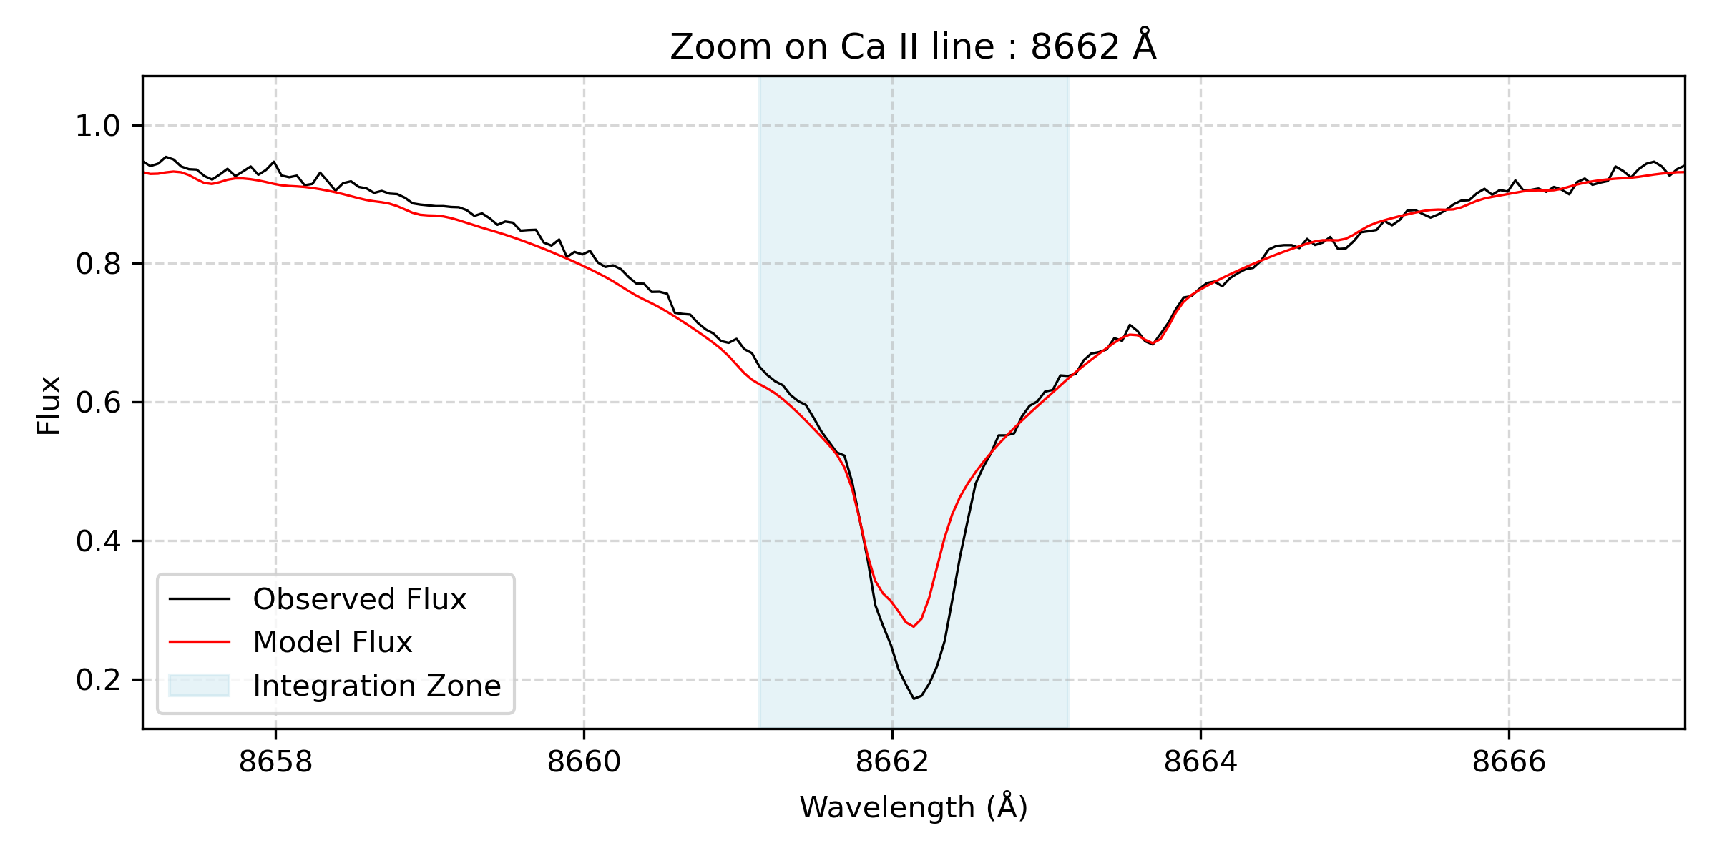
Correlation between individual Ca lines in both indicators
For the α-indice, the three lines behave almost the same

Slide 16
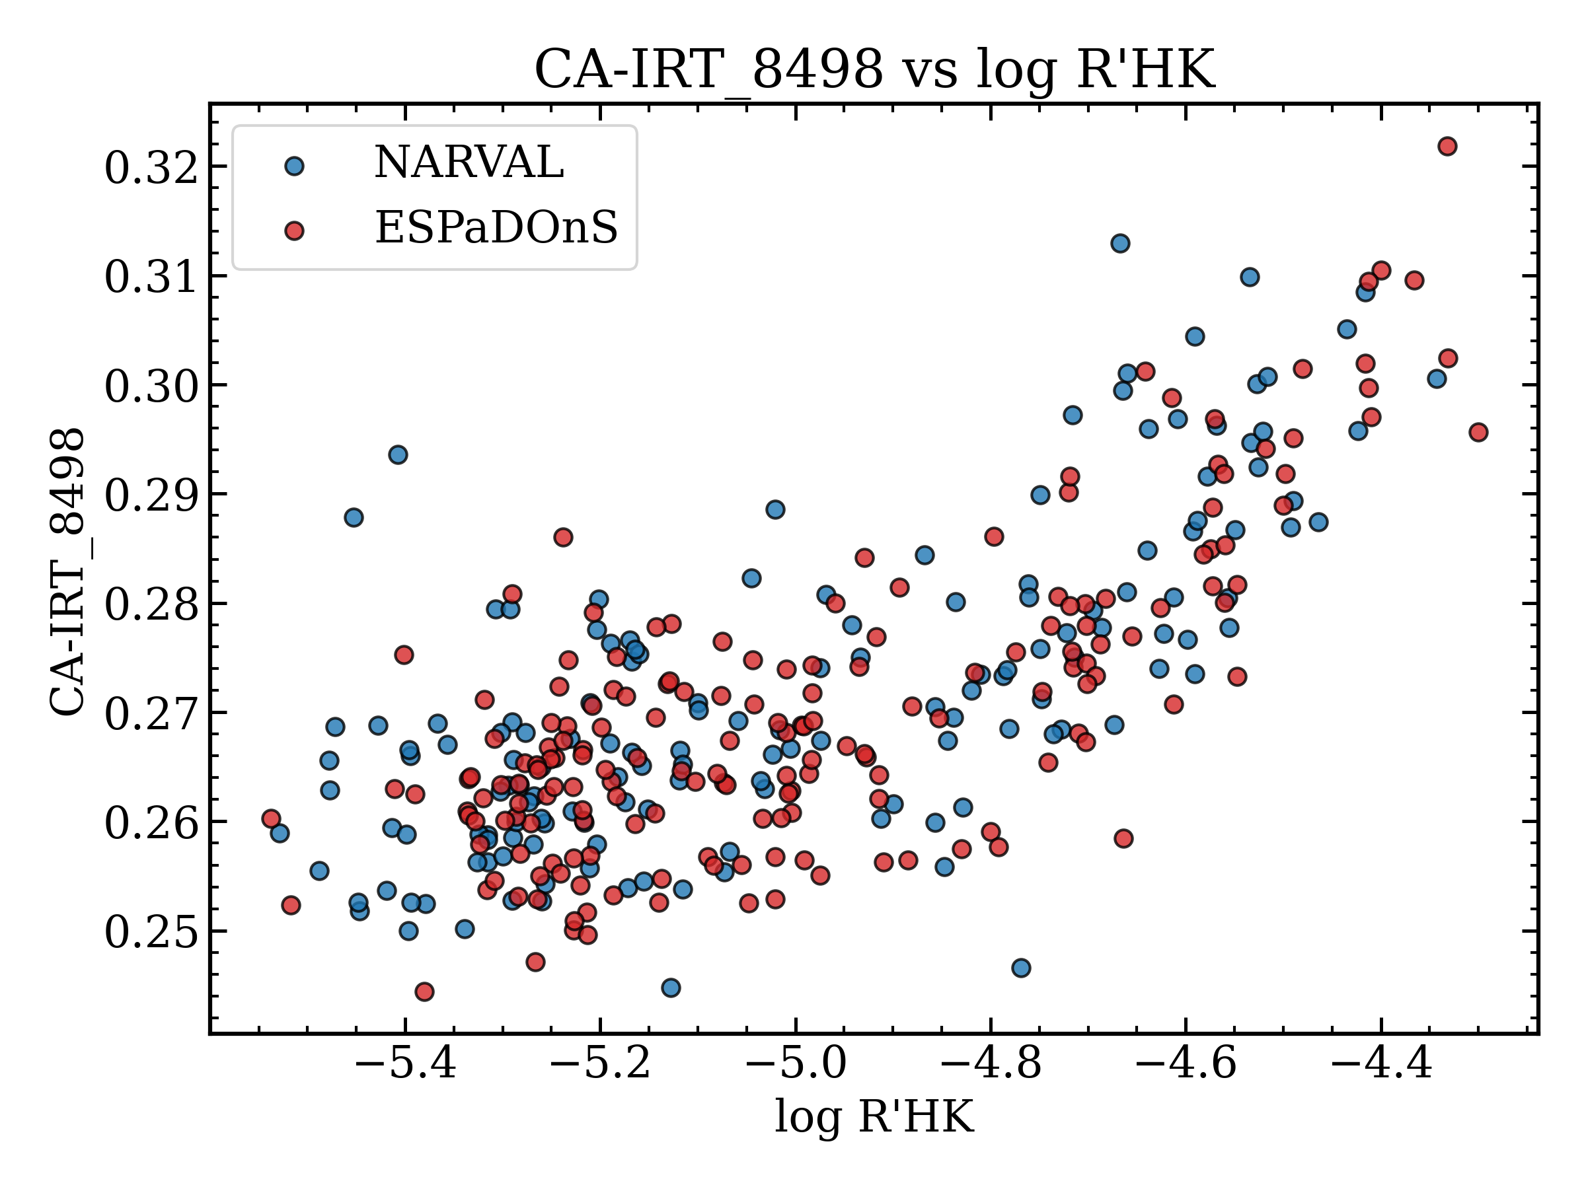
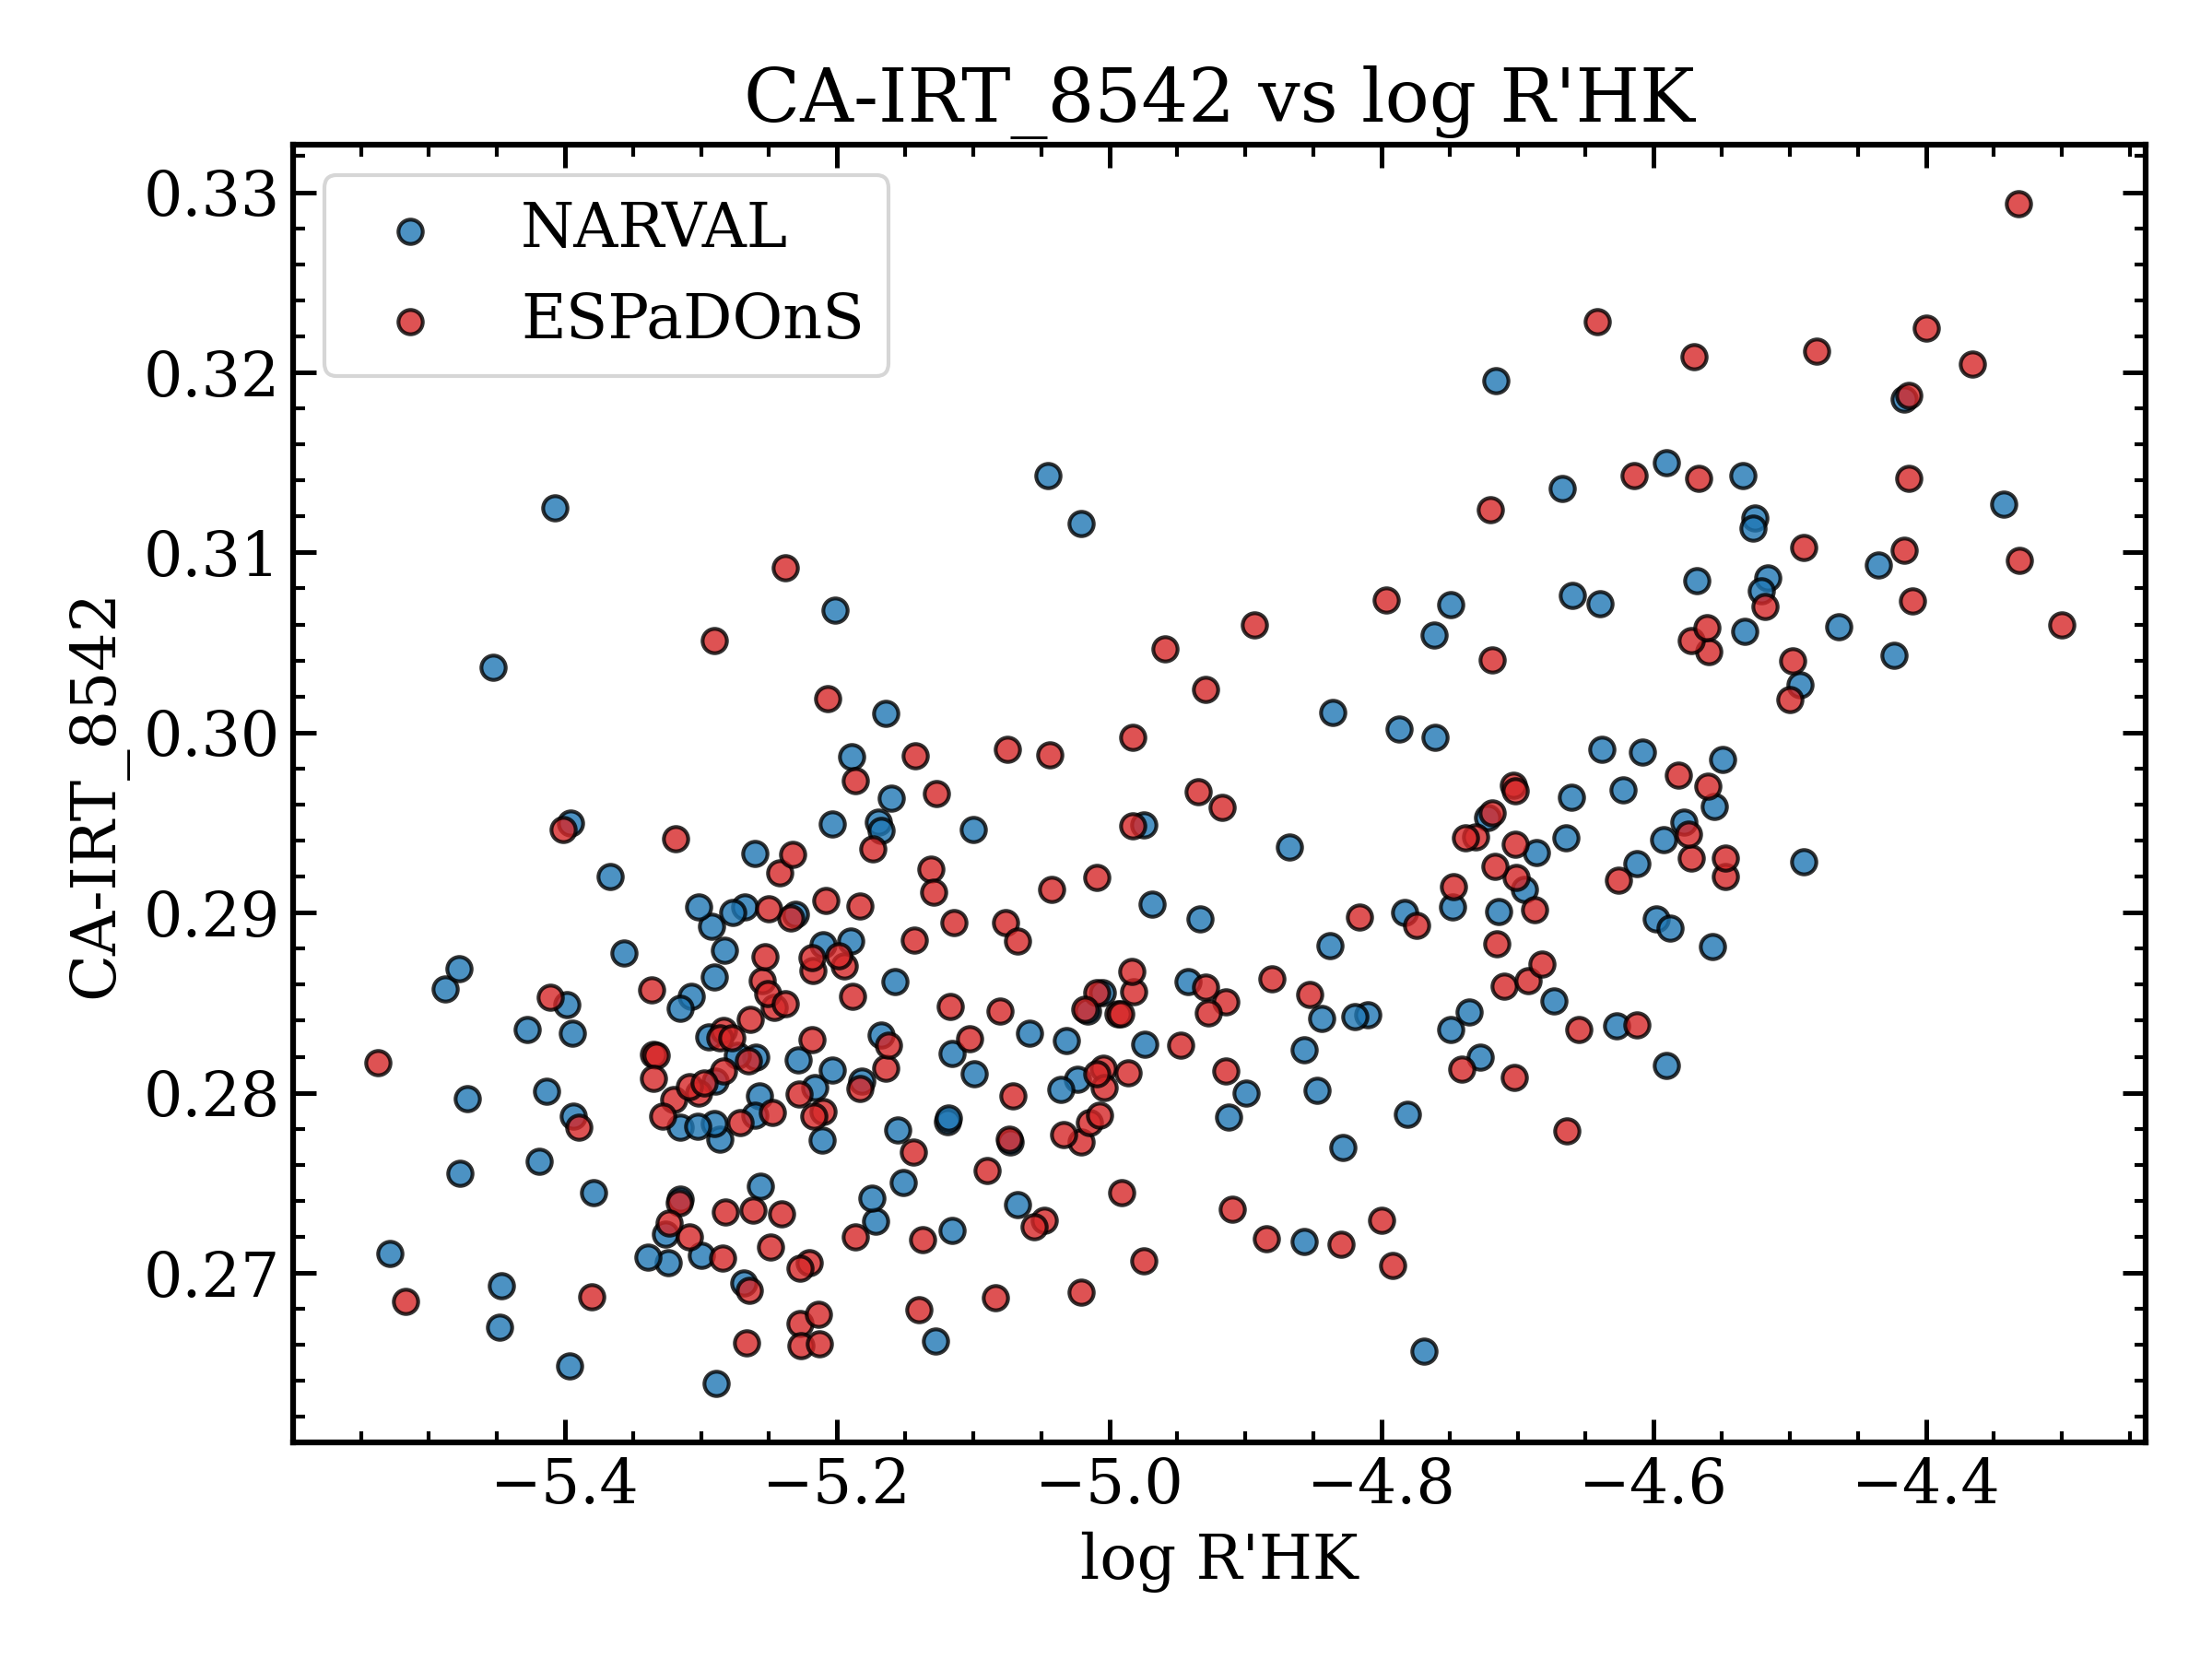
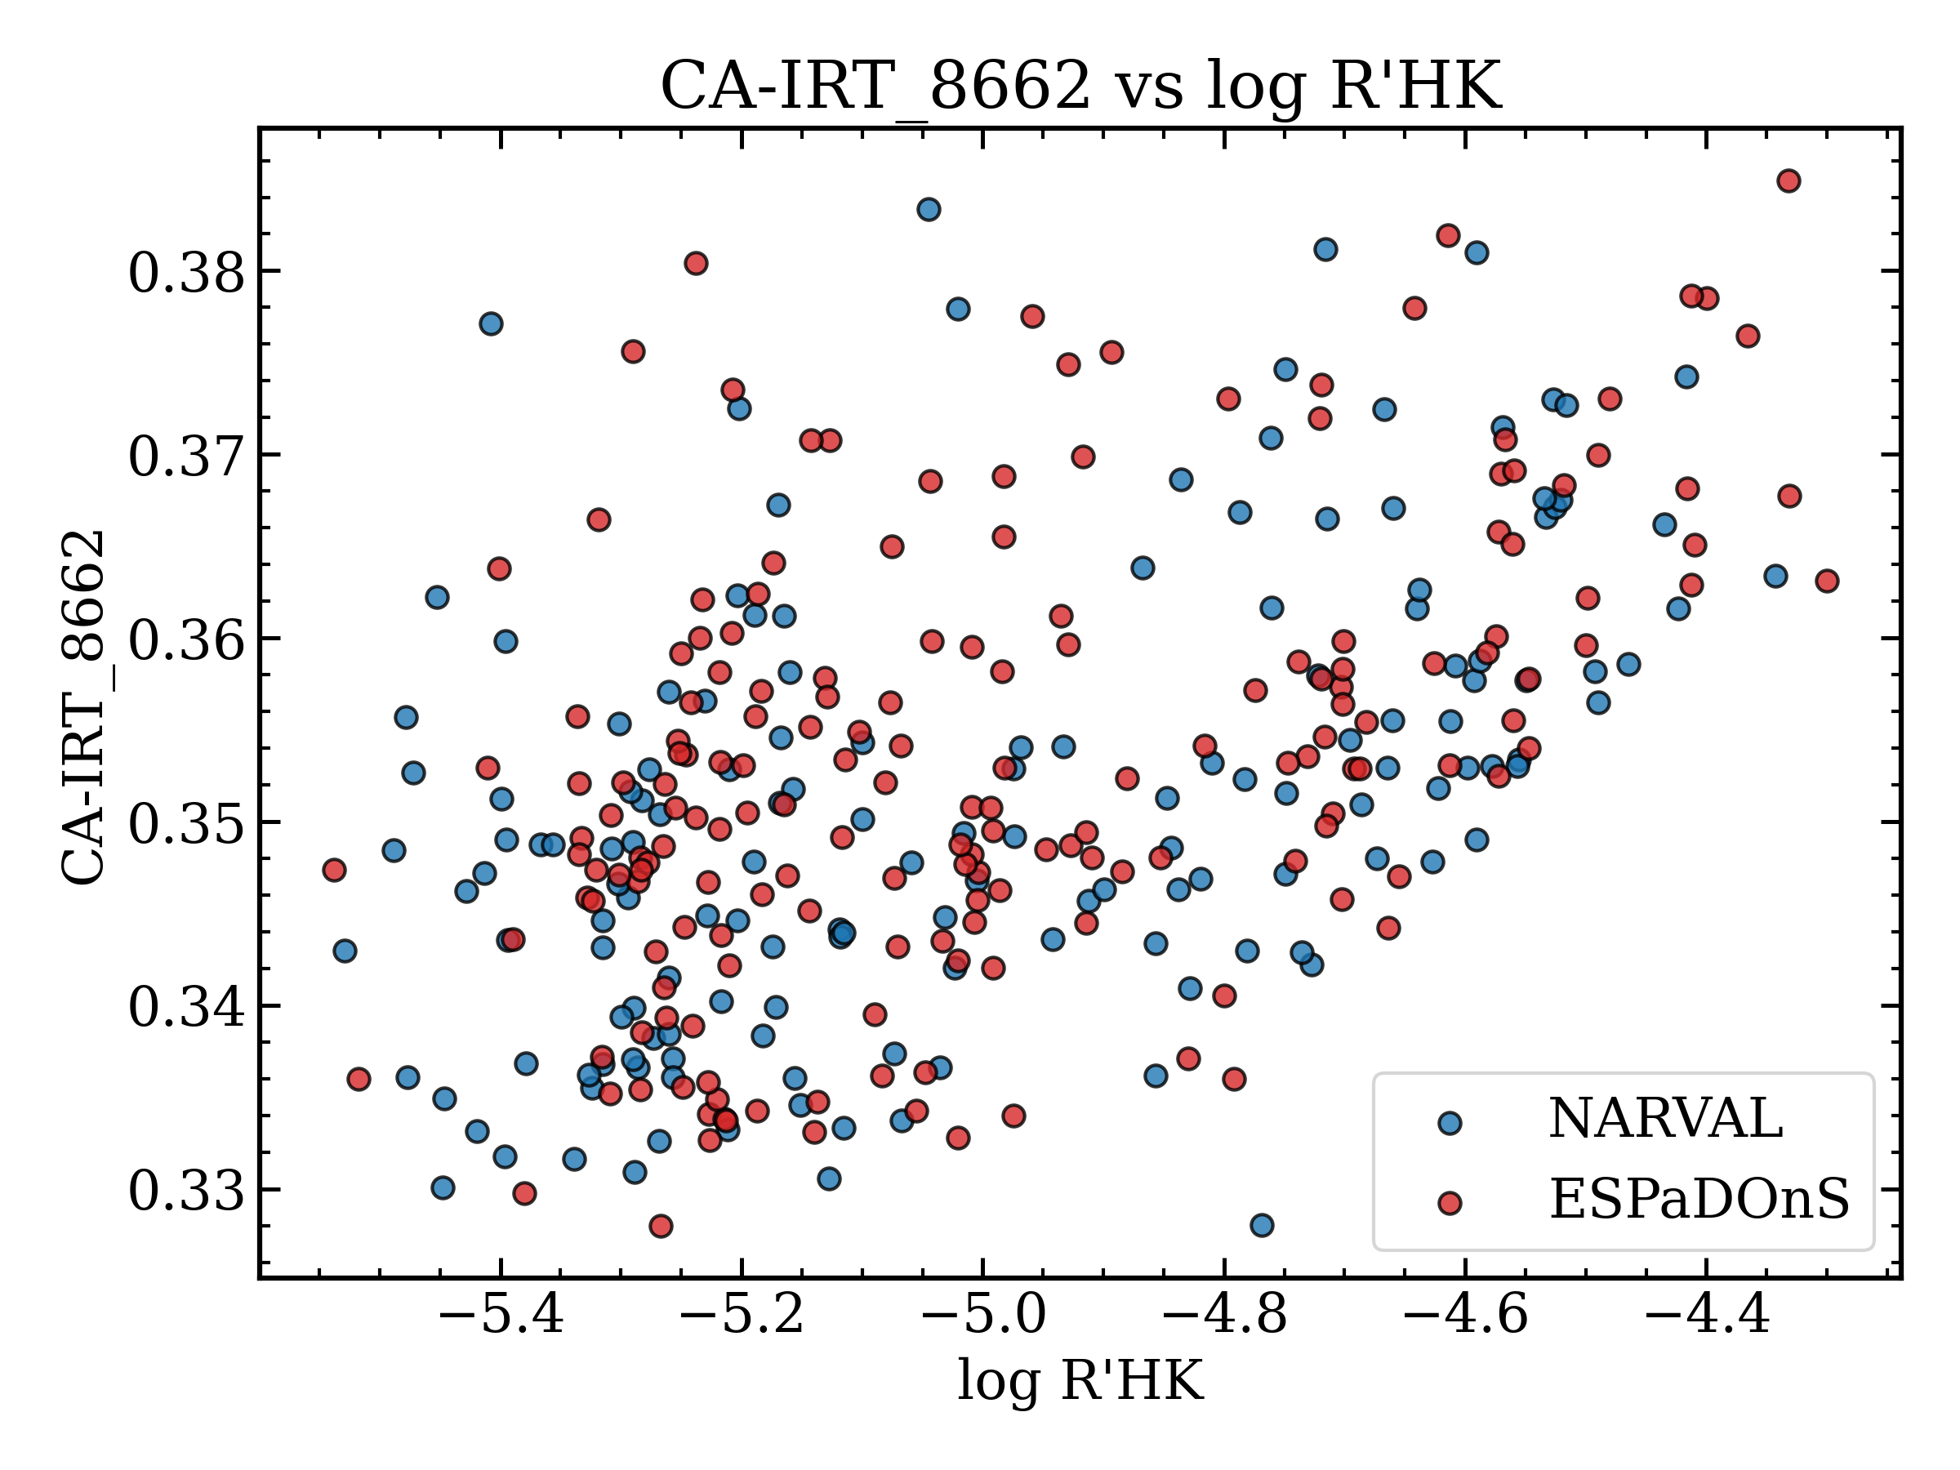
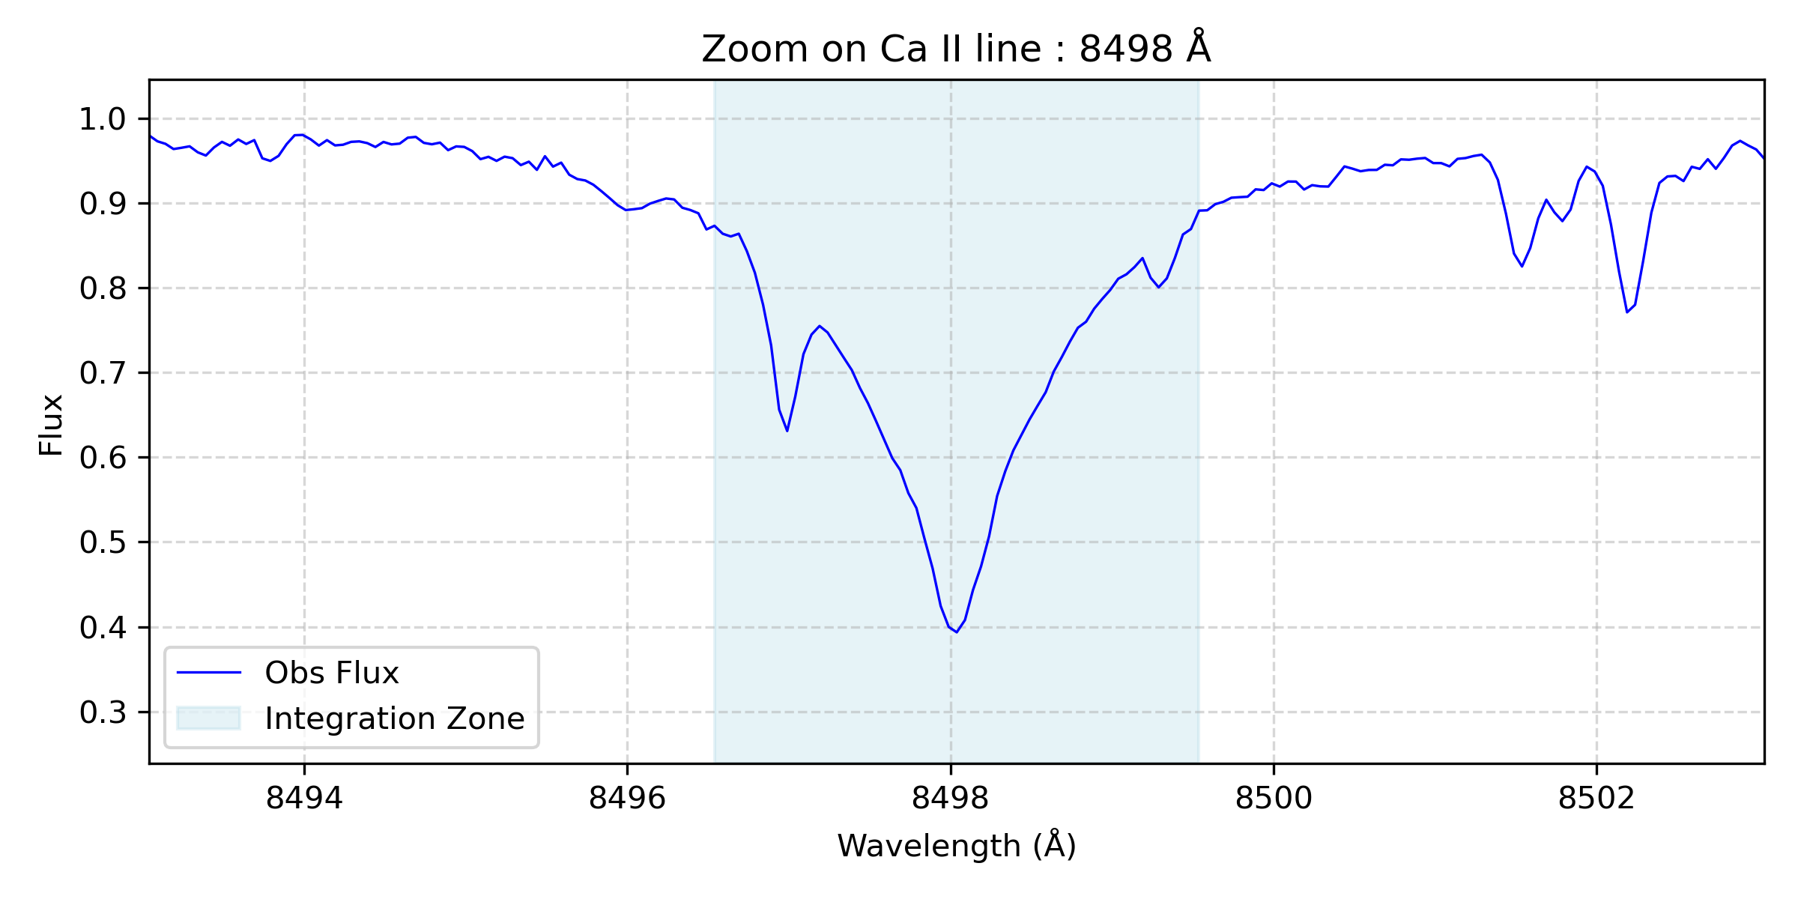
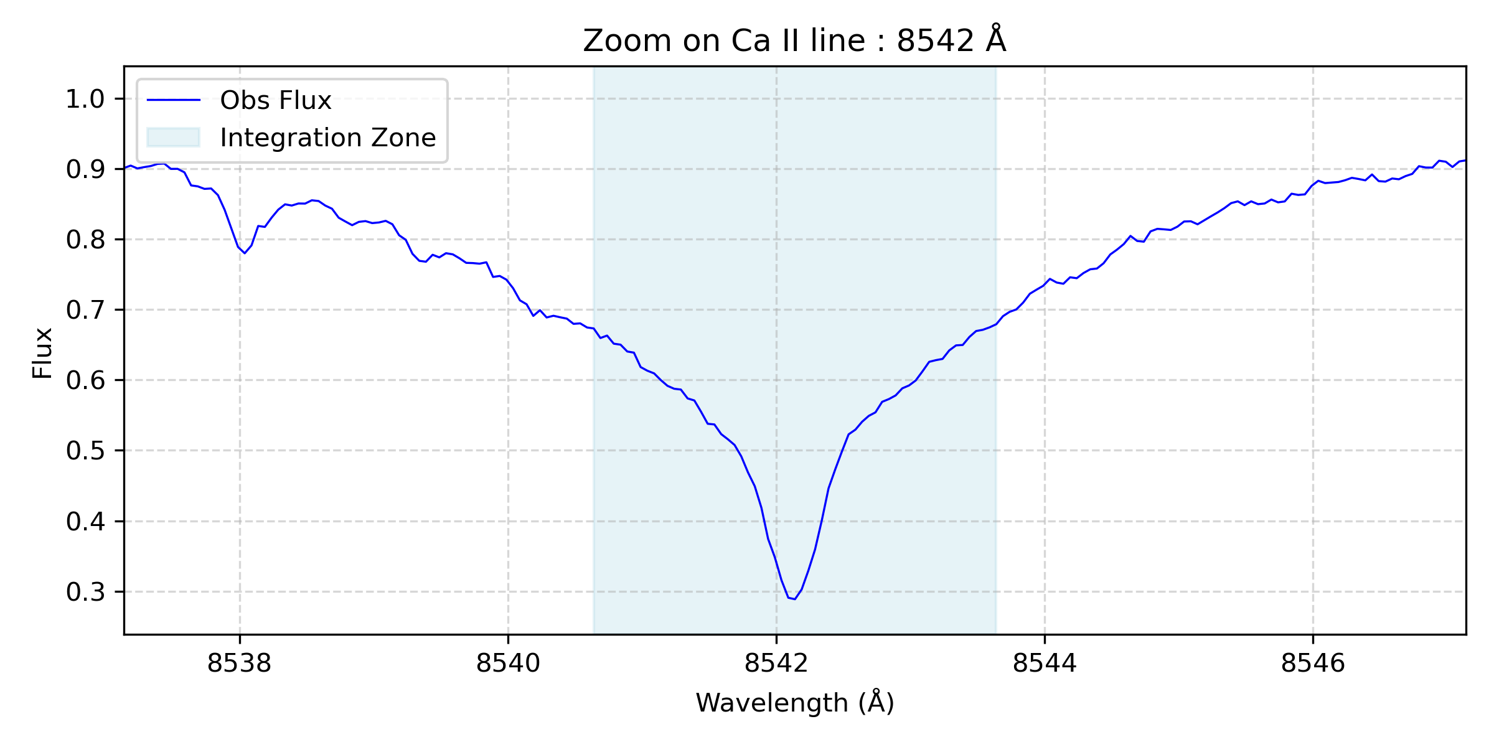
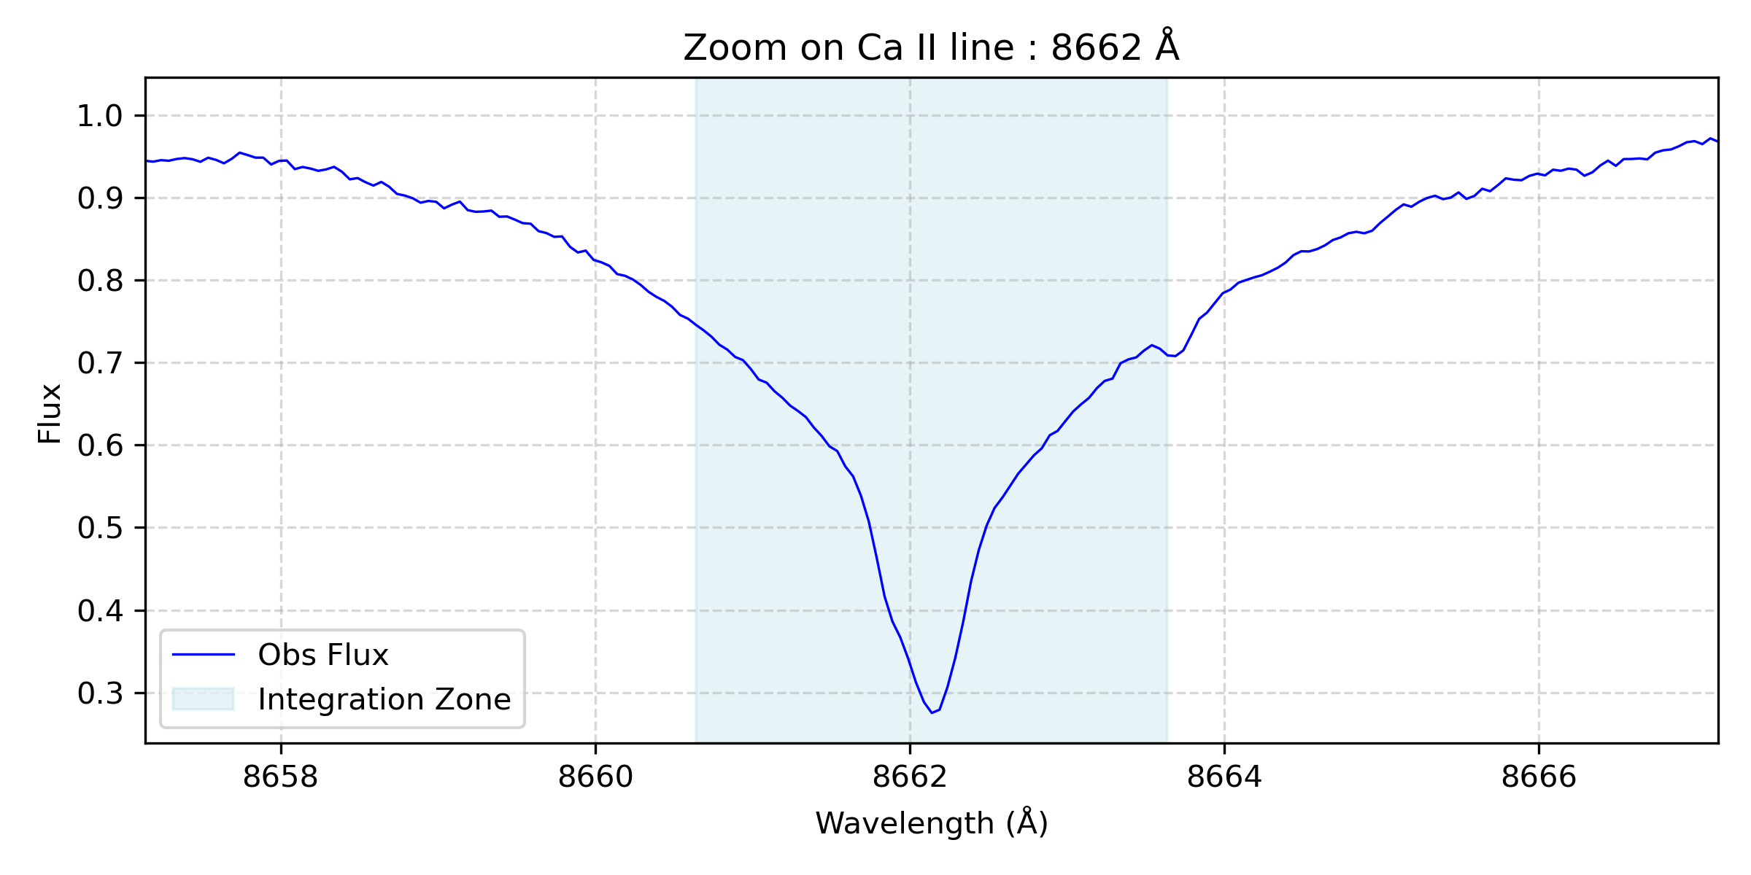
Correlation between individual Ca lines in both indicators
For the CA IRT indice, the three lines do have change in behaviors

Slide 17
T I M E L I N E
NARVAL/ESPaDOnS
Plato
2022
2026
< 2019
2027
Gaia DR3
Gaia DR4

Slide 18
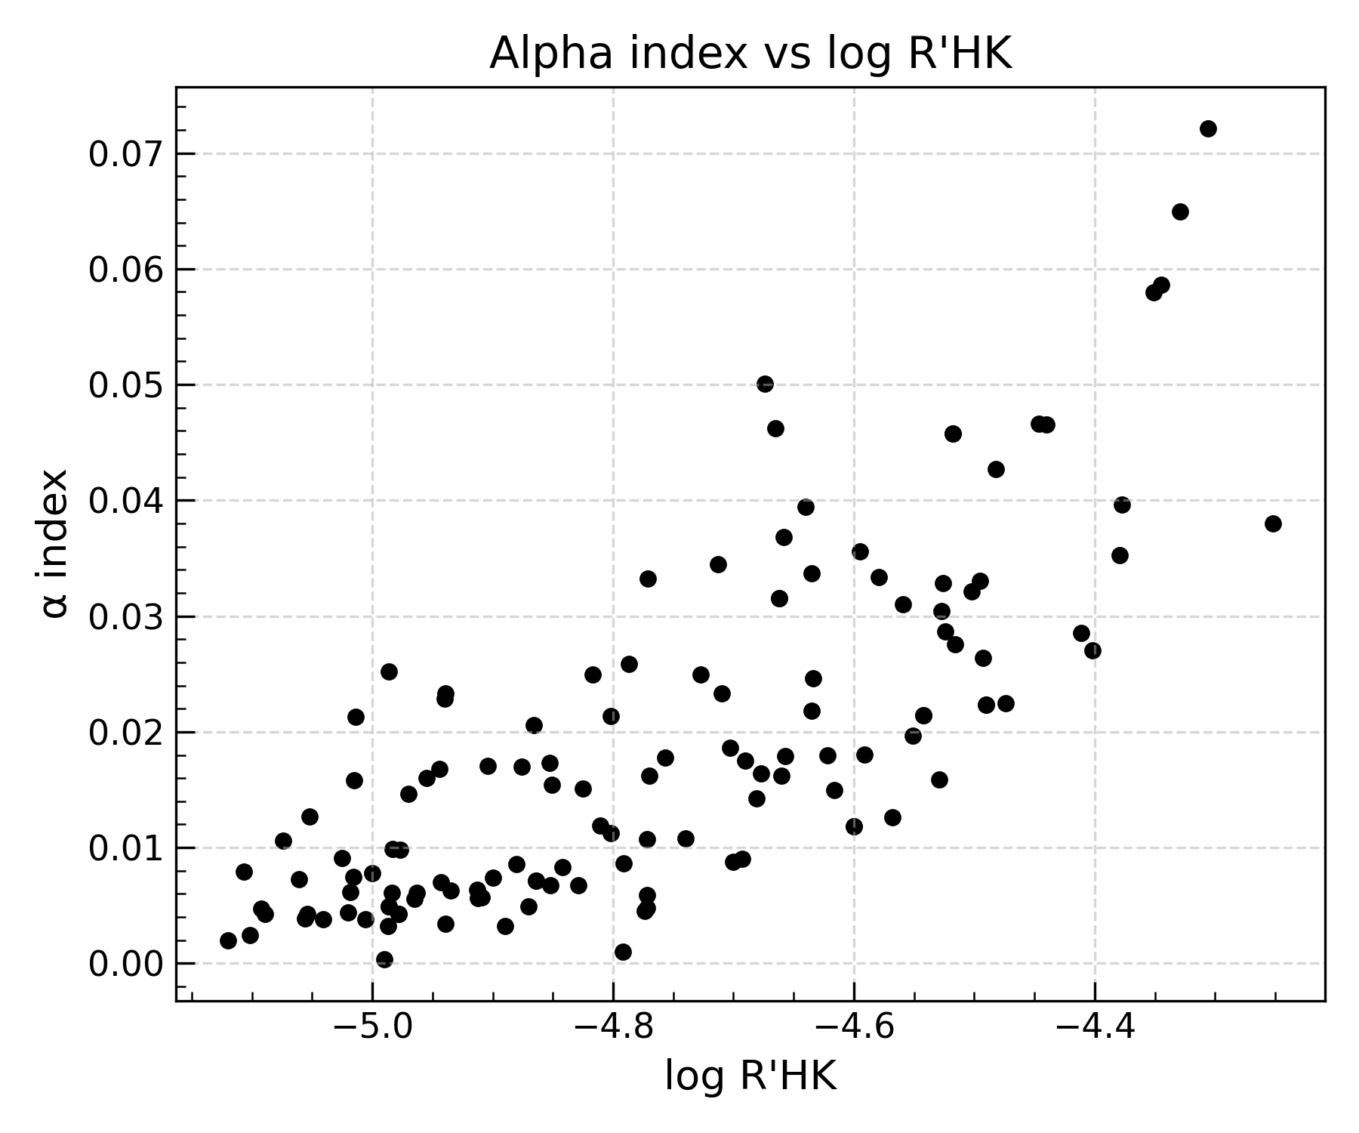
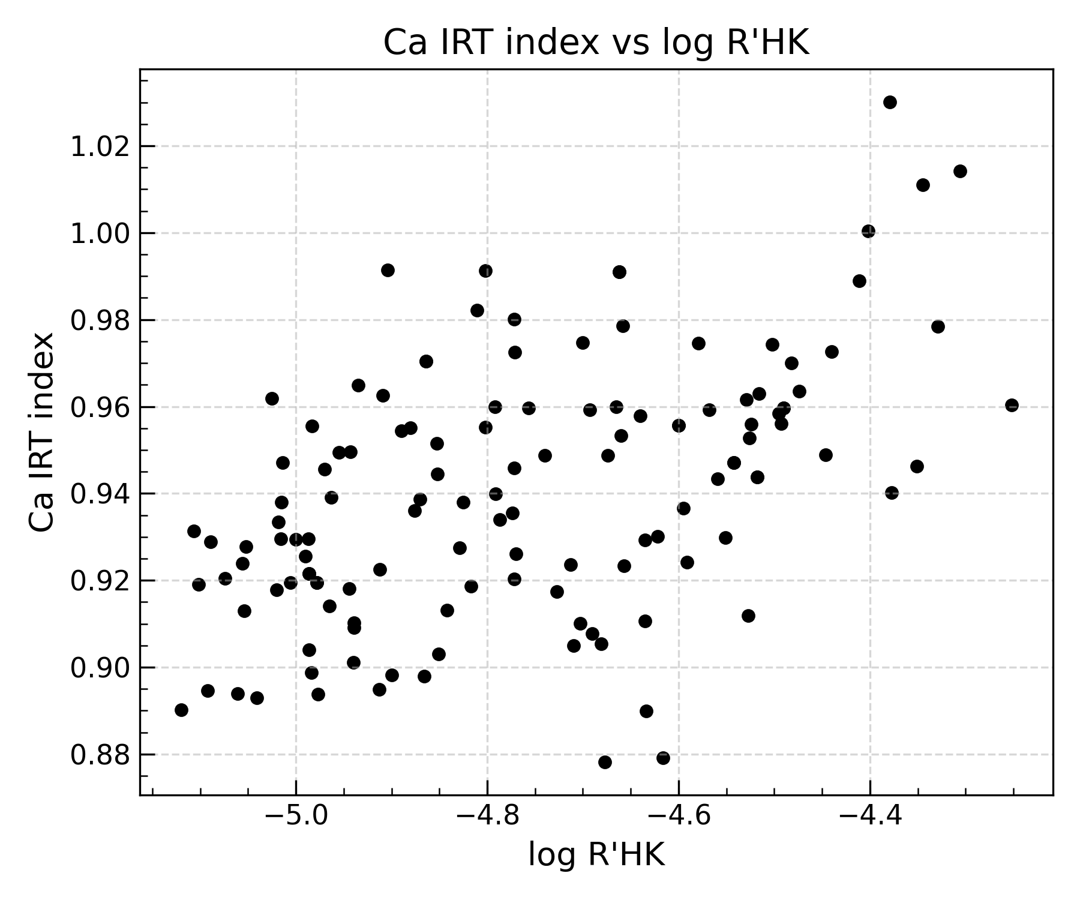
Log R’HK comes from other instruments and isn’t measured simultaneously
Gaia DR3
Bruniquel et al, in prep

Slide 19
T I M E L I N E
NARVAL/ESPaDOnS
Plato
2022
2026
< 2019
2027
Gaia DR3
Gaia DR4

Slide 20
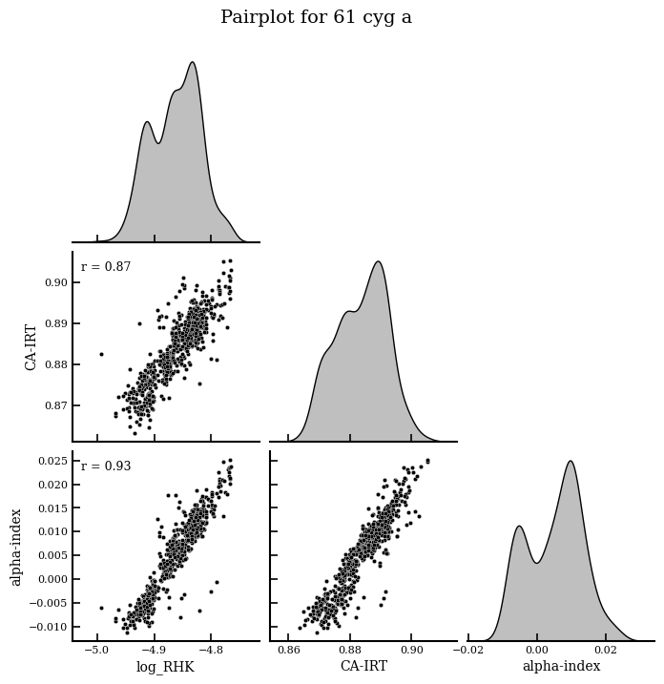
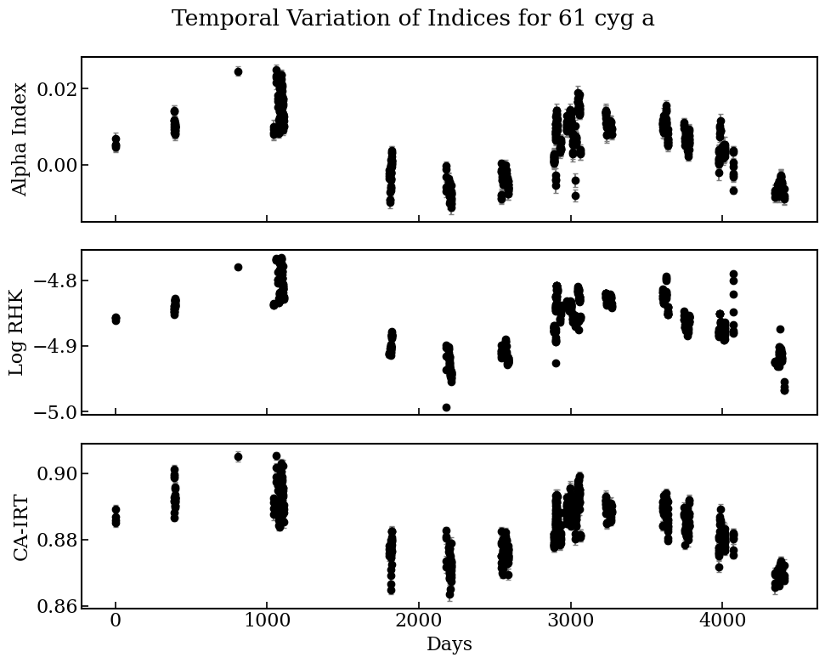

Chromospheric Activity: Temporal Variability
Bruniquel et al, in prep
Temporal variation of indices
Identify activity cycles and correlation/anti-correlation between photometric and chromospheric emissions by only using infra-red observations
* 61 Cyg A

Slide 21
T I M E L I N E
NARVAL/ESPaDOnS
Plato
2022
2026
< 2019
2027
Gaia DR3
Gaia DR4

Slide 22
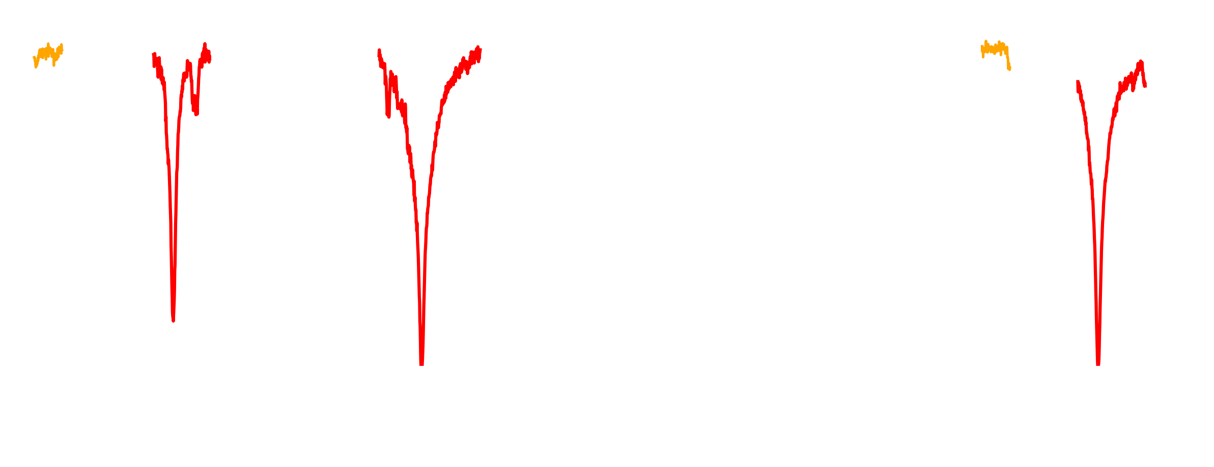

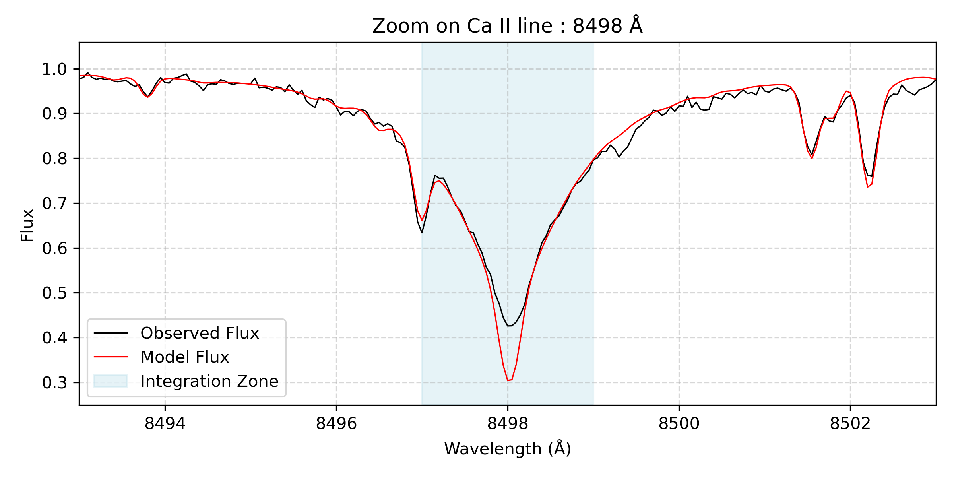
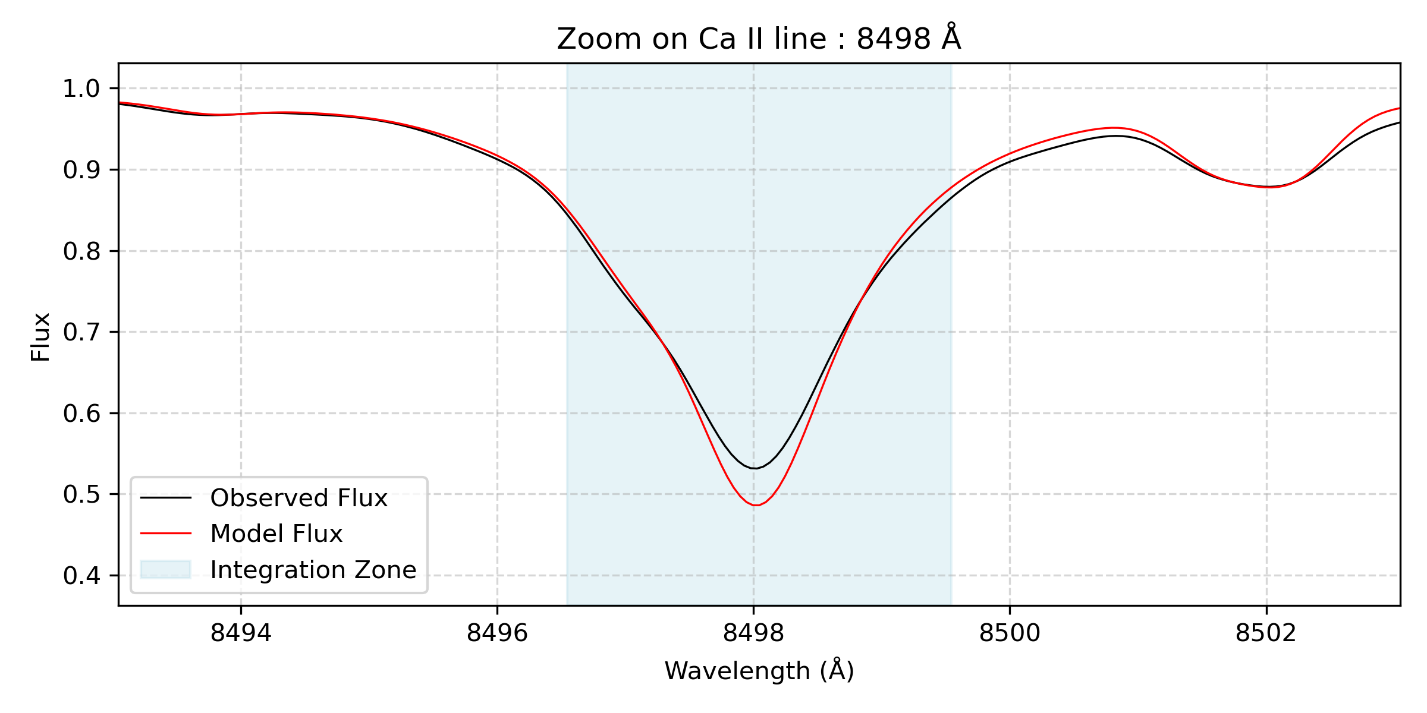
Will this work on Gaia DR4 ?
High Resolution spectrum, R = 65000, NARVAL resolution
Medium Resolution spectrum, R = 11 500, Gaia resolution

Slide 23
Will this work on Gaia DR4 ?
High Resolution spectrum, R = 65000, NARVAL resolution
Medium Resolution spectrum, R = 11 500, Gaia resolution

Slide 24
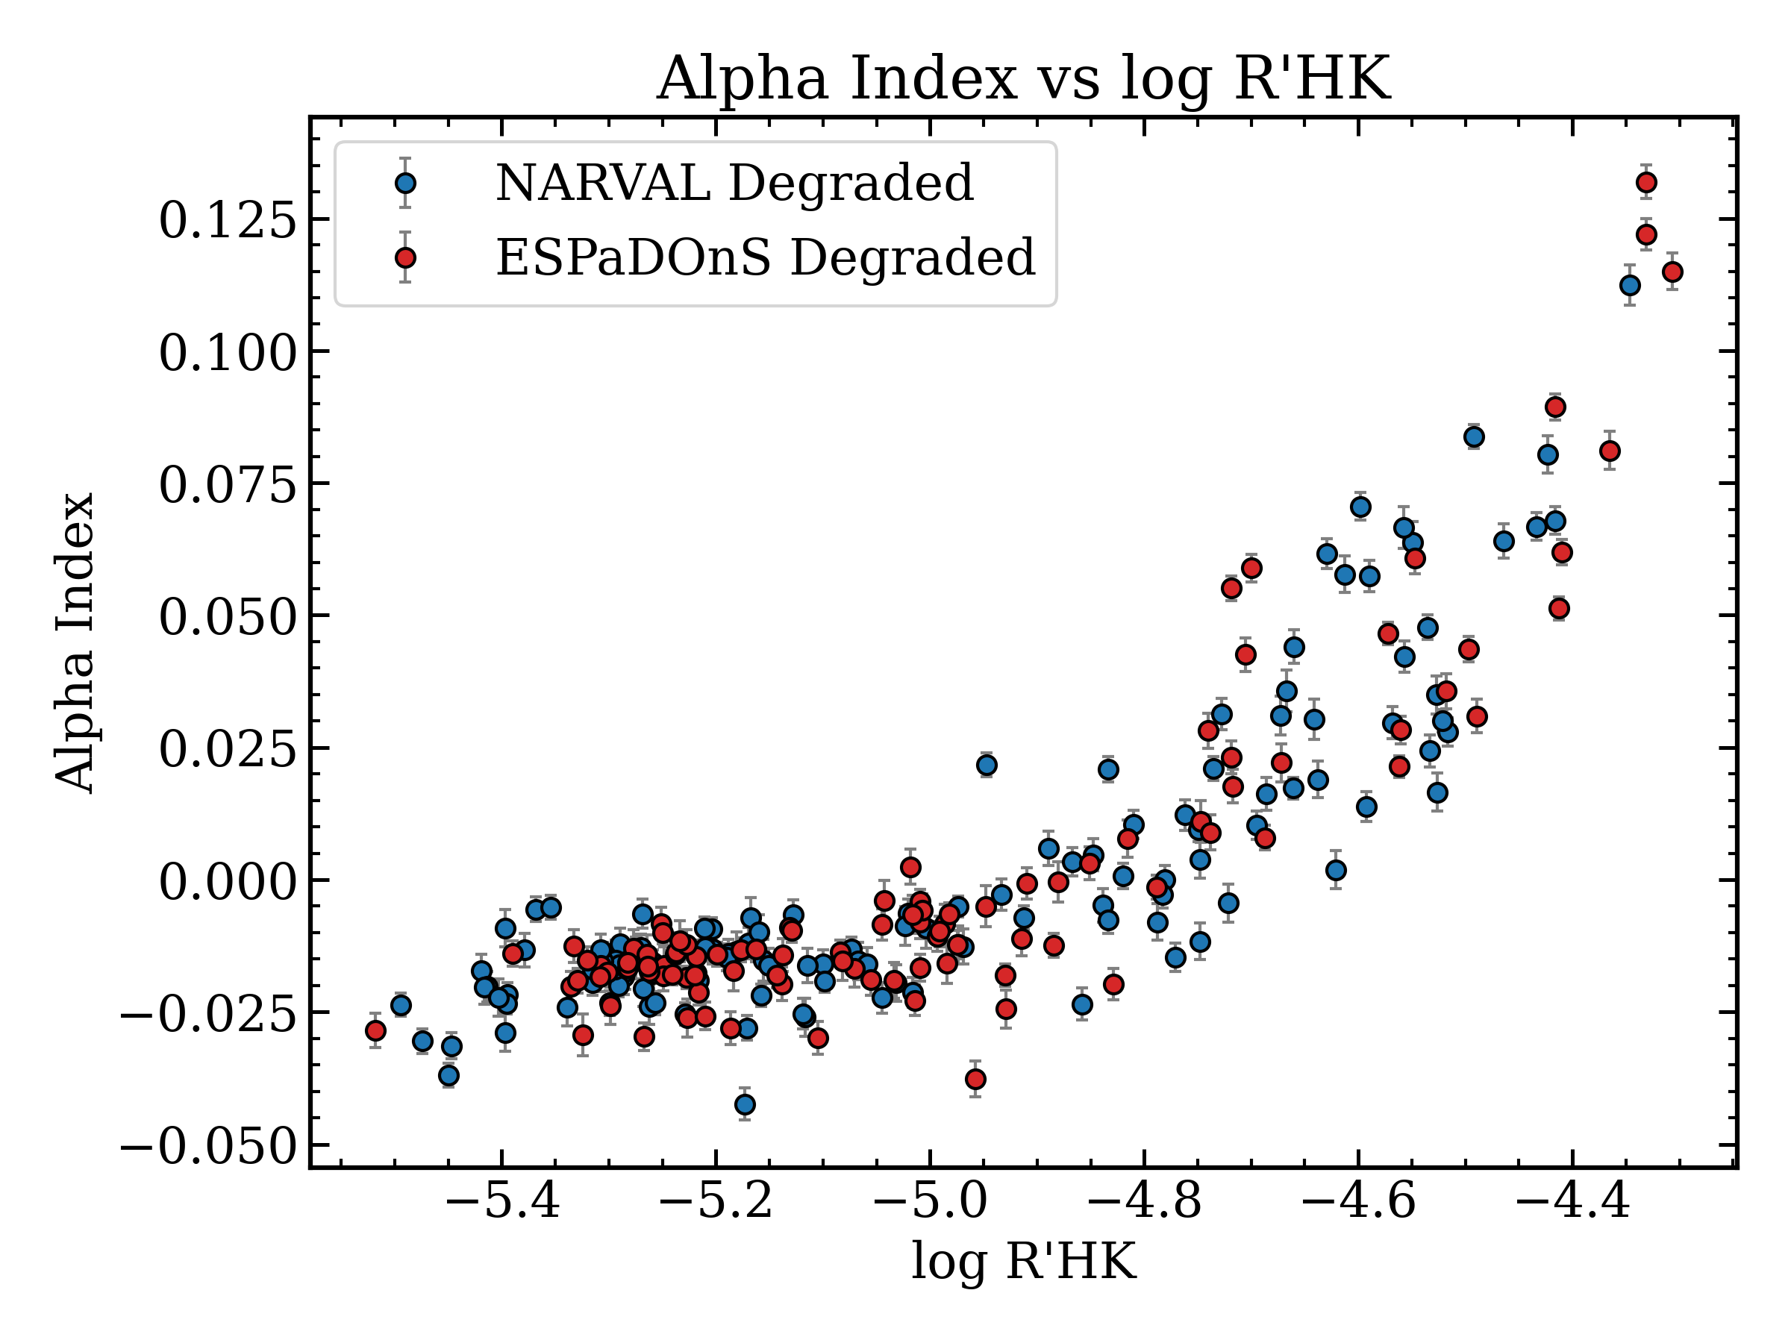
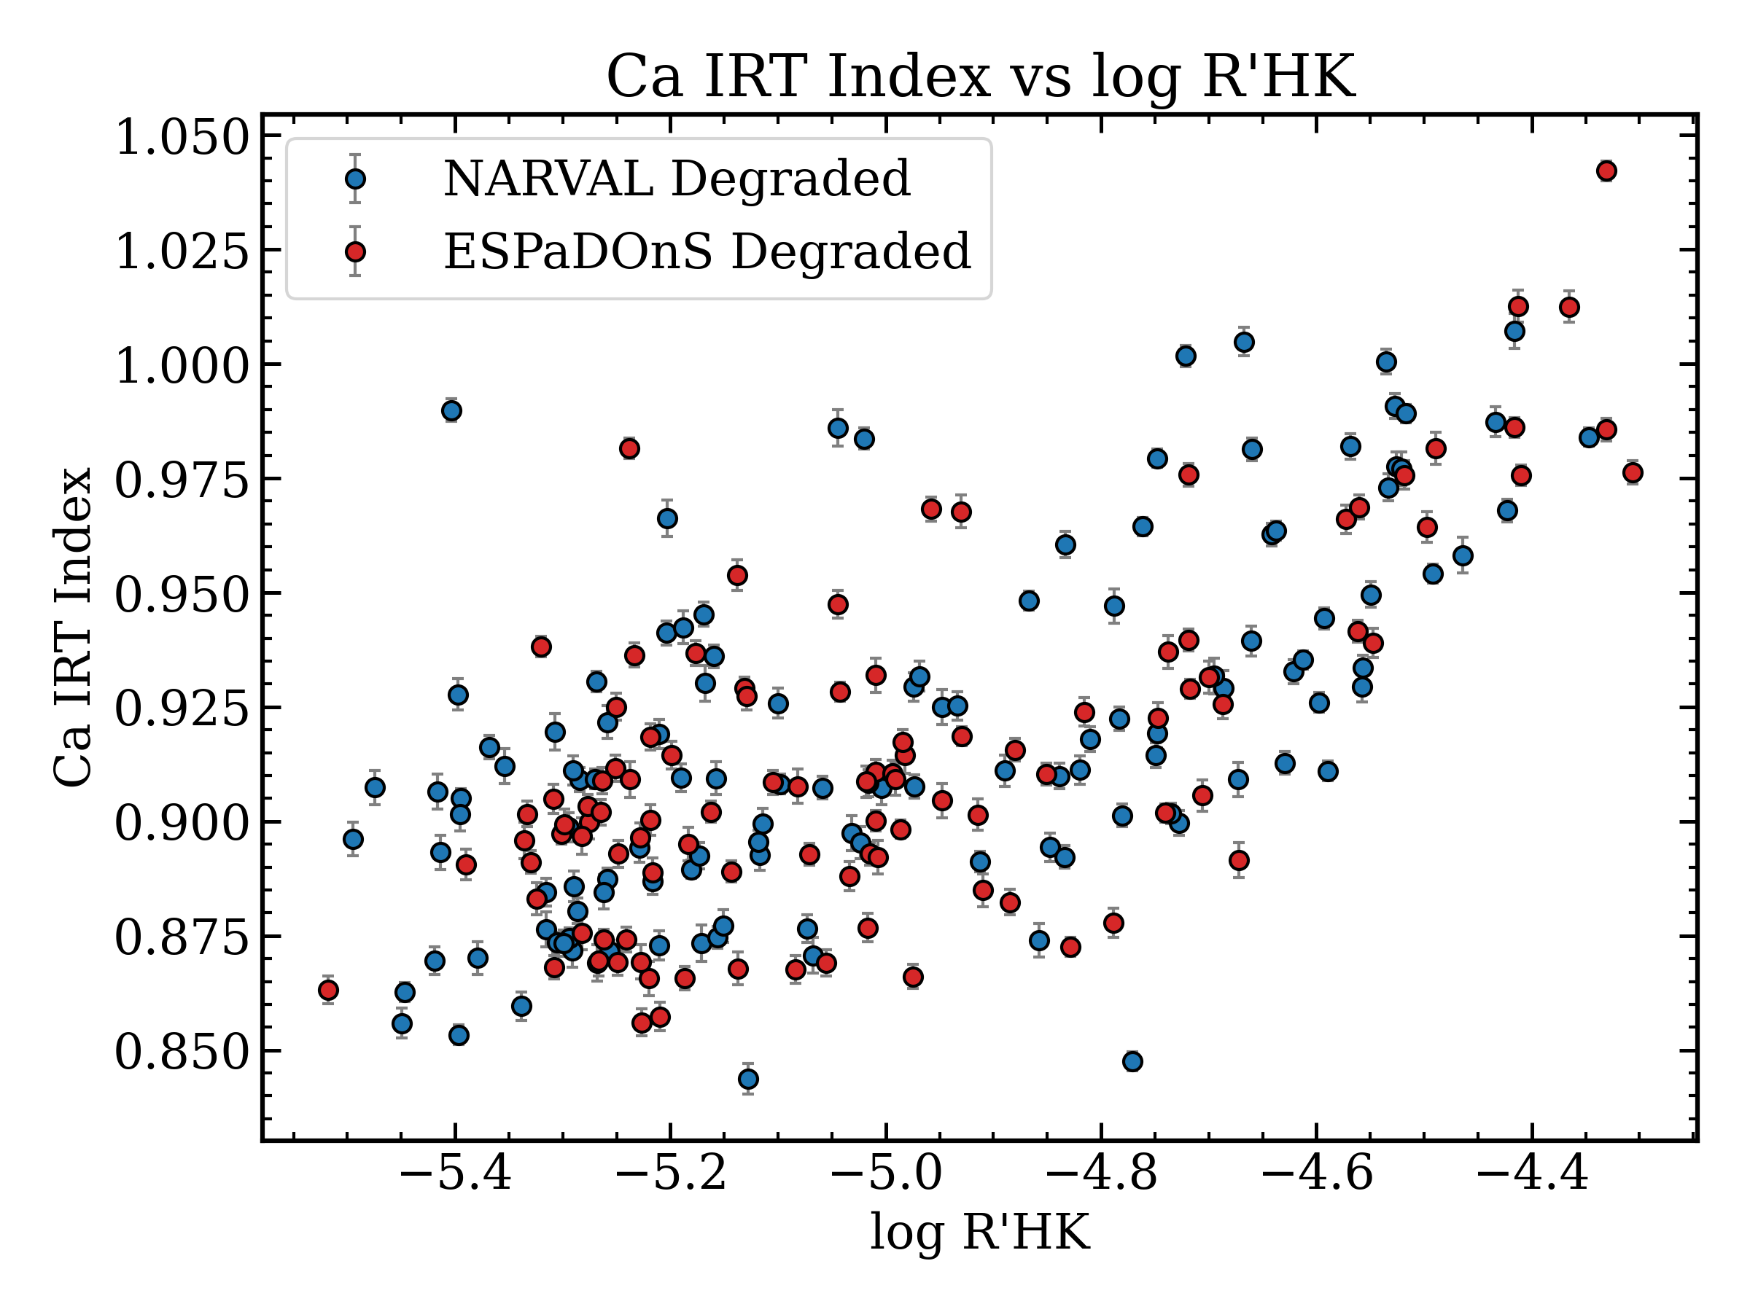
Will this work on Gaia DR4 ?
Compute indicators on degraded spectra
Bruniquel et al, in prep
Degraded NARVAL/ESPaDOnS spectra to Gaia resolution, gives very similar correlation to the higher resolution ones

Slide 25
T I M E L I N E
NARVAL/ESPaDOnS
Plato
2022
2026
< 2019
2027
Gaia DR3
Gaia DR4

Slide 26
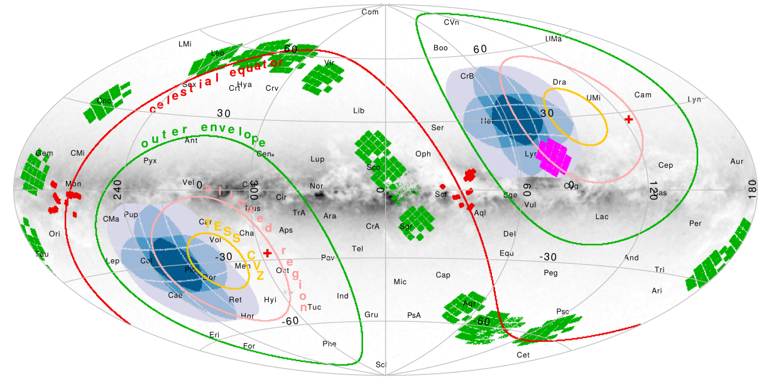
Take home messages
Nascimbeni et al. 2021
Systematic comparison between indicators
Use those infrared indicators on Gaia DR4 spectra time series to infer mean activity level and amplitude of variation
Get a robust activity indicator
Large scale study : Differentiate spot vs faculae-dominated regimes for more stellars parameters. Metallicity/spectral type/… effects.
Very useful for Plato targets follow up !
V.Bruniquel

