Slide 1


The Exoplanet Analysis System: automated detection and analysis of planetary systems
PLATO - ESP2025 | 2025/06/23

Slide 2
What PLATO will tell you about exoplanets
PLATO - ESP2025 | 2025/06/23

Slide 3
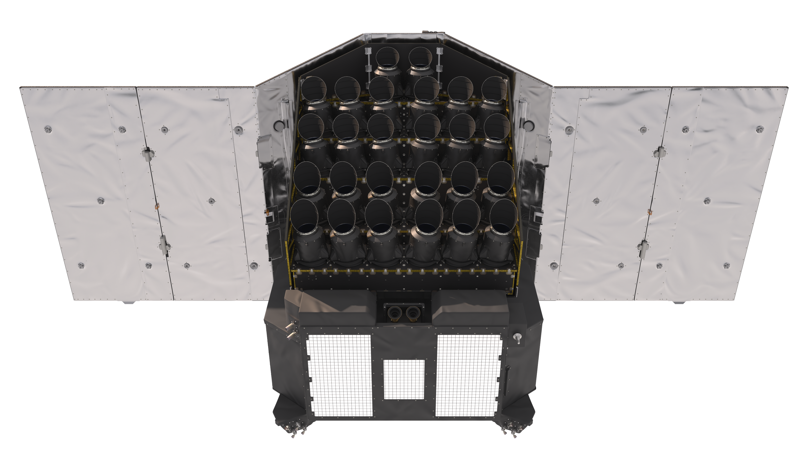
Overview
Exoplanet Analysis System (EAS) design
Exoplanet data products
EAS operations
Implementation status
EAS testing
Completeness, reliability, and occurrence rates
PLATO - ESP2025 | 2025/06/23
Notes:
I’ll cover the design of the pipeline, its products, how it will operate, how we’re getting on with implementation and testing, and finish by talking about how we’ll determine the completeness and reliability of the pipeline.

Slide 4

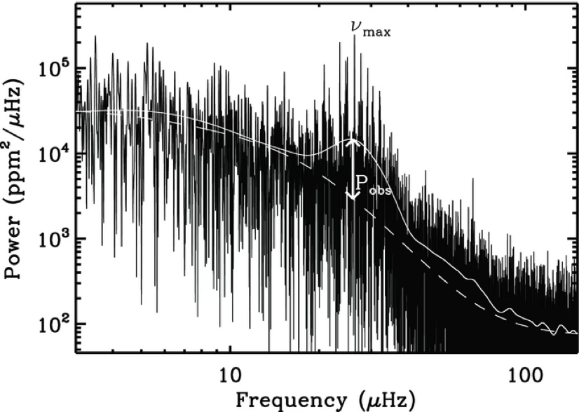
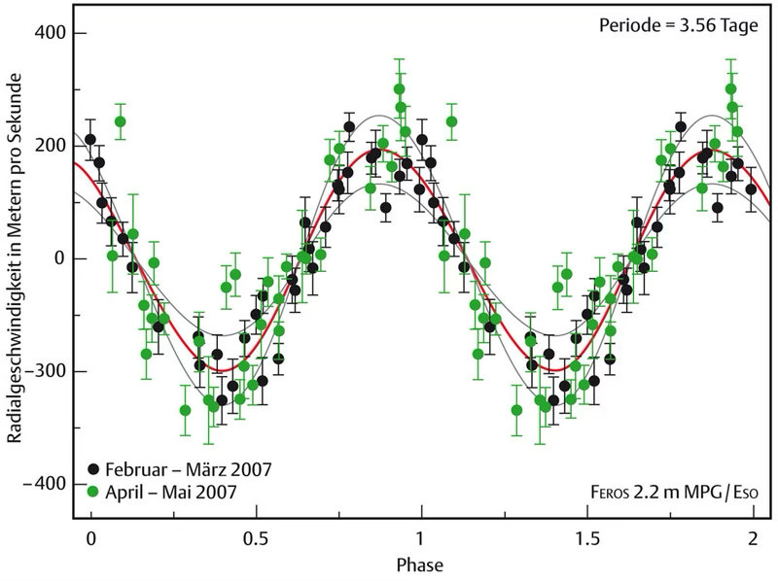
PLATO measurements
Planet/star radius ratio
Inclination
Stellar radius, mass, & age
Activity
Planet mass & radius
Planet density
Planet age
Planet/star minimum mass ratio
PLATO - ESP2025 | 2025/06/23
Notes:
If we think about the ultimate exoplanet science goal of PLATO, what we want to do is:
Take photometric light curves
Combine those with stellar science results
And add to those follow-up observations
To get to our goals of accurate, precise planet masses, radii, densities, and ages.

Slide 5
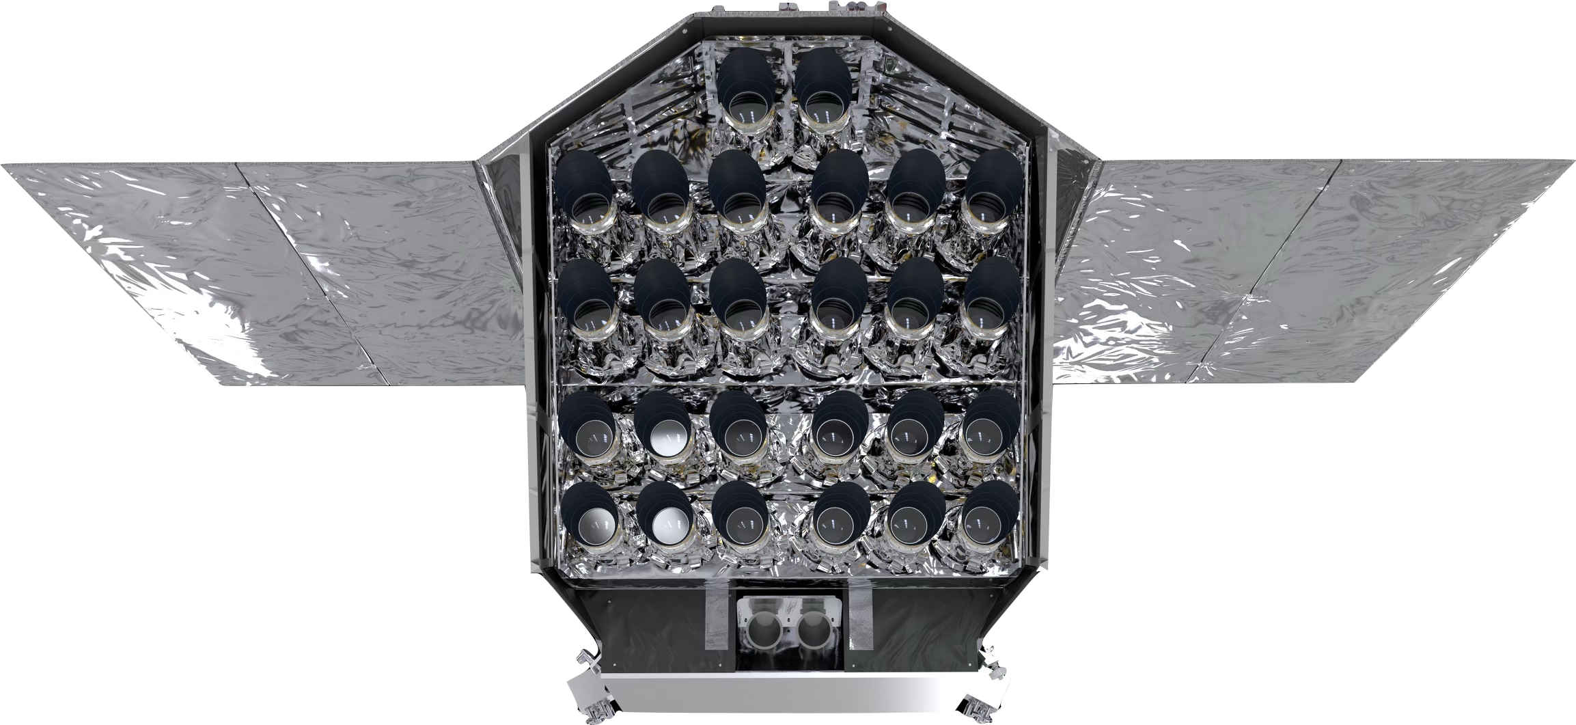

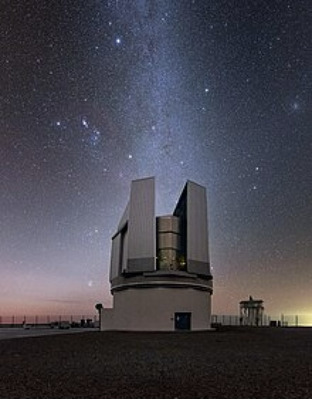
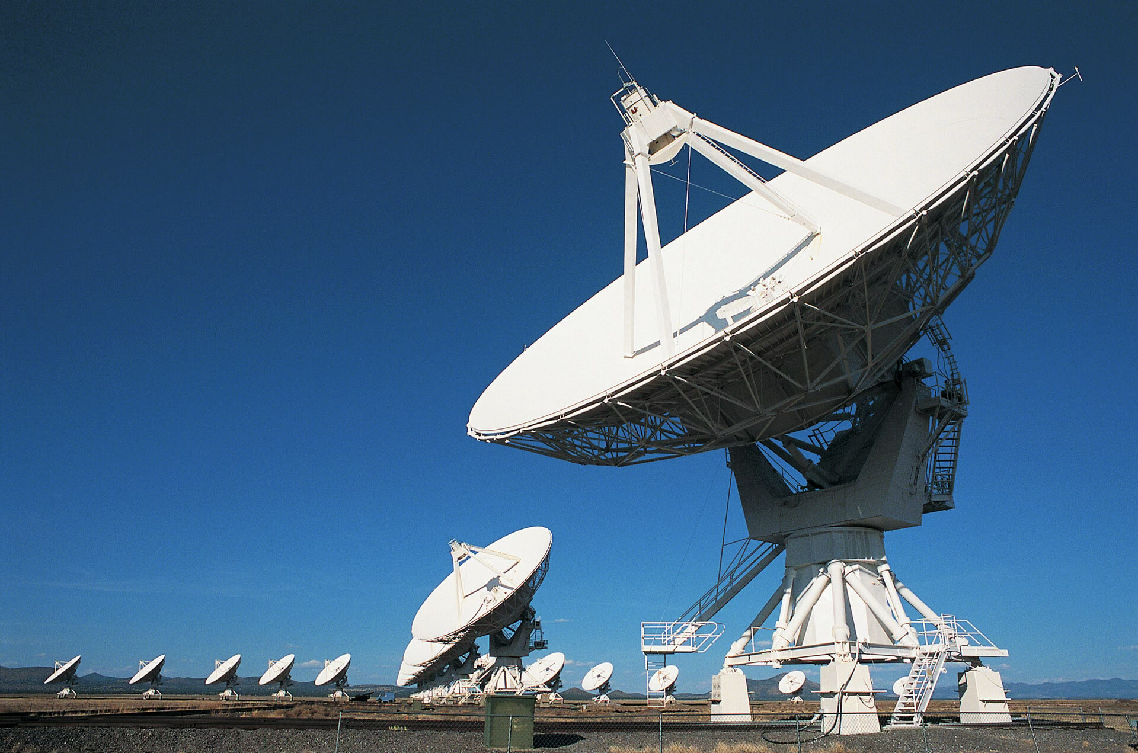
PLATO high-level data flow
L0
Data processing pipelines
L1
EAS
SAS
Ground-based follow-up
Database
Ground stations
PLATO - ESP2025 | 2025/06/23
Notes:
If we consider the high-level data flow to achieve those goals, we have:
The spacecraft collecting observational data
Which are downlinked to the ground, and transferred
To a central database. From there
The data pass backwards and forwards between the various data processing pipelines that produce PLATO light curves and perform exoplanet and science analyses
To get to the ultimate goal we also have contributions from ground-based observatories.
Focusing on the data processing pipelines, Heike gave a brief overview of the L0 and L1 pipelines earlier
Rhita will talk about the stellar analysis system, the SAS, in the next talk.
I'm focusing on the Exoplanet Analysis System, the EAS.

Slide 6
EAS high-level design
PLATO light curves
Stellar science products
Follow-up data
EAS
Exoplanet science products
PLATO - ESP2025 | 2025/06/23
Notes:
As I’ve alluded to already, at very high level the EAS takes in PLATO light curves, stellar science products, and follow-up data, and produces the mission’s exoplanet science products.

Slide 7
EAS high-level design
PLATO light curves
Stellar science products
Follow-up data
EAS
TransitPipe
PlanetPipe
QcPipe
Exoplanet science products
EAS 2025 | SS1 - PLATO's Prospects in Exoplanet and Stellar Science | 2025/06/23
Notes:
At slightly lower level, the EAS consists of three processing chains: TransitPipe, PlanetPipe, and QcPipe.
I

Slide 8
TransitPipe: producing exoplanet candidates
TransitPipe
Consists of five abstract “modules”.
Specifications for the algorithms to be used have been defined by the PLATO Science Management.
The algorithms are being implemented by the PLATO Data Centre.
Filtering light curves
Transit detection
Transit detection
TCE modelling
Vetting possible candidates
Vetting possible candidates
Grading candidates
PLATO - ESP2025 | 2025/06/23
Notes:
Starting with TransitPipe, which is the processing chain that produces PLATO’s exoplanet candidates.
It consists of five abstract modules, the algorithms for which have been chosen by the PLATO Science management.
(Go through the modules)
I’m going to briefly discuss the detection module, the vetting module(s), and the grading.

Slide 9
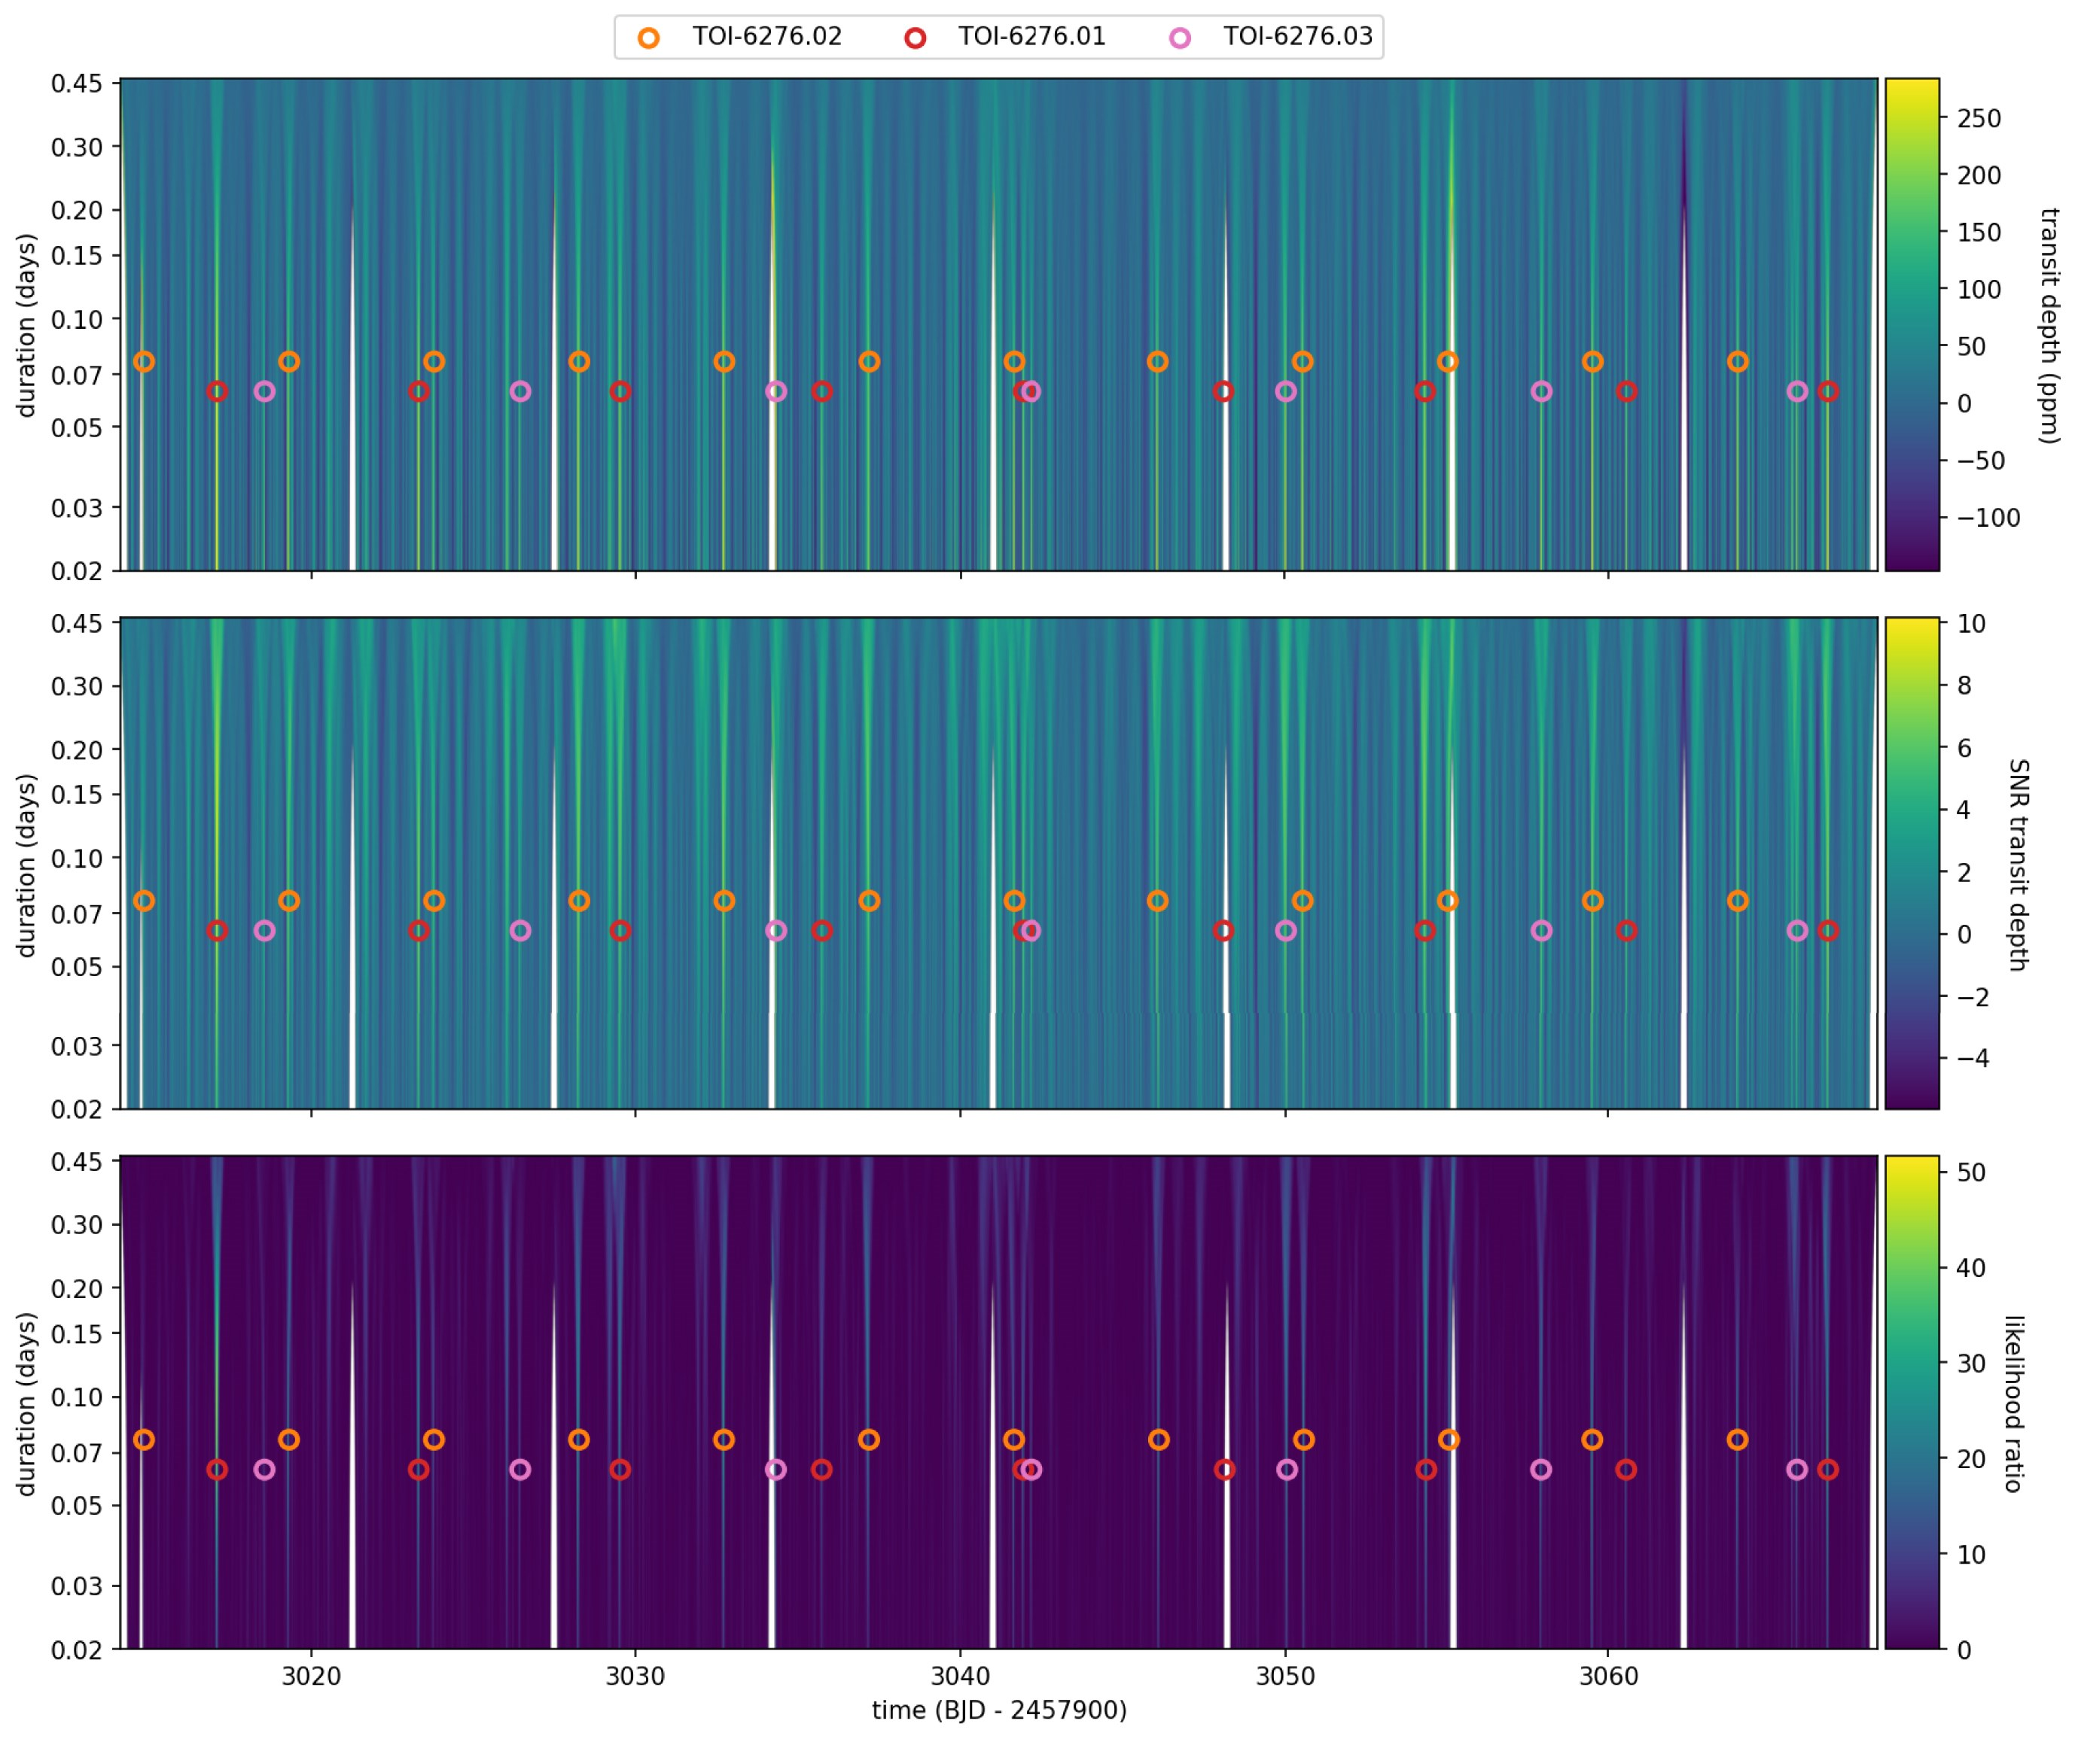
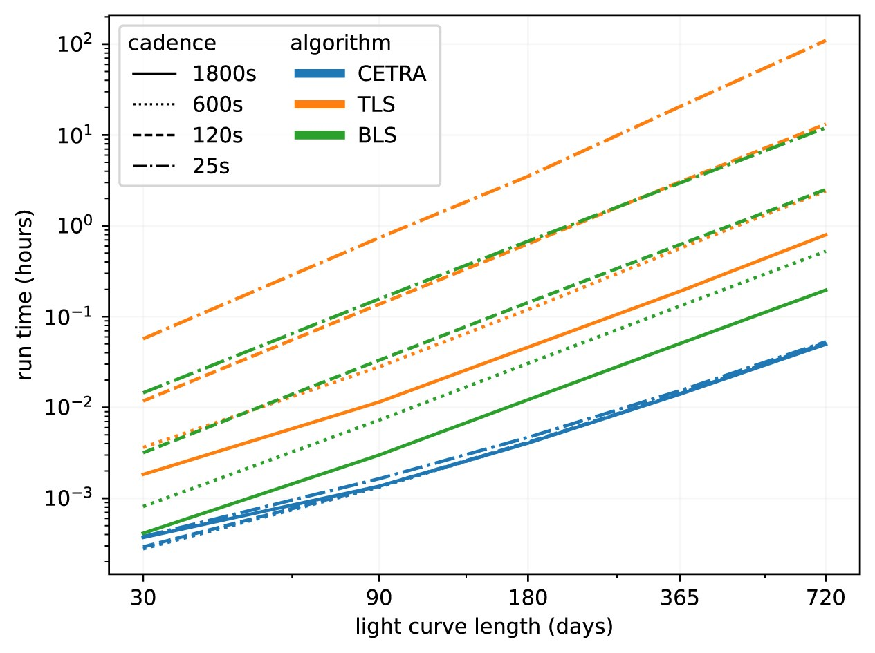
TransitPipe: transit detection with CETRA
Initial plan was to run multiple algorithms.
    They process data differently and make different assumptions.
However, a new algorithm has been developed that combines the best practices from several existing algorithms.
CETRA separates transit detection into two steps:
    First, a search for transit signals across linear time space.
    Then, a phase-fold of the results to enable a periodic signal search using a physically motivated transit model to improve detection sensitivity.
CETRA is optimised for GPUs.
    Performance benchmarking shows significant speed improvements over both TLS and BLS.
Smith, L. et al. (2025)
PLATO - ESP2025 | 2025/06/23
Notes:
We had initially planned to run multiple transit detection algorithms, each processing a different subset of targets depending on its particular optimization. However, that would have introduced complication for limited gain, particularly when combined with multiple variability filtering algorithms.
Furthermore, the development of the new algorithm CETRA by PLATO Consortium members rendered this approach moot.
The EAS will now process all targets using a single defined variability filter + CETRA (though we may still run additional combinations on top of this for particular subsets, e.g. young stars)
CETRA has demonstrated excellent performance. The top figure here shows the results from a CETRA linear transit signal search of the TESS high-cadence light curves of TOI-6276, before any other signals have been removed. TOP: maximum likelihood transit depth in ppm, MIDDLE: corresponding signal-to-noise ratio, LOWER: likelihood ratio of the transit model versus a model with no transit in that location. CETRA detected all three Earth-sized planets in the system, and improved the statistical significance of the signal for the previously unvalidated third planet.

Slide 10
TransitPipe: vetting TCEs & grading candidates
Complex, multi-stage process:
    Three phases of vetting, covering different aspects.
    Grading of candidates based on the results from the vetting tests.
    Candidates that have a sufficiently high grade are ranked for follow-up.
Vetting1 checks for instrumental false alarms.
Vetting2 checks for astrophysical false positives.
    Applied to candidates that pass Vetting1.
Vetting3 is a Bayesian analysis of the impact of contaminants on the light curve.
    Applied to candidates that pass Vetting1 and Vetting2.
    Generates a false positive probability.
Deleuil & Sulis,
PLATO-LAM-PSM-DD-0006
PLATO - ESP2025 | 2025/06/23
Notes:
Looking now at the vetting and grading aspects of TransitPipe, we have quite a complex setup, as you might expect.
Test examples:
Vetting1:
Vetting2:
Vetting3:
This figures does not precisely reflect the details of the implementation, which relies on a specific and complex infrastructure to optimize where and how each processing step is performed. It only gives anoverview of all the steps involved.

Slide 11
TransitPipe: detailed design
TransitPipe
The detailed design of EAS breaks the abstract “modules” down into various processing sub-chains and software components.
Filtering light curves
TransitPipe1
filtering, detection, basic TCE modelling
Runs once per target
Transit detection
TCE modelling
TransitPipe1a
period/epoch matching
Runs once on all TCEs
Vetting possible candidates
TransitPipe2
vetting, iterative TCE modelling, grading & ranking
Runs once per TCE
Grading candidates
PLATO - ESP2025 | 2025/06/23

Slide 12
TransitPipe: data products
PLATO light curves
Stellar science products
Follow-up data
EAS
TransitPipe
PlanetPipe
QcPipe
Catalogue of TCEs & exoplanet candidates (DP2)
QC data for DP2
TCE reports
Eclipsing binary catalogue
EAS 2025 | SS1 - PLATO's Prospects in Exoplanet and Stellar Science | 2025/06/23
Notes:
TransitPipe produces a catalogue of TCEs and exoplanet candidates, which we refer to as DP2. This is the level 2 product that Heike referred to in her talk earlier this morning.
It also produces two additional products, TCE reports, which are very much inspired by the TESS data validation reports, and a catalogue of eclipsing binaries, both known and new, that are identified during the vetting and grading stages of TransitPipe.
Associated QC data for DP2 that is not included in the TCE reports is produced by QCPipe.

Slide 13
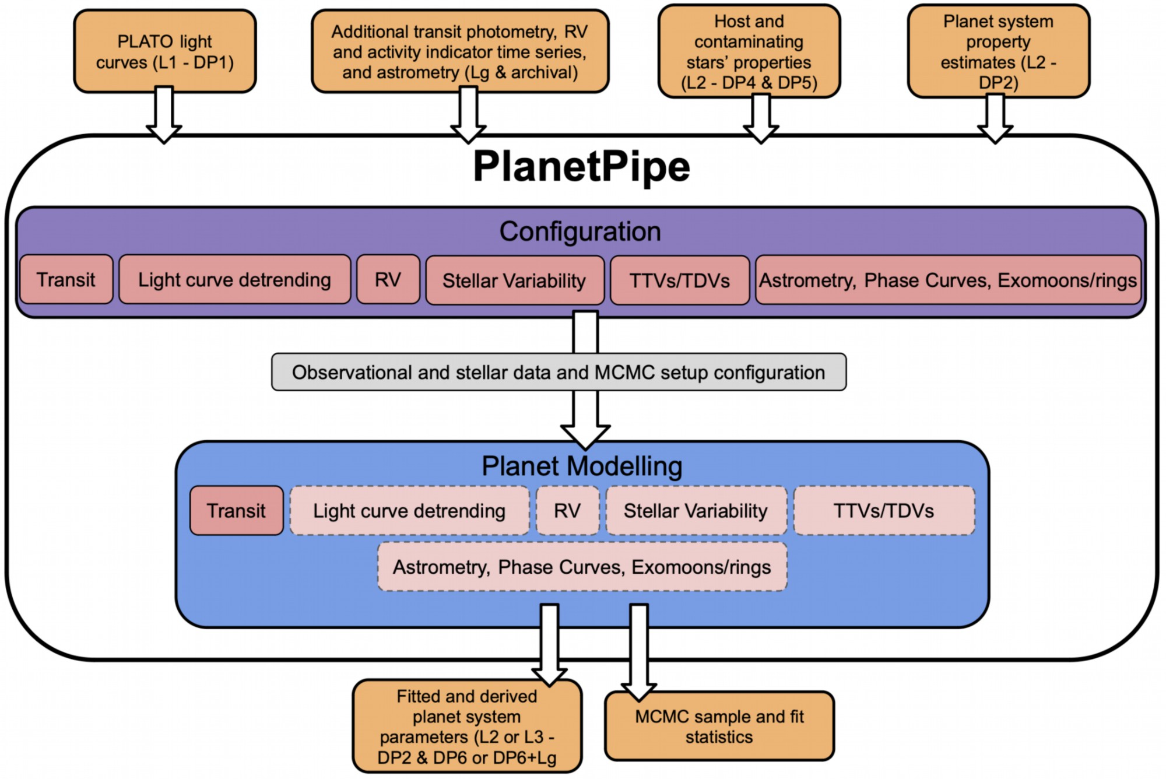
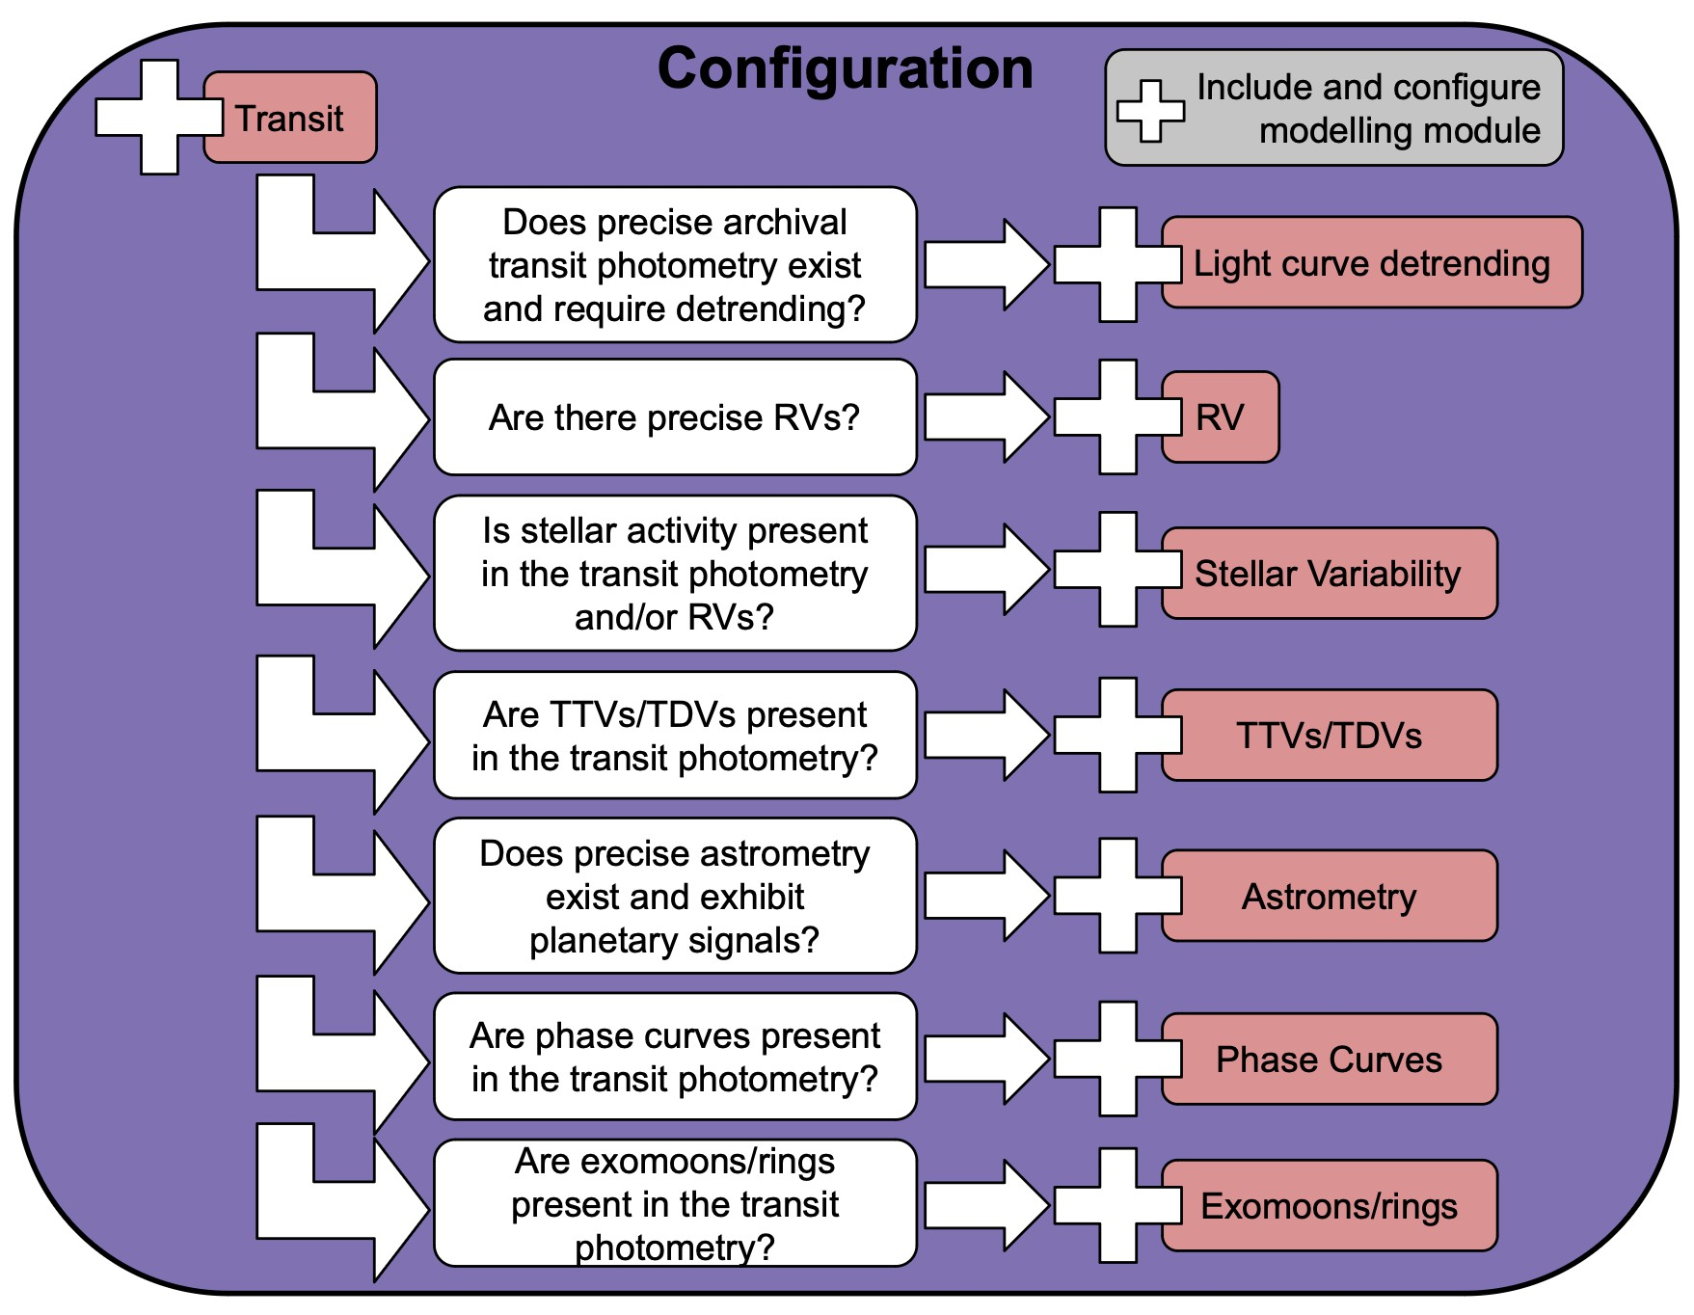
PlanetPipe: planetary system modelling
PlanetPipe is a suite of modelling algorithms.
Only modelling that contributes to optimal, robust determination of precise planet radii and masses is included.
Baseline is for transit modelling only.
Configurable: additional modules can be activated as needed,
based on:
    Candidate properties
    Data availability and
    properties
Wilson, PLATO-UWA-PSM-TN-0006
Wilson,
PLATO-UWA-PSM-TN-0006
PLATO - ESP2025 | 2025/06/23
Notes:
The PlanetPipe processing chain performs planetary system modelling, with a clear focus on robust, precise determination of planet radii and masses. Scientific modelling that does not contribute to that is out of scope and not included.
PlanetPipe is very customisable. As a baseline it performs transit modelling, but additional modules can be activated as needed depending on the properties of the candidate, what data is available, and how good that data is.

Slide 14
PlanetPipe: planetary system modelling
PlanetPipe builds on the legacy of many existing data analysis and modelling software packages.
    E.g. PyORBIT, PlanetPAck, juliet, allesfitter, exoplanet, EXOFAST, starry, pyaneti, S+LEAF, etc.
Bayesian analysis run in an MCMC framework.
Systematics accounted for using a combination of linear
terms, Gaussian
processes, and
‘jitter’ terms.
Wilson, PLATO-UWA-PSM-TN-0006
Wilson,
PLATO-UWA-PSM-TN-0006
PLATO - ESP2025 | 2025/06/23
Notes:
PlanetPipe stands on the shoulders of giants in terms of planetary system modelling; some of the inspirations are listed there. At it’s heart it is Bayesian analysis run in an MCMC framework, with systematics accounted for using a combination of linear terms, jitter terms, and multi-dimensional gaussian processes.

Slide 15
PlanetPipe: stellar variability
                Variability is a significant challenge for PlanetPipe, particularly for the case of Earth-size planets in the habitable zone of Sun-like stars.
Correction at the observation data (image, spectrum) level should be conducted before PlanetPipe modelling.
Modelling of variability in extracted data (RVs, photometry) will be performed by PlanetPipe.
    E.g., using a multi-dimensional Gaussian process to mitigate variability in RV data.
    Further guidance and recommendations are being provided by the Stellar Variability Working Group.
PLATO - ESP2025 | 2025/06/23
Notes:
One major challenge for PlanetPipe is stellar variability, which encompasses oscillations & granulation, spots/faculae/plages/ magnetic cycles, and flares.
These can be dealt with in two ways. Either the observational data are corrected prior to PlanetPipe modelling, or variability in the extracted data is modelled as part of PlanetPipe processing.
Mentioned GPs for systematics modelling, which will be one approach used here. But other approaches, which may help to correct for different expressions of variability, are being explored by PLATO’s SVWG.

Slide 16
PlanetPipe: data products
PLATO light curves
Stellar science products
Follow-up data
EAS
TransitPipe
PlanetPipe
QcPipe
Catalogue of TCEs & exoplanet candidates (DP2)
Planetary system models
(DP6: PLATO data only)
(DP6+Lg: PLATO data + follow-up data)
QC data for DP2
QC data for DP6 & DP6+Lg
TCE reports
Eclipsing binary catalogue
Catalogue summarising the models
EAS 2025 | SS1 - PLATO's Prospects in Exoplanet and Stellar Science | 2025/06/23
Notes:
PlanetPipe produces the set of full planetary system models, both with and without contributions from ground-based follow-up. These are referred to as DP6 and DP6+Lg, respectively, and are level 2 and level 3 products from Heike’s presentation earlier. For simplicity, PlanetPipe produces a combined catalogue of these two products.
Since the full planetary system models are very data-rich, complex products, PlanetPipe will also produce a catalogue summarizing those, while relevant QC data is again produced by QcPipe.

Slide 17
EAS operations
Quarter
n-1
Quarter
n
Quarter
n+1
EAS operates in processing cycles.
    These are aligned with the timing of PLATO’s observing ‘Quarters’.
Each cycle, EAS ingests the latest available:
    Detrended PLATO light curves for the current observing field.
    Stellar science products.
    Exoplanet science products from previous cycles.
    Follow-up data.
Within each cycle, TransitPipe and PlanetPipe run independently and automatically.
t0
cycle n
TransitPipe
Observations
Review DP2
L1 processing
t0 +3mn
cycle n+1
PlanetPipe
TransitPipe
Observations
Review DP2
L1 processing
Review DP6(+Lg)
t0 +6mn
cycle n+2
PlanetPipe
TransitPipe
Review DP6(+Lg)
Review DP2
t0 +9mn
Adapted from Rixon, PLATO-IoA-PDC-DD-0001
PLATO - ESP2025 | 2025/06/23
Notes:
In terms of operations, EAS operates in a cyclical fashion, with the timing of the processing cycles aligned with PLATO’s observing quarters.
On the left here is a simple timeline, with processing cycles running top to bottom, and the different quarters shown as the different columns.
Each processing cycle, EAS ingests the latest set of light curves, the most recent stellar science products and follow-up data, and its own products from the previous cycle. It then runs TransitPipe and PlanetPipe independently and automatically.

Slide 18
EAS timing
Quarter
n-1
Quarter
n
Quarter
n+1
EAS will not run until the detrended light curves for the most recently completed observing quarter are available.
    TransitPipe runs one ‘Quarter’ behind the observations.
PlanetPipe uses the catalogue of TCEs and candidates (DP2) as input.
    It has to wait for this to be validated each cycle.
    Therefore, PlanetPipe runs two cycles behind observations.
t0
cycle n
TransitPipe
Observations
Review DP2
L1 processing
t0 +3mn
cycle n+1
PlanetPipe
TransitPipe
Observations
Review DP2
L1 processing
Review DP6(+Lg)
t0 +6mn
cycle n+2
PlanetPipe
TransitPipe
Review DP6(+Lg)
Review DP2
t0 +9mn
Adapted from Rixon, PLATO-IoA-PDC-DD-0001
PLATO - ESP2025 | 2025/06/23
Notes:
Now, you’ll notice that while PLATO is observing one Quarter, TransitPipe is processing the previous Quarter’s data. This is because EAS will not run until the light curves for a quarter have been detrended for systematics.
PlanetPipe, which uses the catalogue of TCEs and candidates as input to its modelling, runs a further Quarter behind since it must wait for that catalogue to be validated.

Slide 19


Implementation status
EAS-4.1.0
TransitPipe
PlanetPipe
QcPipe
Filtering
Vetting
Planetary system modelling
Per-cycle QC metrics
Detection
Grading
Completeness /reliability
TCE modelling
Prototype implemented & runnable
    Updates needed to follow latest algorithm specifications
Implemented in part & runnable
    Basic modelling & planet masses from RVs
    Planet masses from TTVs
Not started
PLATO - ESP2025 | 2025/06/23
Notes:
In terms of implementation, things are looking good and are on track for the pipeline to be ready for launch. There is a full prototype of TransitPipe running, though some updates are needed to that to account for the most recent changes in algorithm specifications, which PlanetPipe has basic modelling in place and can incorporate RVs, though mass estimates from TTVs still needs to be added.
Implementation of QcPipe, on the other hand, has not yet started.

Slide 20
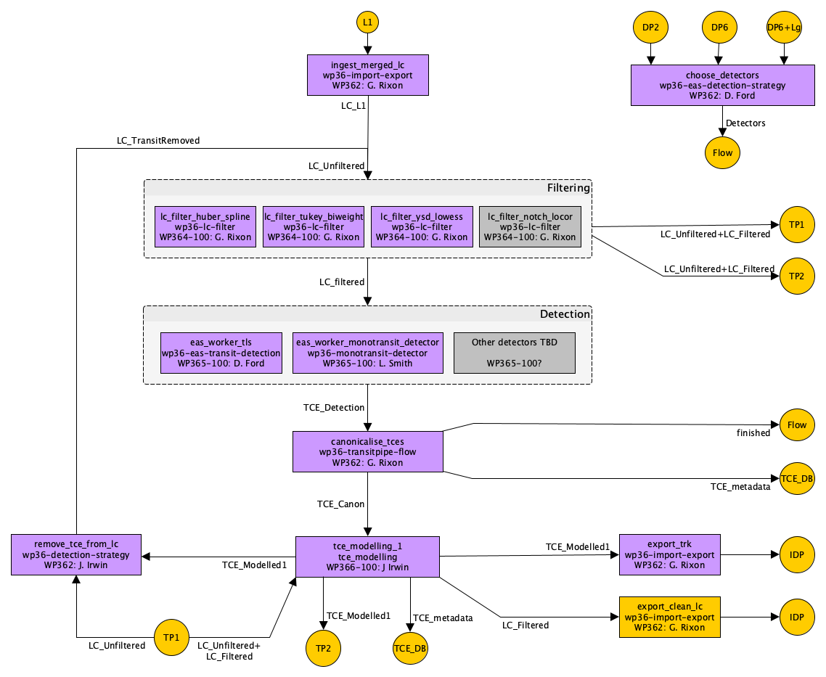
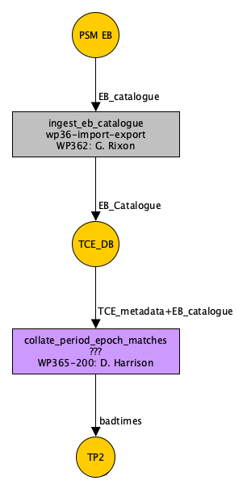
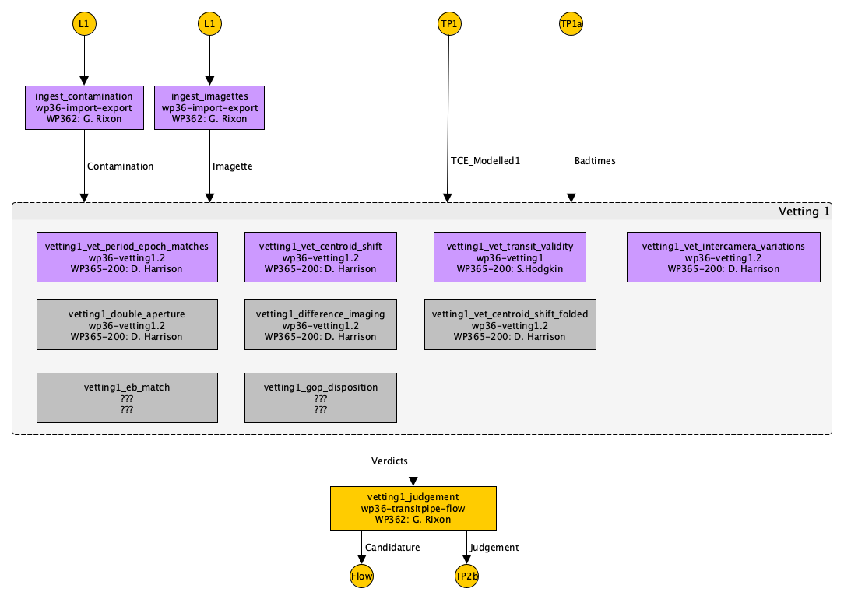
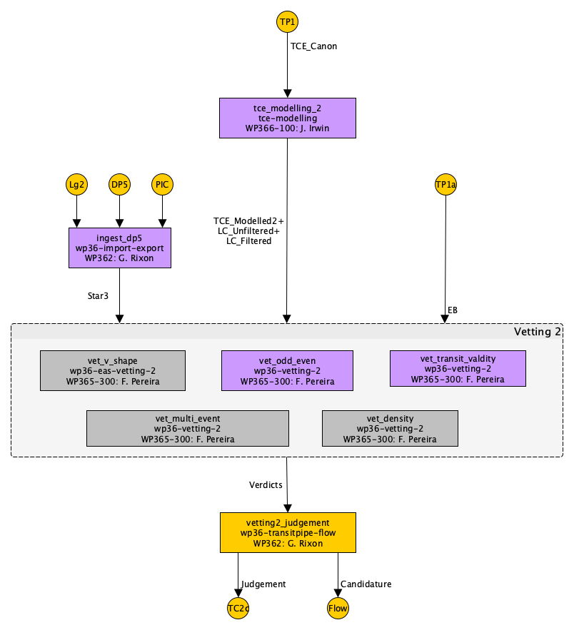
Detailed implementation status
TransitPipe1
1a
TransitPipe2a
TransitPipe2b
Implemented data flow & internal algorithms.
Implemented data flow. Internal algorithms as stubs.
Not yet implemented
Rixon, PLATO-IoA-PDC-DD-0001
PLATO - ESP2025 | 2025/06/23
Notes:
Here I’m showing the detailed design of the sub-chains of TransitPipe, and the detailed implementation status. Each box represents a processing step. Steps in purple are implemented, with both data flow and internal algorithms in place. Steps in yellow are partially implemented, with data flow in place but only stubs in place of the actual processing algorithm. Boxes in grey are not yet implemented.
The overall status is very good, with most processing steps implemented. The largest gaps in coverage right now are in the vetting and grading performed by TransitPipe2.

Slide 21
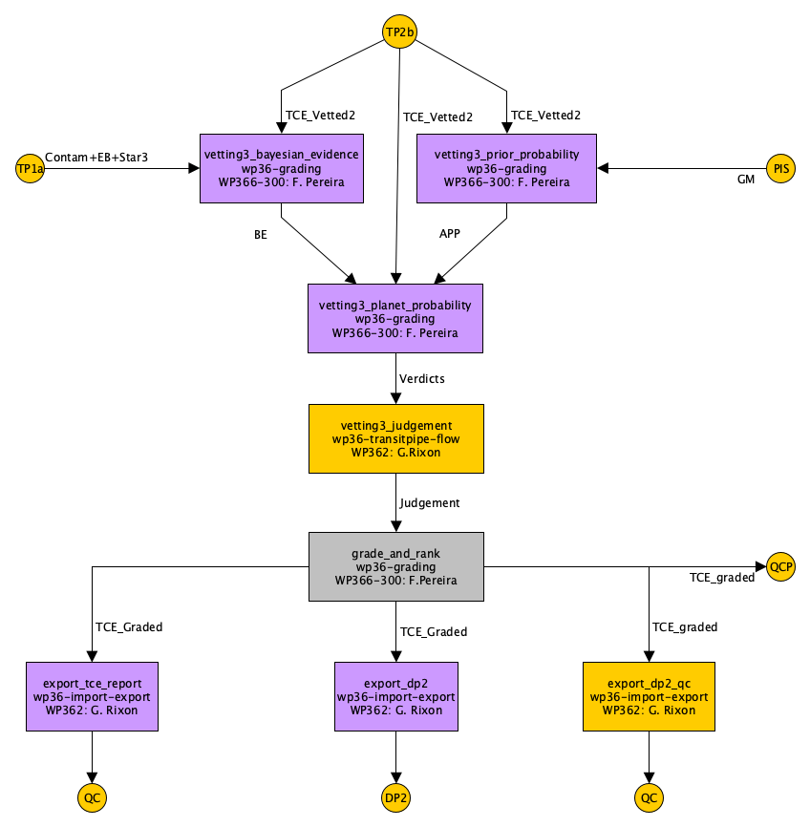
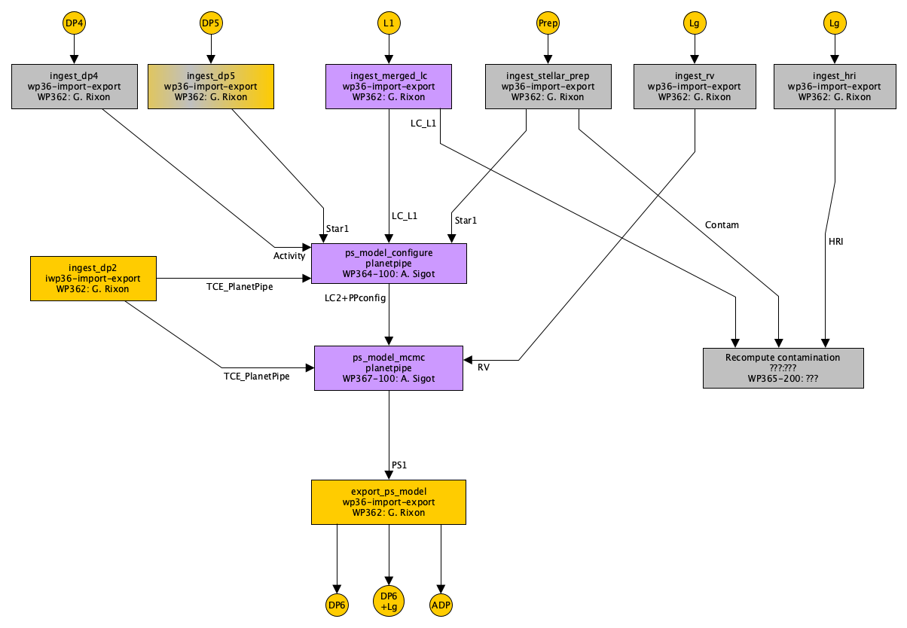
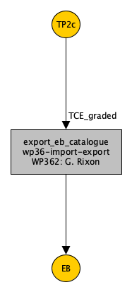
Detailed implementation status
TransitPipe2c
PlanetPipe
QcPipe
Implemented data flow & internal algorithms.
Implemented data flow. Internal algorithms as stubs.
Not yet implemented
Rixon, PLATO-IoA-PDC-DD-0001
PLATO - ESP2025 | 2025/06/23
Notes:
Looking at PlanetPipe, as I suggest previously the implementation is less advanced, with more steps still to be implemented.
QcPipe, as I mentioned earlier, is not yet implemented.

Slide 22
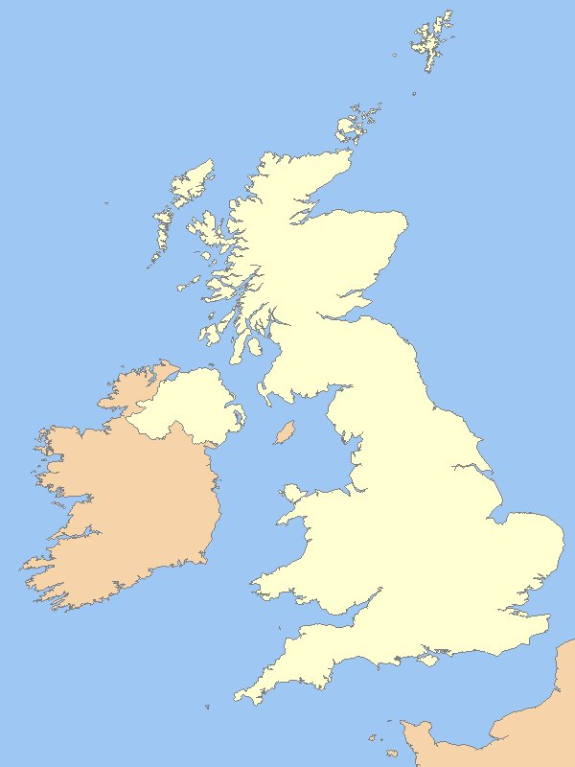
EAS deployment: IRIS
IRIS is a cooperative, federated, community driven digital research infrastructure project.
    Provides compute power and storage.
EAS will be deployed on three IRIS sites:
    Cambridge (working)
    Imperial College London (working)
    Rutherford Appleton Laboratory (planned)
Current allocation to EAS (2024/25) is:
    4000 virtual CPU cores
    5 A100 GPUs
    400TB storage
Deployment could extend to other sites, but preference is to keep major chunks co-located.
    E.g., all of TransitPipe on one site.
Cambridge
RAL
Imperial
PLATO - ESP2025 | 2025/06/23
Notes:
EAS is being deployed to remote computing infrastructure operated by IRIS.

Slide 23
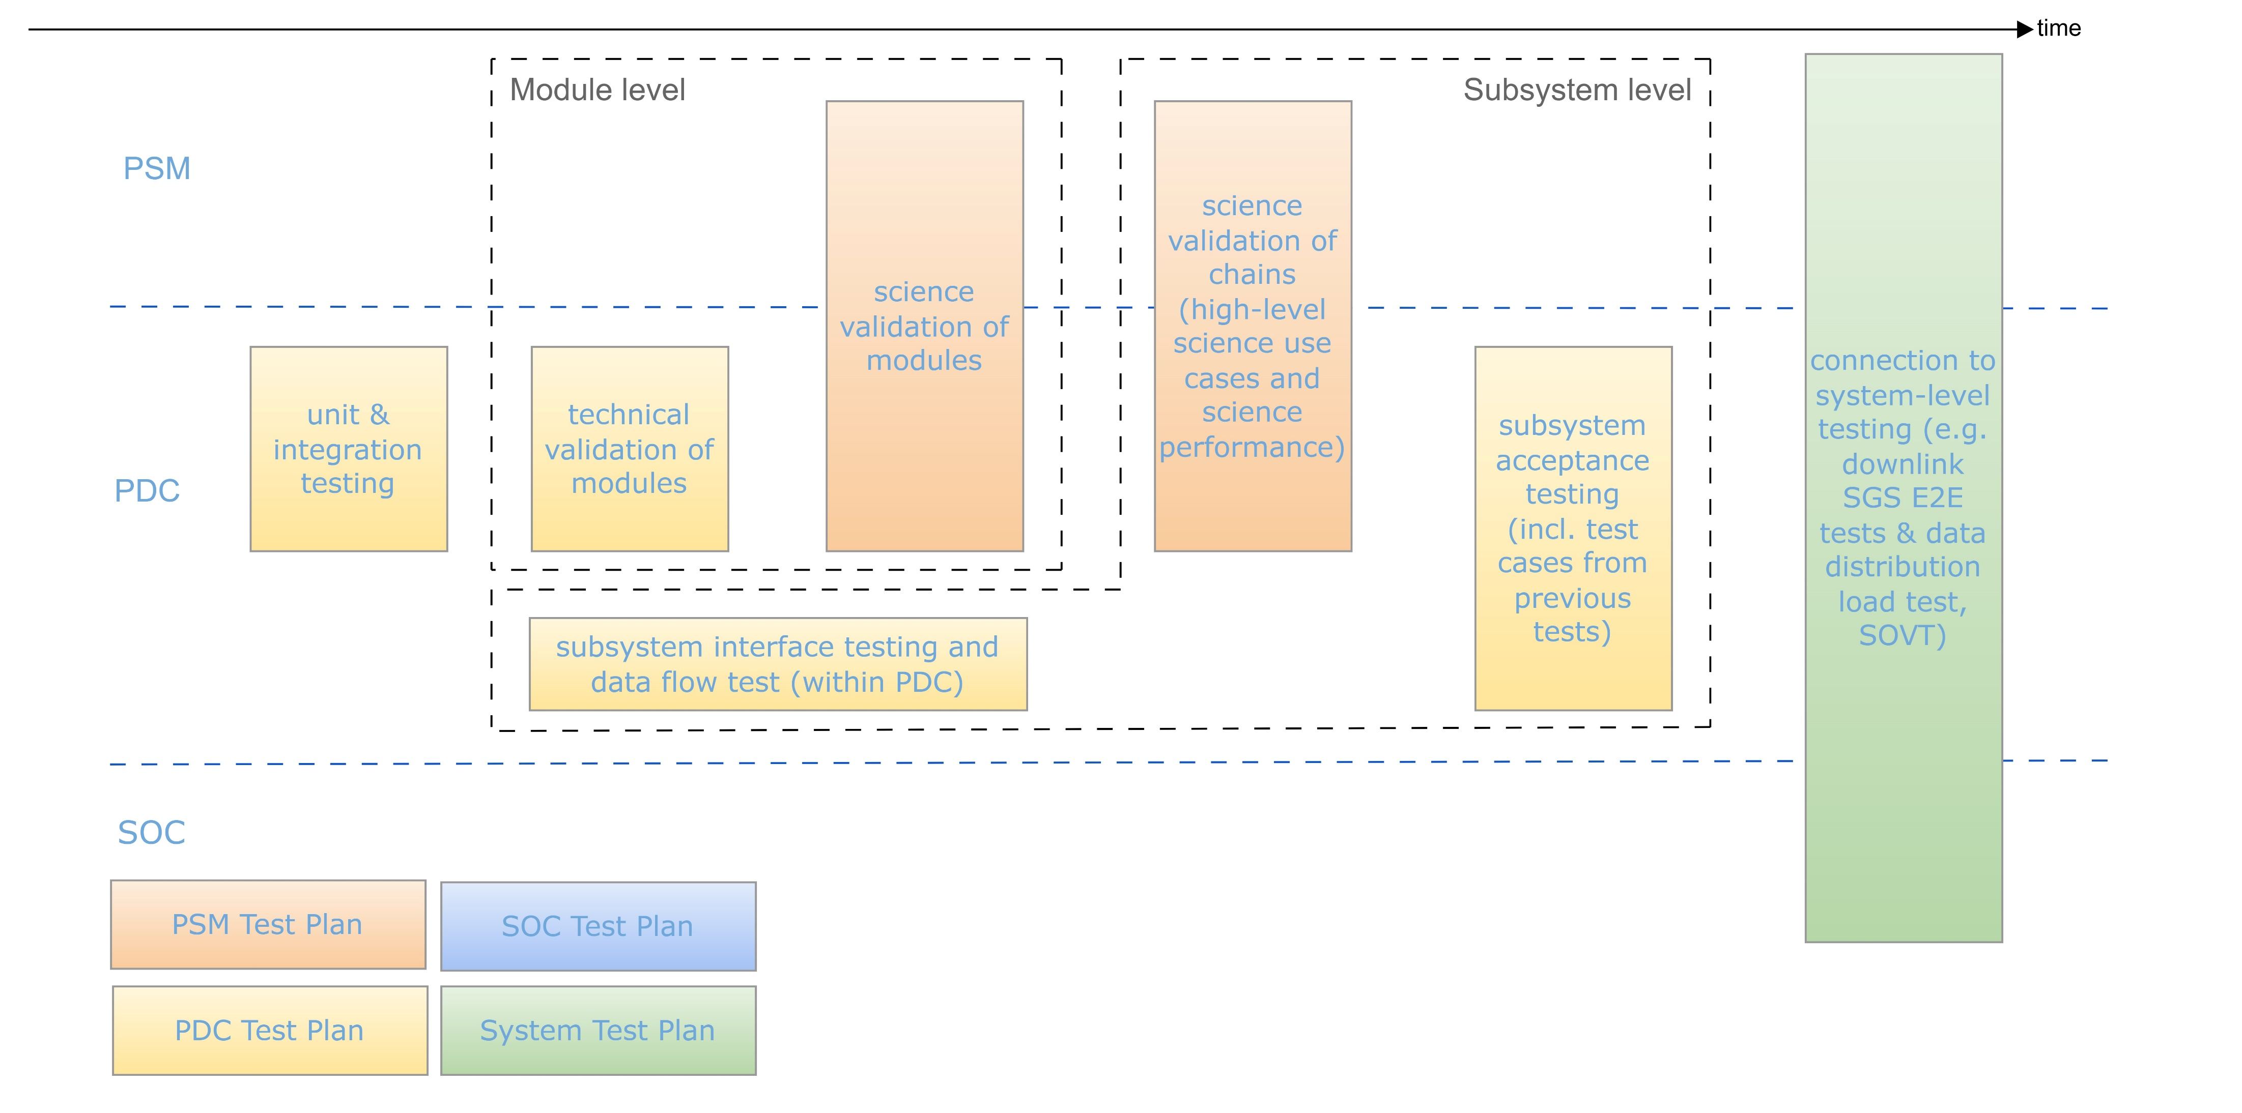
Testing status
Sanchez-Cabezudo, PLATO SGS V&V Plan
PLATO - ESP2025 | 2025/06/23
Notes:
Implementation, of course, has to be tested, and we have a wide-ranging programme of tests, as shown in this figure from the PLATO SGS V&V Plan.

Slide 24
EAS technical testing
Different levels of testing
    Technical V&V
    Interface tests
    Science validation
    Ground segment system tests
Technical V&V
Performed by the PLATO Data Centre team implementing the EAS.
Verification:
    Functional testing (including compatibility tests)
    Software must pass to be accepted into a pipeline release.
Validation:
    Carried out prior to each release.
Interface tests
Part of ongoing, continuous integration testing of all subsystems with the PDC database.
PLATO - ESP2025 | 2025/06/23
Notes:
At a technical level, verification and validation are ongoing, with any software only accepted into an EAS release if it passes functional verification, while validation of the chains against their technical requirements is also performed regularly.
Since EAS isn’t working in isolation, we also have to test the interfaces with other parts of the PLATO ground segment system. That’s ongoing as part of the continuous integration process taking place at the PLATO Data Centre.

Slide 25
EAS scientific testing
Different levels of testing
    Technical V&V
    Interface tests
    Science validation
    Ground segment system tests
Science validation
Performed in a series of campaigns aligned to EAS releases.
    Test cases defined by the PLATO Science Management work packages on Exoplanet Science (WP11x).
Campaign for EAS-4.1.0 is underway:
    Still based around validating individual modules.
    Updated tests currently being defined.
    Runs through to end-August 2025.
A full subsystem campaign is planned for winter 2025/26.
PLATO - ESP2025 | 2025/06/23
Notes:
As well as checking technical aspects, we also want to be sure that the EAS is producing outputs that are scientifically appropriate and correct. So we have an ongoing science validation programme that is being conducted as a series of campaigns tied to the major EAS releases. The most recent of those kicked off a few weeks ago, and we’re at the stage of updating the test cases, with the aim being to run those later in the summer.
So far we’ve focused on the individual modules, but science validation of the full chains is planned for this coming winter.

Slide 26
Ground segment end-to-end tests
Different levels of testing
    Technical V&V
    Interface tests
    Science validation
    Ground segment system tests
Ground segment tests
Two system test relevant to EAS
    EtE#2 - Level 2 Data Generation & Validation
      Tests TransitPipe and other subsystems involved in Level 2 processing
    EtE#3 – Level 3 Data Generation & Validation
      Tests PlanetPipe and other subsystems involved in Level 3 processing
Both use an iterative approach, with a 2-monthly cadence.
    Focused on technical testing.
    Science performance will be assessed in later iterations
Long-term programme of tests
    Kicked off earlier this year and run through to mid-2026.
    Initial iterations completed successfully but failed several tests.
PLATO - ESP2025 | 2025/06/23

Slide 27
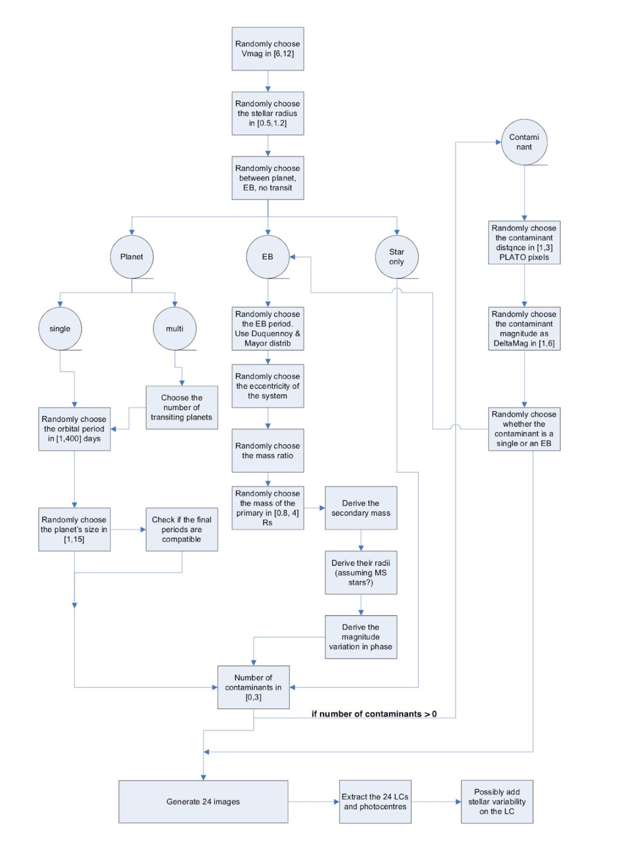
Pipeline completeness and reliability
Will be evaluated:
    Before launch using simulated data, as part of the subsystem science validation campaign.
    During operations using signal injection tests with real data.
      Signal injection software modules and tools will be tested during the ground segment end-to-end tests.
      Data will be processed identically to the science data.
A thorough analysis will be done at the end of the first long
pointing, with a final analysis at the end of science operations.
Large scale datasets are needed.
    How many planets / scenarios do we want / need to simulate?
      With what properties?
      How are they selected?
    How many light curves do we want / need to simulate?
PLATO - ESP2025 | 2025/06/23
Cabrera (priv. comm.)
Notes:
I want to finish by quickly talking about completeness and reliability testing. We want to be able to judge how well the pipeline performs, and how reliable it is.
We plan to do this in several stages. First, as part of that full chain science validation that I mentioned, we’ll use simulated data to evaluate completeness and reliability of the EAS. Then during operations, we’ll use signal injection with real PLATO data to redo the tests.
A fundamental aspect is to understand the fraction of planets that exist but are not detected by PLATO. Non-detections can result from the simple fact that they are not transiting, but also because they are not detectable for any reason, like stellar variability or duty cycle, or too long orbital period, etc. Reliability depends on the fraction of false positives. These can be genuine astrophysical signals of non-planetary nature, but also systematics from instrumental nature
Currently, we’re working out the details of the datasets that will be needed to do this – how many planetary system and false positive scenarios are needed, what properties should they have, and even how many light curves do we need to get good statistics, are the kind of things that we’re considering.

Slide 28
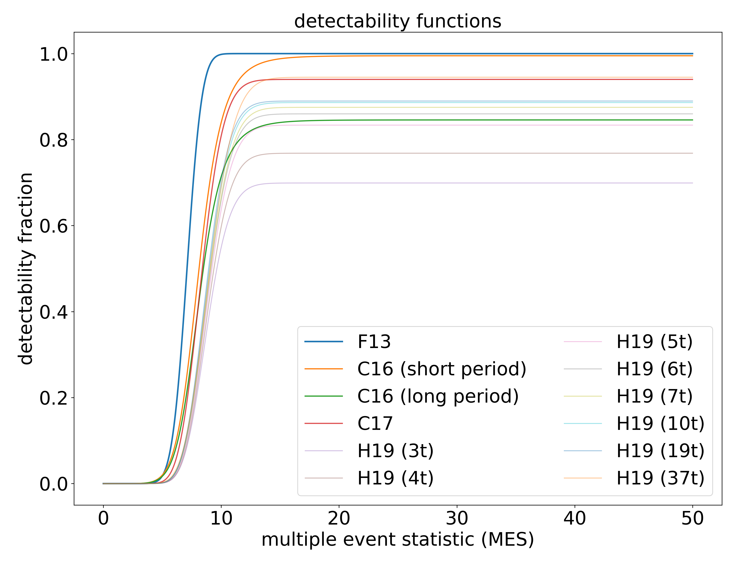
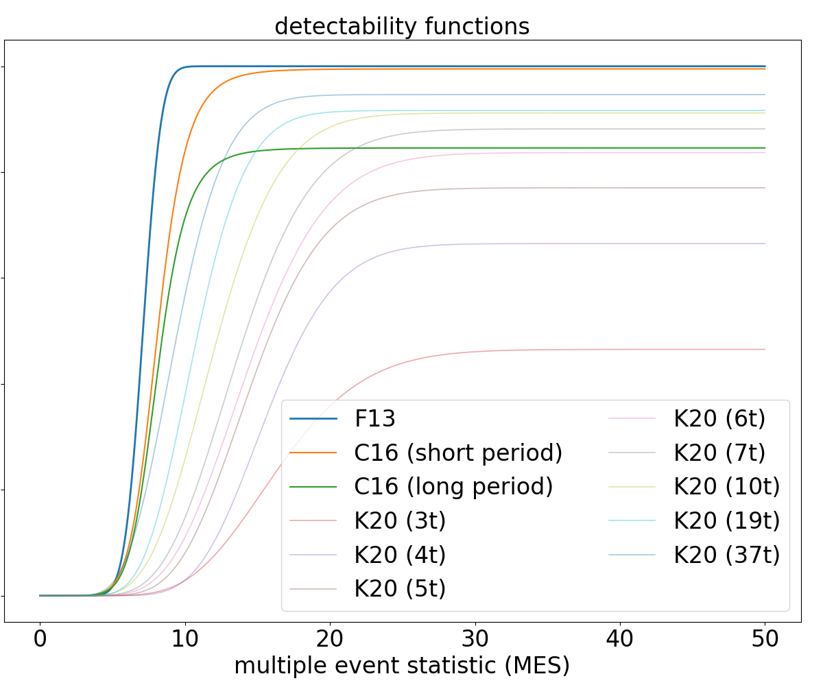
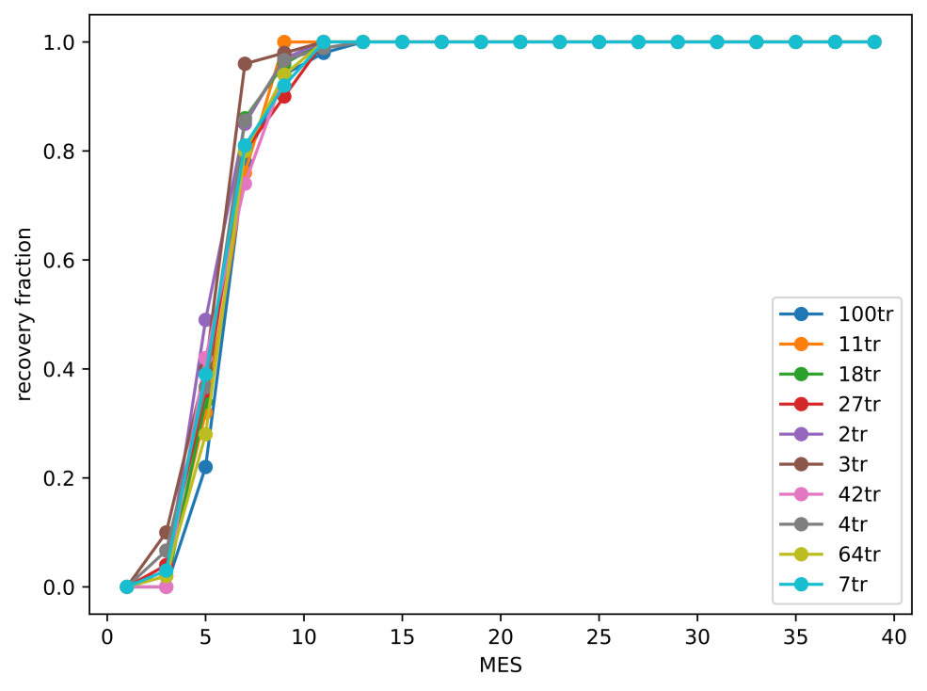
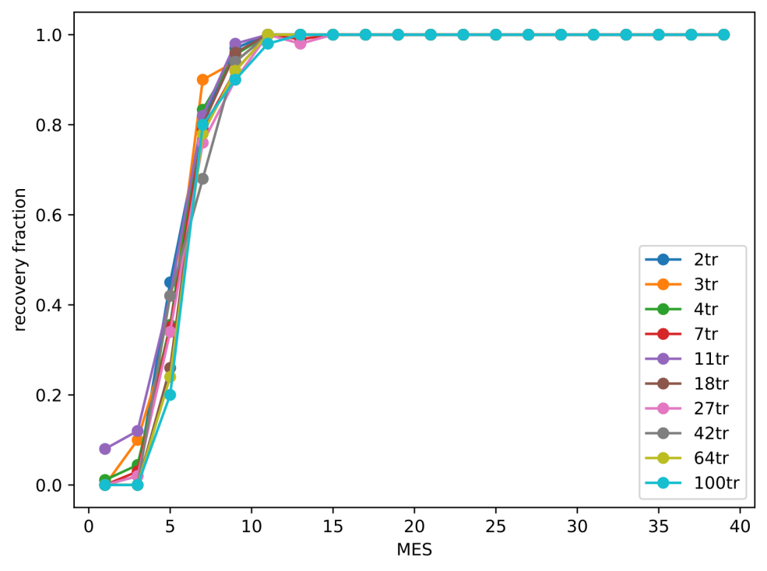
Pipeline completeness and reliability
A dedicated Working Group has been set up to coordinate and manage work on this.
We want to build detectability
function data, following:
    Fressin et al. (2013)
    Christiansen et al. (2016)
    Christiansen et al. (2017)
    Hsu et al. (2019)
    Kunimoto & Matthews (2020)
Initial results using the TransitPipe
detection algorithm are very good.
    CETRA (Smith et al. 2025)
    Not accounting for vetting yet.
Data with representative inter-quarter gaps
Continuous data
PLATO - ESP2025 | 2025/06/23
Cabrera (priv. comm.)
Notes:
Ultimately, we want to build our own versions of the detectability functions that we’ve seen for Kepler and TESS, and that I’m showing in these figures.
We’ve done some initial testing using just the TransitPipe detection algorithm, which shows very good performance, but this isn’t yet accounting for the vetting process.

Slide 29
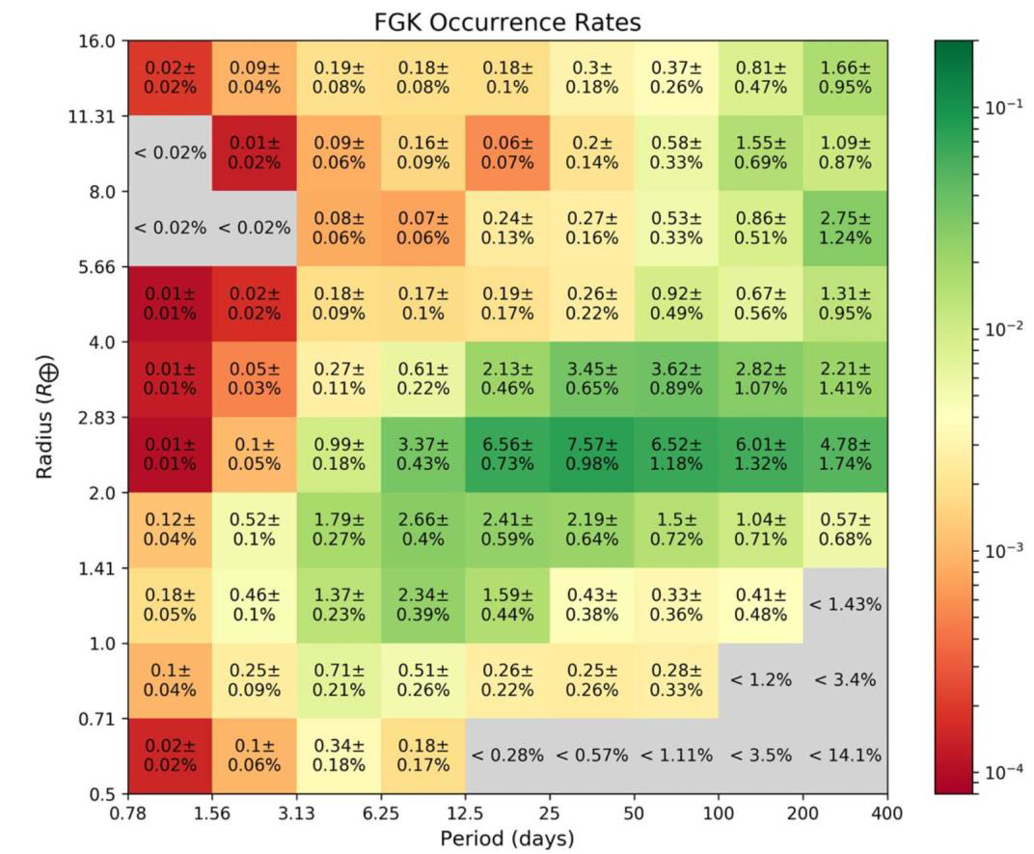
Occurrence rates
Ultimately, we are aiming to produce planet occurrence rates from PLATO.
We have both Working Groups and Work Packages dedicated to this.
Details of the approaches to be used are still being worked out.
Kunimoto & Matthews (2020)
PLATO - ESP2025 | 2025/06/23
Notes:
Here’s an example from Kunimoto & Matthews (2020) showing the kind of results that we are aiming to update with PLATO.

Slide 30
Summary
PLATO’s Exoplanet Analysis System comprises TransitPipe, PlanetPipe, and QcPipe.
The EAS will produce a catalogue of candidates & TCEs, and a catalogue of planetary system models, along with QC data and other secondary products.
Implementation is at an advanced stage, with a full prototype of TransitPipe and a basic PlanetPipe.
Testing is underway, with initial results showing very promising performance.
PLATO - ESP2025 | 2025/06/23

Slide 31
Thank you
psmoffice@warwick.ac.uk
PLATO - ESP2025 | 2025/06/23

